Slide 1





Write the date: 14 April 2025
Write the Title and Golden Thread
Title – impact of social media influencers
Golden Thread – Secure Your Wellbeing
Underline both using your ruler & take out your oracy helpsheet
Complete the following questions:
What is being described: “trends that encourage people to perform a task and share it online”
Give an example of a social media platform
True or False – “it is appropriate to send a group photo if everyone in the photo is happy for it to be shared with others”
Online challenges
Instagram, Facebook, Snapchat, WhatsApp, YouTube
True

Slide 2
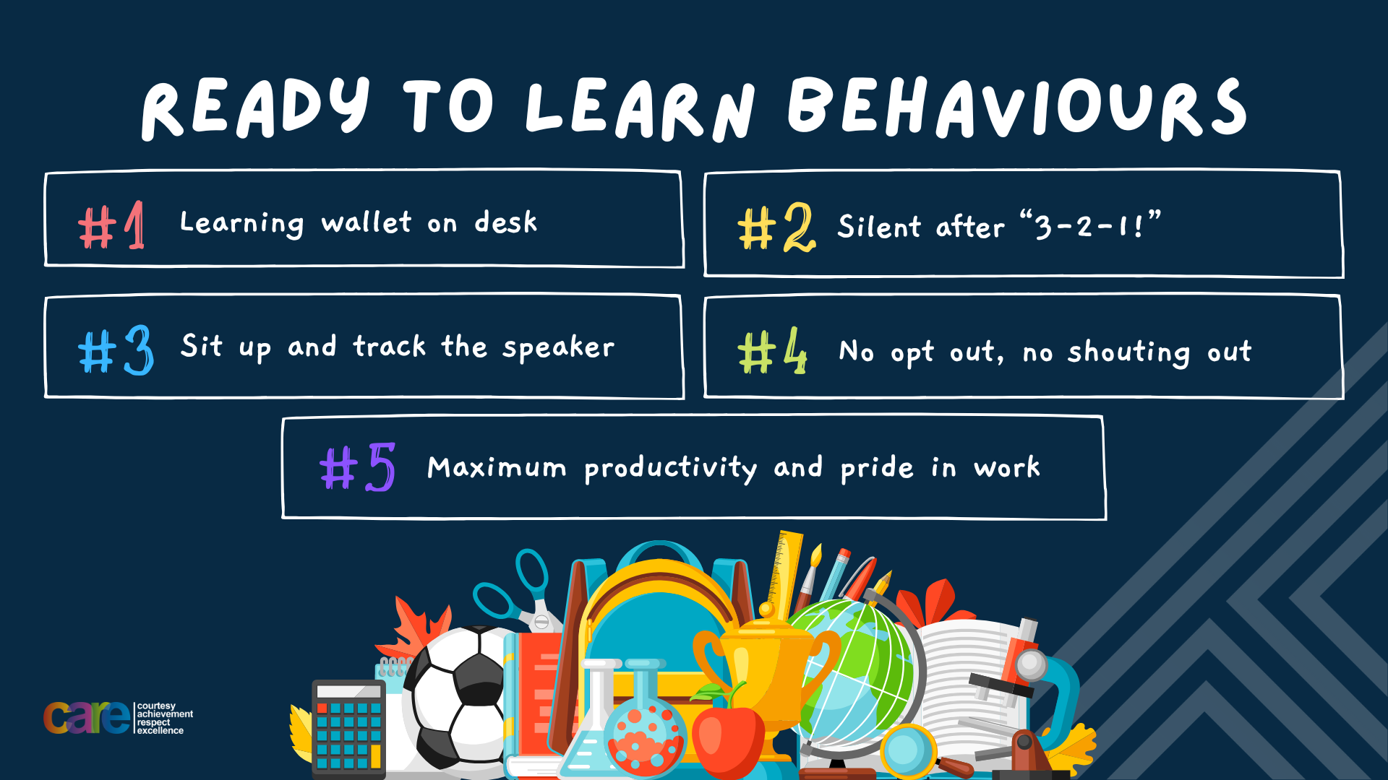

Slide 3


Secure your Wellbeing: Learning Journey
What is social media and how should you use it?
What are online trends and should you follow them?
What impact can social media influences have?
What is fake news?
What is hate speech online?
What is fake news?
Today we will look at:
What is the impact of social media influencers?
This includes:
Definition of social media influencers
Negative impact of social media influencers
Positive impact of social media influencers
Deciding to follow an influencer or not
Please remember that during the lesson we should not be asking any pupil or teacher personal questions.
Your teacher can ask you questions but this will be to check your knowledge in the lesson.

Slide 4
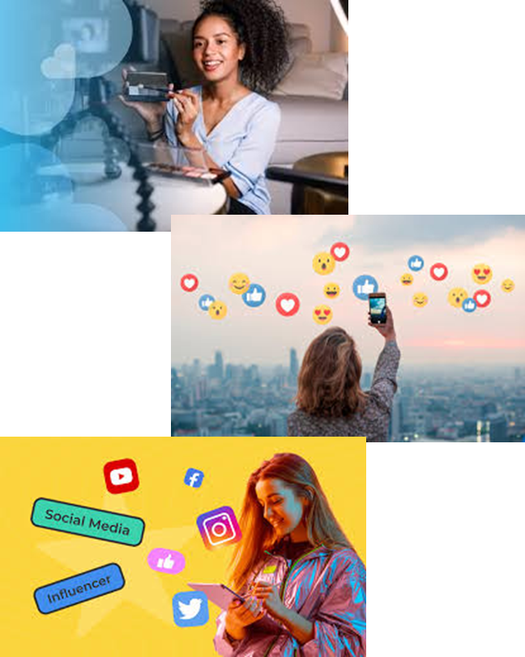
Tutor Time Recap
In your Personal Development Tutor Time activity, you started to look social media influencers
In your books answer the following question:
“What is the definition of social media influencers”
Sentence starters – “social media influencers are…”

Slide 5
Tutor Time Recap
Social media influencers are…
“people who have gained a large following on social media platforms and influences the opinions, behaviours and buying decision of others”
Task – use your red pen to add to the definition you had written down.

Slide 6


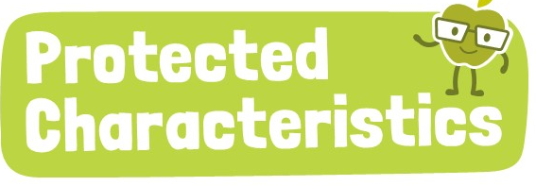
Tutor Time Recap
We are learning this because:
Links to the Golden Thread of “Secure your Wellbeing”. Social media influencers don’t always show reality. This can impact mental wellbeing if you compare lives with something that is not possible
Rule of Law is a British Value. There are laws around social media influencers advertising products so people know they are looking at an advert
Article 3 states that governments should make decisions that are best for children. This includes age limits for children using social media.
The Protected Characteristics have to be respected on social media as well as in real life.
UN Rights
of a Child

Slide 7
Social Media Influencers
Social media influencers can usually be grouped based on the content they post. Some groups include:
Gamers
Beauty and Fashion
Fitness and Sports
Comedy and Entertainment
Educational
Motivational

Slide 8
Social Media Influencers
Task
In the margin write “SYV” – this stands for “Secure Your Voice”
Highlight “SYV”
In your books answer the following sentences:
  One social media influencer I know is…
  They would be grouped as….
  This is because they post content about…
Social media influencers can usually be grouped based on the content they post. Some groups include:
Gamers
Beauty and Fashion
Fitness and Sports
Comedy and Entertainment
Educational
Motivational

Slide 9

Social media influencers
Using your oracy helpsheet, discuss with the person next to you discuss the question:
  “What social media influencers do you know, what group do they belong to and what content do they post?
Remember to use the sentence starters to add, build or challenge what your partner has said.
Be ready to share your discussion with the class

Slide 10
Social Media Influencers
Social media influencers can have a positive impact on their followers.
This can be achieved by…
1. Posting educational content – this helps their followers learn new facts or deepen their understanding of a different subject

Slide 11
Social Media Influencers
Social media influencers can have a positive impact on their followers.
This can be achieved by…
2. Posting inspirational/motivational content – this helps their followers lead an active and healthy lifestyle and look after their mental health

Slide 12
Social Media Influencers
Social media influencers can have a positive impact on their followers.
This can be achieved by…
3. Activism – this helps promote social causes such as body positivity or climate change awareness

Slide 13
Social Media Influencers
Social media influencers can have a positive impact on their followers.
This can be achieved by…
4. Entertainment – this helps their followers laugh and feel good by watching their content. This could be important if their followers have had a bad day

Slide 14
Social Media Influencers
Social media influencers can have a positive impact on their followers.
This can be achieved by…
5. Skill development– this helps their followers learn new skills such as cooking, coding or playing an instrument

Slide 15
Social Media Influencers
Task
In the margin write “SYV” – this stands for “Secure Your Voice”
Highlight “SYV”
In your books answer the following question:
“What positive content do you see posted by social media influencers?”
Positive impacts of social media influencers include:
1. Posting educational content
2. Posting inspirational/motivational content
3. Activism
4. Entertainment
5. Skill development

Slide 16
Social media influencers
Using your oracy helpsheet, discuss with the person next to you discuss the question:
“What positive content do you see posted by social media influencers?”
Remember to use the sentence starters to add, build or challenge what your partner has said.
Be ready to share your discussion with the class

Slide 17
Social Media Influencers
Social media influencers can also have a negative impact on their followers.
This can happen through:
1. Unrealistic beauty and body standards – using filters and photoshop to edit content can make people feel insecure about their own appearance as they do not look like the content posted

Slide 18
Social Media Influencers
Social media influencers can also have a negative impact on their followers.
This can happen through:
2. Promoting unhealthy/risky behaviours – this can be promoting extreme diets or posting online challenges which may cause harm to others

Slide 19
Social Media Influencers
Social media influencers can also have a negative impact on their followers.
This can happen through:
3. Promoting discriminatory attitudes – this can be posting content which is offensive to a different gender, race or sexual orientation. This leads to these views being copied by their followers

Slide 20
Social Media Influencers
Social media influencers can also have a negative impact on their followers.
This can happen through:
4. Spreading misinformation – posting content that includes false information about news topics. This leads to the false news being believed by their followers despite it not being true

Slide 21
Social Media Influencers
Social media influencers can also have a negative impact on their followers.
This can happen through:
5. Pressure to buy things – posting content that promotes products while trying to hide that it is an advert. All influencers will get paid to promote products for their followers to buy. It does not mean they use the product.

Slide 22
Social Media Influencers
Task
In the margin write “SYV” – this stands for “Secure Your Voice”
Highlight “SYV”
In your books answer the following question:
“What negative content do you see posted by social media influencers?”
Negative impacts of social media influencers include:
1. Unrealistic beauty and body standards
2. Promoting unhealthy/risky behaviours
3. Promoting discriminatory attitudes
4. Spreading misinformation
5. Pressure to buy things

Slide 23
Social media influencers
Using your oracy helpsheet, discuss with the person next to you discuss the question:
“What negative content do you see posted by social media influencers?”
Remember to use the sentence starters to add, build or challenge what your partner has said.
Be ready to share your discussion with the class

Slide 24
Hinge Questions – whiteboard activity
3
Rules!
I will ask the question and give you some thinking time. (no more than 10 seconds)
Write the answer and turn your whiteboard over so nobody can see it.
When I am ready I will put on the 3 to 1 counter.
When ‘Show me’ appears on the board you must hold up your whiteboard (even if you don’t know the answer and there is nothing on your board)
2
1
Show me!
(even if your whiteboard is blank)

Slide 25
Hinge Questions – whiteboard activity
What is being described?
“people who have gained a large following on social media platforms and influences the opinions, behaviours and buying decision of others”
Social media influencers

Slide 26

Hinge Questions – whiteboard activity
What golden thread does today’s lesson link to?
A – Secure your Future
B – Secure your Wellbeing
C – Secure your Relationships
D – Secure your Voice

Slide 27
Hinge Questions – whiteboard activity
True or False
“Social media influencers only post positive content”
A – True
B – False

Slide 28
Hinge Questions – whiteboard activity
Is the following statement an example of positive or negative social media influencer content
“Posting about how to cook a healthy meal for their family”
A – Positive
B – Negative

Slide 29
Hinge Questions – whiteboard activity
Is the following statement an example of positive or negative social media influencer content
“Posting about a certain make up brand with links to purchase”
A – Positive
B – Negative

Slide 30
Hinge Questions – whiteboard activity
Is the following statement an example of positive or negative social media influencer content
“Posting content that has been filtered and edited to look better than the original photo”
A – Positive
B – Negative

Slide 31
Hinge Questions – whiteboard activity
Is the following statement an example of positive or negative social media influencer content
“Posting content that promotes a local charity looking for donations”
A – Positive
B – Negative

Slide 32
Social Media Influencers
When choosing to follow a social media influencer people should think about…

Slide 33
Social Media Influencers
Does the social media influencer align with your values
Does the influencer seem genuine or is their content altered to make them look good
Do they share accurate information?
Do you feel good about yourself when looking at their content?

Slide 34
Social Media Influencers
Task
In the margin write “SYV” – this stands for “Secure Your Voice”
Highlight “SYV”
In your books write down the tips in order of most importance to you.
Does the social media influencer align with your values
Does the influencer seem genuine or is their content altered to make them look good
Do they share accurate information?
Do you feel good about yourself when looking at their content?

Slide 35
Social media influencers
Using your oracy helpsheet, discuss with the person next to you discuss the question:
“What do you think is most important to think about before following a social media influencer?”
Remember to use the sentence starters to add, build or challenge what your partner has said.
Be ready to share your discussion with the class

Slide 36

Social Media Influencers
Notes:
https://www.youtube.com/watch?v=TfECiHfAInI

Slide 37
Social Media Influencers
Task
In the margin write “SYV” – this stands for “Secure Your Voice”
Highlight “SYV”
In your books complete the following sentence:
“I agree/disagree with the news report because…”

Slide 38
Social media influencers
Using your oracy helpsheet, discuss with the person next to you discuss the question:
“Did you agree or disagree with the news report? Why?”
Remember to use the sentence starters to add, build or challenge what your partner has said.
Be ready to share your discussion with the class

Slide 39



Support
If you ever need support about social media influencers for yourself, a friend or family member it can be found here:
Childline.org.uk
Call – 08001111
Email or chat online for support
Themix.org.uk
You can email or have one-to-chat online.
There is also a crisis messenger which is available 24/7

Slide 40


