Slide 1





Write the date: 14 April 2025
Write the Title and Golden Thread
Title – what is fake news?
Golden Thread – Secure Your Wellbeing
Underline both using your ruler & take out your oracy helpsheet
Complete the following questions:
What is being described: “people who have gained a large following on social media platforms and influences the opinions, behaviours and buying decision of others”
True or False – “online trends are never dangerous”
Give an example of a social media platform
Social media influencers
False
Snapchat, Instagram, Facebook, X, WhatsApp, YouTube

Slide 2
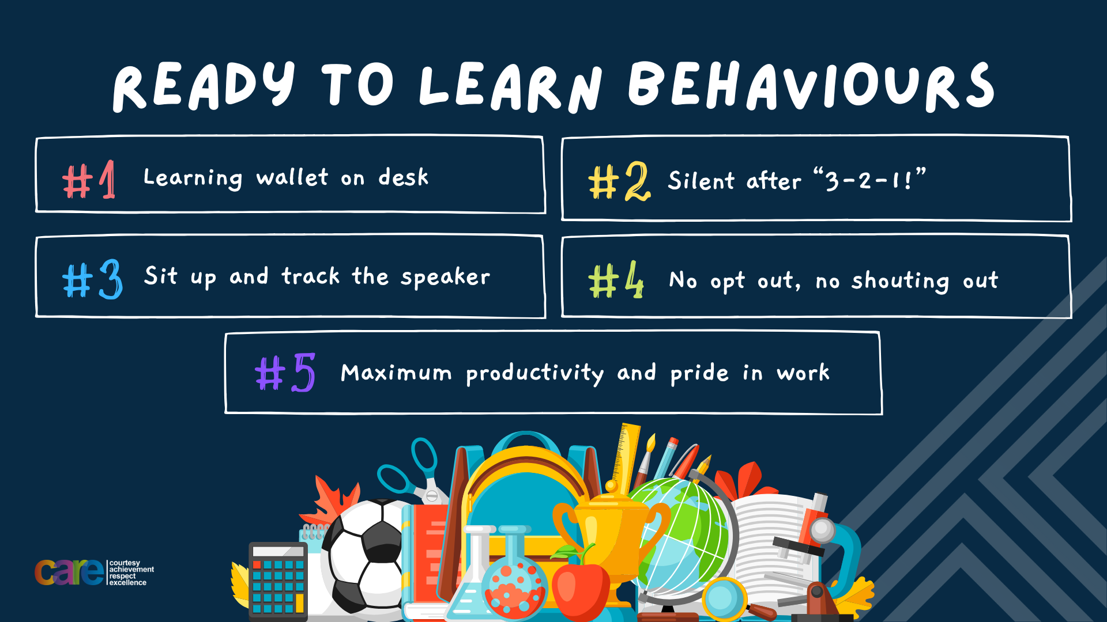

Slide 3


Secure your Wellbeing: Learning Journey
What is social media and how should you use it?
What are online trends and should you follow them?
What impact can social media influences have?
What is fake news?
What is hate speech online?
What is fake news?
Today we will look at:
What is fake news
This includes:
Where people may see fake news
Why people share fake news
How to spot fake news
Please remember that during the lesson we should not be asking any pupil or teacher personal questions.
Your teacher can ask you questions but this will be to check your knowledge in the lesson.

Slide 4

Tutor Time Recap
In your Personal Development Tutor Time activity, you started to look at what is fake news
In your books answer the following question:
“What is the definition of fake news”
Sentence starters – “fake news is…”

Slide 5
Tutor Time Recap
Fake news is…
“false or misleading information that is spread to deceive people or influence their opinions”
Task – use your red pen to add to the definition you had written down.

Slide 6


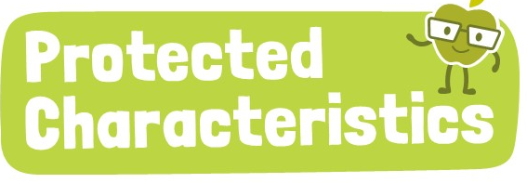
Tutor Time Recap
We are learning this because:
Links to the Golden Thread of “Secure your Wellbeing”. Fake news is can cause confusion or fear which can negatively impact mental wellbeing.
Rule of Law is a British Value. The Online Safety Act 2023 has made publishers online responsible for preventing the publication of certain false information.
Article 17 states that children have the right to get information from different sources. This gives balanced view point of that information.
The Protected Characteristics have to be respected as otherwise this is discrimination. Unfortunately, sometime fake news is circulated about those who identify with a protected characteristic.
UN Rights
of a Child

Slide 7
What is fake news
Many people, whether young or old, get much of their news from an online source.
This could be through:
-social media posts
-online videos
-written articles
However, it is important to remember that not everything written online is true.

Slide 8
What is fake news
An example of fake news could be an article claiming that there are aliens living in the UK.
People could begin to believe this is true if the article also includes pictures

Slide 9
What is fake news
This is an example of fake news as it contains false information.
If this article is shared on social media or other platforms, this is spreading fake news.
Many people do this unintentionally as they are unaware that the information in the article is fake.

Slide 10
Why do people create fake news
Fake news is created for various reasons:
To spread an opinion and change viewpoints without the need to back it up with facts
To make money by encouraging people to click on an article – this is known as “clickbait”

Slide 11
Hinge Questions – whiteboard activity
3
Rules!
I will ask the question and give you some thinking time. (no more than 10 seconds)
Write the answer and turn your whiteboard over so nobody can see it.
When I am ready I will put on the 3 to 1 counter.
When ‘Show me’ appears on the board you must hold up your whiteboard (even if you don’t know the answer and there is nothing on your board)
2
1
Show me!
(even if your whiteboard is blank)

Slide 12
Hinge Questions – whiteboard activity
What is being described?
“false or misleading information that is spread to deceive people or influence their opinions”
Fake news

Slide 13

Hinge Questions – whiteboard activity
What golden thread does today’s lesson link to?
A – Secure your Future
B – Secure your Wellbeing
C – Secure your Relationships
D – Secure your Voice

Slide 14
Hinge Questions – whiteboard activity
True or False
“Fake news is easy to spot”
A – True
B – False

Slide 15
Hinge Questions – whiteboard activity
Give an example of how people may find fake news online?
Social media posts, online videos, written articles

Slide 16
Hinge Questions – whiteboard activity
True or False
“people make fake news to share their opinion and to change peoples viewpoint without facts”
A – True
B – False

Slide 17
Hinge Questions – whiteboard activity
True or False
“people make fake news to make money so people click on their articles”
A – True
B – False

Slide 18
Hinge Questions – whiteboard activity
Fake news designed to get people to click on an article is known as….
A – Clickbait
B – Clickfood
C - Clicktruth

Slide 19
Task
Complete the following sentences in your books:
Fake news may appear as….
It is difficult to spot fake news as it is designed…
One reason people create fake news is….

Slide 20
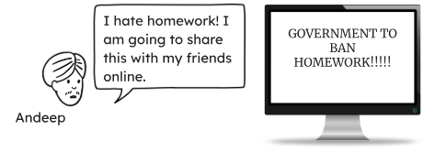
Why people share fake news
People are more likely to read news that may support their own point of view. They are also then more likely to share it online. This is how fake news spreads quickly. An example is:

Slide 21
How to identify fake news
There are some steps people can use to help spot fake news.
These are:
Check the Source
Check the URL (web address)
Look at the headline
Check the author
Check the images
Does the article appear anywhere else?

Slide 22
How to identify fake news
Checking the source
Look at the quality of the article and the site that has published it.
Look for any spelling or grammar errors.
Check the “about” page to read what it says about the website

Slide 23
How to identify fake news
Look at the headline
To generate clicks, the article may have a dramatic or misleading headline. Think about does the headline match what has been written or included in the video?

Slide 24
How to identify fake news
Check the author
Research the author of the article. Have they written an article before.
If there is no author, there is the potential the article was written by a “bot” which could mean that the article includes false information.

Slide 25
How to identify fake news
Check the images
Images are very easily altered. However, these images could have blurred lines or the background is blurred and it may also be pixelated.

Slide 26
How to identify fake news
Does the article appear anywhere else?
If the article, video or social media post does not appear anywhere else, there is a high likelihood that it is fake news.

Slide 27
How to identify fake news
Task
In the margin write “SYV” – this stands for “Secure Your Voice”
Highlight “SYV”
In your books write down the ways to identify fake news in order of what you think is the most important
There are some steps people can use to help spot fake news.
These are:
Check the Source
Check the URL (web address)
Look at the headline
Check the author
Check the images
Does the article appear anywhere else?

Slide 28

How to identify fake news
Using your oracy helpsheet, discuss with the person next to you discuss the question:
“What do you think is the most important way to identify fake news? Why?”
Remember to use the sentence starters to add, build or challenge what your partner has said.
Be ready to share your discussion with the class

Slide 29
Hinge Questions – whiteboard activity
3
Rules!
I will ask the question and give you some thinking time. (no more than 10 seconds)
Write the answer and turn your whiteboard over so nobody can see it.
When I am ready I will put on the 3 to 1 counter.
When ‘Show me’ appears on the board you must hold up your whiteboard (even if you don’t know the answer and there is nothing on your board)
2
1
Show me!
(even if your whiteboard is blank)

Slide 30
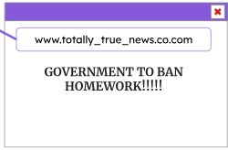
Hinge Questions – whiteboard activity
Could this be an example of fake news?
A – Yes
B – No

Slide 31
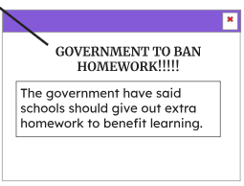
Hinge Questions – whiteboard activity
Could this be an example of fake news?
A – Yes
B – No

Slide 32
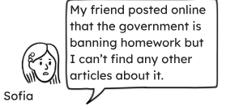
Hinge Questions – whiteboard activity
Could this be an example of fake news?
A – Yes
B – No

Slide 33
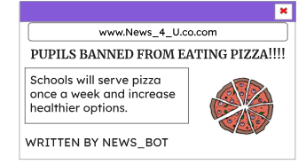
Spotting fake news
Task
In the margin write “SYV” – this stands for “Secure Your Voice”
Highlight “SYV”
In your books explain 3 ways that this picture could be an example of fake news. You should write in full sentences

Slide 34
Spotting fake news
Using your oracy helpsheet, discuss with the person next to you discuss the question:
“Why was the picture an example of fake news?”
Remember to use the sentence starters to add, build or challenge what your partner has said.
Be ready to share your discussion with the class

Slide 35
What are the harms of fake news
Some fake news is created with malicious intent.
This means it is created with the aim to harm others or influence them in a negative way.
This is called disinformation.

Slide 36
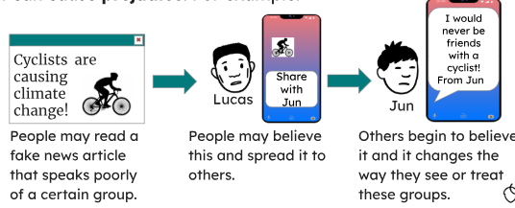
What are the harms of fake news
This can have a serious consequence as it could lead to prejudice against people in society and change the way people treat others. An example is…

Slide 37
What are the harms of fake news
An real life example of this was disinformation shared online regarding the perpetrator of the person who killed 3 young girls over the summer. This caused multiple riots across the UK aimed at immigrants.
The perpetrator was not an immigrant.

Slide 38
What are the harms of fake news
Complete the following sentences
Fake news created with malicious intent wants to…
An consequence of this is...

Slide 39
Consequences of fake news
Using your oracy helpsheet, discuss with the person next to you discuss the question:
“How did you complete the sentences?”
Remember to use the sentence starters to add, build or challenge what your partner has said.
Be ready to share your discussion with the class

Slide 40



Support
If you ever need support about content that you think is fake news for yourself, a friend or family member it can be found here:
Childline.org.uk
Call – 08001111
Email or chat online for support
Themix.org.uk
You can email or have one-to-chat online.
There is also a crisis messenger which is available 24/7

Slide 41


