Slide 1





Write the date: 14 April 2025
Write the Title and Golden Thread
Title – Dangers of online challenges
Golden Thread – Secure Your Wellbeing
Underline both using your ruler & take out your oracy helpsheet
Complete the following questions:
What is being described: “a way people use the internet to share ideas, photos, videos and communicate with others.”
True or False: “it is illegal for anyone to have an indecent image of someone U18, even if they are U18
True or False – “gender identity and sexual orientation are the same thing”
Social Media
True
False

Slide 2
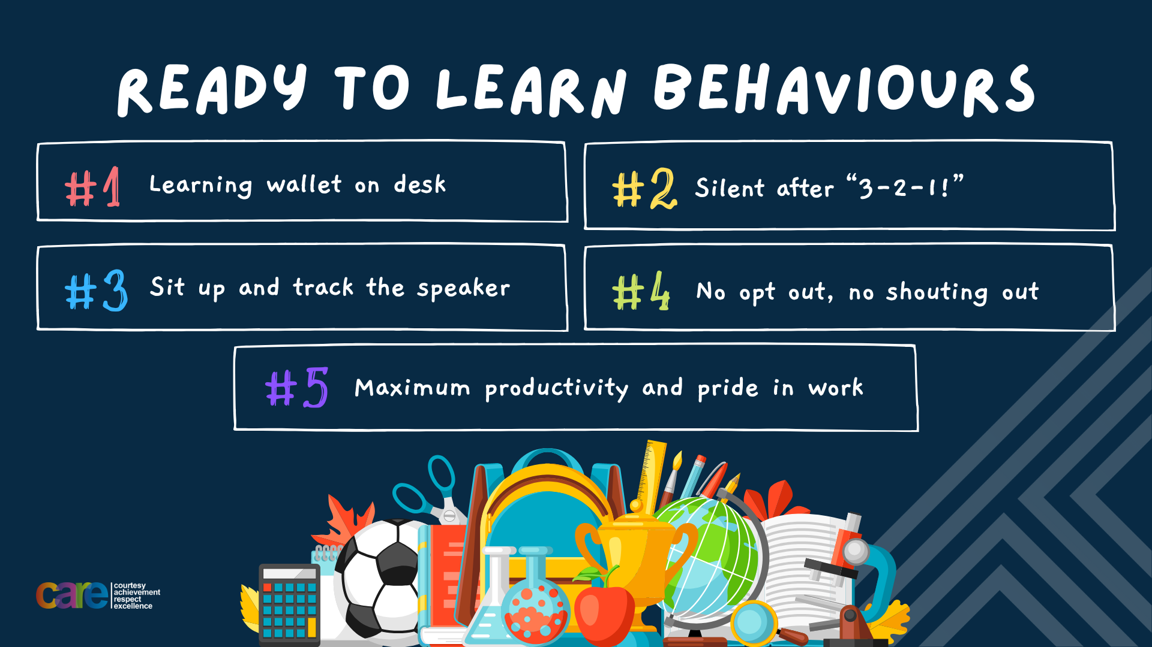

Slide 3


Secure your Wellbeing: Learning Journey
What is social media and how should you use it?
What are online trends and should you follow them?
What impact can social media influences have?
What is fake news?
What is hate speech online?
What is fake news?
Today we will look at:
What is an online trend/challenge?
This includes:
Definition of online challenges
What makes online challenges dangerous
Please remember that during the lesson we should not be asking any pupil or teacher personal questions.
Your teacher can ask you questions but this will be to check your knowledge in the lesson.

Slide 4

Tutor Time Recap
In your Personal Development Tutor Time activity, you started to look online challenges
In your books answer the following question:
“What is the definition of online challenges”
Sentence starters – “online challenges are…”

Slide 5
Tutor Time Recap
Online challenges are…
“trends that encourage people to perform a task and share it online”
Task – use your red pen to add to the definition you had written down.

Slide 6


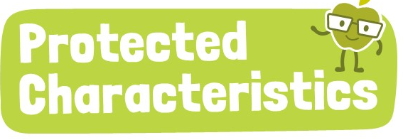
Tutor Time Recap
We are learning this because:
Links to the Golden Thread of “Secure your Wellbeing”. Online challenges can lead to dangerous actions which can cause serious injury
Rule of Law is a British Value. There are laws around the age of children accessing social media
Article 3 states that governments should make decisions that are best for children. This includes age limits for children using social media.
The Protected Characteristics have to be respected on social media as well as in real life.
UN Rights
of a Child

Slide 7
Social Media and Online Challenges
Online challenges can spread rapidly across social media platforms, gaining millions of participants in just a few days.
The viral nature of social media makes both safe and dangerous challenges popular at an alarming rate.

Slide 8
Social Media and Online Challenges
Reasons for this include:
Social media algorithms promote trending content so more people see it in their feeds
Influencers or celebrities participate which encourages more people to copy them

Slide 9
Social Media and Online Challenges
Other more dangerous reasons are:
Challenges include a dare or nomination system. This can make people feel pressurised into completing the challenge even if they do not want too.
Adding shock value – people take greater risks to stand out so they get more attention.

Slide 10
Social Media and Online Challenges
Just to show how quickly a social media post can get 1 million likes:
The World Record for the fastest post to reach 1 million likes on Instagram is 3 minutes!

Slide 11
Social Media and Online Challenges
Task
In the margin write “SYV” – this stands for “Secure Your Voice”
Highlight “SYV”
In your books answer the following question:
why do online challenges go viral so quickly?
Sentence starter – “online challenges go viral quickly because…”

Slide 12

Social media and online challenges
Using your oracy helpsheet, discuss with the person next to you discuss the question:
  “Why do online challenges go viral so quickly?”
Remember to use the sentence starters to add, build or challenge what your partner has said.
Be ready to share your discussion with the class

Slide 13
Hinge Questions – whiteboard activity
3
Rules!
I will ask the question and give you some thinking time. (no more than 10 seconds)
Write the answer and turn your whiteboard over so nobody can see it.
When I am ready I will put on the 3 to 1 counter.
When ‘Show me’ appears on the board you must hold up your whiteboard (even if you don’t know the answer and there is nothing on your board)
2
1
Show me!
(even if your whiteboard is blank)

Slide 14
Hinge Questions – whiteboard activity
What is being described?
“trends that encourage people to perform a task and share it online”
Online Challenges

Slide 15

Hinge Questions – whiteboard activity
What golden thread does today’s lesson link to?
A – Secure your Future
B – Secure your Wellbeing
C – Secure your Relationships
D – Secure your Voice

Slide 16
Hinge Questions – whiteboard activity
True or False
“Online challenges do not spread quickly online”
A – True
B – False

Slide 17
Hinge Questions – whiteboard activity
True or False
“Online challenges normally include a dare or nomination system to keep them trending”
A – True
B – False

Slide 18
Hinge Questions – whiteboard activity
True or False
“Influencers and celebrities have no influence over how popular an online challenge can become”
A – True
B – False

Slide 19
Hinge Questions – whiteboard activity
True or False
“People take risks doing online challenges so they stand out”
A – True
B – False

Slide 20
Dangers of Online Challenges
Many online challenges seem fun at first, but some can lead to serious consequences. It’s important to understand the physical, emotional, and legal risks before taking part in any online trend.

Slide 21
Dangers of Online Challenges
Physical Risks include:
Injuries – such as bruises and cuts
Broken bones
Burns
Head Injuries
Deaths
Last month, TikTok were sued by families over the death of their children after taking part in an online challenge.

Slide 22
Dangers of Online Challenges
Emotional & Mental Health dangers include:
Causing embarrassment and shame especially if a challenge goes wrong but video is still shared
Peer pressure – some people feel like they are forced to do a challenge even if they do not want too
Creates a social media addiction – people do more and more challenges at a riskier level as they crave the likes, views and approval

Slide 23
Dangers of Online Challenges
Legal dangers include:
Fine and criminal records for challenges that include vandalism
School suspensions or exclusions
Blamed by families of people who have seriously hurt themselves due to being encouraged

Slide 24
Dangers of Online Challenges
Copy the table below and add in different physical, emotional and legal dangers of online trends
Physical Dangers | Emotional Dangers | Legal Dangers

Slide 25
Dangers of Online Challenges
Read the challenge and then complete the sentence
“The Dance Challenge – record yourself dancing to a song on your playlist”
Sentence starter – “A emotional danger of this challenge is…”

Slide 26
Dangers of Online Challenges
Using your oracy helpsheet, discuss with the person next to you discuss the question:
  “What are the emotional dangers of the challenge?”
Remember to use the sentence starters to add, build or challenge what your partner has said.
Be ready to share your discussion with the class

Slide 27
Dangers of Online Challenges
Read the challenge and then complete the sentence
“The Blindfold Challenge – walk around blindfolded in a public place”
Sentence starter – “A physical danger of this challenge is…”

Slide 28
Dangers of Online Challenges
Using your oracy helpsheet, discuss with the person next to you discuss the question:
  “What are the physical dangers of the challenge?”
Remember to use the sentence starters to add, build or challenge what your partner has said.
Be ready to share your discussion with the class

Slide 29
Dangers of Online Challenges
Read the challenge and then complete the sentence
“A challenge involves tripping people up”
Sentence starter – “A legal danger of this challenge is…”

Slide 30
Dangers of Online Challenges
Using your oracy helpsheet, discuss with the person next to you discuss the question:
  “What are the legal dangers of the challenge?”
Remember to use the sentence starters to add, build or challenge what your partner has said.
Be ready to share your discussion with the class

Slide 31
Staying Safe
If a person ever does want to participate in an online challenge, they can keep themselves safe by answering the following questions first:
Is the challenge safe for them and other people?
Would their parents/carers be happy they completed the challenge?
Are they doing it out of free choice or are they being pressured?
What could go wrong?

Slide 32
Online Challenge Scenario
Jake has been tagged by his friend Alex in a new challenge video nominating them to do the challenge. Jake found Alex’s video really funny and the video already has over 100 likes. Jake has never had that many likes and is jealous.
Jake checks out other videos of the challenge. There are lots of people who have done it too. However he becomes unsure when he sees a video of a person really hurting themselves doing the challenge. Jake thinks they must be so embarrassed that they were caught on camera
Task
In the margin write “SYV” – this stands for “Secure Your Voice”
Highlight “SYV”
In your books answer the following question:
What advice would you give Jake? Should they do the challenge? What are some of the physical, emotional or legal dangers if they complete the challenge?

Slide 33
Online Challenges - Scenario
Using your oracy helpsheet, discuss with the person next to you discuss the question:
  “What advice would you give to Jake?”
Remember to use the sentence starters to add, build or challenge what your partner has said.
Be ready to share your discussion with the class

Slide 34



Support
If you ever need support about online challenges for yourself, a friend or family member it can be found here:
Childline.org.uk
Call – 08001111
Email or chat online for support
Themix.org.uk
You can email or have one-to-chat online.
There is also a crisis messenger which is available 24/7

Slide 35


