Slide 1





Write the date: 14 April 2025
Write the Title and Golden Thread
Title – Screen Time
Golden Thread – Secure Your Relationships
Underline both using your ruler & take out your oracy helpsheet
Complete the following questions:
What is being described: “a criminal act motivated by prejudice, hostility or hatred towards a person’s race, religion, sexual orientation or gender identity that occurs on the internet”
True or False: It is easy to spot fake news online
What negative impacts can social media influencers have?
Online hate crime
False
Unrealistic beauty and body standards. Promoting unhealthy/risky behaviours, promoting discriminatory attitudes, spreading misinformation, pressure to buy things

Slide 2
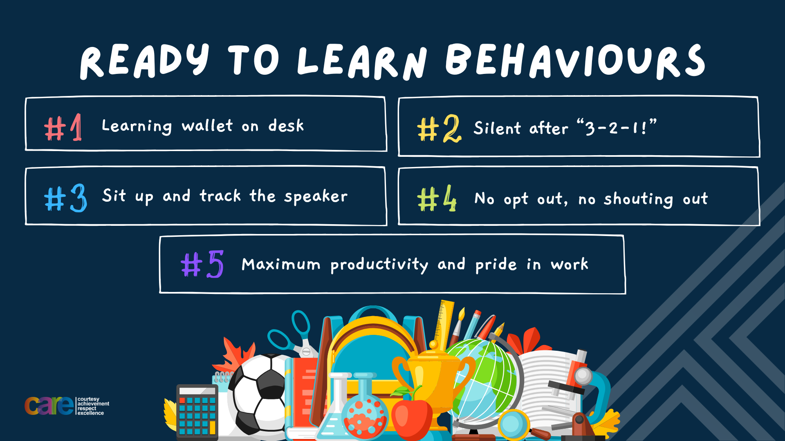

Slide 3


Secure your Wellbeing: Learning Journey
What is social media and how should you use it?
What are online trends and should you follow them?
What impact can social media influences have?
What is fake news?
What is hate speech online?
How do I manage my time online?
Today we will look at:
How do I manage screen time?
This includes:
Definition of screen time
Physical impacts of excessive screen time
Emotional/social impacts of excessive screen time
Please remember that during the lesson we should not be asking any pupil or teacher personal questions.
Your teacher can ask you questions but this will be to check your knowledge in the lesson.

Slide 4
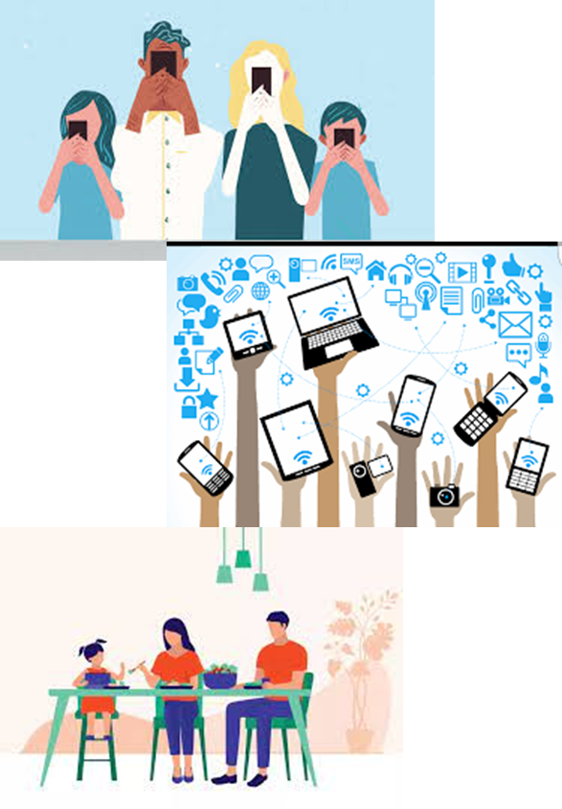
Tutor Time Recap
In your Personal Development Tutor Time activity, you started to look at screen time
In your books answer the following question:
“What is screen time?”
Sentence starter – “Screen time is…”

Slide 5
Tutor Time Recap
Screen time is…
“Any time spent using a device with a screen (mobile phones, tablets, TV, computer/laptop”
Task – use your red pen to add to the definitions you had written down.

Slide 6

Tutor Time Recap
This links to the Golden Thread of “Secure your Relationships” as spending too much time inside looking at screens can have an impact on physical and mental health. It is important to put screens away and enjoy the outdoors too.
Article 3 states that adults should do what is best for children. Although this may mean that children disagree with the decision. An example is schools banning mobile phones. However this allows pupils’ opportunities to enjoy interacting with each other in person and not through a screen
UN Rights
of a Child

Slide 7
What impact does a high screen time have?
In the margin write “SYV” – this stands for “Secure Your Voice”
Highlight “SYV”
Complete the following sentence…
“Reasons I have heard that people should not have extended screen time are…”

Slide 8

What impact does a high screen time have
Using your oracy helpsheet, discuss with the person next to you the question:
“What reasons have you heard that say people should not have extended screen time?”
Remember to use the sentence starters to add, build or challenge what your partner has said.
Be ready to share your discussion with the class

Slide 9
Impact on physical wellbeing
Excessive screen time can have a negative impact on physical wellbeing.
This is due to increased screen time meaning people are less active and eat a less healthy diet. This is made worse by lack of sleep.
One potential consequence of this is weight gain. This could eventually lead to obesity which is linked to lots of serious health issues such as diabetes, cardiovascular diseases and strokes.

Slide 10
Impact on physical wellbeing
Additionally due to people’s posture when looking at screens other physical impacts are:
Eye strain
Neck and shoulder pain
Back pain

Slide 11
Impact on physical wellbeing
Physical impacts of excessive screen time:
Lack of physical activity
Obesity which is linked to major health issues
Eye strain
Neck and shoulder pain
Back pain
In the margin write “SYV” – this stands for “Secure Your Voice”
Highlight “SYV”
Write a subtitle “impact on physical wellbeing” and then write down the effects in order of what you think is the worst effect

Slide 12
What impact does a high screen time have
Using your oracy helpsheet, discuss with the person next to you the question:
“What do you think is the worst physical wellbeing impact of excessive screen time?”
Remember to use the sentence starters to add, build or challenge what your partner has said.
Be ready to share your discussion with the class

Slide 13
Hinge Questions – whiteboard activity
3
Rules!
I will ask the question and give you some thinking time. (no more than 10 seconds)
Write the answer and turn your whiteboard over so nobody can see it.
When I am ready I will put on the 3 to 1 counter.
When ‘Show me’ appears on the board you must hold up your whiteboard (even if you don’t know the answer and there is nothing on your board)
2
1
Show me!
(even if your whiteboard is blank)

Slide 14
Hinge Questions – whiteboard activity
What is being described?
“Any time spent using a device with a screen (mobile phones, tablets, TV, computer/laptop”
Screen time

Slide 15

Hinge Questions – whiteboard activity
What Golden Thread does today’s lesson relate to?
A – Secure your Voice
B – Secure your Relationships
C – Secure your Wellbeing
D – Secure your Future

Slide 16
Hinge Questions – whiteboard activity
What physical wellbeing impact of excessive screen time is being described?
“putting on weight due to snacking while watching hours of netflix”
A – obesity
B – neck and shoulder pain
C – back pain

Slide 17
Hinge Questions – whiteboard activity
What physical wellbeing impact of excessive screen time is being described?
“after scrolling on Instagram for one hour, a person walks to the kitchen rubbing their neck”
A – eye strain
B – neck and shoulder pain
C – back pain

Slide 18
Hinge Questions – whiteboard activity
What physical wellbeing impact of excessive screen time is being described?
“starting to feel like you are squinting at a screen to focus on it properly”
A – lack of physical activity
B – eye strain
C – neck and shoulder pain

Slide 19
Impact on mental wellbeing
Excessive screen time can also have a negative impact on mental wellbeing.
Too much screen time can reduce a person’s self-esteem and self-worth. This is largely due to comparisons with unrealistic body images and lifestyle compared to their own lives.

Slide 20
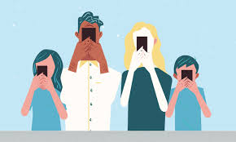

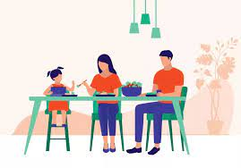
Screen Time
Screen time can also impact mental wellbeing of young people by making them feeling more lonely, stressed, anxious, tense or angry.
This could be explained by young people being able to access too much information about current global issues or seeing graphic or violent content that is not appropriate for their age.

Slide 21
Screen Time
In the margin write “SYV” – this stands for “Secure Your Voice”
Highlight “SYV”
Write a subtitle “impact on mental wellbeing” and then complete the following sentence:
“I think the biggest impact on mental wellbeing from excessive screen time is…”

Slide 22
What impact does a high screen time have
Using your oracy helpsheet, discuss with the person next to you the question:
“What do you think is the biggest impact on mental wellbeing from excessive screen time?”
Remember to use the sentence starters to add, build or challenge what your partner has said.
Be ready to share your discussion with the class

Slide 23
Screen Time
There is one element of excessive screen time that can have a physical and mental wellbeing impact.
Screen time negatively impacts a person’s quality of sleep. This lack of sleep can explain why people may be less active and eat a diet that contains too much sugar as they need more energy.

Slide 24
Screen Time
This can also explain why people feel more anxious, tense and angry as they are very tired.
These impacts are worse when there is excessive screen time just before going to sleep.
This is due to screens emitted blue light. This type of light disturbs a sleep hormone. If this happens the brain thinks the body is not tired despite it being very late at night.

Slide 25
Screen Time
In the margin write “SYV” – this stands for “Secure Your Voice”
Highlight “SYV”
Complete the following sentences:
“Blue light from screens stops the brain thinking…”
“This is bad for a persons wellbeing because…”

Slide 26
Hinge Questions – whiteboard activity
3
Rules!
I will ask the question and give you some thinking time. (no more than 10 seconds)
Write the answer and turn your whiteboard over so nobody can see it.
When I am ready I will put on the 3 to 1 counter.
When ‘Show me’ appears on the board you must hold up your whiteboard (even if you don’t know the answer and there is nothing on your board)
2
1
Show me!
(even if your whiteboard is blank)

Slide 27
Hinge Questions – whiteboard activity
Write down 1 negative mental wellbeing impact of excessive screen time
Reduced self/esteem/self-worth, loneliness, increased stress/anxiety, feeling tense/angry

Slide 28
Hinge Questions – whiteboard activity
True or False
“excessive screen use can impact a person’s quality of sleep”
A – True
B – False

Slide 29
Hinge Questions – whiteboard activity
What type of light is emitted that is the reason behind screen time impact a person’s quality of sleep?
A – Green Light
B – Black Light
C – Blue Light
D – Red Light

Slide 30
Signs to turn screens off
Although it can be difficult to turn screens off, it is important to recognise and listen to signs from the world around you and from your body that it is time to turn the screens off

Slide 31
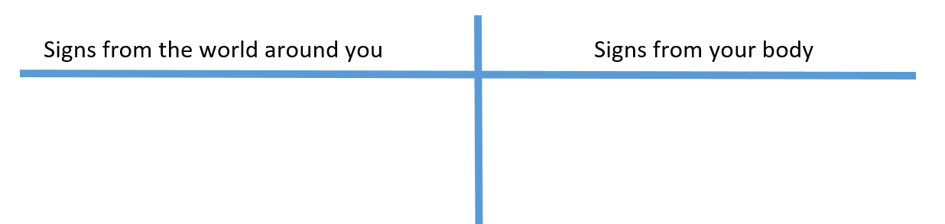
Signs to turn screens off
Draw the following table in your books

Slide 32
Signs to turn screens off
Using the phrases below, write them under the heading you think best describes them
Headaches
The device feels hot
Sore eyes
Looking at the clock and realizing lots of time has passed
Thumbs are sore
Didn’t realise it had become dark
Parents/carers telling you to put the screen away
Needing to constantly charge devices
Feeling thirsty or hungry

Slide 33
Screen Time
Using your oracy helpsheet, discuss with the person next to you the question:
“What did you write under signs from the world around you?”
Remember to use the sentence starters to add, build or challenge what your partner has said.
Be ready to share your discussion with the class

Slide 34
Screen Time
Using your oracy helpsheet, discuss with the person next to you the question:
“What did you write under signs from your body?”
Remember to use the sentence starters to add, build or challenge what your partner has said.
Be ready to share your discussion with the class

Slide 35
Reflection
Screens are very addictive due to them providing so much entertainment.
However too much screen time can have negative impacts on both physical and mental wellbeing.
Think about your screen time this week. Could you have turned the screen off earlier? What else could you do instead of using a screen?

Slide 36



Support
If you ever need support about excessive screen time for yourself, a friend or family member you can find it here:
Childline.org.uk
Call – 08001111
Email or chat online for support
Themix.org.uk
You can email or have one-to-chat online.
There is also a crisis messenger which is available 24/7

Slide 37


