Slide 1
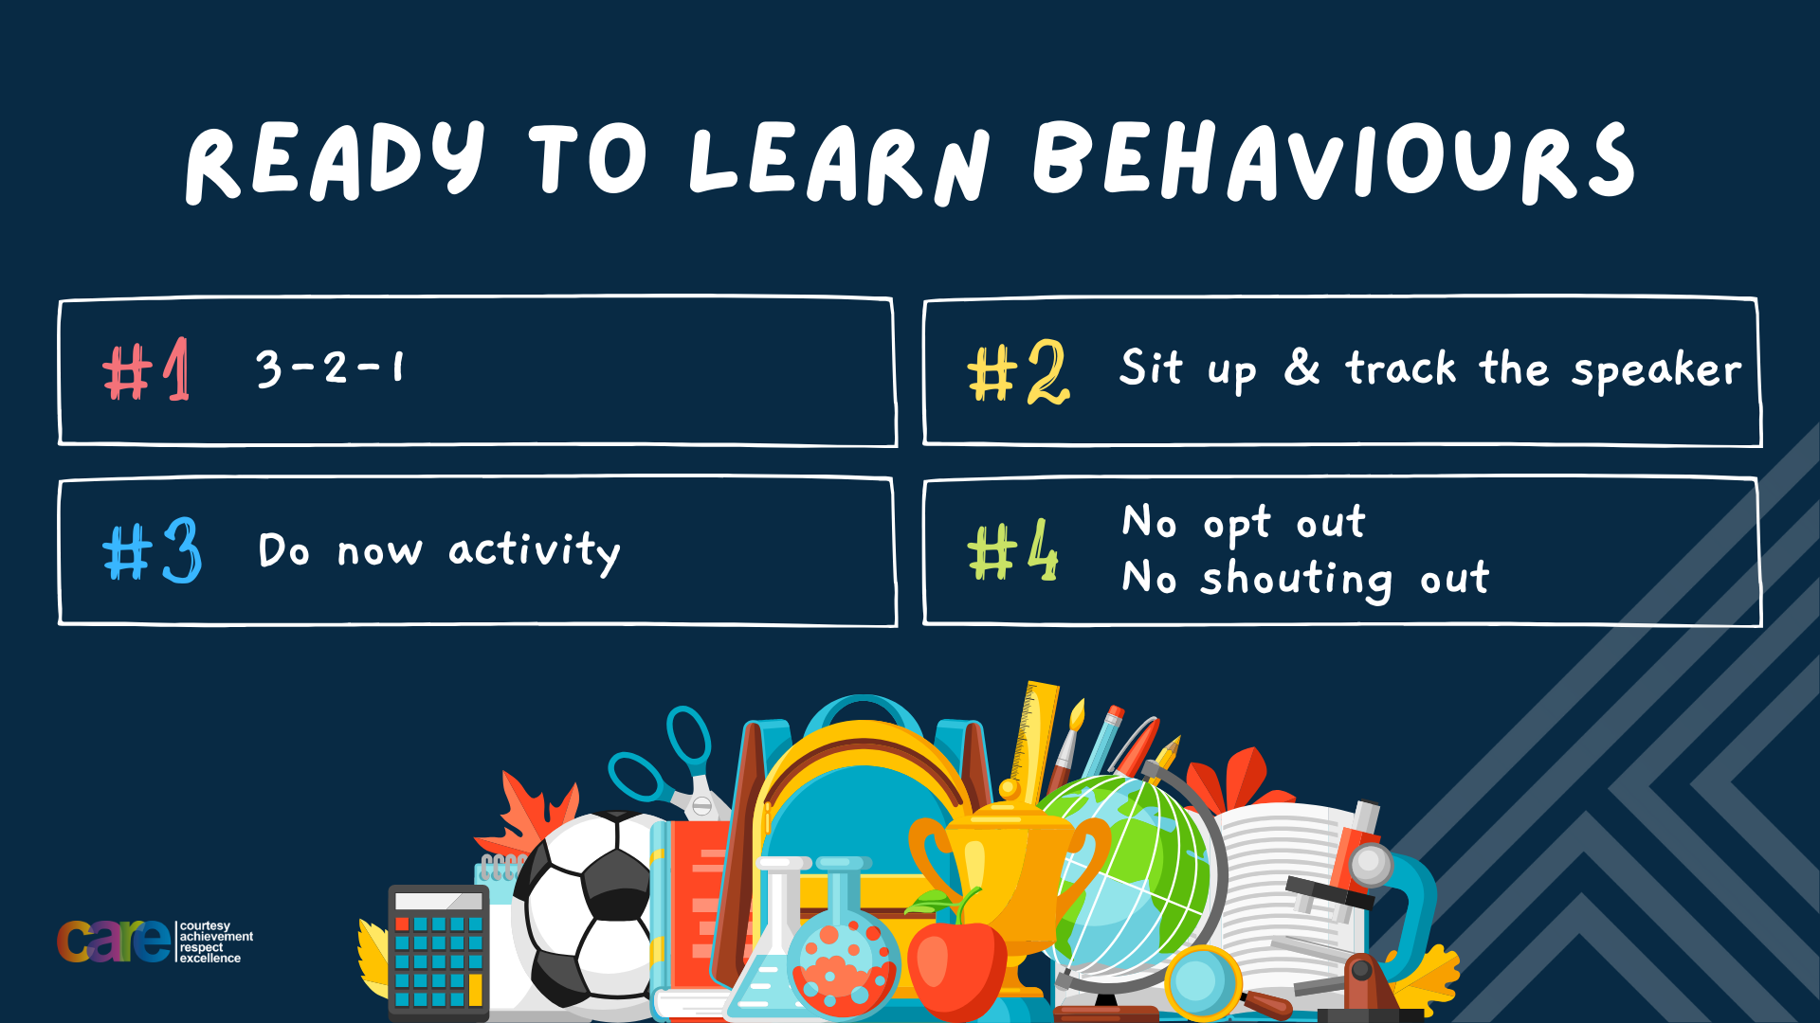

Slide 2








Write the date: 14 April 2025
Write the title: What are healthy relationships?
Underline both with your ruler in your learning wallet. Take out your oracy helpsheet too.
Complete the following questions:
What is being described? “giving time, money or resources to help people or causes in need”
What is being described? “the variety of differences among people”
True or False – compromise is a good skill to help resolve conflict
Charity work
DIversity
True

Slide 3


Secure your Relationships: Learning Journey
What does a healthy relationship look like
What does an unhealthy relationship look like?
What are romantic relationships?
Different types of committed relationships
What is gender identity and sexual orientation?
What are appropriate/ inappropriate images to send?
Today we will look at:
What does a healthy relationship look like?
This includes:
Types of relationships
Why relationships are important
Please remember that during the lesson we should not be asking any pupil or teacher personal questions.
Your teacher can ask you questions but this will be to check your knowledge in the lesson.

Slide 4

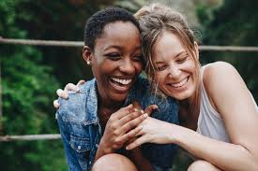

Tutor Time Recap
A relationship is “the way in which 2 or more people regard and behave towards each other.”
Examples of relationships are friendships, romantic relationships, family relationships, community relationships and professional relationships

Slide 5
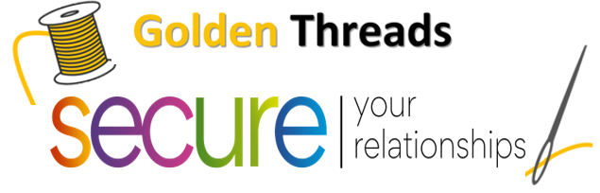

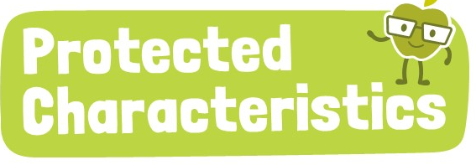
Tutor Time Recap
We are learning this because:
It helps to secure your relationships” relationships are an important aspect of life so it important that they are healthy
Individual Liberty is a British Value and people in relationships should respect who you are as a person and not force you to be someone you are not.
Relationships are referenced throughout but highlight that these should protect children due to them being safe and healthy.
People in healthy relationships will celebrate their differences such as those outlined as protected characteristics
UN Rights
of a Child

Slide 6
Principles of a healthy relationship
Regardless of the type of relationship, a healthy relationship will have 6 key principles:
Communication
Respect
Best Interests
Trust
Equality
Honesty

Slide 7
Principles of a healthy relationship
You have 1 minute to think about what definition matches up with the principle
Communication
Treats each other the way they should be treated
Respect
Actions and behaviours are based on what is good for each person in the relationship
Best Interests
There is clear communication between people so everyone knows what the other is thinking
Trust
Tell each other the truth and there are no secrets in the relationship
Equality
You can share your thoughts and feelings without feeling judged
Honesty
Each person in the relationship is equal to each other. There is no power imbalance

Slide 8
Principles of a healthy relationship
In your books write down the 6 principles in the order of most importance for you.
As a reminder the principles are:
Communication
Respect
Best interests
Trust
Equality
honesty

Slide 9

Principles of a healthy relationship
Using your oracy helpsheet, discuss with the person next to you the question:
“What was your most important principle of a healthy relationship?”
Remember to use the sentence starters to add, build or challenge what your partner has said.
Be ready to share your discussion with the class

Slide 10
Hinge Questions – whiteboard activity
3
Rules!
I will ask the question and give you some thinking time. (no more than 10 seconds)
Write the answer and turn your whiteboard over so nobody can see it.
When I am ready I will put on the 3 to 1 counter.
When ‘Show me’ appears on the board you must hold up your whiteboard (even if you don’t know the answer and there is nothing on your board)
2
1
Show me!
(even if your whiteboard is blank)

Slide 11
Hinge Questions – whiteboard activity
What is being described?
“the way in which 2 or more people regard and behave towards each other.”
relationships

Slide 12

Hinge Questions – whiteboard activity
What golden thread does today’s lesson link to?
A – Secure your Future
B – Secure your Wellbeing
C – Secure your Relationships
D – Secure your Voice

Slide 13
Hinge Questions – whiteboard activity
What principle of a healthy relationship is being described?
“Making decisions that will benefit everyone in the relationship and not just one person”
A – Respect
B – Best Interest
C – Honesty
D - Trust

Slide 14
Hinge Questions – whiteboard activity
Is this a description of a healthy relationship?
“My sibling shares their favourite snacks with me”
A – Yes
B - No

Slide 15
Hinge Questions – whiteboard activity
Is this a description of a healthy relationship?
“My friend gets annoyed if I don’t reply to a message straight away”
A – Yes
B - No

Slide 16
Hinge Questions – whiteboard activity
Is this a description of a healthy relationship?
“A local youth worker helps me deal with issues I am having”
A – Yes
B - No

Slide 17
Hinge Questions – whiteboard activity
Is this a description of a healthy relationship?
“2 people who work together ignore each other and only talk to each other when they have to.”
A – Yes
B – No
This is a difficult scenario. People may not always like each other when in a professional relationship but still have to be professional and ensure work is completed.

Slide 18
Showing appreciation
One other principle in a healthy relationship is showing appreciation.
Appreciation is a way to let people know that they feel valued.
Appreciation strengthens relationships by making others feel respected, loved and/or supported.
Simple act of kindness or gratitude can really cement a relationship

Slide 19
Showing appreciation
You now have 1 minute to think about the question:
“How can people show appreciation?”
Write your ideas in your book by completing the following sentence.
“Ways people can show appreciation are…”

Slide 20
Showing appreciation
Using your oracy helpsheet, discuss with the person next to you the question:
“How can people show appreciation?”
Remember to use the sentence starters to add, build or challenge what your partner has said.
Be ready to share your discussion with the class

Slide 21
Showing appreciation
Ways to show appreciation include:
Saying thank you to a person who has helped you
Giving a person a compliment on their efforts or how they look
Helping someone without being asked
Celebrate another person’s success regardless of how big or small

Slide 22
Showing appreciation
You now have 1 minute to think about the following statement:
“Saying thank you is the best way of showing appreciation”
Write your ideas in your book by completing the following sentence.
“I agree/disagree with this statement because…

Slide 23
Showing appreciation
Using your oracy helpsheet, discuss with the person next to you the statement:
““Saying thank you is the best way of showing appreciation”
Remember to use the sentence starters to add, build or challenge what your partner has said.
Be ready to share your discussion with the class

Slide 24
Showing appreciation
Sometimes it can be difficult to verbally show your appreciation. A nice way to get around this is to write a letter/postcard.

Slide 25
Showing appreciation
Write a letter/postcard to someone you have a relationship to show them appreciation for what they do for you.
This should include:
The person’s name
At least 1 thing you are thankful for
How they positively impact you.

Slide 26
Reflection
Throughout life, people will experience multiple relationships.
Regardless of the type of relationship, they should always be healthy relationships.
How are you going to ensure your relationships with people are healthy and show your appreciation for the relationship?

Slide 27


