Slide 1
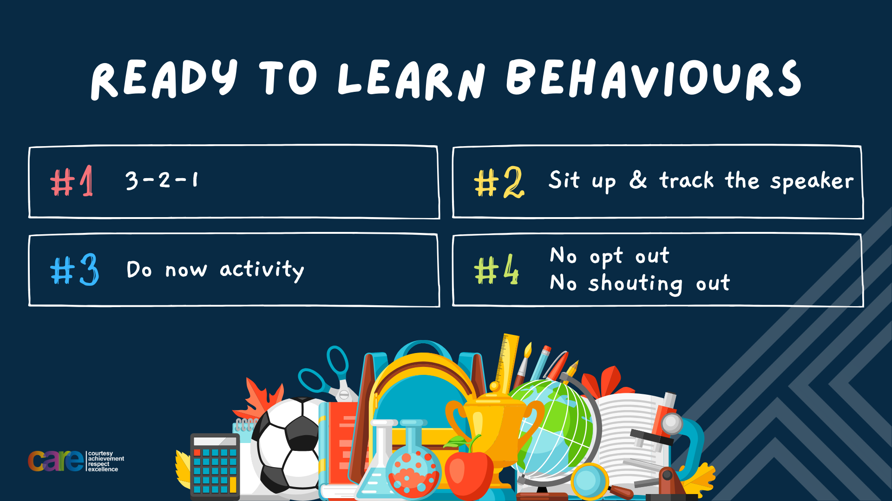

Slide 2








Write the date: 14 April 2025
Write the title: importance of charity work
Underline both with your ruler in your learning wallet. Take out your oracy helpsheet too.
Complete the following questions:
What is being described? “a way of life of a group of people”
Give an example of how to resolve conflict
Give an example of a skill required for good teamwork?
Culture
Focus on the problem at hand, recognize and control own feelings, be willing to forgive, actively listen, negotiate and compromise
Communication, collaboration, compromise, reliability

Slide 3


Secure your Relationships: Learning Journey
Issues faced by people in the UK
What is loneliness?
Importance of working together
What is conflict resolution?
Importance of celebrating culture and diversity
Importance of charity work
Today we will look at:
Importance of charity work
This includes:
- Why charity work is important
Difference between local, national and international charities
Please remember that during the lesson we should not be asking any pupil or teacher personal questions.
Your teacher can ask you questions but this will be to check your knowledge in the lesson.

Slide 4



Tutor Time Recap
Charity work is “giving time, money or resources to help people or causes in need”
Charities are struggling with the cost of living crisis due to:
Increased costs of running the charity
Decreased contributions from people due to their own financial pressures
Volunteers no longer able to commit their time
More and more people requiring the services supplied by the charity

Slide 5
Why is charity work important
Taking part in charity work is important for many reasons. Some of these reasons are:
Improves lives of individuals and communities.
Helps to address issues like homelessness, poverty and environmental protection
Encourages people to show empathy to others in need

Slide 6
Why is charity work important
Charities can work locally, nationally or internationally.
Local charities are those that are solely based in a person’s local area. For example a charity might only work in Birmingham

Slide 7
Why is charity work important
Charities can work locally, nationally or internationally.
National charities are those that work across a whole country. For example a charity that works in multiple places around the UK

Slide 8
Why is charity work important
Charities can work locally, nationally or internationally.
International charities are those that work across different countries. This can be across the same continent or across the whole globe.

Slide 9
Examples of local charities
There are many charities that are solely based in Birmingham.
Some examples are:
Birmingham’s Children’s Hospital. This raises funds for advanced medical care and comfort for young patients
LoveBrum – This aims to improve the city through small, impactful community projects.
St Basil’s. This focuses on preventing youth homelessness in the West Midlands

Slide 10

Examples of a local charity
Notes:
https://www.youtube.com/watch?v=9ByaglIG9AU

Slide 11
Examples of national charities
There are many charities that work across the whole of the UK. Some examples of these are:
Children in Need. The fund many other charities across the UK that help improves the lives of children
The British Red Cross – This charity responds to UK emergencies such as floods and fires to help those who have been affected
RSPCA – This charity protects animals from neglect and abuse
Trussell Trust – This is a network or food banks that provide emergency support for families without enough money to live on.

Slide 12
Examples of a national charity
Notes:
httpshttps://www.youtube.com/watch?v=WDEt4EH_JOg

Slide 13
Examples of international charities
There are many charities that work across multiple countries. Some examples are:
UNICEF – This charity provides food, education and vaccines to children in need worldwide
Oxfam – This charity combats global poverty through education, fair trade and emergency relief
WWF – this charity protects wildlife and works on climate change initiatives

Slide 14
Examples of an international charity
Notes:
https://www.youtube.com/watch?v=0ZiEwDJMxjs

Slide 15
Hinge Questions – whiteboard activity
3
Rules!
I will ask the question and give you some thinking time. (no more than 10 seconds)
Write the answer and turn your whiteboard over so nobody can see it.
When I am ready I will put on the 3 to 1 counter.
When ‘Show me’ appears on the board you must hold up your whiteboard (even if you don’t know the answer and there is nothing on your board)
2
1
Show me!
(even if your whiteboard is blank)

Slide 16
Hinge Questions – whiteboard activity
What is being described?
“giving time, money or resources to help people or causes in need”
Charity work

Slide 17

Hinge Questions – whiteboard activity
True or False
Many charities are struggling due to the cost of living crisis?
A – True
B - False

Slide 18
Hinge Questions – whiteboard activity
True or False
Many charities are struggling due to the cost of living crisis?
A – True
B - False

Slide 19
Hinge Questions – whiteboard activity
True or False
Taking part in charity work can encourage people to show empathy to others in need
A – True
B - False

Slide 20
Hinge Questions – whiteboard activity
What is being described?
A charity that works solely in one local area?
A – International charity
B – National charity
C – Local charity

Slide 21
Hinge Questions – whiteboard activity
What is being described?
A charity that works across one country?
A – National charity
B – International charity
C – Local charity

Slide 22
Hinge Questions – whiteboard activity
What is being described?
A charity that works across multiple countries?
A – Local charity
B – International charity
C – National charity

Slide 23

Charity work
You now have 1 minute to think about the question:
“Would you rather help a local, national or international charity? Why?”
Write your reasons and why in your book.

Slide 24
Charity work
Using your oracy helpsheet, discuss with the person next to you the question:
“Would you rather help a local, national or international charity? Why?”
Remember to use the sentence starters to add, build or challenge what your partner has said.
Be ready to share your discussion with the class

Slide 25
Importance of charity work
Charity work does not just help other people. There are many personal benefits of participating in charity work.
Some of these benefits are:
Feeling fulfilled knowing that you have made a difference
Expands social network as you can make new like minded friends
Develops teamwork, communication and organizational skills which are all sought after employability skills.

Slide 26
Importance of charity work
One way of getting involved in charity work is by running a charity event.
These events can be simple things like a bake sale or even a sponsored challenge.
One reason why young people do not run events is they think they are too young. Think again while watching this video

Slide 27
Running a fundraising event
Notes:
https://www.youtube.com/watch?v=-auxugVTe1w

Slide 28
Importance of charity work
In groups of 3-4 you must now:
Choose a charity that you would like to raise money for
Identify if it is a local, national or international charity
Come up with a fundraising idea. This should include how other people can get involved.
Be ready to share your chosen charity and fundraising idea with the class.

Slide 29


