Slide 1
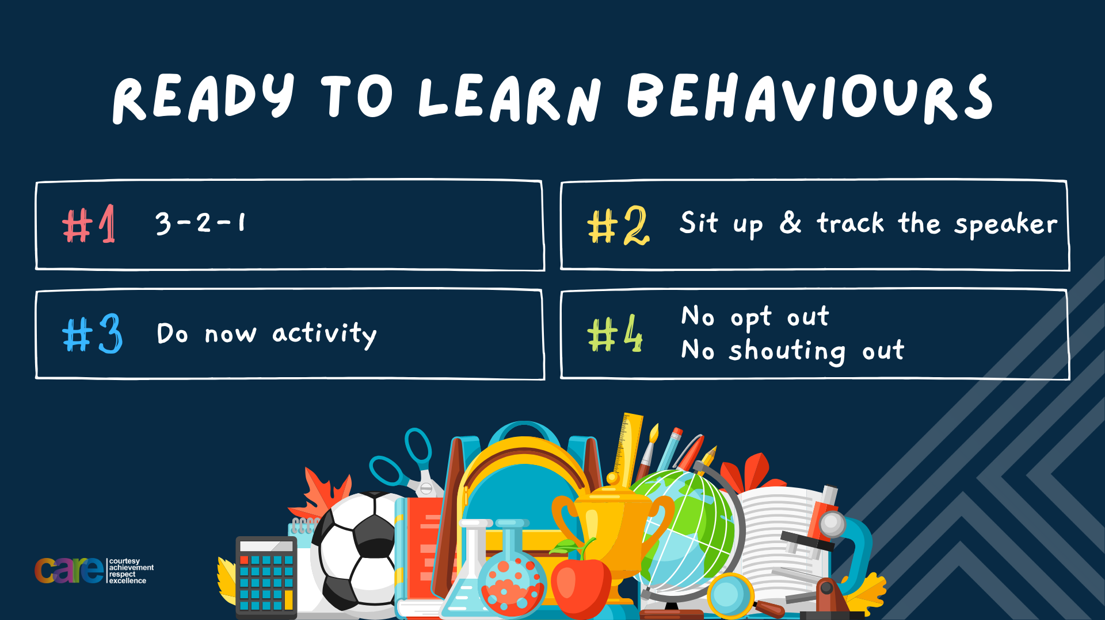

Slide 2








Write the date: 14 April 2025
Write the title: culture and diversity in Birmingham
Underline both with your ruler in your learning wallet. Take out your oracy helpsheet too.
Complete the following questions:
What is being described? “a way to settle a disagreement peacefully”
What roles are there in a team?
Give an example of an activity that can be completed in solitude
Conflict resolution
Leader, thinker, organiser, helper
Reading, listening to music, playing an instrument, drawing/painting, going for a walk

Slide 3


Secure your Relationships: Learning Journey
Issues faced by people in the UK
What is loneliness?
Importance of working together
What is conflict resolution?
Importance of celebrating culture and diversity
Importance of charity work
Today we will look at:
Celebrating culture and diversity in Birmingham
This includes:
Different celebrations of culture that happen in Birmingham
Why it is important to celebrate culture and diversity
Please remember that during the lesson we should not be asking any pupil or teacher personal questions.
Your teacher can ask you questions but this will be to check your knowledge in the lesson.

Slide 4
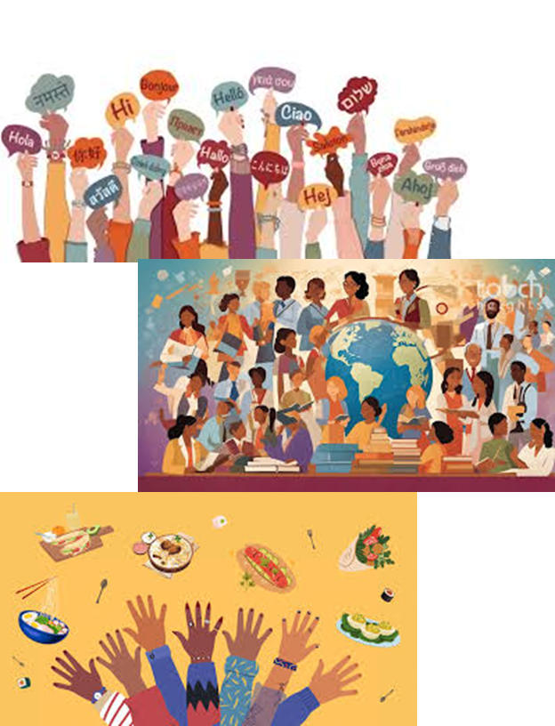
Tutor Time Recap
Culture is “a way of life of a group of people” It includes behaviours, beliefs, values and symbols
Diversity is “the variety of differences among people” It includes race, gender, age, experiences, talents, skills and opinions

Slide 5
Tutor Time Recap
This will help secure your relationships and you will build better and stronger relationship if you can appreciate and respect other cultures
Celebrating culture, especially if it is different than yours is an example of the British Values; mutual respect and tolerance

Slide 6
Tutor Time Recap
It also links to many different articles in the UN Rights of a Child, especially article 7 (a right to a nationality) and article 30 (those from a minority group have the right to share their culture, language and religion
Aspects of culture include race and religion. No one should be discriminated against due to their race or religion. In fact these differences in people should be celebrated.

Slide 7

Diversity in Birmingham
Notes:
https://www.youtube.com/watch?v=wlf6Un_Ks9Y

Slide 8
Diversity in Birmingham
Birmingham is home to 1.1 million people from over 187 nationalities.
Each of these nationalities will have its own culture.
This makes Birmingham one of the most diverse cities in the UK

Slide 9
Diversity in Birmingham
There are over 90 languages spoken in the city. These include English, Urdu, Punjab, Bengali, Polish and Somali
There are lots of religions represented in the city including; Christianity, Islam, Hinduism, Sikhism, Buddhism, Judaism.

Slide 10
How does Birmingham celebrate different cultures
One way Birmingham celebrates different cultures is through religious events.
Examples of these events are:
Diwali (Festival of Lights) at Soho Road
Eid in the Park Celebrations in Small Heath Park

Slide 11
How does Birmingham celebrate different cultures – Diwali Mela
Notes:
https://www.youtube.com/watch?v=170JWijdR9g

Slide 12
How does Birmingham celebrate different cultures
One way Birmingham celebrates different cultures is through specific cultural events.
Examples of these events are:
St Patrick’s Day parade in Digbeth
Caribbean Carnival in Handsworth Park

Slide 13
How does Birmingham celebrate different cultures – St Patrick’s Day Parade
Notes:
https://www.youtube.com/watch?v=K4rJ7pKVHQU

Slide 14
How does Birmingham celebrate different cultures
One way Birmingham celebrates different cultures is through festivals
Examples of these festivals are:
Birmingham International Dance Festival
German Christmas Markets

Slide 15
How does Birmingham celebrate different cultures – Birmingham international dance festival
Notes:
https://www.youtube.com/watch?v=nfkiZrg3w0E

Slide 16

Celebrating culture
You now have 1 minute to think about the question:
“From the events you have just seen, what event would you like to go to?”
Write your reasons and why in your book.

Slide 17
Celebrating culture
Using your oracy helpsheet, discuss with the person next to you the question:
““From the events you have just seen, what event would you like to go to?”
Remember to use the sentence starters to add, build or challenge what your partner has said.
Be ready to share your discussion with the class

Slide 18
Why celebrate culture and diversity
Promotes understanding – People can learn about different cultures in their own city. The more people learn the more cultural stereotypes reduce
Fosters community spirit – Having cultural celebrations in the city you live in creates a sense of belonging specially when they are attended by people of other cultures.

Slide 19
Celebrating culture and diversity
You now have 1 minute to think about the question:
“Festivals and other events are big celebrations but how can people celebrate culture and diversity everyday?”
Write your reasons and why in your book.

Slide 20
Celebrating culture
Using your oracy helpsheet, discuss with the person next to you the question:
“Festivals and other events are big celebrations but how can people celebrate culture and diversity everyday?”
Remember to use the sentence starters to add, build or challenge what your partner has said.
Be ready to share your discussion with the class

Slide 21
Everyday celebrations of culture and diversity
Everyday ways of celebrating culture and diversity are:
1. Learn about traditions from friends and neighbours that come from a different background than you

Slide 22
Everyday celebrations of culture and diversity
Everyday ways of celebrating culture and diversity are:
2. Explore cultural art and music exhibitions in museums and art galleries in Birmingham

Slide 23
Everyday celebrations of culture and diversity
Everyday ways of celebrating culture and diversity are:
3. Learn to simple words in different languages of your friends and neighbours

Slide 24
Everyday celebrations of culture and diversity
Everyday ways of celebrating culture and diversity are:
4. Be open to trying new foods or listening to different music of friends or neighbours in they are from a different culture to you

Slide 25
Why you matter in celebrating diversity
It can seem daunting to celebrate a culture that you do not follow or know a lot about.
However, every small action that celebrates culture or promotes diversity has a huge impact.
The more culture and diversity is celebrate the more people feel welcome. This makes people happy. This makes the atmosphere and feeling around the city better.

Slide 26
Celebrating culture and diversity
You now have 1 minute to think about the question:
“How would you like culture and diversity celebrated at Hodge Hill College?”
Write your reasons and why in your book.

Slide 27
Celebrating culture
Using your oracy helpsheet, discuss with the person next to you the question:
“How would you like culture and diversity celebrated at Hodge Hill College?”
Remember to use the sentence starters to add, build or challenge what your partner has said.
Be ready to share your discussion with the class

Slide 28
Reflection
Diversity is not just a fact in Birmingham and the UK, it is also a strength of the city and wider country.
Celebrating it just makes Birmingham and the UK more special.
It is important to never stop learning and sharing culture with other people.

Slide 29


