Slide 1
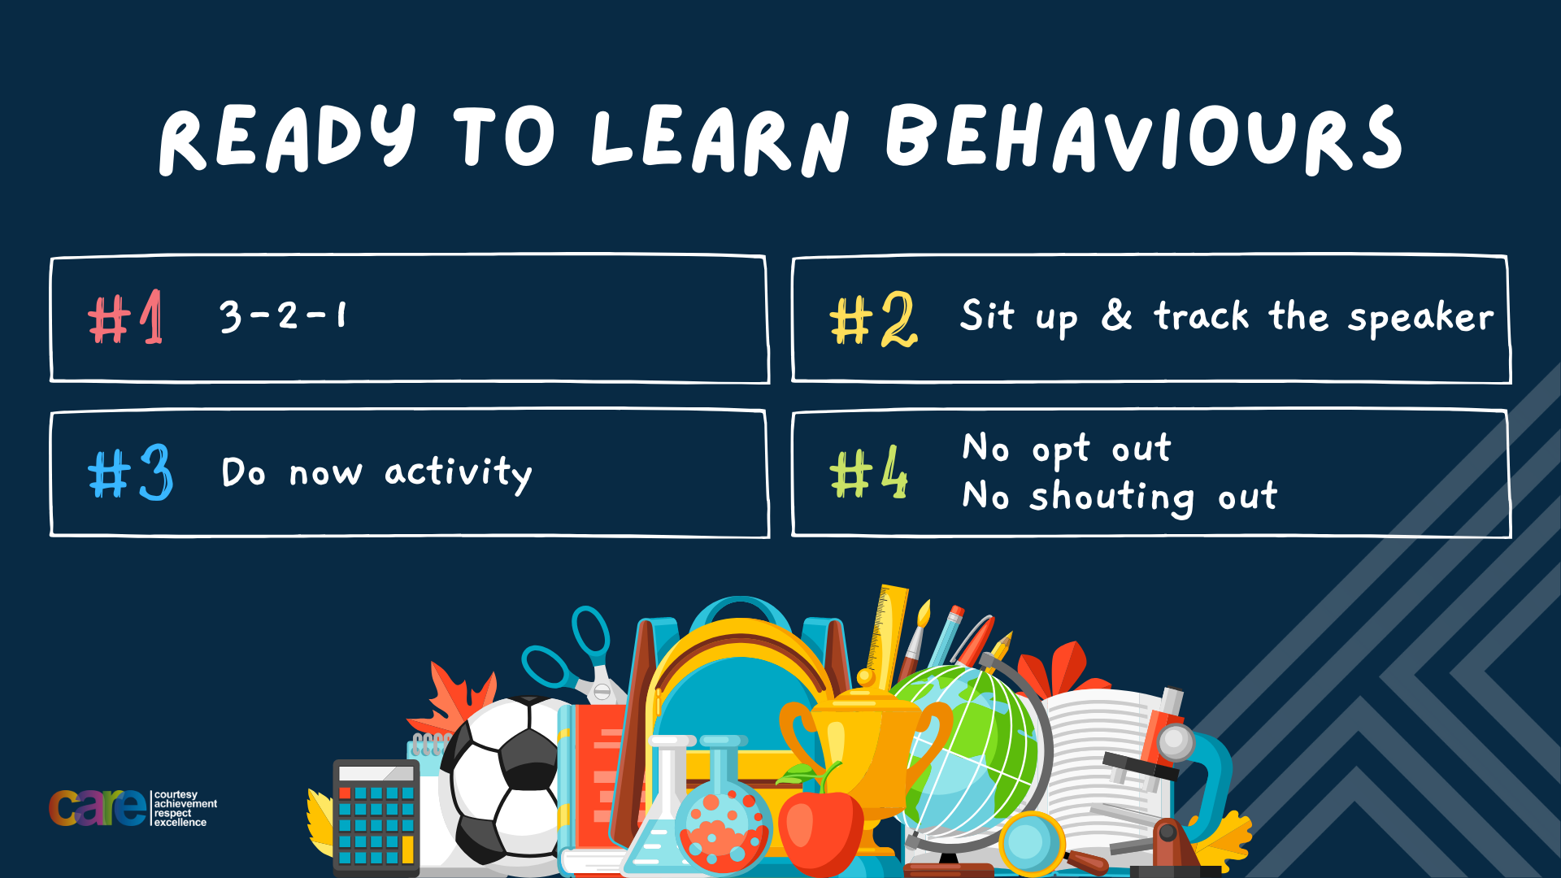

Slide 2








Write the date: 14 April 2025
Write the title: What are unhealthy relationships?
Underline both with your ruler in your learning wallet. Take out your oracy helpsheet too.
Complete the following questions:
Name 2 principles of a healthy relationship.
National charities work where?
True or False – culture and diversity is a good thing
Communication, respect, best interests, trust, equality, honesty
Across one country
True

Slide 3


Secure your Relationships: Learning Journey
What does a healthy relationship look like
What does an unhealthy relationship look like?
What are romantic relationships?
Different types of committed relationships
What is gender identity and sexual orientation?
What are appropriate/ inappropriate images to send?
Today we will look at:
What does an unhealthy relationship look like?
This includes:
Principles of an unhealthy relationship
What each principles looks like and sounds like
How unhealthy relationships can lead to abuse
Please remember that during the lesson we should not be asking any pupil or teacher personal questions.
Your teacher can ask you questions but this will be to check your knowledge in the lesson.

Slide 4



Tutor Time Recap
A relationship is “the way in which 2 or more people regard and behave towards each other.”
Unfortunately relationships can be unhealthy for the people in the relationship

Slide 5
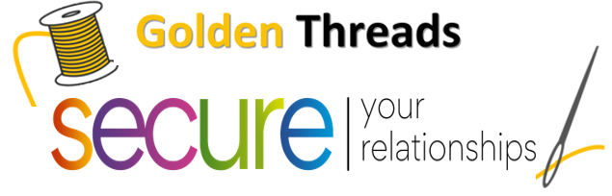

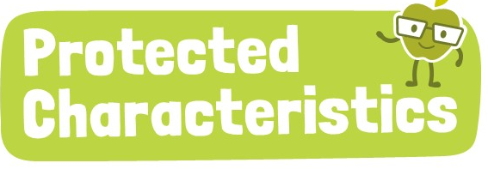
Tutor Time Recap
We are learning this because:
It helps to secure your relationships” relationships are an important aspect of life so it important to know what makes a relationship unhealthy so it can be fixed or ended.
Individual Liberty is a British Value and people in relationships should respect who you are as a person and not force you to be someone you are not.
Relationships are referenced throughout but highlight that these should protect children due to them being safe and healthy. If a relationship is unhealthy then a child is not receiving that right.
People in unhealthy relationships may be made to feel ashamed due to one of the protected characteristics
UN Rights
of a Child

Slide 6
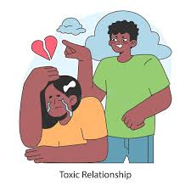
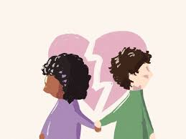
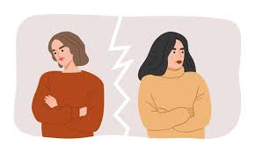
Principles of an unhealthy relationship
Unhealthy relationships have 3 key characteristics:
Disrespect
Control
Neglect

Slide 7
Principles of an unhealthy relationship
You have 1 minute to think about what definition matches up with the principle
Disrespect
When a person consistently fails to notice or respond to the other’s emotions or feelings
Control
When a person dominates the other person in the relationship to get their own way
Neglect
When a person doesn’t feel valued or equal in the relationship

Slide 8
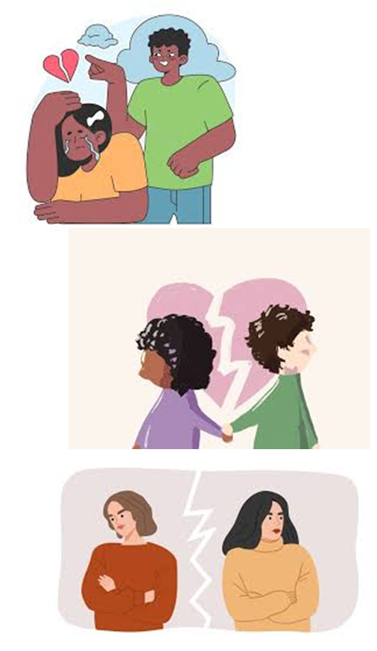
Principles of an unhealthy relationship
Disrespect looks like…
People not caring about what the other person thinks and continues to do things even if they have been asked to stop
Disrespect sounds like…
“I don’t care what you think”
“What does it matter to you anyway?”
“Who even are you?”

Slide 9
Principles of an unhealthy relationship
Control looks like…
One person in the relationship making all the decisions without asking for other’s opinions
Control sounds like…
“we are going to do this my way”
“you must do what I say”

Slide 10
Principles of an unhealthy relationship
Neglect looks like…
Somebody walking past or away from someone who is very emotional when they are meant to care for that person
Neglect sounds like…
This could be complete silence or it could be comments such as “what are you crying for anyway?”

Slide 11
Hinge Questions – whiteboard activity
3
Rules!
I will ask the question and give you some thinking time. (no more than 10 seconds)
Write the answer and turn your whiteboard over so nobody can see it.
When I am ready I will put on the 3 to 1 counter.
When ‘Show me’ appears on the board you must hold up your whiteboard (even if you don’t know the answer and there is nothing on your board)
2
1
Show me!
(even if your whiteboard is blank)

Slide 12
Hinge Questions – whiteboard activity
What is being described?
“the way in which 2 or more people regard and behave towards each other.”
relationships

Slide 13

Hinge Questions – whiteboard activity
What golden thread does today’s lesson link to?
A – Secure your Future
B – Secure your Wellbeing
C – Secure your Relationships
D – Secure your Voice

Slide 14
Hinge Questions – whiteboard activity
What principle of an unhealthy relationship is being described?
“When a person doesn’t feel valued or equal in the relationship”
A – Neglect
B – Control
C – Disrespect

Slide 15
Hinge Questions – whiteboard activity
What principle of an unhealthy relationship is being described?
“When one person dominates the other person in the relationship to get their own way”
A – Disrespect
B – Neglect
C – Control

Slide 16
Hinge Questions – whiteboard activity
What does disrespect sound like?
A – “I didn’t see you there”
B – “We are going to do things my way”
C – “I don’t care what you think”

Slide 17
Hinge Questions – whiteboard activity
What does control look like?
A – walking past or away from someone who is emotional
B – one person always making the decisions
C – people not caring what you think and continuing to do things even if they have been asked to stop

Slide 18
Hinge Questions – whiteboard activity
What does neglect look like?
A – walking past or away from someone who is emotional
B – one person always making the decisions
C – people not caring what you think and continuing to do things even if they have been asked to stop

Slide 19

Principles of an unhealthy relationship
In your books answer the following question:
“Identify a characteristic of an unhealthy relationship”
Sentence starters:
A characteristic of an unhealthy relationship is…
This characteristic looks like…
This characteristics sounds like…

Slide 20
Characteristics of an unhealthy relationship
Using your oracy helpsheet, discuss with the person next to you the question:
“Identify a characteristic of an unhealthy relationship”
Remember to use the sentence starters to add, build or challenge what your partner has said.
Be ready to share your discussion with the class

Slide 21
When unhealthy relationships become abusive
In more serious cases, unhealthy relationships are deem abusive.
Abuse can happen in any type of relationship, abuse is not limited to romantic relationships.
There is no excuse for any type of abuse to happen in any relationship

Slide 22
When unhealthy relationships become abusive
Examples of abuse are:
1. Physical – When a person consistently punches, kicks or pushes another person in the relationship.

Slide 23
When unhealthy relationships become abusive
Examples of abuse are:
2. Emotional – When a person makes another person in the relationship feel bad about themselves by consistently saying negative things about them.

Slide 24
When unhealthy relationships become abusive
Examples of abuse are:
3. Financial – When a person limits the amount of money or takes money away from other’s in the relationship.

Slide 25
Hinge Questions – whiteboard activity
3
Rules!
I will ask the question and give you some thinking time. (no more than 10 seconds)
Write the answer and turn your whiteboard over so nobody can see it.
When I am ready I will put on the 3 to 1 counter.
When ‘Show me’ appears on the board you must hold up your whiteboard (even if you don’t know the answer and there is nothing on your board)
2
1
Show me!
(even if your whiteboard is blank)

Slide 26
Hinge Questions – whiteboard activity
What type of abuse is being described?
“When a person consistently punches, kicks or pushes another person in the relationship.”
Physical

Slide 27
Hinge Questions – whiteboard activity
What type of abuse is being described?
“When a person limits the amount of money or takes money away from other’s in the relationship.”
Financial

Slide 28
Hinge Questions – whiteboard activity
What type of abuse is being described?
“When a person makes another person in the relationship feel bad about themselves by consistently saying negative things about them.”
Emotional

Slide 29
Types of abuse
In your books answer the following question:
“Identify a type of abuse”
Sentence starters:
One type of abuse is…
This is when…

Slide 30
Characteristics of an unhealthy relationship
Using your oracy helpsheet, discuss with the person next to you the question:
“Identify a type of abuse”
Remember to use the sentence starters to add, build or challenge what your partner has said.
Be ready to share your discussion with the class

Slide 31
Types of abuse - scenario
Liam and Jake often hang out together after school. Lately, Jake has been acting differently. When they play video games, Jake gets angry if he loses and hits Liam on the arm, saying, “You’re so annoying! Why do you always have to win?”
At first, Liam laughs it off, but Jake starts doing it more often. One day, when Liam tries to stop Jake from cheating in the game, Jake pushes him hard and says, “Don’t tell me what to do, or I’ll really hurt you.”
When Liam tells Jake to stop, Jake says, “I’m just messing around. Don’t be so soft. It’s not a big deal.”
Liam starts feeling scared to hang out with Jake but doesn’t know how to handle the situation without making things worse.
In your books answer the following questions:
What principle of an unhealthy relationship is shown in the scenario?
What type of abuse is described in the scenario?
What advice would you give Liam?

Slide 32
Types of abuse - scenario
Using your oracy helpsheet, discuss with the person next to your answers to the questions on the previous slide.
Remember to use the sentence starters to add, build or challenge what your partner has said.
Be ready to share your discussion with the class

Slide 33



Types of abuse
If you need any support about unhealthy relationships for yourself, a friend or family member there is support out there for you
Childline.org.uk
Call – 08001111
Email or chat online for support
Themix.org.uk
You can email or have one-to-chat online.
There is also a crisis messenger which is available 24/7

Slide 34


