Slide 1
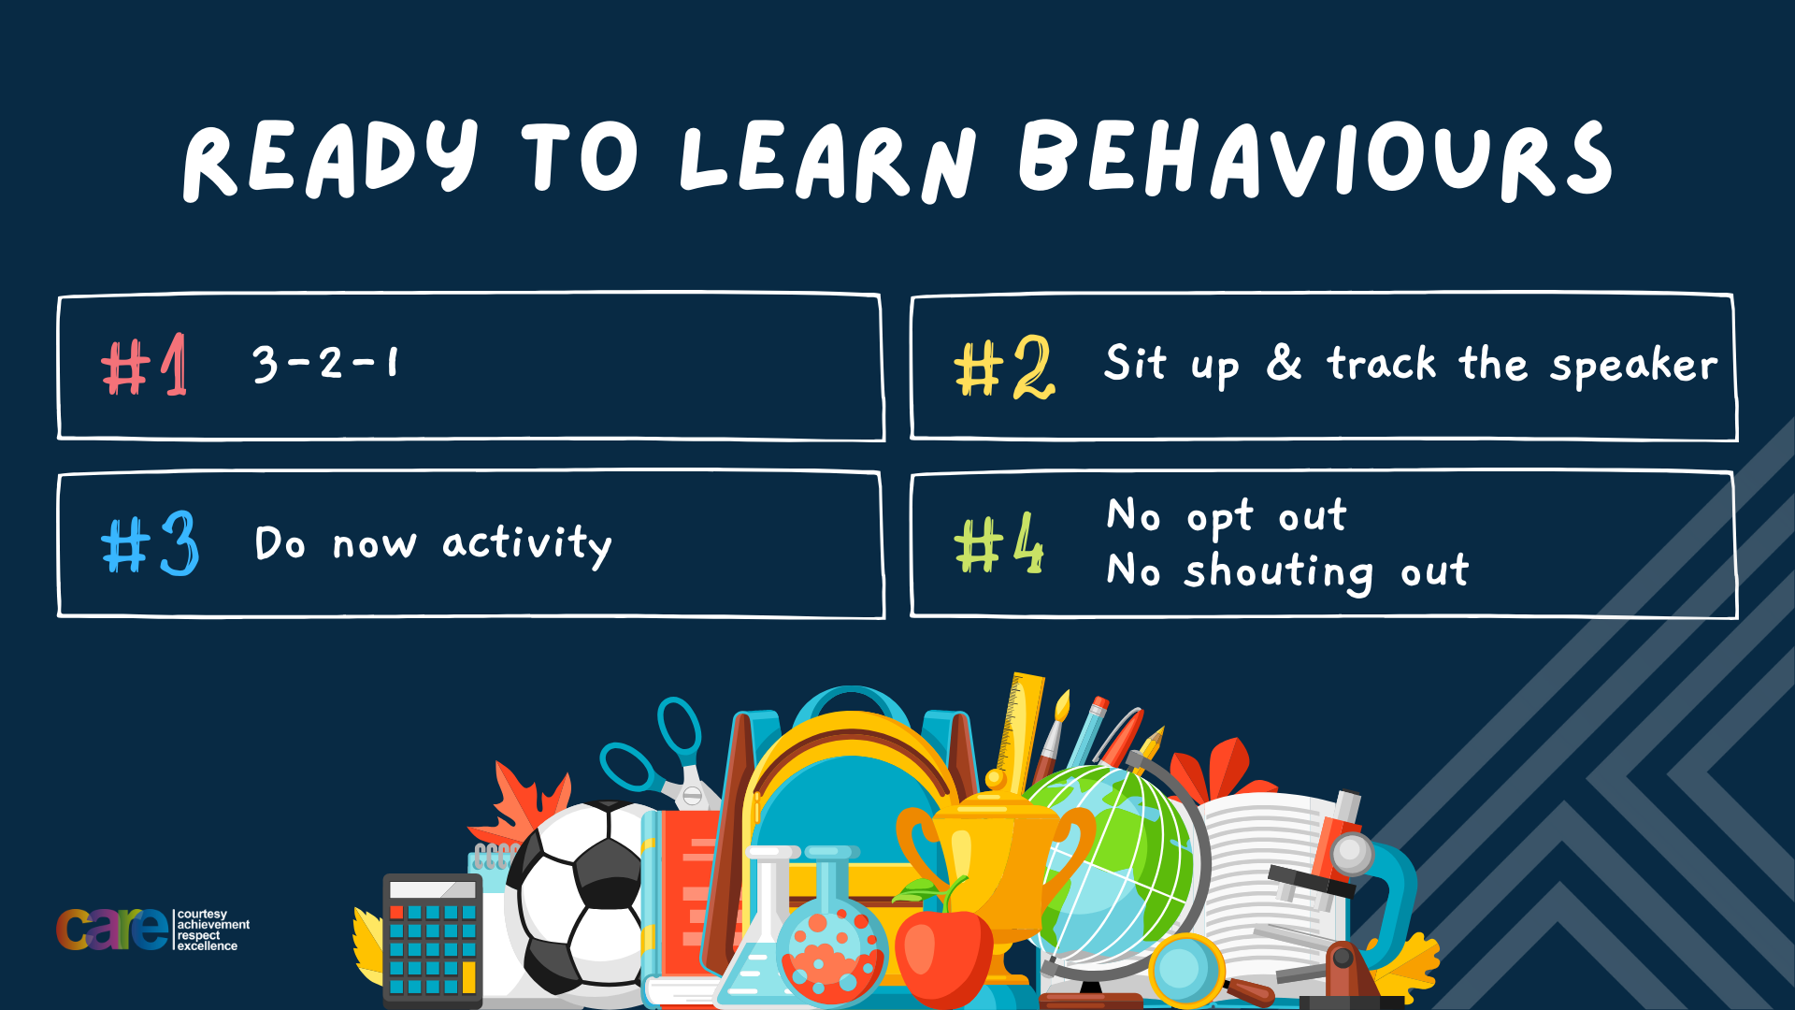

Slide 2








Write the date: 14 April 2025
Write the title: importance of working with others
Underline both with your ruler in your learning wallet. Take out your oracy helpsheet too.
Complete the following questions:
What is being described? “a feeling of sadness or distress about being by oneself, even if others are nearby”
True or False – Racist language used in music lyrics normalizes the use of this language which makes people use it more
True or False – FGM is happens due to religious reasons
Loneliness
True
False

Slide 3


Secure your Relationships: Learning Journey
Issues faced by people in the UK
What is loneliness?
Importance of working together
What is conflict resolution?
Importance of celebrating culture and diversity
Importance of charity work
Today we will look at:
Importance of working together
This includes:
Skills required for teamwork
Different roles within a team
Please remember that during the lesson we should not be asking any pupil or teacher personal questions.
Your teacher can ask you questions but this will be to check your knowledge in the lesson.

Slide 4
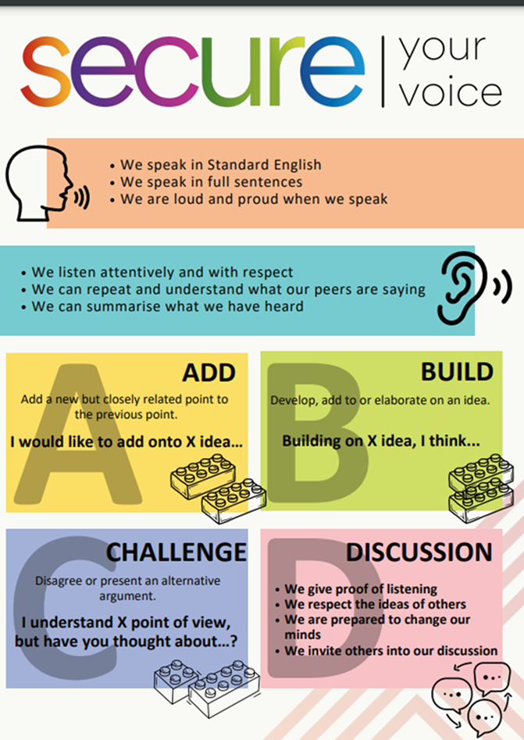
Recap of Tutor Time
In Tutor Time this week you started to learn about importance of working in a team
You have 1 minute to write down 3 things you can remember from your Personal Development tutor time activity on Monday

Slide 5

Tutor Time Recap
Using your oracy helpsheet, discuss with the person next to you the things you remember from your Personal Development tutor time activity.
Remember to use the sentence starters to add, build or challenge what your partner has said.
Be ready to share your discussion with the class

Slide 6

Tutor Time Recap
Teamwork is “when a group of people come together to reach a shared goal”
This is important for securing your relationships and future as it increases your ability to work with other people. Teamwork is also one of the most sought after employability skills which will help you get a job.
Article 15 of the UN Rights of a Child states that children have the right to form groups. As part of a group, you will have to work with other people for that group to be effective and be a success

Slide 7
Skills required for teamwork
There are some skills that are important for teamwork to be successful. They are:
1. Communication – Be able to speak clearly and listen well allows messages to the team to be easily understood and avoids confusion

Slide 8
Skills required for teamwork
There are some skills that are important for teamwork to be successful. They are:
2. Collaboration – This means working together and combining people’s strength. It is not one person taking over and having full control

Slide 9
Skills required for teamwork
There are some skills that are important for teamwork to be successful. They are:
3. Compromise – This means adjusting or giving up some of your ideas to find a solution that works for everyone. A common ground if found for the team to be successful.

Slide 10
Skills required for teamwork
There are some skills that are important for teamwork to be successful. They are:
4. Reliability - This means that others can count on you to complete your part of the task to the best of your ability. This means that other people in the team will not have to cover other people’s parts too.

Slide 11
Skills for teamwork
You now have 1 minute to think about the question:
“what skill for teamwork do you think is most important?”
Write your reasons and why in your book.

Slide 12
Solitude Activites
Using your oracy helpsheet, discuss with the person next to you the question:
“what skill for teamwork do you think is most important?”
Remember to use the sentence starters to add, build or challenge what your partner has said.
Be ready to share your discussion with the class

Slide 13
Hinge Questions – whiteboard activity
3
Rules!
I will ask the question and give you some thinking time. (no more than 10 seconds)
Write the answer and turn your whiteboard over so nobody can see it.
When I am ready I will put on the 3 to 1 counter.
When ‘Show me’ appears on the board you must hold up your whiteboard (even if you don’t know the answer and there is nothing on your board)
2
1
Show me!
(even if your whiteboard is blank)

Slide 14

Hinge Questions – whiteboard activity
What is being described?
“when a group of people come together to reach a shared goal”
A – Teamwork
B – Working as an individual

Slide 15
Hinge Questions – whiteboard activity
True or False
Article 15 of the UN Rights of a Child states that children have the right to form groups. This will be an opportunity children to work with each other
True

Slide 16
Hinge Questions – whiteboard activity
True or False
Teamwork is not a skill that employers look for?
False

Slide 17
Hinge Questions – whiteboard activity
What teamwork skill is being described?
“This means adjusting or giving up some of your ideas to find a solution that works for everyone.”
A – Compromise
B – Communication
C - Reliability

Slide 18
Hinge Questions – whiteboard activity
What teamwork skill is being described?
“Be able to speak clearly and listen well allows messages to the team to be easily understood and avoids confusion”
A – Collaborate
B – Communication
C - Reliability

Slide 19
Roles within a Team
Within a team there are different roles for people. These roles are defined as:
1. Leader – This person guides the team, encourages participation and keeps the group focused

Slide 20
Roles within a Team
Within a team there are different roles for people. These roles are defined as:
2. Thinker – This person comes up with ideas and solutions to problems

Slide 21
Roles within a Team
Within a team there are different roles for people. These roles are defined as:
3. Organiser – This person keeps everyone on track and ensures deadlines are met

Slide 22
Roles within a Team
Within a team there are different roles for people. These roles are defined as:
4. Helper – This person lends support and fills in where they are needed most.

Slide 23

Roles within a Team
You watched this video during tutor time this week. While watching the video again identify who was the:
Leader
Thinker
Organiser
Helper
Notes:
https://www.youtube.com/watch?v=0pRLUta7QCY

Slide 24
Roles within a Team
You now have 1 minute to think about the question:
“what happens if everyone in the team tries to be the leader?”
Write your reasons and why in your book.

Slide 25
Roles within a Team
Using your oracy helpsheet, discuss with the person next to you the question:
“what happens if everyone in the team tries to be the leader?”
Remember to use the sentence starters to add, build or challenge what your partner has said.
Be ready to share your discussion with the class

Slide 26
Hinge Questions – whiteboard activity
3
Rules!
I will ask the question and give you some thinking time. (no more than 10 seconds)
Write the answer and turn your whiteboard over so nobody can see it.
When I am ready I will put on the 3 to 1 counter.
When ‘Show me’ appears on the board you must hold up your whiteboard (even if you don’t know the answer and there is nothing on your board)
2
1
Show me!
(even if your whiteboard is blank)

Slide 27
Hinge Questions – whiteboard activity
What role in a team is being described?
“This person guides the team, encourages participation and keeps the group focused”
A – Helper
B – Organiser
C - Leader

Slide 28
Hinge Questions – whiteboard activity
What role in a team is being described?
“This person keeps everyone on track and ensures deadlines are met”
A – Organiser
B – Leader
C - Thinker

Slide 29
Hinge Questions – whiteboard activity
What role in a team is being described?
“This person lends support and fills in where they are needed most.”
A – Organiser
B – Helper
C - Thinker

Slide 30
Working as a Team
You will be working in teams of at least 4.
In your groups you must assign everyone a role:
1 person is the leader
1 person is the thinker
1 person is the organizer
1 person is the helper
If you are working in a group of more than 4, an additional person can be a thinker or a helper

Slide 31
Working as a Team
Teamwork challenge 1:
Leaders come get your first challenge. You will then explain it to your team.
It is a race between each team who can complete the challenge first. Remember to respect the roles you have been assigned.

Slide 32
Working as a Team
Teamwork challenge 1:
Answers
Riddle 1 – What has keys but can’t open locks? = a piano
Riddle 2 – What has to be broken before you can use it? = an egg
Riddle 3 – A man shaves many times during the day but at the end of the day he still has a beard, How is this possible? = The man is a barber

Slide 33
Working as a Team
Teamwork challenge 2:
Leaders come get your second challenge. You will then explain it to your team.
It is a race between each team who can complete the challenge first. Remember to respect the roles you have been assigned.

Slide 34
Working as a Team
The cipher lock
“yobxh fp lro dlxi”
This became “break is our goal”
Each letter in the alphabet moved forward 3 letters. For example:
A becomes D
B becomes E
C becomes F

Slide 35
Working as a Team
Teamwork challenge 3:
Leaders come get your third challenge. You will then explain it to your team.
It is a race between each team who can complete the challenge first. Remember to respect the roles you have been assigned.

Slide 36
Working as a Team
Teamwork challenge 3:
(5 x 3) + 7 – 4 =
18

Slide 37
Working as a Team
Teamwork challenge 4:
Leaders come get your 4th challenge. You will then explain it to your team.
It is a race between each team who can complete the challenge first. Remember to respect the roles you have been assigned.

Slide 38
Working as a Team
Teamwork challenge 4:
You had to unscramble the words:
“het nlfai nmrueb si vsene”
“the final number is seven”

Slide 39
Roles within a Team
You now have 1 minute to think about the question:
“where you successful in your role within the team?”
Write your reasons and why in your book.

Slide 40
Roles within a Team
Using your oracy helpsheet, discuss with the person next to you the question:
“where you successful in your role within the team?”
Remember to use the sentence starters to add, build or challenge what your partner has said.
Be ready to share your discussion with the class

Slide 41


Slide 42
Teamwork Challenge 1
As a team you need to solve the following riddles:
Riddle 1 – What has keys but can’t open locks?
Riddle 2 – What has to be broken before you can use it?
Riddle 3 – A man shaves many times during the day but at the end of the day he still has a beard, How is this possible?

Slide 43
Teamwork Challenge 2
This is called a Cipher Lock
You need to solve what the following words translate too:
“yobxh fp lro dlxi”
Clue – each letter in the alphabet shifts forward 3 letters. If you get to “z” then restart at “A” Example – Y is B

Slide 44
Teamwork Challenge 3
You need to solve the following maths equation
(5x3) + 7 - 4

Slide 45
Teamwork Challenge 4
You need to unscramble the following words:
“het nlfai nmrueb si vsene”

