Slide 1
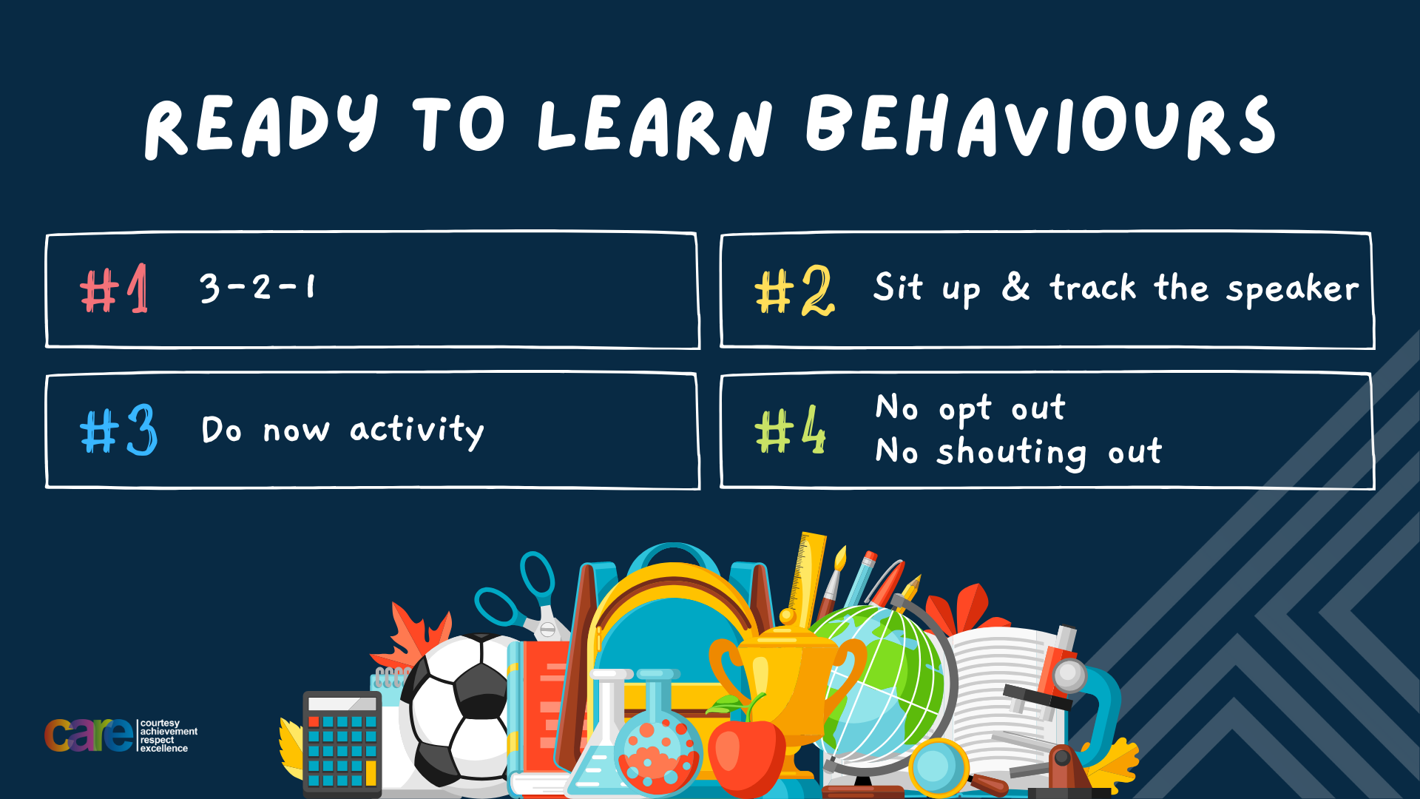

Slide 2








Write the date: 14 April 2025
Write the title: what is conflict resolution
Underline both with your ruler in your learning wallet. Take out your oracy helpsheet too.
Complete the following questions:
What is being described? “when a group of people come together to reach a shared goal”
What is being described? “choosing to be alone and feeling peaceful or content, often for relaxation, self-reflection, or engaging in personal interests
True or False – racist banter is acceptable because it involves humour
Teamwork
solitude
False

Slide 3


Secure your Relationships: Learning Journey
Issues faced by people in the UK
What is loneliness?
Importance of working together
What is conflict resolution?
Importance of celebrating culture and diversity
Importance of charity work
Today we will look at:
What is conflict resolution
This includes:
Why is conflict resolution important?
How to resolve conflict
Application to scenario
Please remember that during the lesson we should not be asking any pupil or teacher personal questions.
Your teacher can ask you questions but this will be to check your knowledge in the lesson.

Slide 4


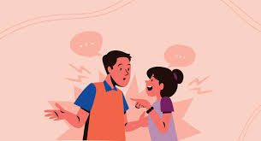
Tutor Time Recap
Conflict is “a disagreement where there is tension”
Disagreements happen all the time but not all disagreements lead to conflict.
A disagreement becomes conflict when people get tense and take a position on the issue that is the cause of the disagreement.

Slide 5
Tutor Time Recap
During conflicts people respond by either:
Fight – the person is ready to stand up or argue because they feel challenged or threatened
Flight – a person wants to avoid or escape the conflict
Freeze – a person feels stuck or unsure so does not do anything at all.

Slide 6
Tutor Time Recap
You are learning about conflict resolution because:
It helps to secure your relationship with friends and family by being able to resolve conflicts so the relationship is not harmed
Conflict resolution highlights the importance of the British Values of mutual respect, tolerance and individual liberty. These mean that everyone has the right to their own opinions even if others disagree but they can still live side by side without conflict
Article 13 of the UN Rights of the Child states that child have the right to freedom of expression. It is important to respect this and not cause conflict even if you do not agree with the opinion.

Slide 7
Conflict resolution?
Now that you know what conflict is, in your books write down your answer to the question below:
“What is conflict resolution?”

Slide 8

Conflict resolution
Using your oracy helpsheet, discuss with the person next to you the question:
“what is conflict resolution?”
Remember to use the sentence starters to add, build or challenge what your partner has said.
Be ready to share your discussion with the class

Slide 9
Conflict resolution?
Conflict resolution is…
“a way to settle a disagreement peacefully”

Slide 10
Conflict resolution
You now have 1 minute to think about the question:
“why is conflict resolution important?”
Write your reasons and why in your book.

Slide 11
Conflict resolution
Using your oracy helpsheet, discuss with the person next to you the question:
“why is conflict resolution important?”
Remember to use the sentence starters to add, build or challenge what your partner has said.
Be ready to share your discussion with the class

Slide 12
Conflict resolution?
Conflict resolution is important because:
Help people work together
Improves friendships and relationships
Reduces stress
Creates a peaceful environment for people to live and work in.

Slide 13
Hinge Questions – whiteboard activity
3
Rules!
I will ask the question and give you some thinking time. (no more than 10 seconds)
Write the answer and turn your whiteboard over so nobody can see it.
When I am ready I will put on the 3 to 1 counter.
When ‘Show me’ appears on the board you must hold up your whiteboard (even if you don’t know the answer and there is nothing on your board)
2
1
Show me!
(even if your whiteboard is blank)

Slide 14

Hinge Questions – whiteboard activity
What is being described?
“a disagreement where there is tension”
A – Conflict
B – Discussion
C - Peace

Slide 15
Hinge Questions – whiteboard activity
What is being described?
“a way to settle a disagreement peacefully”
A – Discussion
B – Conflict resolution
C - Argument

Slide 16
Hinge Questions – whiteboard activity
True or False
Article 13 of the UN Rights of a Child states that children have the right to freedom of expression.
True

Slide 17
Hinge Questions – whiteboard activity
True or False
Learning about conflict resolution helps to develop British Values such as individual liberty, mutual respect and tolerance
True

Slide 18
Hinge Questions – whiteboard activity
Conflict can cause multiple responses. What response are they?
A – Fight and Freeze
B – Funny, Flip, Fill
C – Fight, Flight, Freeze

Slide 19

How to resolve conflict
While watching the video identify the top 5 tips to resolve conflicts.
These should be written in your books
Notes:
https://www.youtube.com/watch?v=zHXYWMnm7Yg

Slide 20
How to resolve conflict
Using your oracy helpsheet, discuss with the person next to you the question:
“what were the top 5 tips to resolving conflict?”
Remember to use the sentence starters to add, build or challenge what your partner has said.
Be ready to share your discussion with the class

Slide 21
How to resolve conflict?
Top tips to resolve conflict are:
1. Focus on the problem at hand – do not bring up old mistakes or previous disagreements as this can make the current conflict worse and get in the way of finding a resolution.

Slide 22
How to resolve conflict?
Top tips to resolve conflict are:
2. Recognise and control own feelings – during conflict take a moment to collect your own thoughts and feelings and then response calmly and respectfully. This will mean the person(s) who are involved in the conflict will do the same

Slide 23
How to resolve conflict?
Top tips to resolve conflict are:
3. Be willing to forgive – everyone makes mistakes so it is important to be open to apologising and accepting apologies as this will end up strengthening the relationship

Slide 24
How to resolve conflict?
Top tips to resolve conflict are:
4. Don’t just listen, but hear – It is important to keep an open mid and actively listening when the other person is speaking to try to understand their point of view

Slide 25
How to resolve conflict?
Top tips to resolve conflict are:
5. Negotiate and compromise – people’s ideas and perspectives may be different from yours. It is important to try to take this into consideration and work towards a compromise.

Slide 26
Hinge Questions – whiteboard activity
3
Rules!
I will ask the question and give you some thinking time. (no more than 10 seconds)
Write the answer and turn your whiteboard over so nobody can see it.
When I am ready I will put on the 3 to 1 counter.
When ‘Show me’ appears on the board you must hold up your whiteboard (even if you don’t know the answer and there is nothing on your board)
2
1
Show me!
(even if your whiteboard is blank)

Slide 27
Hinge Questions – whiteboard activity
True or False
“during a conflict it is recommended to bring up old issues”
A – True
B – False

Slide 28
Hinge Questions – whiteboard activity
True or False
“during a conflict a person should recognize and control their own feelings so they respond calmly and respectfully”
A – True
B – False

Slide 29
Hinge Questions – whiteboard activity
True or False
“during a conflict it is important not to apologise”
A – True
B – False

Slide 30
Hinge Questions – whiteboard activity
True or False
“during a conflict it is important to actively listen so you can understand the other persons point of view”
A – True
B – False

Slide 31
Hinge Questions – whiteboard activity
True or False
“during a conflict it is important to find a compromise if you cannot agree”
A – True
B – False

Slide 32
Conflict resolution scenario
Emma and Liam are working together on an art project for school. However they both have different ideas on how their project so look. The two start discussing their ideas but it soon turns into a disagreement. Liam thinks Emma’s idea is childish and Emma thinks Liam’s idea is boring. During the disagreement Emma starts to raise her voice and says “you’re so annoying, why can’t we just do it my way for once?” Liam feels hurt by Emma’s tone and criticism. He does not know what to say back so he just stands there feeling upset.
In your books write down answers to the following questions:
What type of response did Emma and Liam have?
What conflict resolution techniques could be use to end the conflict?

Slide 33
Conflict resolution scenario
Emma and Liam are working together on an art project for school. However they both have different ideas on how their project so look. The two start discussing their ideas but it soon turns into a disagreement. Liam thinks Emma’s idea is childish and Emma thinks Liam’s idea is boring. During the disagreement Emma starts to raise her voice and says “you’re so annoying, why can’t we just do it my way for once?” Liam feels hurt by Emma’s tone and criticism. He does not know what to say back so he just stands there feeling upset.
Using your oracy helpsheet, discuss with the person next to you the answers you have suggested.
Remember to add, build or challenge during the discussion.
Be ready to share your answers with the class.

Slide 34


