Slide 2
Write the date: 05 November 2024
Write the title: loneliness and solitude
Underline both with your ruler in your learning wallet. Take out your oracy helpsheet too.
Complete the following questions:
What is being described? “jokes or comments targeting someone's race or ethnicity under the guise of humour”
True or False – FGM is illegal in the UK
True or False – everyone experiences the same puberty changes at the same time.
Racist Banter
True
False

Slide 3
Secure your Relationships: Learning Journey
Issues faced by people in the UK
What is loneliness?
Importance of working together
What is conflict resolution?
Importance of celebrating culture and diversity
Importance of charity work
Today we will look at:
Loneliness and solitude
This includes:
What activities count as solitude
Loneliness and mental health
Social media and COVID-19 impact on loneliness
Please remember that during the lesson we should not be asking any pupil or teacher personal questions.
Your teacher can ask you questions but this will be to check your knowledge in the lesson.

Slide 4
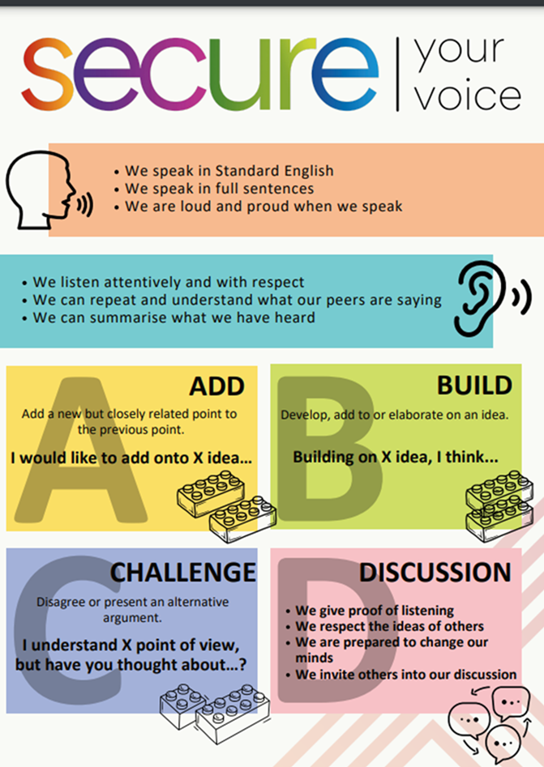
Recap of Tutor Time
In Tutor Time this week you started to learn about loneliness and solitude
You have 1 minute to write down 3 things you can remember from your Personal Development tutor time activity on Monday

Slide 5
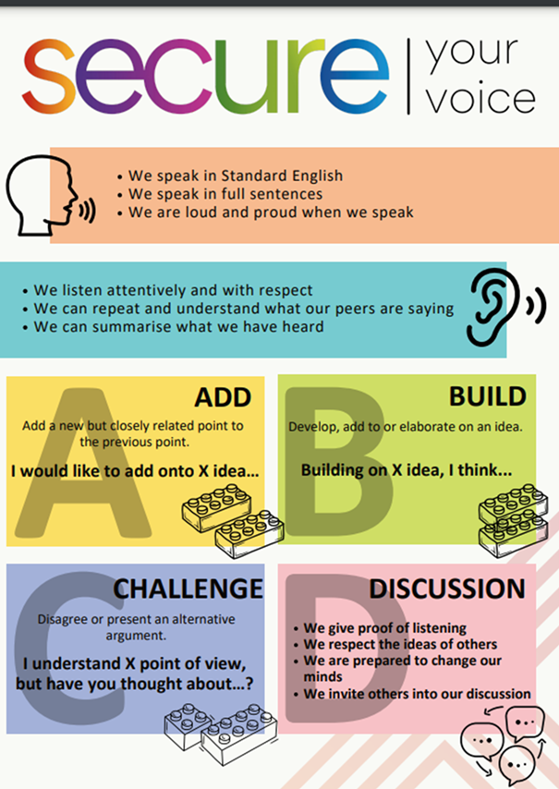
Tutor Time Recap
Using your oracy helpsheet, discuss with the person next to you the things you remember from your Personal Development tutor time activity.
Remember to use the sentence starters to add, build or challenge what your partner has said.
Be ready to share your discussion with the class

Slide 6
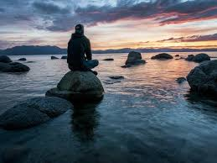
Tutor Time Recap
Loneliness is “a feeling of sadness or distress about being by oneself, even if others are nearby”
Solitude is “choosing to be alone and feeling peaceful or content, often for relaxation, self-reflection, or engaging in personal interests”

Slide 7
Tutor Time Recap
It is important to learn about the difference as 10% of 10-15 year old children report feeling lonely and this increases to 19% of children if they live in a city.
It is also important as the UN Rights of a Child states that it is important that children are able to live in a way that will help them reach their full mental and social potential. Understanding loneliness and solitude will help develop your mental and social awareness and will ensure that you can secure your relationships and wellbeing.

Slide 8
Solitude activities
You now have 1 minute to think about the question:
“what activities can be classed as solitude?”
Write your activities and reasons why in your book.

Slide 9
Solitude Activites
Using your oracy helpsheet, discuss with the person next to you the question:
“what activities can be classed as solitude?”
Remember to use the sentence starters to add, build or challenge what your partner has said.
Be ready to share your discussion with the class

Slide 10
Solitude Activities
Solitude activities are anything that can be enjoyed while being on your own.
Activities include:
Reading a book
Drawing or painting
Playing a musical instrument
Listening to music
Going for a walk/bike ride
Although many of these things can be done with other people, being in solitude is choosing to be alone and being ok with that.

Slide 11
Signs of Loneliness
If solitude is enjoying time on your own, how can you tell if someone is lonely?

Slide 12
Signs of Loneliness
Signs of loneliness include:
Feeling sad or down frequently even if there is no specific reason for these feelings
Low self esteem. People experiencing loneliness may start to feel like they are not good enough which can lead to negative thoughts about themselves
Withdrawing from friends/family. This happens when a person experiencing loneliness avoids social events because they feel disconnected
Acting moody or irritable. This happens because loneliness can make people frustrated causing them to act grumpy or become upset more often
Seeking reassurance from others. This can be seen in asking if others like them or if they are being “annoying”

Slide 13
Solitude activities
You now have 1 minute to think about the question:
“what’s one thing you could say or do to support a friend or family member who may be feeling lonely?”
Write your activities and reasons why in your book.

Slide 14
Solitude Activites
Using your oracy helpsheet, discuss with the person next to you the question:
“what’s one thing you could say or do to support a friend or family member who may be feeling lonely?”
Remember to use the sentence starters to add, build or challenge what your partner has said.
Be ready to share your discussion with the class

Slide 15
Hinge Questions – whiteboard activity
3
Rules!
I will ask the question and give you some thinking time. (no more than 10 seconds)
Write the answer and turn your whiteboard over so nobody can see it.
When I am ready I will put on the 3 to 1 counter.
When ‘Show me’ appears on the board you must hold up your whiteboard (even if you don’t know the answer and there is nothing on your board)
2
1
Show me!
(even if your whiteboard is blank)

Slide 16
Hinge Questions – whiteboard activity
What is being described?
“a feeling of sadness or distress about being by oneself, even if others are nearby”
Loneliness

Slide 17
Hinge Questions – whiteboard activity
What is being described?
“choosing to be alone and feeling peaceful or content, often for relaxation, self-reflection, or engaging in personal interests”
Solitude

Slide 18
Hinge Questions – whiteboard activity
Give an example of an activity that can be completed in solitude.
Reading a book
Drawing or painting
Playing a musical instrument
Listening to music
Going for a walk/bike ride

Slide 19
Hinge Questions – whiteboard activity
Give an example of a sign that someone is feeling lonely
Feeling sad or down frequently
Low self esteem.
Withdrawing from friends/family.
Acting moody or irritable.
Seeking reassurance from others.

Slide 20
Did the COVID Pandemic make loneliness worse?
In March 2020, due to the spread of COVID-19, the UK went into lockdown.
This meant that people could only mix with their other people in their household. People could not visit other people’s houses, meet other people in restaurants/cafes and schools were only open for a minority of pupils. Many workplaces also closed which forced people to work remotely from their homes.

Slide 21
Did the COVID Pandemic make loneliness worse?
Discuss with the person next to you the question below:
“Did the COVID-19 lockdowns increase loneliness in the UK?”
Be ready to share your discussion with the class

Slide 22
Did the COVID Pandemic make loneliness worse?
Using your oracy helpsheet, discuss with the person next to you the question:
“Did the COVID-19 lockdowns increase loneliness in the UK?”
Remember to use the sentence starters to add, build or challenge what your partner has said.
Be ready to share your discussion with the class

Slide 23
Did the COVID Pandemic make loneliness worse?
Research shows that feelings of loneliness increased significantly in people.
40% of young people reported feeling “often or always” lonely during the lockdowns.
Loneliness also affected many adults due to the separation from family, friends and colleagues. This was particularly found in adults who lived alone during the lockdowns.

Slide 24
Social Media use to combat loneliness
One way that loneliness (especially during COVID lockdowns) was combatted was through using social media.
This allowed people to stay in touch with family and friends during the lockdowns.
Even today, social media is still used to keep people connected, particularly if they live far away from friends and family.

Slide 25
Social Media use to combat loneliness
However social media use can also increase feelings of loneliness if a person is already lonely.
This is due to:
Increased feeling of isolation seeing friends and family posting pictures seemingly having a good time
Spending too much time on social media takes away from real life experiences and interacting with others. This leads to more time spent alone, wishing that they had company or interaction with others

Slide 26
Social media impact on loneliness
Discuss with the person next to you the question below:
“Is social media better for combatting loneliness or should it be avoided if feeling lonely?”
Be ready to share your discussion with the class

Slide 27
Did the COVID Pandemic make loneliness worse?
Using your oracy helpsheet, discuss with the person next to you the question:
“Is social media better for combatting loneliness or should it be avoided if feeling lonely?”
Remember to use the sentence starters to add, build or challenge what your partner has said.
Be ready to share your discussion with the class

Slide 28
Hinge Questions – whiteboard activity
3
Rules!
I will ask the question and give you some thinking time. (no more than 10 seconds)
Write the answer and turn your whiteboard over so nobody can see it.
When I am ready I will put on the 3 to 1 counter.
When ‘Show me’ appears on the board you must hold up your whiteboard (even if you don’t know the answer and there is nothing on your board)
2
1
Show me!
(even if your whiteboard is blank)

Slide 29
Hinge Questions – whiteboard activity
True or False
COVID-19 lockdowns increased the feeling of loneliness in young people and adults
True

Slide 30
Hinge Questions – whiteboard activity
Give one reason why social media is good for combatting loneliness
Allows people to be connected if they live far away from family and friends

Slide 31
Hinge Questions – whiteboard activity
True or False
Social media can make loneliness worse
True

Slide 32
Scenario
Jamie has had a busy week with school and decides to spend Saturday afternoon at home to relax. She picks up her phone and starts scrolling through social media, looking at posts from her friends. She notices that a few of her classmates went to the mall together that afternoon, sharing fun pictures and videos.
As Jamie looks at the photos, she starts to feel a bit left out, wishing she had been invited. She begins thinking that maybe her friends don’t like her as much as she thought. She tries to distract herself by scrolling more, but the feeling doesn’t go away, and she starts to feel sad.
After a while, Jamie decides to put her phone away. She picks up a book she’s been wanting to read and sits by the window, listening to music. As she gets into her book, she starts to feel calmer and enjoys the quiet time by herself.
Thinking time – write down ideas to discuss the following questions.
What emotions did Jamie feel when she was looking at social media?
Do you think Jamie was feeling lonely or experiencing solitude while she was on social media? Why?
When Jamie started reading and listening to music, do you think she was feeling lonely or did it become solitude?

Slide 33
Scenario
Jamie has had a busy week with school and decides to spend Saturday afternoon at home to relax. She picks up her phone and starts scrolling through social media, looking at posts from her friends. She notices that a few of her classmates went to the mall together that afternoon, sharing fun pictures and videos.
As Jamie looks at the photos, she starts to feel a bit left out, wishing she had been invited. She begins thinking that maybe her friends don’t like her as much as she thought. She tries to distract herself by scrolling more, but the feeling doesn’t go away, and she starts to feel sad.
After a while, Jamie decides to put her phone away. She picks up a book she’s been wanting to read and sits by the window, listening to music. As she gets into her book, she starts to feel calmer and enjoys the quiet time by herself.
Using your oracy help sheet discuss your responses to the questions. Remember to add, build and challenge what your partner has said.
What emotions did Jamie feel when she was looking at social media?
Do you think Jamie was feeling lonely or experiencing solitude while she was on social media? Why?
When Jamie started reading and listening to music, do you think she was feeling lonely or did it become solitude?

Slide 34
Support
If you are concerned loneliness either about yourself, a friend or a family member, support is available through
Childline.org.uk
Call – 08001111
Email or chat online for support
Themix.org.uk
You can email or have one-to-chat online.
There is also a crisis messenger which is available 24/7

