Slide 1
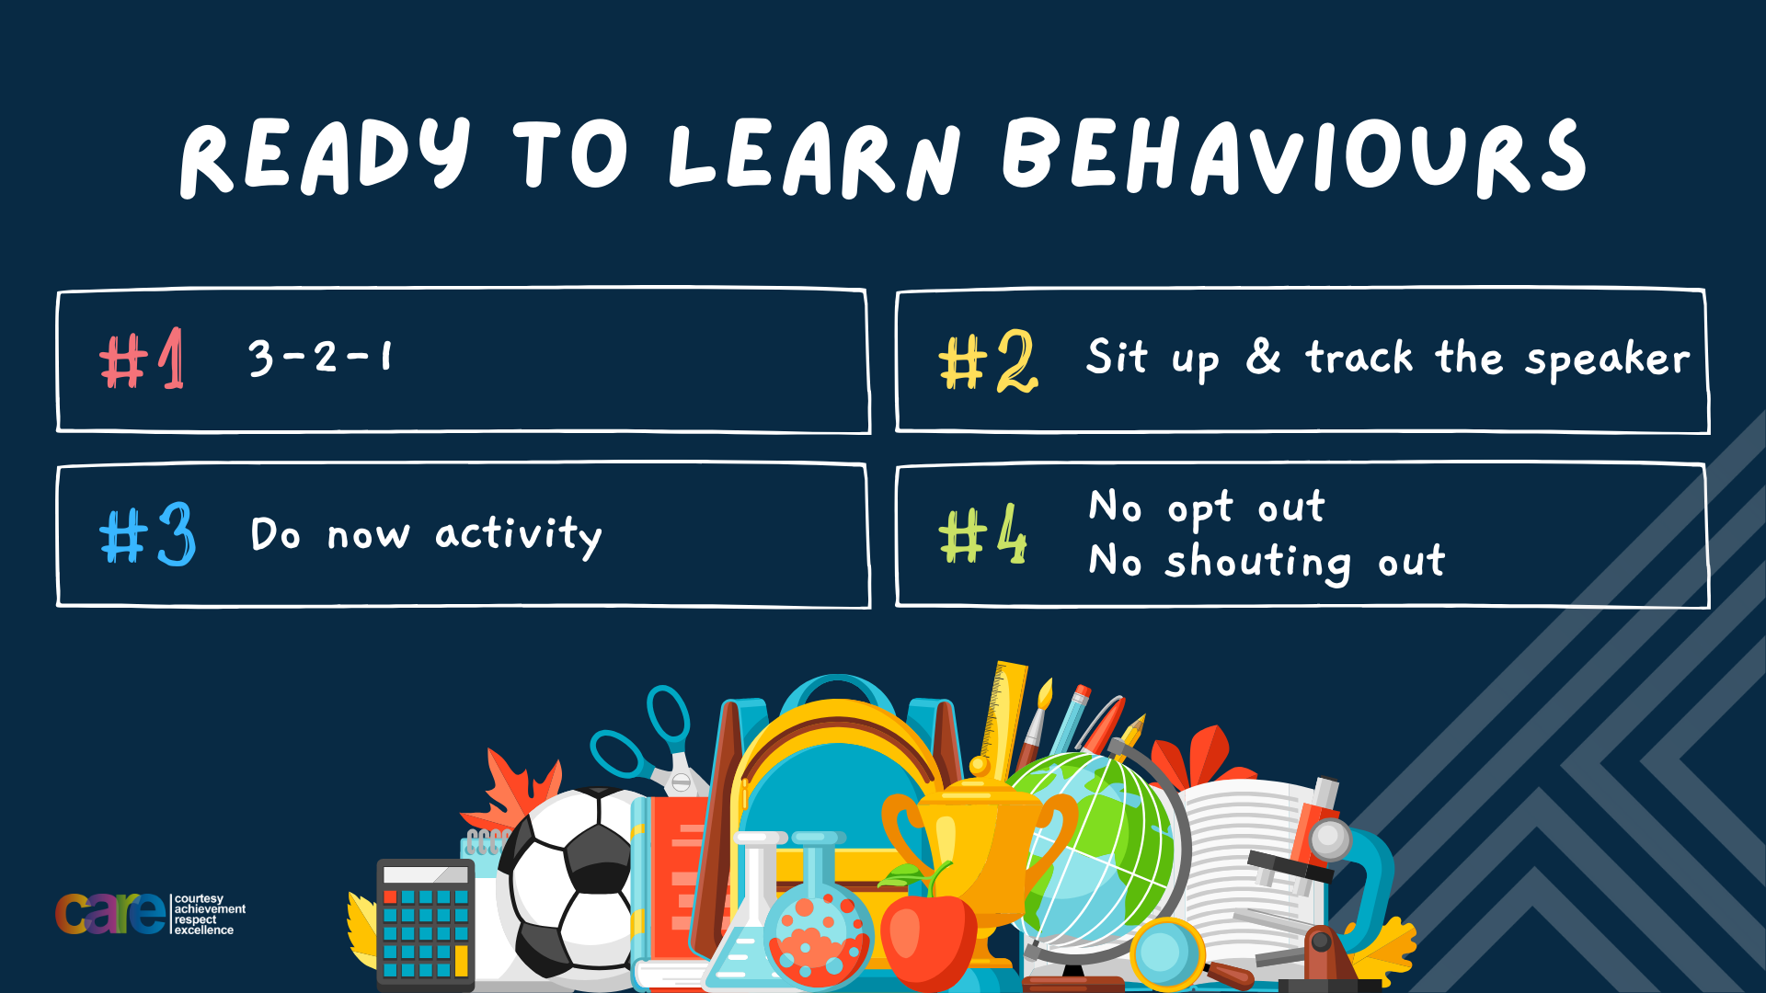

Slide 2


Slide 3








Write the date: 25 September 2024
Write the title: Making Friends
Underline both!
Complete the following questions:
Name 1 quality of a good friend
Name 1 tip to making friendships last
Name 1 thing you should not do if you fall out with a friend
Honesty. Loyalty kindness, respect, support, trust, communication, individuality, growth, humour
Communicate regularly, be authentic, find common interests/activities, show appreciation, embrace each others differences
Never call friends names or behave in a threatening way, never broadcast feeling to other people/online, always stay calm and walk away if angry/put phone or tablet away, don’t bring up old issues

Slide 4


Secure your Future: Learning Journey
Impact of energy drinks
Drugs and alcohol impact on the body
Dangers of smoking and vaping
What is the importance of body image?
What changes can I expect during puberty?
What is FGM?
Today we will look at:
The effect of drugs and alcohol on the body
This includes:
What impact alcohol has on the body
What impact drugs have on the body
Please remember that during the lesson we should not be asking any pupil or teacher personal questions.
Your teacher can ask you questions but this will be to check your knowledge in the lesson.

Slide 5
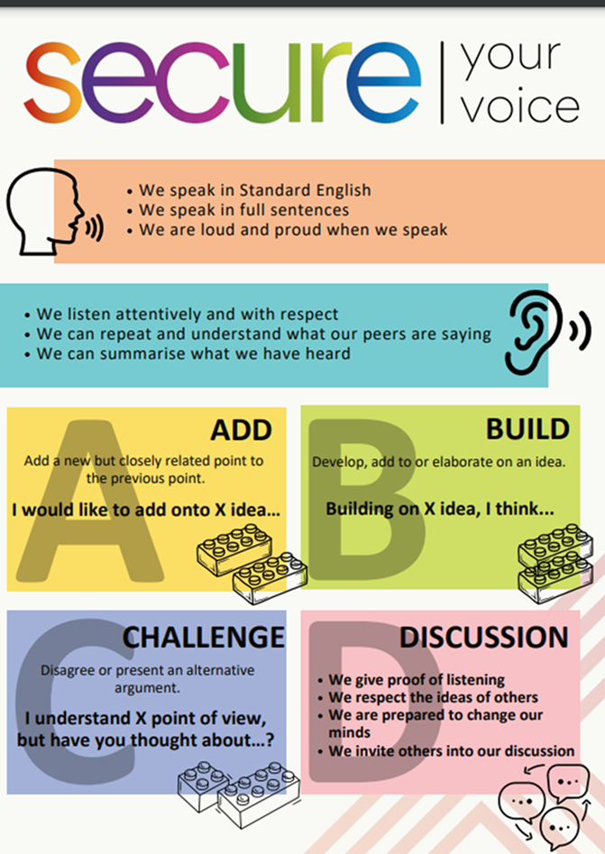
Recap of Tutor Time
In Tutor Time this week you looked at the laws around drugs and alcohol.
Discuss with the person next to you what you can remember about the laws around drugs and alcohol.
Be ready to share your discussion with the class

Slide 6

What do you know already?
You may already have learnt about the effects of alcohol before.
What effects do you think alcohol has on the body?

Slide 7

Impact of alcohol on the body
While watching the video answer the questions in your book
What is the first stop of alcohol in the body?
Where is the second stop of alcohol in the body?
Does everyone’s liver work the same?
What type of drug is alcohol?
What happens if too much alcohol is consumed?
What 3 things are impacted by alcohol?
Notes:
Answers to questions
Stomach
The liver
No – young peoples liver will have to work harder to process alcohol
Depressant
Worst case is comas/death
Learning, memory and brain growth
Link to video - https://www.youtube.com/watch?v=325TfQ2d6Fg

Slide 8
Impact of alcohol on the body
The video showed how alcohol can impact the stomach, liver and the brain.
However there are many other ways that alcohol can impact the body.

Slide 9
Impact of alcohol on the body
There are a number of posters around the room.
You now have to read the posters to find out at least 3 other effects of alcohol in the body.
You should read 1 point on a poster. Go to your book and write down this 1 point. You then repeat this for the other posters

Slide 10
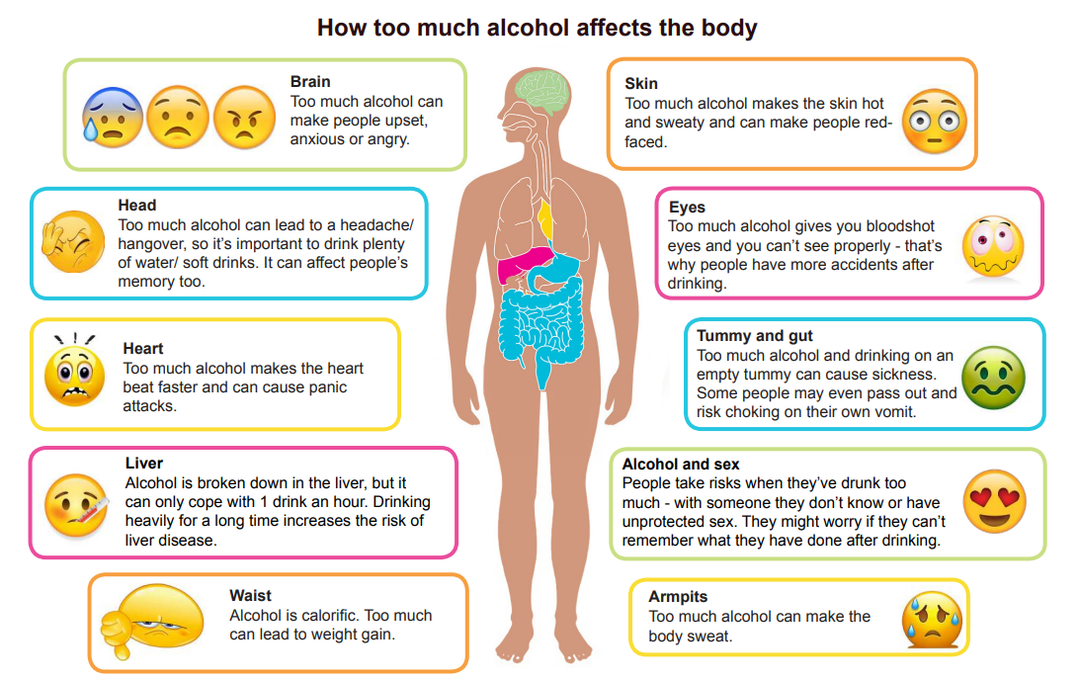
Impact of alcohol on the body

Slide 11
Hinge Questions – whiteboard activity
3
Rules!
I will ask the question and give you some thinking time. (no more than 10 seconds)
Write the answer and turn your whiteboard over so nobody can see it.
When I am ready I will put on the 3 to 1 counter.
When ‘Show me’ appears on the board you must hold up your whiteboard (even if you don’t know the answer and there is nothing on your board)
2
1
Show me!
(even if your whiteboard is blank)

Slide 12
Hinge Questions – whiteboard activity
True or False
Alcohol goes straight to the brain?
False – the first stop in the body is the stomach

Slide 13
Hinge Questions – whiteboard activity
True or False
Alcohol is a depressant drug which slows everything down?
True

Slide 14
Hinge Questions – whiteboard activity
True or False
Drinking too much alcohol can lead to liver damage
True

Slide 15
Hinge Questions – whiteboard activity
True or False
Drinking alcohol gives you nice skin
False – alcohol can make your face red and hot

Slide 16
Scenario
David has moved to a new area and is starting to make new friends.
One night at the park, one of David’s friends has brought along some alcohol that his older sister has bought for him.
He offers David a drink and says “go on. What is there to be worried about? It is only a drink”
With the person next to you, discuss the advice you would give to David. Think about what you have learnt in this lesson and tutor time
Remember to use your oracy helpsheet to help your discussion
Be ready to share the discussion with the class
Notes:
Some things pupils might say
What short term effects alcohol can have
What long term effects alcohol can have
It is illegal for alcohol to be bought for U18’s and his sister might get fined or cautioned
The Police might see them and get in trouble as it is illegal to drink in some public places

Slide 17
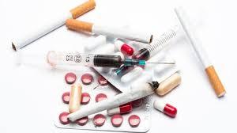
Impact of drugs on the body
Drugs can have different impacts on the body.
This is because there are different categories of drugs.
These categories are:
Stimulants
Depressants
Hallucinogens

Slide 18
Impact of drugs on the body
With the person next to you discuss which definition matches up to each category of drug
Stimulants
These alter a person’s awareness of their surroundings as well as their own thoughts and feelings
Depressants
These raise levels of physiological or nervous activity in the body
Hallucinogens
These lower neurotransmission levels which is to depress or reduce arousal or stimulation

Slide 19
Short term impact of drugs on the body
After drugs have worn off, people experience a “come down”
Common effects of a come down are:
Starting to feel anxious
Tiredness
Shaky and dizzy
Sweaty
Headaches
nauseous

Slide 20
Short term impact of drugs on the body
As the effects of a come down are not pleasant, it can make people take more drugs.
This is one reason why people can become addicted and dependent on drugs.
This results in more drug use and potential longer term effects on the body

Slide 21
Long term impact of drugs on the body
Some long term effects of drugs on the body include:
Changes in behaviour such as mood swings and increased aggression towards others
Negatively impacts sleep and can lead to insomnia
Memory problems
Liver, kidney and heart conditions including cancer
Dental health problems – teeth fall out and gums recede

Slide 22
Hinge Questions – whiteboard activity
3
Rules!
I will ask the question and give you some thinking time. (no more than 10 seconds)
Write the answer and turn your whiteboard over so nobody can see it.
When I am ready I will put on the 3 to 1 counter.
When ‘Show me’ appears on the board you must hold up your whiteboard (even if you don’t know the answer and there is nothing on your board)
2
1
Show me!
(even if your whiteboard is blank)

Slide 23

Hinge Questions – whiteboard activity
What type of drug is being described?
“These raise levels of physiological or nervous activity in the body”
A – Stimulants
B – Depressants
C - Hallucinogens

Slide 24
Hinge Questions – whiteboard activity
True or False
“A come down happens after drugs have worn off. The effects of this are unpleasant which can lead to more drug taking”
True

Slide 25
Hinge Questions – whiteboard activity
Name one long term effect of drugs on the body
Changes in behaviour such as mood swings and increased aggression towards others
Negatively impacts sleep and can lead to insomnia
Memory problems
Liver, kidney and heart conditions including cancer
Dental health problems – teeth fall out and gums recede

Slide 26
Scenario
Sophie has been to show a new girl around school and to help her settle in.
Sophie and the new girl get on really well and decided to meet up at the weekend.
When they meet up at the weekend, Sophie’s new friend brings along cannabis rolled into a spliff. She offers Sophie to try it and says “Go on- what is the worst that can happen?”
With the person next to you, discuss the advice you would give to Sophie. Think about what you have learnt in this lesson and tutor time
Remember to use your oracy helpsheet to help your discussion
Be ready to share the discussion with the class
Notes:
Some things pupils might say
What short term effects drugs can have
What long term effects drugs can have
Cannabis is an illegal drugs
By Sophie taking the spliff (even without taking a drag) she will be breaking the law

Slide 27



Support
Support around drugs and alcohol for either yourself, friends or family can be found in the following places
Childline.org.uk
Call – 08001111
Email or chat online for support
Themix.org.uk
You can email or have one-to-chat online.
There is also a crisis messenger which is available 24/7

Slide 28


