Slide 1
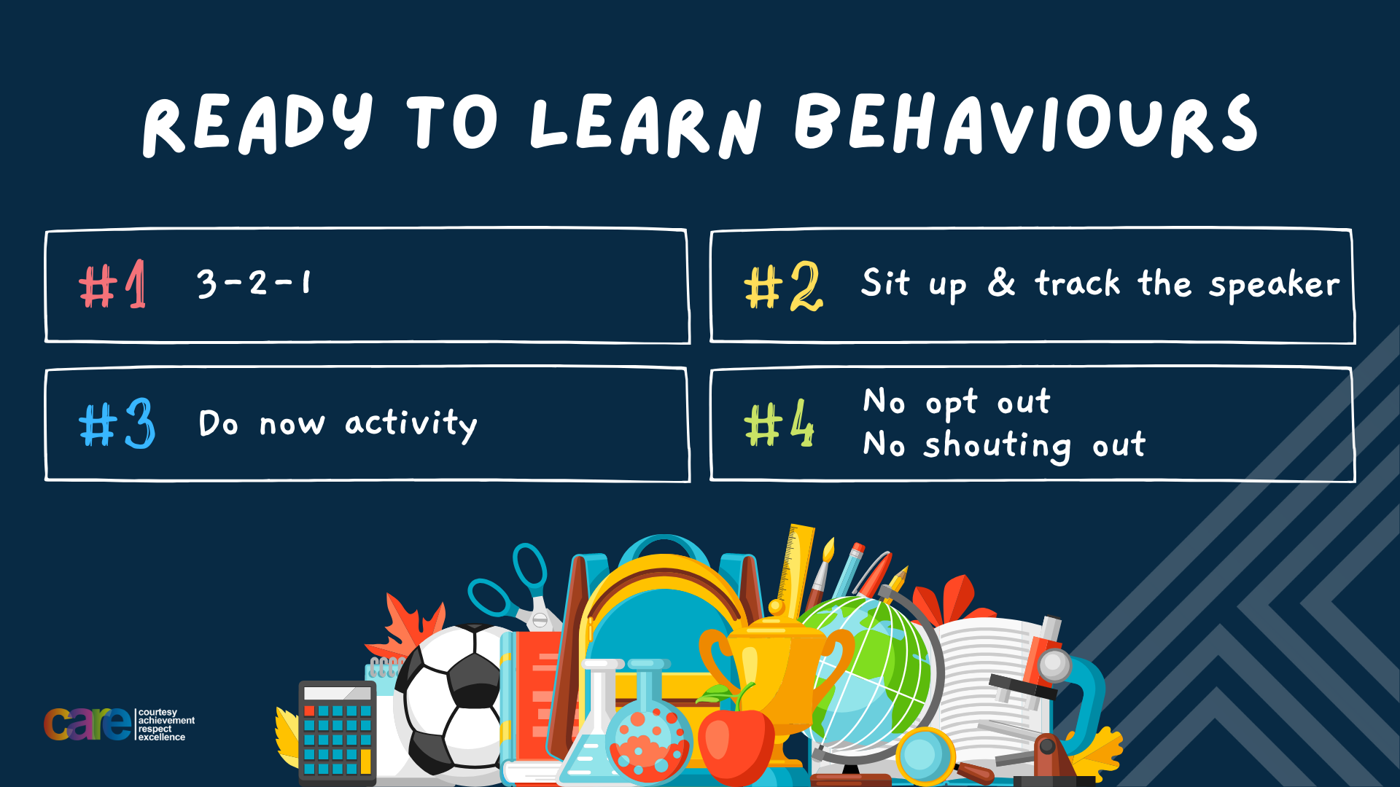

Slide 2


Slide 3








Write the date: 05 November 2024
Write the title: Issues in the UK
Underline both!
Complete the following questions:
What does FGM stand for?
Give an example of a puberty change that happens to everyone
True or False – everyone is happy with their body image
Female Genital Mutilation
Growth spurt and weight gain, stretch marks, genitals grow, sweat more, spots/acne
False – not everyone likes the way they look

Slide 4


Secure your Relationships: Learning Journey
Issues faced by people in the UK
What is loneliness?
Importance of working together
What is conflict resolution?
Importance of celebrating culture and diversity
Importance of charity work
Today we will look at:
Issues faced by people in the UK
This includes:
Racism
NHS
Crime
Please remember that during the lesson we should not be asking any pupil or teacher personal questions.
Your teacher can ask you questions but this will be to check your knowledge in the lesson.

Slide 5
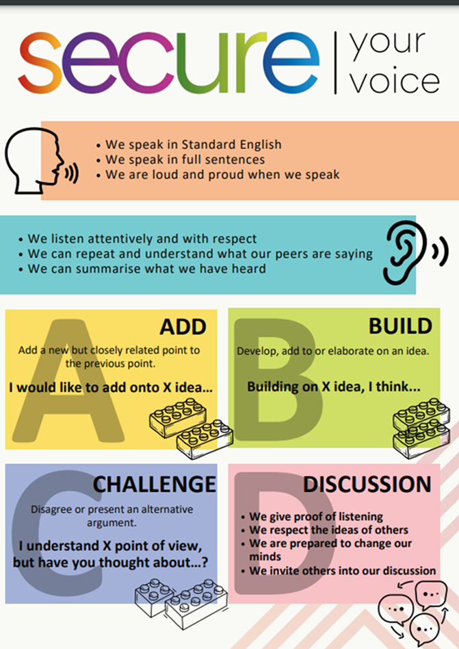
Recap of Tutor Time
In Tutor Time this week you looked at the cost of living crisis
Discuss with the person next to you what you can remember about the cost of living crisis?
Be ready to share your discussion with the class

Slide 6



Tutor Time Recap
Cost of living crisis is “a scenario in which the cost of everyday essentials like energy and food is rising much faster than the average household incomes”
This is controlled by inflation which is currently 1.7% but this is down from 11.1%
Many more people are now feeling hardship due to the rising cost of everyday essentials and bills

Slide 7
Is racism an issue in the UK?
Discuss with the person next to you the question below:
“Is racism an issue in the UK?”
Be ready to share your discussion with the class

Slide 8

Is racism an issue in the UK?
Racism is defined as:
“when people are treated unfairly because of their skin colour or background”

Slide 9
Is racism an issue in the UK?
It is important to remember that “Race” is a protected characteristic in the UK.
This means that people should not be treated unfairly because of their race.
If a person is treated unfairly, this is illegal as the protected characteristics form the Equality Act 2010.

Slide 10
Is racism an issue in the UK?
Despite this research by Statista in September 2024 found that 46% of people thought racism was somewhat prevalent in the UK.
34% of people thought that there was a great deal of racism in the UK.

Slide 11
Why is racism an issue?
There are many reasons why racism is still an issue in the UK.
Two of these reasons are:
Language used in popular culture such as music lyrics
Racist banter is common

Slide 12
Popular culture language
Popular culture such as music is extremely influential, especially with young people.
Some artists, particularly rap and hip hop artists, use lyrics that normalize disrespectful attitudes to different races

Slide 13
Popular culture language
An example of this is the use of “N-word” in music lyrics largely by black artists.
Discuss with your partner why this could be an issue that leads to racism. Be ready to share your answers.

Slide 14
Popular culture language
This leads to the argument that if black people can use this word, then any non black person can use it too.
This is a misconception. The “N-word” is used by black people as a form of resistance as historically it was used to dehumanise black people

Slide 15
Popular culture language
Hence why black people may feel upset or feel threatened when the “N-word” is used around them by a non black person.
Social rule – do not use the “N-word”

Slide 16
Racist banter
Discuss with the person next to you the question below:
“What is racist banter?”
Be ready to share your discussion with the class

Slide 17
What is racist banter?
Racist banter is defined as…
“jokes or comments targeting someone's race or ethnicity under the guise of humour”
This banter may be presented as harmless fun or lighthearted teasing, but it carries harmful implications.

Slide 18
Impact of racist banter
Despite this being described as a “joke” there are serious implications to racist banter:
It reinforces negative stereotypes
Promotes a culture of exclusion – people of different races may not feel safe or welcome
Normalises racism – laughing at jokes can make racism socially acceptable even though discrimination of race is against the law
Impacts relationships – if one person thinks it’s a joke but the other doesn’t it erodes trust and respect in that relationship/friendship

Slide 19
Common justification of racist banter
When people are called out on their racist comments or behaviour, they may say:
“it’s just a joke” – however it may have been deeply hurtful. Humour does not take away harm
“I don’t mean it seriously” – Regardless of intent, racist banter can have serious effects on those who hear it.

Slide 20
Common justification of racist banter
When people are called out on their racist comments or behaviour, they may say:
3.“Everyone says things like this”: Just because something is common doesn’t make it right. Challenging such behavior can create a more inclusive and respectful environment.

Slide 21
Impact of racism
Discuss with the person next to you the question below:
“Why is it important for racism to no longer be an issue in the UK?
Be ready to share your discussion with the class

Slide 22
Racism
Remember that it is illegal to discriminate against a person because of their race.
Mutual respect is also a British Value that means that people should value people’s differences.
If everyone followed this, everyone would feel safe and welcome in their communities regardless of their race or background.

Slide 23

Is the NHS an issue in the UK?
Another issue faced by people in the UK is the NHS.
With the person next to you discuss what you know about why the NHS may be an issue for people in the UK.
Be ready to share your discussions

Slide 24
Is the NHS an issue in the UK?
Although the NHS means that health care is free at the point of delivery, there are currently issues in receiving healthcare.
This is shown by there being over 7.5 million people waiting on a NHS appointment including some surgeries.
For context 10 years ago this number was 3 million.

Slide 25
Other pressures on the NHS
Other pressures on the NHS include:
Increasing A&E waiting times. The average wait time is around 5 hours. In April 2024 10% of people attending A&E waited over 12 hours. The target wait time is 4 hours
NHS dental appointments are harder to book as many dental practices are now private customers only.

Slide 26
Impact of NHS waiting times
Discuss with the person next to you the question below:
“What is the potential impact of these waiting times?”
Be ready to share your discussion with the class

Slide 27
Potential impacts
The potential impacts of these are:
People do not use the NHS and ignore health problems. This leads to health problems becoming worse
People treat themselves – this is more applicable to dentistry work – people may remove teeth themselves

Slide 28
Crime
Discuss with the person next to you the question below:
“Is crime an issue in the West Midlands?”
Be ready to share your discussion with the class

Slide 29

Crime
In June 2024 it was reported that crime rates in the West Midlands had dropped by 10%.
This means that compared to 2023, there are around 35,000 fewer victims of crime.

Slide 30
Crime
However 40% of all crimes in the West Midland region are classed as violent crimes.
This may explain why the West Midlands Police Force have the highest rates of knife crime in the UK.
Last year there were over 5,000 knife offences in the region.

Slide 31
Crime Impact
Ultimately the biggest impact is that people will feel unsafe in their local communities.
It is important to remember that “Rule of Law” is a British Value. Everyone has the responsibility of following the law to ensure that everyone remain safe.

Slide 32

Personal Reflection
We have looked at a range of different issues facing the people of the UK.
In your books complete the following reflection:
The biggest issue I think is…
The reason for this is…
Something I would like done about this issue is…
Be ready to share your reflections with the class.

Slide 33



Support
If you, a friend or a family member need any support about any of the issues discussed in this lesson, support is available
Childline.org.uk
Call – 08001111
Email or chat online for support
Themix.org.uk
You can email or have one-to-chat online.
There is also a crisis messenger which is available 24/7

Slide 34


