Slide 1
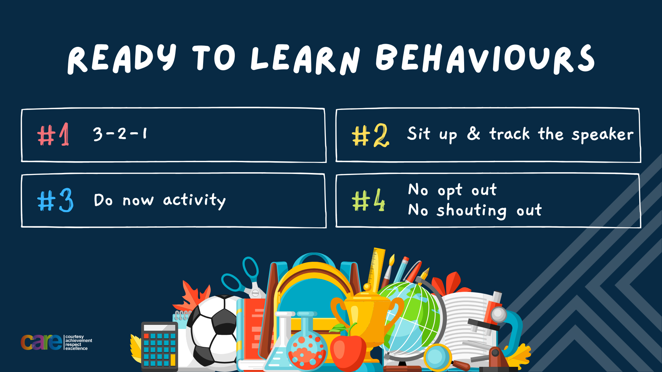

Slide 2


Slide 3








Write the date: 11 October 2024
Write the title: Dangers of smoking and vaping
Underline both!
Complete the following questions:
What is the legal age to buy alcohol?
What are the 3 different types of drugs?
True or False – energy drinks disturb a persons sleep
18 years old
Stimulants, depressants, hallucinogens
True

Slide 4


Secure your Future: Learning Journey
Impact of energy drinks
Drugs and alcohol impact on the body
Dangers of smoking and vaping
What is the importance of body image?
What changes can I expect during puberty?
What is FGM?
Today we will look at:
The dangers of smoking and vaping
This includes:
The law around vaping
Dangers of vaping
Please remember that during the lesson we should not be asking any pupil or teacher personal questions.
Your teacher can ask you questions but this will be to check your knowledge in the lesson.

Slide 5
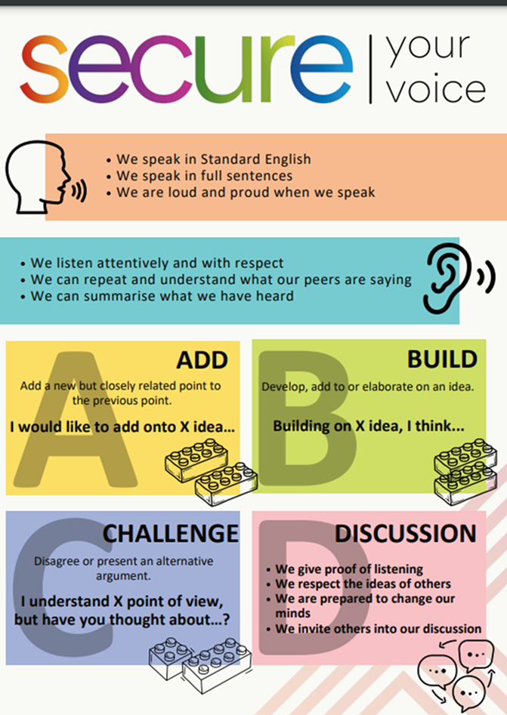
Recap of Tutor Time
In Tutor Time this week you looked at the laws around cigarette smoking
Discuss with the person next to you what you can remember about the laws around cigarettes and smoking
Be ready to share your discussion with the class

Slide 6
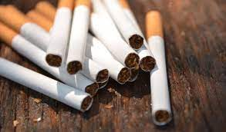
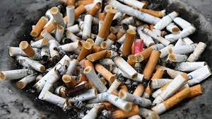
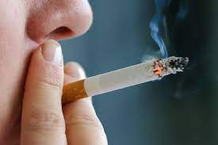
Law on cigarette/smoking
Key reminders:
It is illegal to purchase cigarettes if the person is under 18 years old
Cigarettes must be in plain packaging with health warnings displayed
It is illegal to smoke in enclosed workplaces such as shops, restaurants, offices and schools
The new law will make it illegal for anyone born on or after 1st January 2009 to purchase cigarettes even if they are over 18 years old

Slide 7
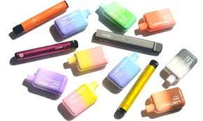
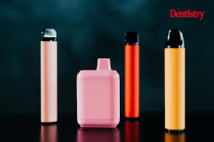
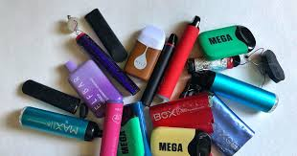
What is a vape?
Vapes were designed to act as a cigarette replacements for cigarette smokers.
This is due to vapes still containing nicotine which is what makes smoking addictive.

Slide 8
Vapes – the law
On your whiteboards write what age you think you have to be in order to legally buy a vape
The law for vapes is the same as cigarettes – you must be 18 years old to buy a vape.

Slide 9
Vapes – the law
Currently there are very few other laws around vapes compared to cigarettes.
One reason for this is that vapes are relatively new to society whereas cigarettes have been around 100’s of years.

Slide 10
Vapes – the law
The government have promised to enforce new laws around vapes. These new laws have been proposed due to:
An increased number of young people using vapes
A significant percentage of people who vape never smoked cigarettes
Scientists are unsure of the long term health effects of regular vaping – current finding suggest it is harmful to the body.

Slide 11
Vapes – the law
The new law would:
Regulate the flavours allowed in vapes. Flavours such as candy floss and bubble gum would be banned.
Bright coloured packaging will be banned. Packaging may be similar to cigarettes (plain and with graphic health warnings)
Vapes will not be able to displayed visibly in shops.

Slide 12
Vaping – new law
Discuss with your partner the following question
“how effective do you think this new law will be in stopping more young people vaping?”
Remember to use your oracy helpsheet to aid your discussion and be ready to feedback to the class

Slide 13
Hinge Questions – whiteboard activity
3
Rules!
I will ask the question and give you some thinking time. (no more than 10 seconds)
Write the answer and turn your whiteboard over so nobody can see it.
When I am ready I will put on the 3 to 1 counter.
When ‘Show me’ appears on the board you must hold up your whiteboard (even if you don’t know the answer and there is nothing on your board)
2
1
Show me!
(even if your whiteboard is blank)

Slide 14
Hinge Questions – whiteboard activity
True or False
U16’s can legally buy a vape?
False – a person buying a vape has to be 18 years old or older

Slide 15
Hinge Questions – whiteboard activity
True or False
Vapes were designed to help cigarette smokers give up smoking
True – this is because both contain nicotine

Slide 16
Hinge Questions – whiteboard activity
On your whiteboard write down one new proposed law on vapes
Regulate the flavours allowed in vapes. Flavours such as candy floss and bubble gum would be banned.
Bright coloured packaging will be banned. Packaging may be similar to cigarettes (plain and with graphic health warnings)
Vapes will not be able to displayed visibly in shops.

Slide 17
Dangers of vaping
You are now going to watch a BBC documentary about the dangers of vaping.
This was made in 2023.
While watching the video answer the questions on your worksheet
https://www.bbc.co.uk/iplayer/episode/m001xj1p/jordan-north-the-truth-about-vaping
Notes:
If you are asked for log in details they are:
Username – ryan.stewart@hodgehill.bham.sch.uk
Password – Hodgehill1

Slide 18
Dangers of vaping - answers
Why did Jordan start vaping? – To quit smoking
How many 18-24 year olds were using vapes in 2023? - 1/7 – 50% of this number had never smoked cigarettes
True or False – UK Government don’t know the long term health impacts of vaping - True

Slide 19
Dangers of vaping - answers
4. What is in a vape? – battery, switch to activate, coil of wire, spongy wick material to absorb the vape oil
5. How many chemicals might be in vape smoke? Thousands
6. How much nicotine is allowed in a legal vape? – 20mg per ml

Slide 20
Dangers of vaping - answers
7. Was Jordan able to buy an illegal vape easily? – Yes
8. What can carbonyls found in illegal vapes lead too? – changes in DNA which can cause cancer
9. What harmful metals were found in vapes? – lead and nickel

Slide 21
Dangers of vaping - answers
10. How many illegal vapes are sold in the UK every year? – 45 million which is worth £300 million
11. What are the potential problems of banning disposable vapes? – people will buy more illegal ones
12. What does the scientist think they will find from the long term study? – smokers will have the worst fitness and cardiovascular health, vapers will not be as bad but will still be worse than non smokers/vapers
13. Did Jordan want to continue to vape? - No

Slide 22
Reflection
Remember that vapes are banned in school. If you are found with a vape you will face consequences.
Now that you have learnt more about vapes – how will you react if you are offered a puff on a vape or to buy one?

Slide 23



Support
Support around cigarettes and vapes for either yourself, friends or family can be found in the following places
Childline.org.uk
Call – 08001111
Email or chat online for support
Themix.org.uk
You can email or have one-to-chat online.
There is also a crisis messenger which is available 24/7

Slide 24


