Slide 1
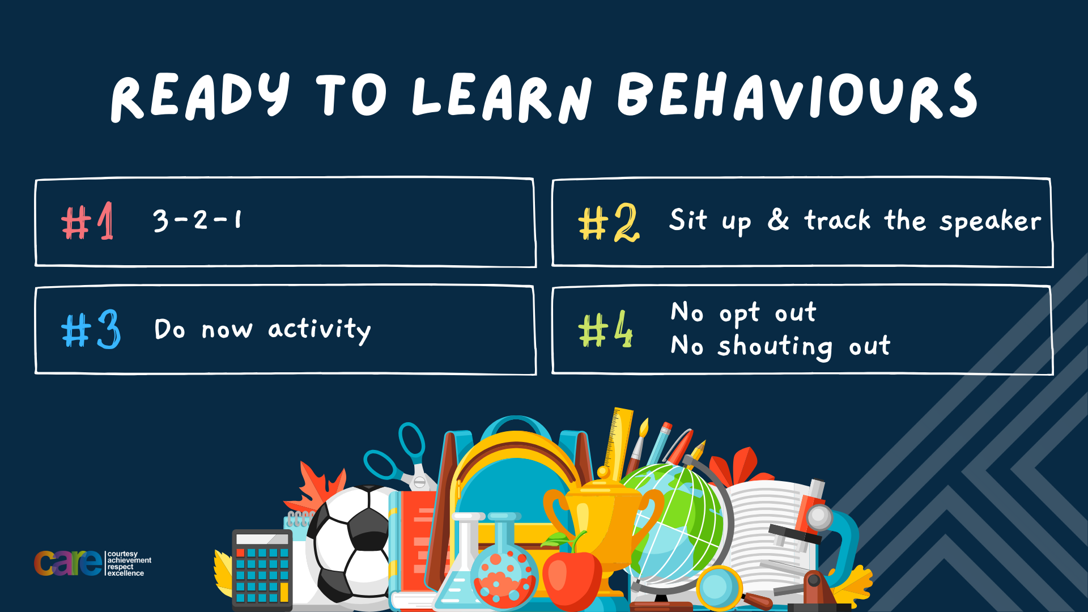

Slide 2


Slide 3








Write the date: 11 October 2024
Write the title: What is body confidence?
Underline both!
Complete the following questions:
What is in vapes and cigarettes that make them addictive?
What is one long term impact of drugs on the body?
True or False – energy drinks can lead to dental problems
nicotine
Changes in behaviour such a mood swings, negatively impacts sleep, memory problems, liver kidney and heart conditions, dental problems
True

Slide 4


Secure your Future: Learning Journey
Impact of energy drinks
Drugs and alcohol impact on the body
Dangers of smoking and vaping
What is the importance of body image?
What changes can I expect during puberty?
What is FGM?
Today we will look at:
What is body image
This includes:
What is body image
What can influence body image
Please remember that during the lesson we should not be asking any pupil or teacher personal questions.
Your teacher can ask you questions but this will be to check your knowledge in the lesson.

Slide 5
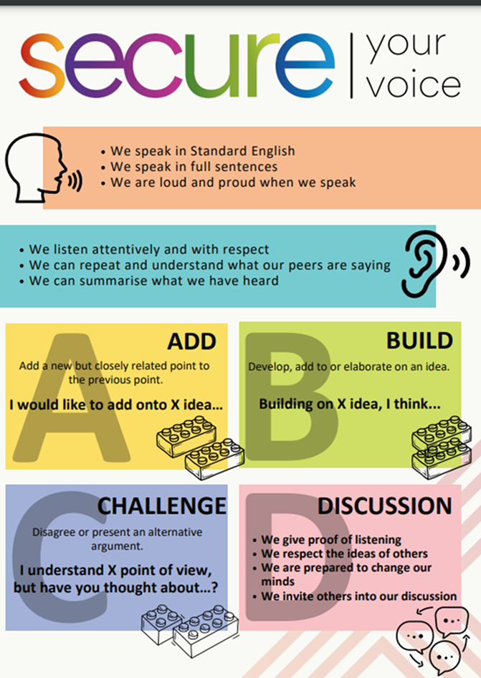
Recap of Tutor Time
In Tutor Time this week you looked at body image
Discuss with the person next to you what you can remember about body image?
Be ready to share your discussion with the class

Slide 6
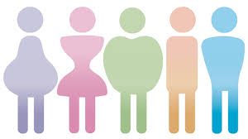
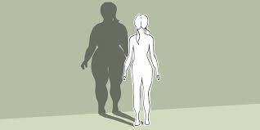

What is body image?
The definition of body image is…
“the way people see themselves and how they feel about their bodies”

Slide 7
Positive vs Negative Body Image
Positive body image is defined as…
“When a person feels good about their body. They are more confident and comfortable”
Negative body image is defined as…
“Sometimes people may not feel happy about how they look, which can make them feel sad or insecure”

Slide 8
Ideal Image
Society, particularly the media/social media project what should be the “ideal appearance” for males and females.
With the person next to you discuss what society tell us is the ideal appearance for boys and girls? How are these different?

Slide 9
Ideal Image
Some ideal appearance that society tells us are:
Girls – long, slim and hairless legs, toned, flat stomach, manicured nails, defined eyebrows, straight white teeth
Boys – muscular (big chest and biceps), tall, 6 pack, thick hair, some facial hair, straight white teeth

Slide 10
Ideal Image
Is it possible for every single girl and boy to have these “ideal appearances”?
No it is impossible for a number of reasons:
People have a range of different body types
Peoples looks are defined by their genes which have been inherited from their parents and their parents.
These reasons make it impossible for most people to match the “ideal appearance”

Slide 11
Where do these ideal appearances come from?
With the person next to you discuss the question:
“where do these appearance ideals come from? Where might young people find out about them?
Remember to listen to what your partner has to say and then respond.
Be ready to share your discussion with the class.

Slide 12
Where do these ideal appearances come from?
The appearance ideals come from:
Media such as magazines
Social media (influencers)
A focus on celebrity culture
Fashion industry
Pressure from friends
Adverts
It is important to know where these ideals come from so that people can change how they respond to these ideals

Slide 13

How can images be manipulated?
Questions
What did you find surprising in the film?
What actions took place before the photo was taken?
What actions took place after the photo was taken and before it was posted?
Who benefits from the social media post?
How do you think the image makes the girl who likes the post at the end of film feel?
Notes:
https://www.youtube.com/watch?v=sQS9pymkLiU

Slide 14
Recap of Tutor Time
With person beside you discuss the question:
“why might it be unfair for young people to compare the way they look to manipulated images of people in the media/social media”
Be ready to share your discussion with the class

Slide 15
Hinge Questions – whiteboard activity
3
Rules!
I will ask the question and give you some thinking time. (no more than 10 seconds)
Write the answer and turn your whiteboard over so nobody can see it.
When I am ready I will put on the 3 to 1 counter.
When ‘Show me’ appears on the board you must hold up your whiteboard (even if you don’t know the answer and there is nothing on your board)
2
1
Show me!
(even if your whiteboard is blank)

Slide 16
Hinge Questions – whiteboard activity
What is being described?
“the way people see themselves and how they feel about their bodies”
Body Image

Slide 17
Hinge Questions – whiteboard activity
Where do appearance ideals come from?
Media such as magazines
Social media (influencers)
A focus on celebrity culture
Fashion industry
Pressure from friends
Adverts

Slide 18
Hinge Questions – whiteboard activity
True or False
Everyone should be able to meet the appearance ideals
False

Slide 19
Hinge Questions – whiteboard activity
True or False
Every photo you see in the media/social media has not be altered in any way
False – many photos are manipulated to meet the appearance ideals

Slide 20
Body Talk
Body Talk refers to any conversation or comment that reinforces and keeps appearance ideals and pressures going

Slide 21
Body Talk
Questions
What is being said regarding appearance? Does it seem well-meaning or harmful?
Why do you think they were talking about appearance?
How do both young people feel about their appearance?
Will this conversation affect their feeling about their appearance in the long term?
Notes:
https://www.youtube.com/watch?v=YVD_--CVZaU&list=PLct19d3Dm92mmMNnQg1fWX7ctmwXCHQ-9

Slide 22
Body Talk
In the video one girl compliments the other on their hair. However the girl rejects the compliment and act self consciously. The initial comment was well intentioned but this shows that even compliments sometimes can make people think about their body image.
They could have been talking about appearance as is a common form of greeting especially when people haven’t seen each other in a while.
Without reading into comments to deeply (as this is also damaging) the girl giving the compliment may actually be self conscious about her own hair. This means that having seen her friends hair she may start thinking about it more and spending more time on it so it looks more like her friends.

Slide 23
Challenging Body Talk
It is important to challenge the use of body talk.
Challenging body talk can help reduce pressures faced by people to meet appearance ideals.
The next time your friendship group brings up someone’s appearance be brave enough to challenge should this be being discussed.
This may seem difficult but if there is a person within the group feeling particularly bad about their current body appearance they will be thanking you and really appreciate having you as a friend

Slide 24
Scenario
Jake has started using social media and follows lots of popular influencers and athletes. He notices that his feed is full of guys with muscular bodies, cool haircuts and expensive clothes. Every time he sees a post like this he thinks “I don’t look like that, I wish I did”.
Jake’s friends at school have been talking about appearance more and more. They compare who has gotten taller and who’s hair looks the best everyday. They sometimes even joke about each other’s appearance. Jake is glad that they haven’t joked about his appearance…yet.
When changing for PE another boy in Jake’s class told him that he is really skinny and needs to hit the gym. This made Jake feel even worse about his appearance as he is naturally slim. He is thinking about changing his diet so he can eat more protein to hopefully bulk up before he can join a gym when he turns 16.
With the person next to you discuss the following questions:
What advice would you give Jake about what he sees on social media?
Do you think Jake feels comfortable when his friends talk about their appearance? Why?
Do you think Jake should feel pressured to “bulk up” after the comment made to him in PE?

Slide 25



Support
Support around body image for either yourself, friends or family can be found in the following places
Childline.org.uk
Call – 08001111
Email or chat online for support
Themix.org.uk
You can email or have one-to-chat online.
There is also a crisis messenger which is available 24/7

Slide 26


