Slide 1
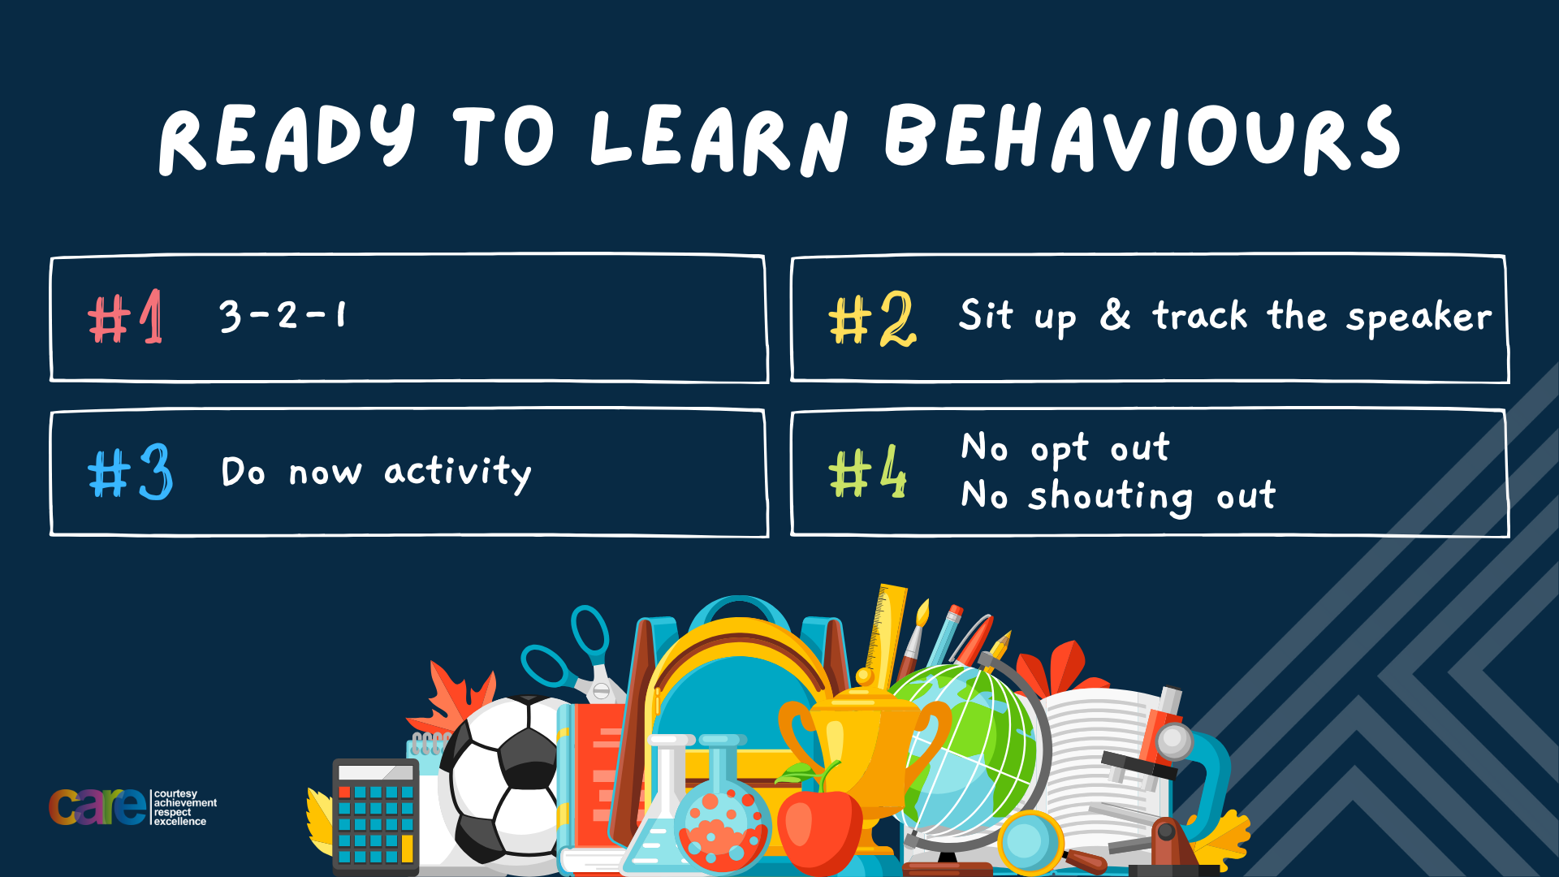

Slide 2


Slide 3








Write the date: 11 October 2024
Write the title: What is FGM?
Underline both!
Complete the following questions:
True or False – “puberty happens to everyone at the same time and last for the same amount of time”
Where have ideal appearances come from that cause people to be less body confident?
True or False – It is legal to smoke cigarettes in a working environment such as offices, shops, restaurants
False
Media, social media, celebrity culture, fashion industry, pressure from friends
False – this is illegal

Slide 4


Secure your Future: Learning Journey
Impact of energy drinks
Drugs and alcohol impact on the body
Dangers of smoking and vaping
What is the importance of body image?
What changes can I expect during puberty?
What is FGM?
Today we will look at:
What is FGM?
This includes:
What is FGM?
What parts of the body does it impact
What countries allow FGM
Myths around FGM
Please remember that during the lesson we should not be asking any pupil or teacher personal questions.
Your teacher can ask you questions but this will be to check your knowledge in the lesson.

Slide 5
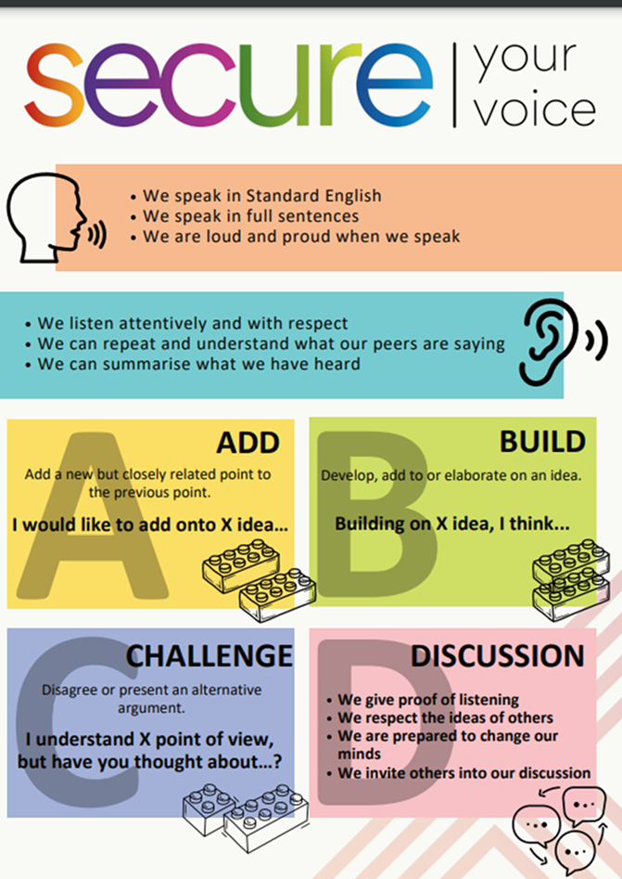
Recap of Tutor Time
In Tutor Time this week you looked at what is FGM
Discuss with the person next to you what you can remember about FGM?
Be ready to share your discussion with the class

Slide 6

Tutor Time Recap
FGM stands for “Female Genital Mutilation” FGM is also referred to as “cutting” “closing” or “female circumcision”.
It is against the law for FGM to happen in the UK.
It is also illegal for any British citizen or permanent resident to be take abroad for FGM to happen.
It is also illegal to help someone trying to take some abroad

Slide 7
IS FGM just like male circumcision?
FGM and male circumcision are 2 very different things.
Male circumcision (when the foreskin is removed) can be completed for medical reasons.
However, there are never any medical reasons for FGM to be carried out on females.
Additionally, while male circumcision does not affect a male’s ability to urinate, ejaculate or enjoy sex, FGM carries a significantly higher risk of harm and causes lasting damage.

Slide 8
What parts of the genitals are involved?
The female genitals are made up of different parts.
The most common genital removed during FGM is the clitoris (a button shaped bump above the vagina) and labia (soft skin that covers the clitoris and vagina).

Slide 9
Where does FGM happen?
FGM occurs in different cultures around the world including countries in Africa, Asia and the Middle East.
However, it also happens in Europe and in the UK.

Slide 10
When does FGM happen to a girl?
FGM can happen at different times in a female’s life.
These times can include:
When a baby is new-born
During childhood or as a teenager
Just before marriage
During pregnancy

Slide 11
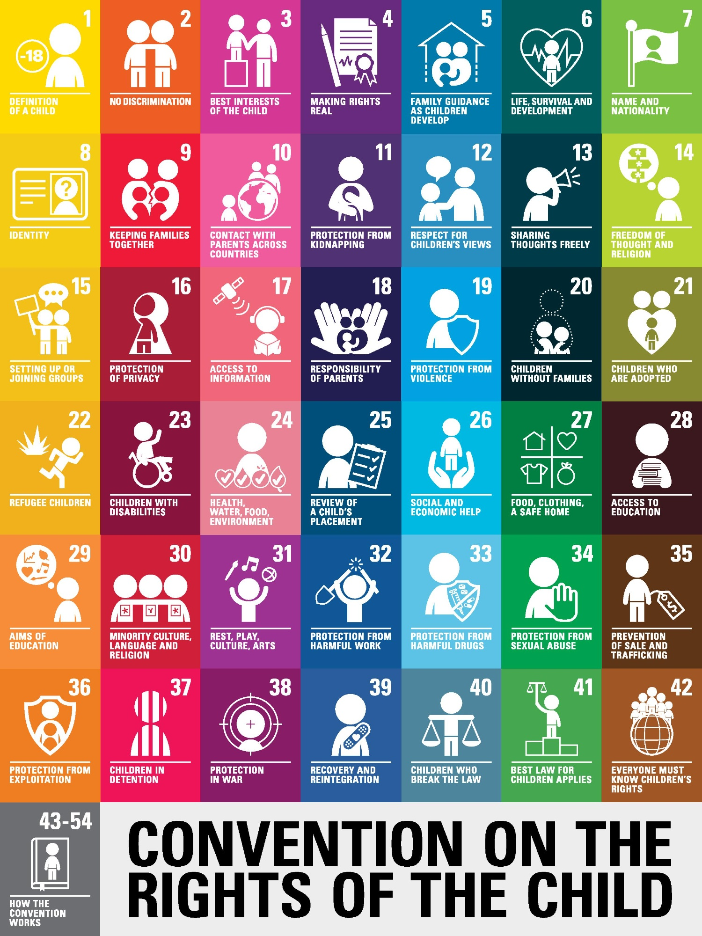
FGM and Human Rights
This is a diagram, displaying all the rights listed under the United Nations Convention on the Rights of the Child (UNCRC)
This convention is a set of rules for Governments that have been signed and agreed by most countries around the world.
Every right is equally important and link together to protect children/young people to keep them safe and happy.
Hodge Hill College has achieved Bronze Award as a UNICEF Rights Respecting School. You will learn more about the rights during your tutor time activities

Slide 12
FGM and Human Rights
With the person next to you, discuss the following question:
“What right does FGM go against?”
Be ready to share your discussion.

Slide 13
FGM and Human Rights
FGM goes against article 19 – Protection from violence, abuse and neglect).
This right states that Governments must do all they can to ensure that children are protected from all forms of violence, abuse, neglect and bad treatment by their parents or anyone else who looks after them.

Slide 14
FGM and Human Rights
In addition to the UNCRC, there is also the Universal Declaration of Human Rights.
FGM goes against article 5 of this declaration. This article states that no one shall be subjected to torture, nor to cruel, inhuman or degrading treatment.

Slide 15
Hinge Questions – whiteboard activity
3
Rules!
I will ask the question and give you some thinking time. (no more than 10 seconds)
Write the answer and turn your whiteboard over so nobody can see it.
When I am ready I will put on the 3 to 1 counter.
When ‘Show me’ appears on the board you must hold up your whiteboard (even if you don’t know the answer and there is nothing on your board)
2
1
Show me!
(even if your whiteboard is blank)

Slide 16
Hinge Questions – whiteboard activity
Is the statement myth or fact
FGM is part of becoming a woman?
Myth – Although this is sometimes given as a reason for committing FGM, it is not part of growing up and is often practised to control girls and women. Other claims used to justify FGM include: FGM protects virginity, FGM decreases sexual desire and stops women from being unfaithful, FGM prepares a girl for marriage – these are all false.

Slide 17
Hinge Questions – whiteboard activity
Is the statement myth or fact
FGM is illegal
Fact - The FGM Act (2003) makes it illegal to take a British national or permanent resident abroad for FGM or to help someone trying to do this.

Slide 18
Hinge Questions – whiteboard activity
Is the statement myth or fact
FGM makes the vagina more hygienic
Myth – The vagina is designed to keep itself clean. FGM has no health benefits

Slide 19
Hinge Questions – whiteboard activity
Is the statement myth or fact
FGM can lead to medical problems
Fact – There may be immediate medical problems following the procedure, such as pain, shock, bleeding, swelling, infection. Long term effects might include urinary problems, menstrual problems, pain during sex, greater risk of complications during childbirth. Additionally, FGM is likely to affect an individual’s mental health in both the short and long term.

Slide 20
Hinge Questions – whiteboard activity
Is the statement myth or fact
If it is not cut, the clitoris will continue to grow
Myth - The clitoris stops growing after puberty. Another common myth is that the clitoris will harm a baby during childbirth if it is not cut.

Slide 21
Hinge Questions – whiteboard activity
Is the statement myth or fact
FGM is child abuse
Fact - FGM is internationally recognised as a violation of human rights and all children and young people have the right to be protected from harm. Parents are not allowed to give permission for FGM.

Slide 22
Hinge Questions – whiteboard activity
Is the statement myth or fact
FGM is a religious requirement
Myth - There is no evidence that it is a religious requirement and FGM is not found in any religious book.

Slide 23
Hinge Questions – whiteboard activity
Is the statement myth or fact
FGM is an unsafe procedure
Fact – FGM is often committed by traditional ‘cutters’ or ‘circumcisers’ and in an unsafe environment, without sterilised, medical equipment. In some places, it is carried out in a medical setting, but there can still be serious risks and short- and long-term medical problems.

Slide 24
Hinge Questions – whiteboard activity
Is the statement myth or fact
If a girl or woman consents to FGM, the person performing the procedure can’t get in trouble
Myth – FGM is illegal and a girl cannot consent to it. No one is allowed to carry out FGM, even if they are a doctor, nurse or a family member. It's an offence to perform or help anyone perform FGM - anyone who performs FGM can face up to 14 years in prison and anyone found guilty of failing to protect a girl from FGM can face up to 7 years in prison.

Slide 25
Hinge Questions – whiteboard activity
Is the statement myth or fact
If a girl or woman has undergone FGM, nothing can be done to help her
Myth – Lots of support is available to girls and women, including physical assessment and treatment, and emotional support and counselling. It is important that a girl or woman tells someone if they have had FGM so that they can access correct medical advice to keep their body healthy and well and support their mental wellbeing. It is also very important to report a risk of FGM happening before it can happen. This might mean breaking a confidence, but should be done to keep the person safe.

Slide 26
Barriers to reporting FGM?
There are a number of barriers facing females, especially children and young people, reporting FGM or that FGM has been planned.
An example of this is that the person worries about getting into trouble. This is particularly with their parents/carers who may have organised FGM as it is part of their culture.

Slide 27
Barriers to reporting FGM?
With the person next to you discuss the following question:
“What might prevent somebody reporting FGM – either before or after FGM has taken place?”
Be ready to share your discussion with the class

Slide 28
Barriers to reporting FGM?
Other barriers include:
Fear if getting people they love into trouble
Finding it difficult, upsetting or embarrassing to tell others what has happened to them
Feeling confused about whether it is right, wrong, healthy or unhealthy
Being told that it is the right thing to do and that it is essential for their future wellbeing
Not knowing what will happen to them or their family

Slide 29
What to watch or listen for if a friend/family member is at risk of FGM?
People may feel under pressure to keep FGM a secret.
This is true for the people organising the procedure and also those who FGM will be happening too.

Slide 30
What to watch or listen for if a friend/family member is at risk of FGM?
However there are a few things people may say that can highlight FGM might be happening.
This include:
Being told that they are going on a special holiday but not to tell anyone
They are going to have a special secret ceremony to do with growing up or becoming a woman

Slide 31
What to watch or listen for if a friend/family member is at risk of FGM?
With the person next to you, discuss the following questions:
What can you do if you think a friend/family member is at risk of FGM?
How should you react if a friend/family member says that you should keep this a secret?
Be ready to share your discussion with the class

Slide 32



Support
If you, a friend or a family member need any support about FGM, you can contact the places below. If support is required urgently please contact the Police by dialing 999.
Childline.org.uk
Call – 08001111
Email or chat online for support
Themix.org.uk
You can email or have one-to-chat online.
There is also a crisis messenger which is available 24/7

Slide 33
Scenario
Oliver just had a lesson on FGM in school. It’s got him thinking about a conversation he had with his friend Amira recently. Amira was telling him that she went on holiday last year, and had to take part in a special ceremony. Amira said her little sister would go to the same ceremony next year, but then she got a bit upset and didn’t want to talk about it anymore. Oliver wasn’t worried at the time – he thought that if Amira and her sister were with their family everything must have been fine - but now he’s not so sure. He doesn’t know what to do.
Questions
What do you think happened to Amira during the “special ceremony”?
How could Amira help her younger sister?
What could Oliver do?

Slide 34

Extension Activity
While watching the video, reflect on what you have learnt today and what you see in the video.
Be ready to share at least 1 key message from the lesson
Notes:
https://www.youtube.com/watch?v=W2IStB6Z3Vw

Slide 35


