Slide 1
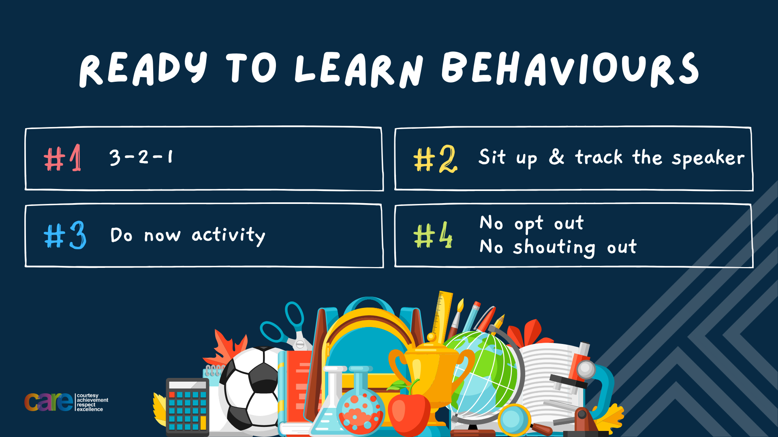

Slide 2








Write the date: 25 September 2024
Write the title: Making Friends
Underline both!
Complete the following tasks (if you haven’t done so already):
Put together your exercise book
  Plastic cover
  White paper at the back for your mini whiteboard
  Golden thread sticker on the front
Write your full name, Personal Development and your class name on the front of your book

Slide 3


Slide 4


Secure your Future: Learning Journey
Impact of energy drinks
Drugs and alcohol impact on the body
Dangers of smoking and vaping
What is the importance of body image?
What changes can I expect during puberty?
What is FGM?
Today we will look at:
Impact of energy drinks
This includes:
Recap what is in energy drinks
Impacts of ingredients on the body
The law around energy drinks
Please remember that during the lesson we should not be asking any pupil or teacher personal questions.
Your teacher can ask you questions but this will be to check your knowledge in the lesson.

Slide 5

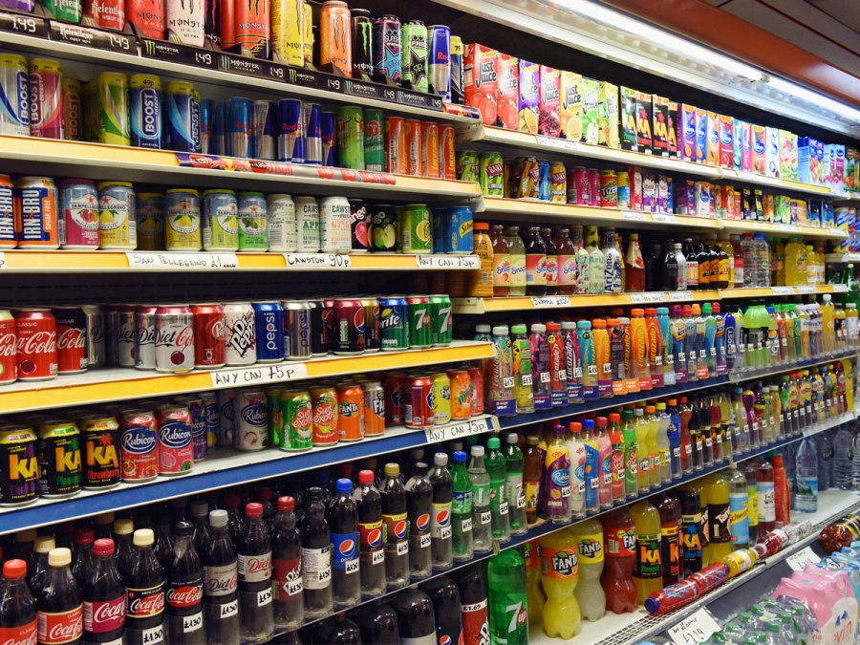
What can you remember?
In tutor time this week you looked at what are the 2 main ingredients in energy drinks.
In your books write down the 2 ingredients

Slide 6
What can you remember?
In tutor time this week you looked at what are the 2 main ingredients in energy drinks.
The 2 main ingredients are:
Caffeine
Sugar

Slide 7
Impact of sugar on the body
Last year when you looked at this topic we discussed what impact sugar has on the body.
With the person next to you can you remember what impact sugar had on the body?

Slide 8
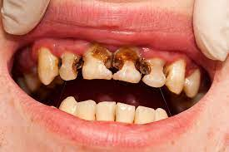
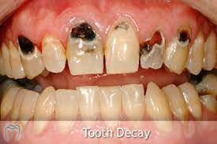
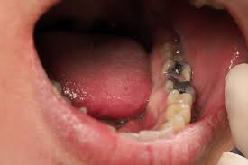
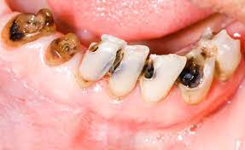
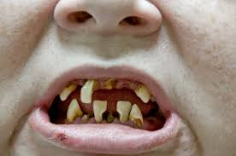
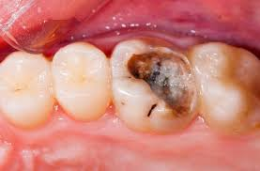
Impact of sugar on the body
Tooth Decay – In 2021 46% of teenagers in UK had obvious tooth decay

Slide 9
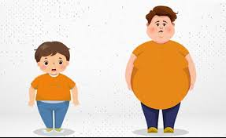
Impact of sugar on the body
Weight Gain – Sugar is addictive and also has a lot of calories.
This means that people want more and more of it.
This can potentially lead to weight gain and increased risk of obesity

Slide 10

Impact of sugar on the body
Hyperactivity of the Brain–
This means that the brain is over active which makes people “hyper”
This often leads to poor behaviour choices.
This can mean:
More chance of falling out with family and friends
Negatively impacts school life with more detentions and poor grades

Slide 11
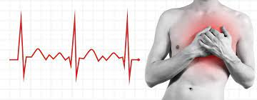
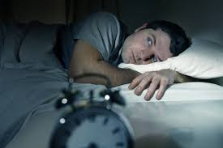
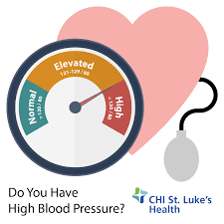
Impact of caffeine on the body
Last year when you looked at this topic we discussed what impact caffeine has on the body.
With the person next to you can you remember what impact caffeine had on the body? There are 3 pictures on the right to help you

Slide 12
Impact of caffeine on the body
Sleep disturbance which leads to a lack of focus and concentration
Increased heart rate. This can make it feel like you are having palpitations
Increased blood pressure which puts your heart under undue pressure

Slide 13
Hinge Questions – whiteboard activity
3
Rules!
I will ask the question and give you some thinking time. (no more than 10 seconds)
Write the answer and turn your whiteboard over so nobody can see it.
When I am ready I will put on the 3 to 1 counter.
When ‘Show me’ appears on the board you must hold up your whiteboard (even if you don’t know the answer and there is nothing on your board)
2
1
Show me!
(even if your whiteboard is blank)

Slide 14
Hinge Questions – whiteboard activity
What are the 2 main ingredients in energy drinks?
Sugar, Caffeine

Slide 15
Hinge Questions – whiteboard activity
Give one impact of sugar on the body?
Tooth Decay
Possible weight gain
Hyperactivity of the brain

Slide 16
Hinge Questions – whiteboard activity
Give one impact of caffeine on the body?
Sleep disturbance
Increased heart rate
Increased blood pressure

Slide 17
Scenario
We are now going to look at a scenario of 2 young people that are drinking too many energy drinks.
You will need to read the scenario and answers the questions in your books.
Be ready to share your answers with the class

Slide 18
Scenario
Jordan and Kelly walk to school together everyday. They always stop at the shop and buy an energy drink to drink on the way to school. They also regularly buy another energy on the way home from school. Both Jordan and Kelly complain to each other that they are always tired in the mornings as they didn’t sleep well. They both say they need the energy drink before school to waken up and one after as they are tired from their lessons. At Kelly’s parents evening, teachers complained that Kelly can be very hyper at times in school and is very silly and this has led to her not concentrating, not completing all her work and getting more detentions. Jordan is also thinking that he needs to ask his parents for new t-shirts as his are becoming a bit tight but he doesn’t think he has grown much. He also is finding it difficult to drink hot or cold drinks as these make his teeth feel very sensitive
Questions
Why might Jordan and Kelly be waking up feeling tired due to not sleep well?
Why could Kelly’s behaviour not be great at school?
What advice would you give Jordan about his clothes and teeth problems?

Slide 19
Law around energy drinks
Last year when you looked at this topic we discussed the law around energy drinks and U16’s.
What can you remember about this law?

Slide 20
Law around energy drinks
Key points from last year:
There is no law about selling energy drinks to U16’s
Major retailers such as Tesco have voluntarily banned selling energy drinks to U16’s due to their health implications
Smaller stores such as corner shops do not have to follow this ban and can sell energy drinks to anyone

Slide 21
Law around energy drinks - Update
However, since last year we have had a change of Government.
Labour have said that they will bring in a law that will ban all sales of energy drinks to those U16.
They have said “Any drink containing more than 150mg of caffeine per litre would be restricted and shops will require ID from young looking customers before sale”

Slide 22
Law around energy drinks - Update
Think – How much do you agree with the law banning energy drink sales to U16’s
Pair – discuss your thoughts with the person next to you.
Share – be ready to share your thoughts with the class.

Slide 23
Reflection
Complete the following sentences in your books
The main ingredients in energy drinks are…
One thing I did not know about energy drinks are…
I agree/disagree with the new incoming law because…

Slide 24


