Slide 1
Thought of the Day
“Your teeth will last a lifetime – if you take care of them”
Dr. Richard H. Price (Dental Health Educator)

Slide 2


Homework will be set today.
Remember to log in and complete your set tasks.
We still use Classcharts for announcements, surveys and revision material
Homework Club every morning in West Canteen from 8am
Library is open before school and at break times
Students on the following slides have not completed ALL tasks
Make sure you are completing the SET TASKS! These are the tasks your teachers have set.
Notes:
Please give time for the students to produce answers for themselves before showing answers.

Slide 3


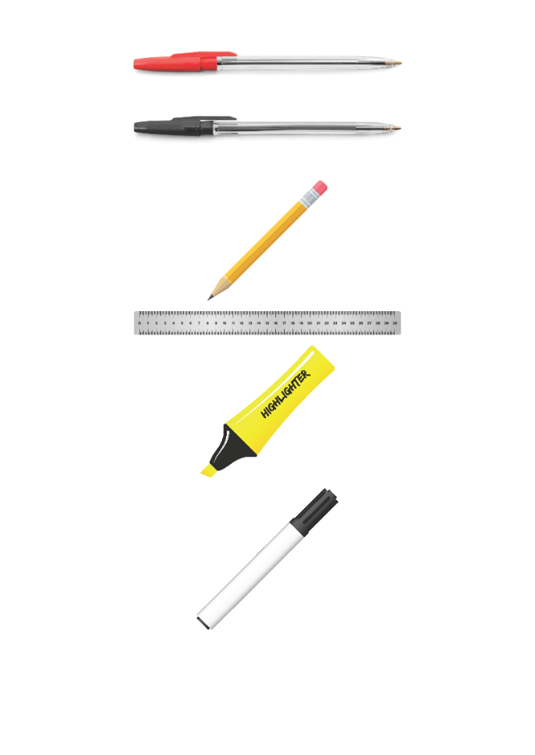


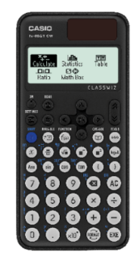


Replacement equipment for your learning wallet can be purchased at the following locations/times:
The following items can be purchased for 10p each (cash only) from West Canteen, East Canteen, the Library, and
LRC (next to W214):
Day | West Canteen | East Canteen | Library or LRC | Library
Monday | 08:00–08:35 | 08:30–08:35 | 10:10– 10:30 11:10–11:30 12:40–13:00 13:40–14:00 | 16:10–16:30
Tuesday | 08:00–08:35 | 08:30–08:35 | 10:10– 10:30 11:10–11:30 12:40–13:00 13:40–14:00 | 15:10–15:30
Wednesday | 08:00–08:35 | 08:30–08:35 | 10:10– 10:30 11:10–11:30 12:40–13:00 13:40–14:00 | 15:10–15:30
Thursday | 08:00–08:35 | 08:30–08:35 | 10:10– 10:30 11:10–11:30 12:40–13:00 13:40–14:00 | 15:10–15:30
Friday | 08:00–08:35 | 08:30–08:35 | 11:10–11:30 12:40–12:30 | 13:40–14:00
The following items can be purchased from West Office using money on your ParentPay:
£1.70
£15.00

Slide 4

Secure your Wellbeing: Learning Journey
Staying safe – rail, bike and water
What is oral health
What is personal hygiene?
What is mental health?
What is social and physical health?
What does puberty mean?
Today we will look at:
Oral Health
This includes:
Definition of oral health
Importance of oral health
Fact vs myth oral health quiz
Please remember that during the lesson we should not be asking any pupil or teacher personal questions.
Your teacher can ask you questions but this will be to check your knowledge in the lesson.

Slide 5
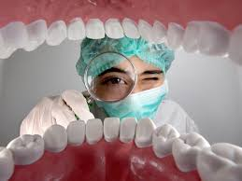
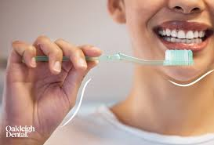
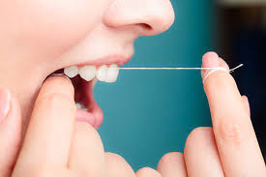
What is Oral Health?
Oral Health is…
“the practice of keeping the mouth clean and free from disease, decay and other problems”
The main way of maintaining good oral health is regularly brushing and cleaning teeth and gums

Slide 6

Why are we learning about this?
This links to the Golden Thread of “Secure your Wellbeing“
Poor oral health can lead to tooth decay and gum disease. Good oral health is also linked to better physical and mental health.

Slide 7
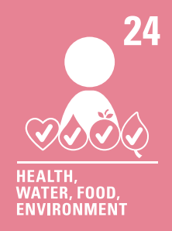
Why are we learning about this?
Article 24 states that children have the right to the best health care possible. In the UK, children receive free dental care. It is important to visit the dentist in order to maintain good oral health. Dental care can be very expensive in the future if oral health is not maintained during childhood
UN Rights
of a Child

Slide 8

Importance of brushing teeth

Slide 9

Oral Health
Using your oracy helpsheet, with the person next to you, discuss your response to the question:
“Did the video include any information you did not know before?”
Remember to use the sentence starters to add, build or challenge what your partner has said.
Be ready to share your discussion with the class

Slide 10
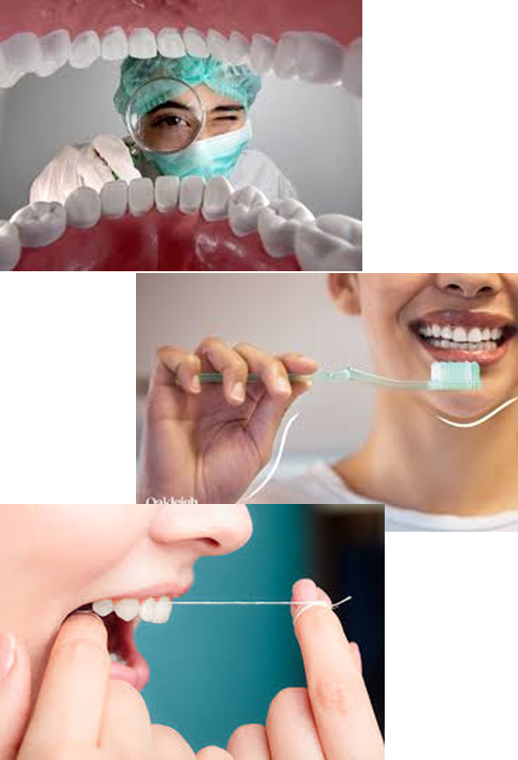
Oral Health
Despite brushing teeth being an everyday occurrence for everyone, there are lots of myths about oral health. Decide if the following statement is a myth or fact
“You only need to brush your teeth once a day”
This is a myth. Teeth should be cleaned twice a day; once in the morning and once at night

Slide 11
Oral Health
Despite brushing teeth being an everyday occurrence for everyone, there are lots of myths about oral health. Decide if the following statement is a myth or fact
“Brushing teeth should also include flossing or using interdental brushes”
This is a fact. Using floss or interdental brushes helps remove food and plaque between teeth where a toothbrush can’t reach

Slide 12
Oral Health
Despite brushing teeth being an everyday occurrence for everyone, there are lots of myths about oral health. Decide if the following statement is a myth or fact
“Drinking fizzy drinks doesn’t harm teeth as long as you brush them later”
This is a myth. The acid and sugar in fizzy drinks weakens the tooth enamel and brushing straight after fizzy drinks can cause more damage

Slide 13
Oral Health
Despite brushing teeth being an everyday occurrence for everyone, there are lots of myths about oral health. Decide if the following statement is a myth or fact
“Baby teeth aren’t important as they fall out anyway”
This is a myth. Baby teeth help with speech development, eating and guidance adult teeth into place.

Slide 14
Oral Health
Despite brushing teeth being an everyday occurrence for everyone, there are lots of myths about oral health. Decide if the following statement is a myth or fact
“Smoking and vaping can cause gum disease and bad breath”
This is a fact. Chemical in cigarettes and vapes reduce the blood flow to gums, leading to gum disease, bad breath and potentially even tooth loss

Slide 15
Oral Health
Despite brushing teeth being an everyday occurrence for everyone, there are lots of myths about oral health. Decide if the following statement is a myth or fact
“Brushing really hard cleans teeth better”
This is a myth. Brushing too hard can wear down the enamel and damage gums.

Slide 16
Oral Health
You will be learning more about the importance of oral health in your Personal Development lesson.
Until then reflect on some of the myths and facts you learnt about today. Is there anything you need to change about your oral health?

