Slide 1

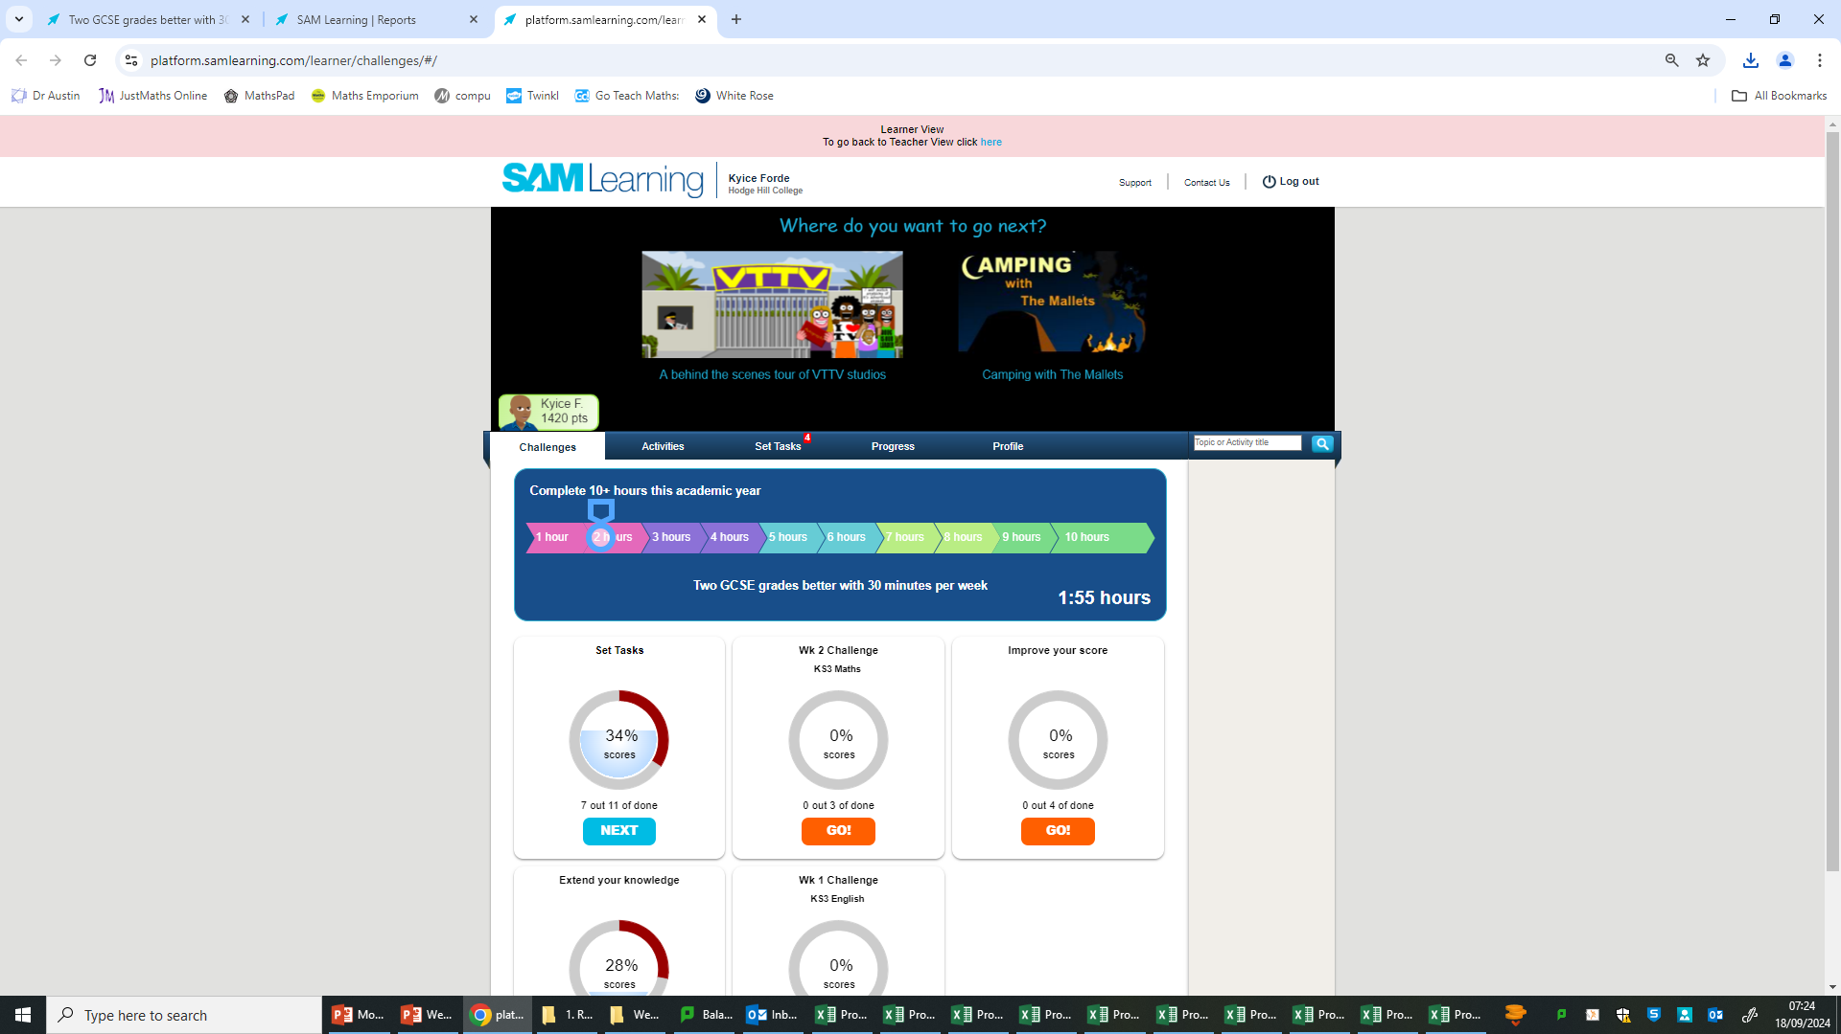
Remember to complete all homework tasks on SAM Learning
We still use Classcharts for announcements, surveys and revision material
Homework Club every morning in West Canteen from 8am
Library is open before school and at break times
Students on the following slides have incomplete Homework Tasks
Make sure you are completing the SET TASKS! These are the tasks your teachers have set.
Notes:
Please give time for the students to produce answers for themselves before showing answers.

Slide 2
Thought of the Day
“Be patient with yourself. Puberty is a time of big changes, but it is also the start of discovering who you really are”
Naomi Wolf

Slide 3


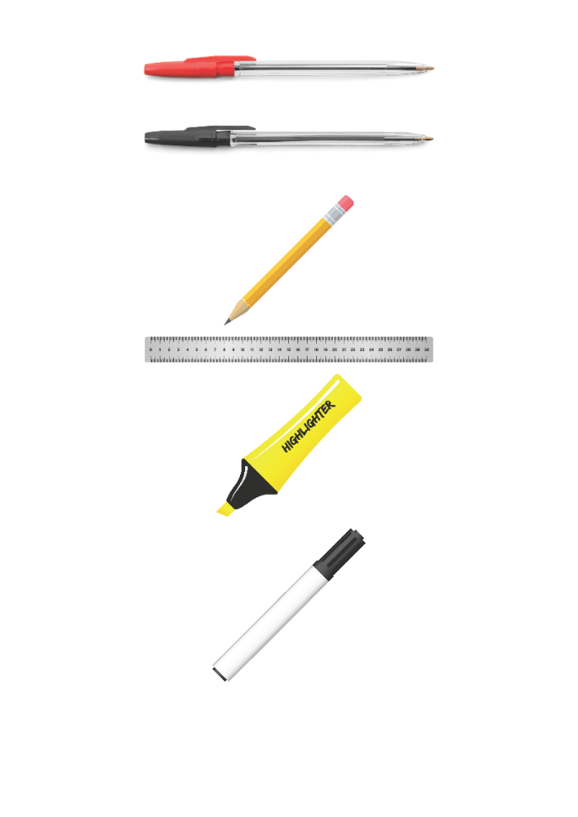





Replacement equipment for your learning wallet can be purchased at the following locations/times:
The following items can be purchased for 10p each (cash only) from West Canteen, East Canteen, the Library, and
LRC (next to W214):
Day | West Canteen | East Canteen | Library or LRC | Library
Monday | 08:00–08:35 | 08:30–08:35 | 10:10– 10:30 11:10–11:30 12:40–13:00 13:40–14:00 | 16:10–16:30
Tuesday | 08:00–08:35 | 08:30–08:35 | 10:10– 10:30 11:10–11:30 12:40–13:00 13:40–14:00 | 15:10–15:30
Wednesday | 08:00–08:35 | 08:30–08:35 | 10:10– 10:30 11:10–11:30 12:40–13:00 13:40–14:00 | 15:10–15:30
Thursday | 08:00–08:35 | 08:30–08:35 | 10:10– 10:30 11:10–11:30 12:40–13:00 13:40–14:00 | 15:10–15:30
Friday | 08:00–08:35 | 08:30–08:35 | 11:10–11:30 12:40–12:30 | 13:40–14:00
The following items can be purchased from West Office using money on your ParentPay:
£1.70
£15.00

Slide 4

Secure your Wellbeing: Learning Journey
Staying safe – rail, bike and water
What is oral health
What is personal hygiene?
What is mental health?
What is social and physical health?
What does puberty mean?
Today we will look at:
What does puberty mean?
This includes:
Definition of puberty
When does puberty begin
Myth busting
Please remember that during the lesson we should not be asking any pupil or teacher personal questions.
Your teacher can ask you questions but this will be to check your knowledge in the lesson.

Slide 5

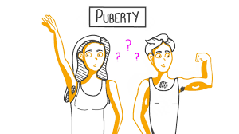
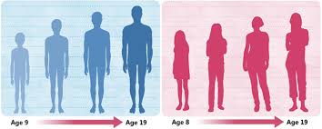
What is puberty?
Puberty is…
“a period of time when a child’s body starts to develop into an adult body”

Slide 6

Why are we learning about this?
This links to the Golden Thread of “Secure your Wellbeing“
Puberty can mean lots of physical and emotional changes as people become a teenager. It is important to learn that these changes are completely natural and happen to all people (but at different times). This helps secure your wellbeing as people can become upset or worried about these changes.

Slide 7

Why are we learning about this?
Article 24 states that children have the right to information about how to stay healthy. Due to all the changes during puberty, it is important to learn about these changes so people can understand why this is happening to their bodies and their emotions.
UN Rights
of a Child

Slide 8
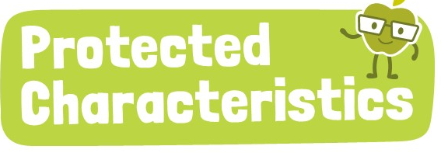
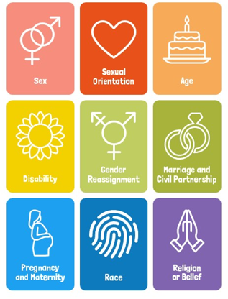
Why are we learning about this?
Age is a Protected Characteristic. Puberty happens to everyone, at different speeds during teenage years. This means they should not be treated differently to people of other ages, however people may need to be more patient with teenagers due to emotional and hormonal changes happening.

Slide 9
When does puberty begin?
Puberty begins for people between the ages of 8-14 years old.
This shows that puberty is different for everyone and the changes during this time can take several years to complete.

Slide 10
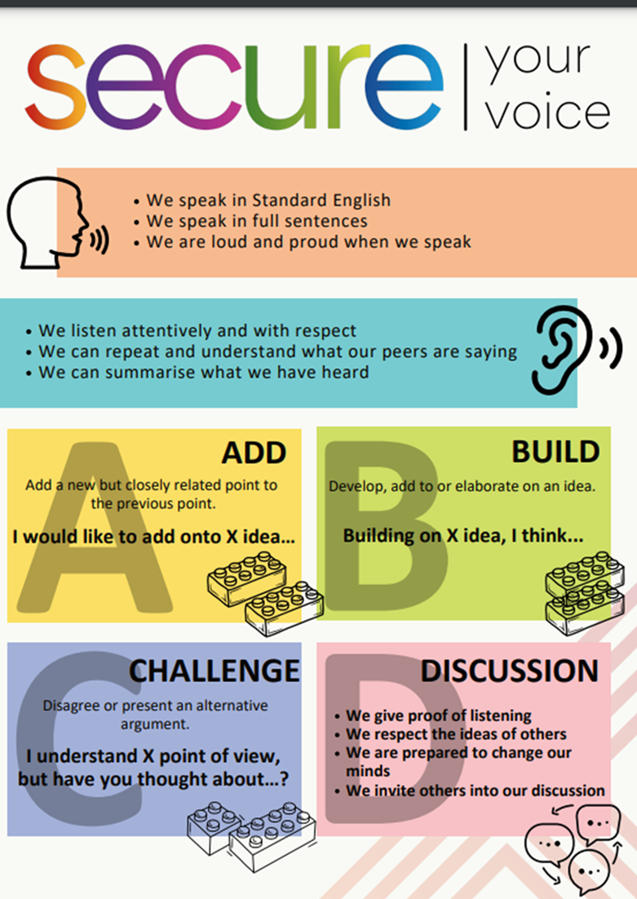
Discussion
With the person next to you discuss if the following is a fact or a myth about puberty:
“All boys’ voices break at the same time during puberty”
This is a myth. Boys' voices can change at different ages, usually between ages 11 and 15. Some boys may experience voice changes earlier, while others may notice them later.

Slide 11
Discussion
With the person next to you discuss if the following is a fact or a myth about puberty:
“Girls can’t participate in sports or swim when they have their period”
This is a myth. Girls can absolutely participate in sports, swim, and continue with their normal activities while on their period. There are various menstrual products (e.g., pads, tampons, menstrual cups) designed to make this possible, and staying active can even help alleviate some period symptoms like cramps.

Slide 12
Discussion
With the person next to you discuss if the following is a fact or a myth about puberty:
“Girls start menstruation (getting their period around 10-16 years old”
This is a fact. Most girls start their period between ages 10 and 16, but the exact age varies. It’s a natural part of growing up for girls, and it signals that their body is able to have children in the future.

Slide 13
Discussion
With the person next to you discuss if the following is a fact or a myth about puberty:
“Acne is a normal party of puberty but not everyone will get it.”
This is a fact. Acne happens due to hormonal changes during puberty, but not everyone will get it. Some people might have mild acne, while others may have more severe cases. Keeping your skin clean can help, but sometimes acne is just part of growing up.

Slide 14
Discussion
With the person next to you discuss if the following is a fact or a myth about puberty:
“People need to start shaving as soon as body hair appears.”
This is a myth. Shaving is a personal choice, and there’s no rule saying people have to shave when hair starts growing. Some people choose to shave, and others don’t.

Slide 15
Discussion
With the person next to you discuss if the following is a fact or a myth about puberty:
“Once puberty starts, the changes happen quickly, and it’s over in a few months”
This is a myth. Puberty is a gradual process that can take several years to complete. Changes like growth spurts, voice deepening, and body development happen over time, not all at once.

Slide 16
Puberty
You will be learning much more about puberty in your Personal Development lessons this week.
If you do have any questions about puberty you can speak to a staff member or an older relative that you trust.

