Slide 1
Thought of the Day
“What mental health needs is more sunlight, more candor, and more unashamed conversation”
Glenn Close

Slide 2


Homework has been set for this week.
Remember to log in and complete your set tasks.
We still use Classcharts for announcements, surveys and revision material
Homework Club every morning in West Canteen from 8am
Library is open before school and at break times
Students on the following slides have not completed ALL tasks
Make sure you are completing the SET TASKS! These are the tasks your teachers have set.
Notes:
Please give time for the students to produce answers for themselves before showing answers.

Slide 3


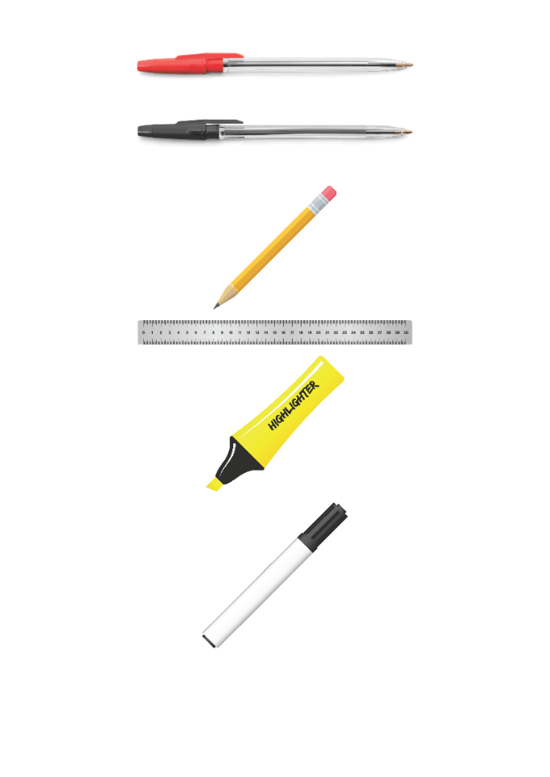


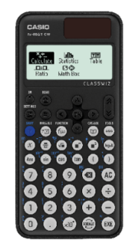


Replacement equipment for your learning wallet can be purchased at the following locations/times:
The following items can be purchased for 10p each (cash only) from West Canteen, East Canteen, the Library, and
LRC (next to W214):
Day | West Canteen | East Canteen | Library or LRC | Library
Monday | 08:00–08:35 | 08:30–08:35 | 10:10– 10:30 11:10–11:30 12:40–13:00 13:40–14:00 | 16:10–16:30
Tuesday | 08:00–08:35 | 08:30–08:35 | 10:10– 10:30 11:10–11:30 12:40–13:00 13:40–14:00 | 15:10–15:30
Wednesday | 08:00–08:35 | 08:30–08:35 | 10:10– 10:30 11:10–11:30 12:40–13:00 13:40–14:00 | 15:10–15:30
Thursday | 08:00–08:35 | 08:30–08:35 | 10:10– 10:30 11:10–11:30 12:40–13:00 13:40–14:00 | 15:10–15:30
Friday | 08:00–08:35 | 08:30–08:35 | 11:10–11:30 12:40–12:30 | 13:40–14:00
The following items can be purchased from West Office using money on your ParentPay:
£1.70
£15.00

Slide 4

Secure your Wellbeing: Learning Journey
Staying safe – rail, bike and water
What is oral health
What is personal hygiene?
What is mental health?
What is social and physical health?
What does puberty mean?
Today we will look at:
What is mental health?
This includes:
Definition of mental health?
Difference between mental health and mental illness
Ways to improve mental health?
Please remember that during the lesson we should not be asking any pupil or teacher personal questions.
Your teacher can ask you questions but this will be to check your knowledge in the lesson.

Slide 5
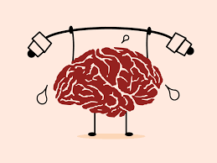
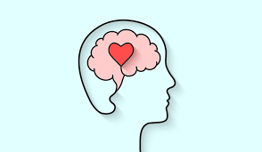

What is mental health?
Mental Health is…
“mental health is a state of mental well being that enables people to cope with the stresses of life, realise their abilities, learn well and work well and contribute to their community”

Slide 6

Why are we learning about this?
This links to the Golden Thread of “Secure your Wellbeing“
Mental health is just as important as our physical health. It is important to look after your mental health in order to feel good, be productive and have an overall better wellbeing

Slide 7
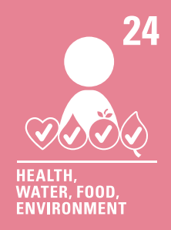
Why are we learning about this?
Article 24 states that children should have information about how to stay healthy. This includes mental health. It is important to know how to look after your mental health as this will include doing things that make you and other people around you happy.
UN Rights
of a Child

Slide 8
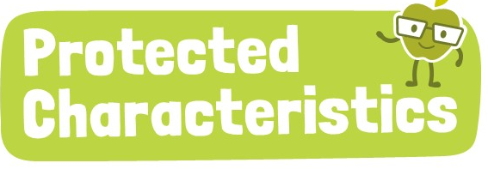
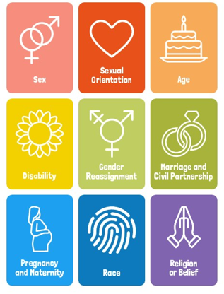
Why are we learning about this?
The Equality Act (2010) sets out 9 Protected Characteristics. No one should be treated differently due to identifying with one or more of the characteristics. Unfortunately, this still happens to many people who identify with one or more of the characteristics. This can negatively impact their mental health.

Slide 9
What is mental health?
Mental health is not just when people are feeling down. People have mental health when they are feeling good.
Mental health is something everyone has and it impacts everyone, everyday.

Slide 10

What is mental health?
Notes:
https://www.youtube.com/watch?v=DxIDKZHW3-E play from beginning to 4.50

Slide 11
What is the difference between mental health and mental illness?
People often confuse mental health and mental illness.
Everyone has mental health but not everyone has mental illness
Mental illness can include things like depression, eating disorders, mood disorders and anxiety. These things affect a persons ability to function over a long period of time. They also need to be diagnosed by a trained professional.
When a person is suffering from poor mental health one day, it does not mean that they have a mental illness. This is because it is not over a long period of time.

Slide 12

How to have good mental health
You have 1 minute to think about the following question:
“What do you think can help a person’s mental health?”
Social media includes Instagram, Snapchat, YouTube etc

Slide 13
How to have good mental health
Using your oracy helpsheet, with the person next to you, discuss your response to the question:
“What do you think can help a person’s mental health?”
Remember to use the sentence starters to add, build or challenge what your partner has said.
Be ready to share your discussion with the class

Slide 14
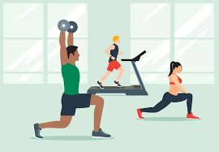
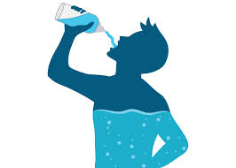



How to have good mental health
Studies have shown that there are a number of things that can help you have good mental health.
Exercise
Stay hydrated
Eat healthy food
Do things that make you happy
Speak to people in person to feel connected. Speaking online is not as effective

Slide 15
Mental Health
You will be learning more about mental health in your Personal Development lessons this week.
Until then, reflect on what you do to look after your mental health. What do you do to make you feel happy and content? What things do not make you happy and content – you should try to avoid these.

Slide 16



Support
If you ever need support about mental health for either yourself or a friend/family member, you can get support from the following places
Childline.org.uk
Call – 08001111
Email or chat online for support
Themix.org.uk
You can email or have one-to-chat online.
There is also a crisis messenger which is available 24/7

