Slide 1
Thought of the Day
“Look out for each other. Stick together. Help others when you can”
Marcus Rashford

Slide 2

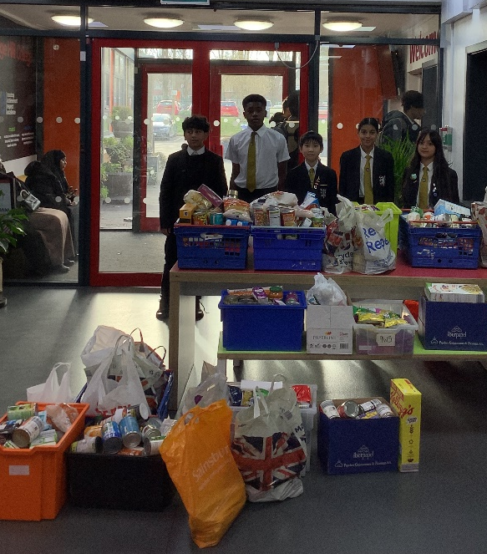
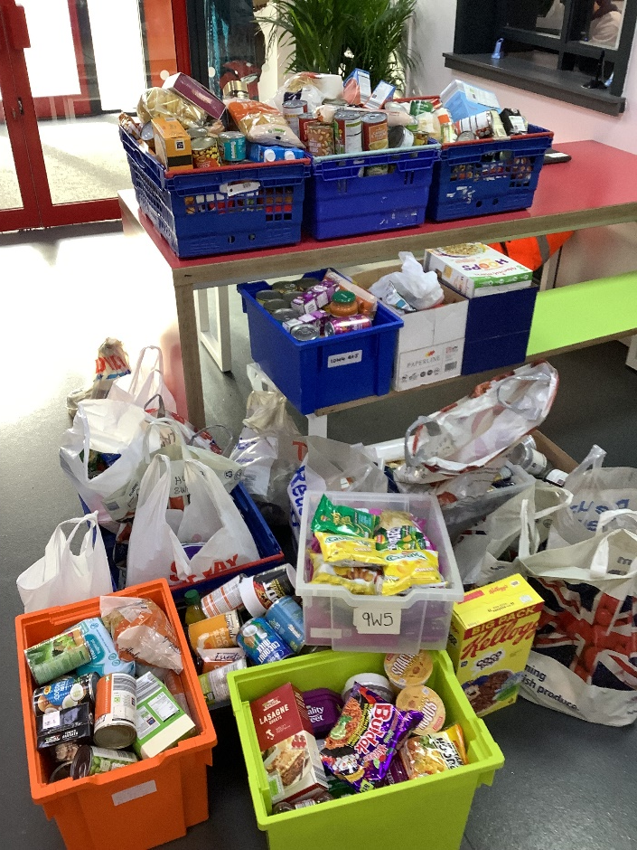
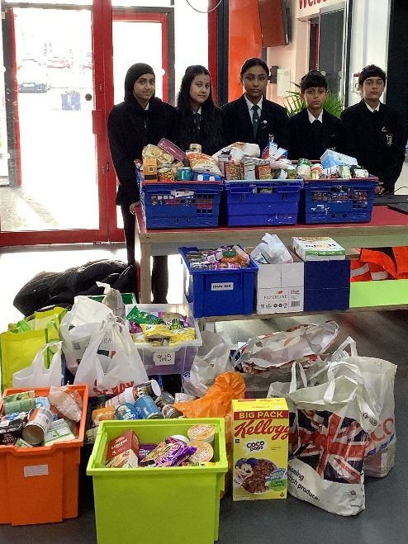
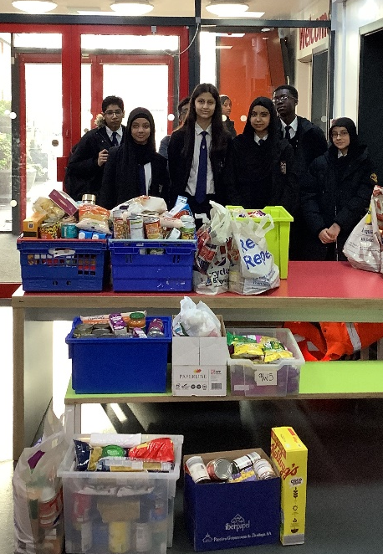



Food Bank Collection for Ramadan
We would like to say a big well done to everyone who contributed to the charity food donation! The food that HHC have collected all week for families in need this Ramadan will make a huge difference!
Thank you to everyone who has participated in this event. And the prize for the winning forms (contributing the most donations) goes to ….
Year 7 – 7W1 Miss Zahir
Year 8 – 8W3 Mr Matin
Year 9 – 9W1 Mr Khan
"The believer’s shade on the Day of Resurrection will be his charity." – Prophet Muhammad (Tirmidhi 604)

Slide 3


Homework has been set for this week.
Remember to log in and complete your set tasks.
We still use Classcharts for announcements, surveys and revision material
Homework Club every morning in West Canteen from 8am
Library is open before school and at break times
Students on the following slides have not completed ALL tasks
Make sure you are completing the SET TASKS! These are the tasks your teachers have set.
Notes:
Please give time for the students to produce answers for themselves before showing answers.

Slide 4

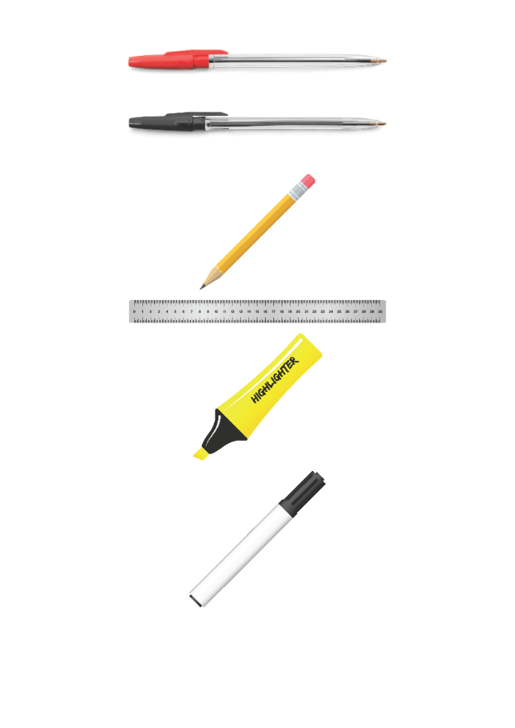


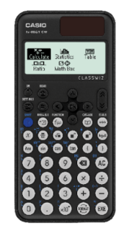


Replacement equipment for your learning wallet can be purchased at the following locations/times:
The following items can be purchased for 10p each (cash only) from West Canteen, East Canteen, the Library, and
LRC (next to W214):
Day | West Canteen | East Canteen | Library or LRC | Library
Monday | 08:00–08:35 | 08:30–08:35 | 10:10– 10:30 11:10–11:30 12:40–13:00 13:40–14:00 | 16:10–16:30
Tuesday | 08:00–08:35 | 08:30–08:35 | 10:10– 10:30 11:10–11:30 12:40–13:00 13:40–14:00 | 15:10–15:30
Wednesday | 08:00–08:35 | 08:30–08:35 | 10:10– 10:30 11:10–11:30 12:40–13:00 13:40–14:00 | 15:10–15:30
Thursday | 08:00–08:35 | 08:30–08:35 | 10:10– 10:30 11:10–11:30 12:40–13:00 13:40–14:00 | 15:10–15:30
Friday | 08:00–08:35 | 08:30–08:35 | 11:10–11:30 12:40–12:30 | 13:40–14:00
The following items can be purchased from West Office using money on your ParentPay:
£1.70
£15.00

Slide 5

Secure your Wellbeing: Learning Journey
Staying safe – rail, bike and water
What is oral health
What is personal hygiene?
What is mental health?
What is social and physical health?
What does puberty mean?
Today we will look at:
What is social health?
This includes:
Definition of social health
Why social health is important to wellbeing
Please remember that during the lesson we should not be asking any pupil or teacher personal questions.
Your teacher can ask you questions but this will be to check your knowledge in the lesson.

Slide 6

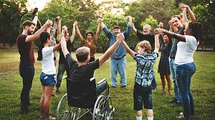
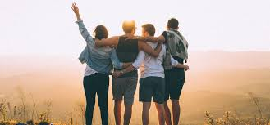
What is social health?
Social Health is…
“how we interact with other people in different situations”

Slide 7

Why are we learning about this?
This links to the Golden Thread of “Secure your Wellbeing“
Social health, may seem to be about relationships, but it is also a core element of a persons overall wellness. Good social health and improve a persons physical and mental health

Slide 8

Why are we learning about this?
Article 15 states that children have the right to join or set up groups as long as these do not harm others. This is an example of having good social health as it will mean people are surrounded by people who have similar interests. This can help combat things like loneliness.
UN Rights
of a Child

Slide 9
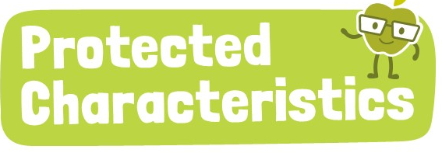
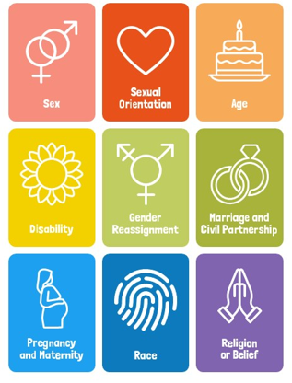
Why are we learning about this?
The Equality Act (2010) sets out 9 Protected Characteristics. No one should be treated differently due to identifying with one or more of the characteristics. Unfortunately, this still happens to many people who identify with one or more of the characteristics. This can lead to people having poor social health which can potentially lead to a negative impact in physical and mental health

Slide 10
What is social health?
Having good social health means having positive relationships, working well in groups and feeling comfortable in social settings.
Poor social health can lead to loneliness, misunderstandings and difficulty in making friends.

Slide 11

What is social health?
Notes:
https://www.youtube.com/watch?v=f3dBPulbLSk

Slide 12

Benefits of social health?
You have 1 minute to think about the following question:
“The video explained that social health has lots of benefits. What were these benefits?”

Slide 13
Benefits of social health
Using your oracy helpsheet, with the person next to you, discuss your response to the question:
“The video explained that social health has lots of benefits. What were these benefits?”
Remember to use the sentence starters to add, build or challenge what your partner has said.
Be ready to share your discussion with the class

Slide 14
Benefits of social health
Benefits of social health are:
Eat a healthier diet
Be more physical active
Less likely to smoke/vape
Manage stress
Lower risk of major health problems
Overall happier life

Slide 15
Social Health and teamwork
A sign of good social health is the ability to work in a team.
You have 1 minute to think about the following question:
“Think about someone who works well in a team. What makes the good at working in a team?”

Slide 16
Social Health and Teamwork
Using your oracy helpsheet, with the person next to you, discuss your response to the question:
“Think about someone who works well in a team. What makes the good at working in a team?”
Remember to use the sentence starters to add, build or challenge what your partner has said.
Be ready to share your discussion with the class

Slide 17
Social Health and Teamwork
Those who work best in a team…
Have positive relationships with everyone in the team
They are good at listening to others in the team which makes people feel valued
They can handle disagreements calmly and do not get angry
They always show kindness and respect

Slide 18
Reflection
Around school today, think about your social health. What can you do to improve your social health so you get all of the wellbeing benefits?
In your Personal Development lesson this week, you will look more at social health.

Slide 19



Support
If you ever need support about social health for either yourself or a friend/family member, you can get support from the following places
Childline.org.uk
Call – 08001111
Email or chat online for support
Themix.org.uk
You can email or have one-to-chat online.
There is also a crisis messenger which is available 24/7

