Slide 1
Thought of the Day
“Health and hygiene are a basic personal need for all”
Manushi Chhillar

Slide 2

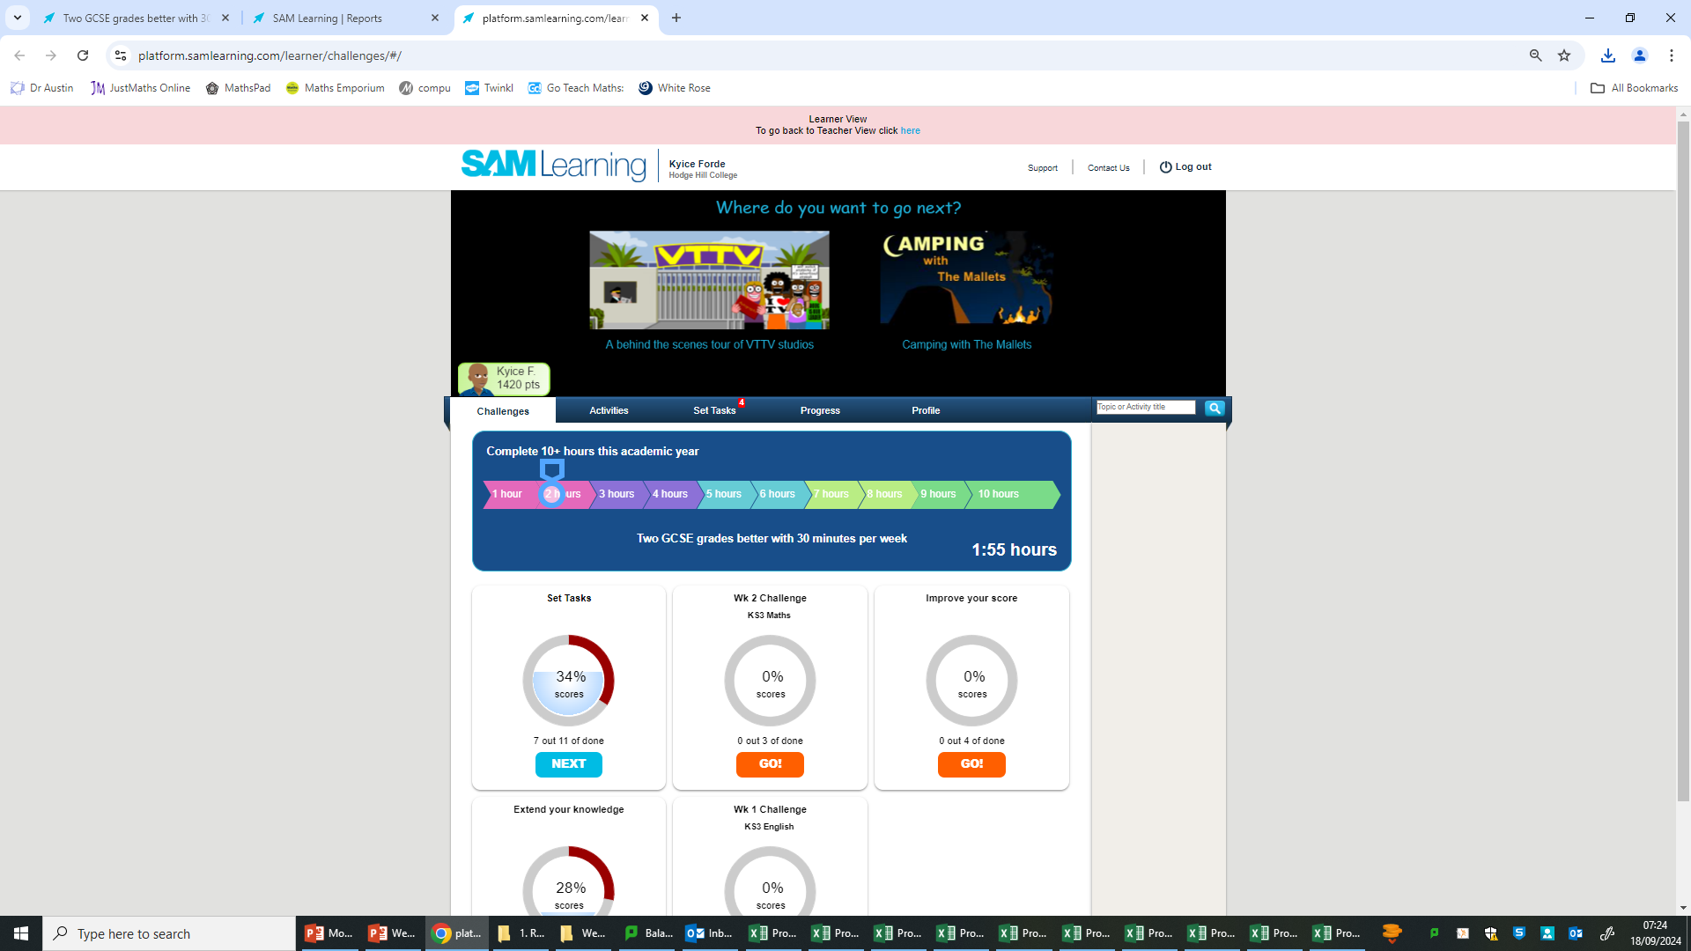
Homework will be set today.
Remember to log in and complete your set tasks.
We still use Classcharts for announcements, surveys and revision material
Homework Club every morning in West Canteen from 8am
Library is open before school and at break times
Students on the following slides have not completed ALL tasks
Make sure you are completing the SET TASKS! These are the tasks your teachers have set.
Notes:
Please give time for the students to produce answers for themselves before showing answers.

Slide 3




Food Bank Collection for Ramadan
"Do not withhold good from those to whom it is due, when it is in your power to act." – Proverbs 3:27
During March, many Muslims will be observing Ramadan by fasting.
As a school, we aim to come together to share food and support those who may have limited resources to break their fast.
So for a whole week (from Monday 3rd March 2025 until Friday 7th March), all students will have the opportunity to bring food items from home in to school to donate to their form tutor.
On Friday our Pupil Leaders will collect all donations, which will be recorded on the Secure Tracker, and there will be a prize for the best form!
Thank you for your kindness and generosity in supporting our community
Mrs Sajed and Miss Reid
"The believer’s shade on the Day of Resurrection will be his charity." – Prophet Muhammad (Tirmidhi 604)
Notes:
Form tutors please keep all collected food items with you in your rooms until Friday 7th when our Pupil Leaders will come and take these all from you during form/period 1.
And if you could make sure the secure tracker is being filled also if students bring donations in under Charity contribution.

Slide 4
Food Bank Collection for Ramadan
"Do not withhold good from those to whom it is due, when it is in your power to act." – Proverbs 3:27
What items could you bring to donate?
Dried food such as rice and pasta
Tinned food such as beans, soup, and canned vegetables
Tinned desserts such as custard, rice pudding
Boxes of cereal
Packet food such as noodles, ramen
Bottles of squash
Please do not bring fresh fruit or vegetables, or frozen food, as these will spoil.
"The believer’s shade on the Day of Resurrection will be his charity." – Prophet Muhammad (Tirmidhi 604)
Notes:
Form tutors please keep all collected food items with you in your rooms until Friday 7th when our Pupil Leaders will come and take these all from you during form/period 1.
And if you could make sure the secure tracker is being filled also if students bring donations in under Charity contribution.

Slide 5

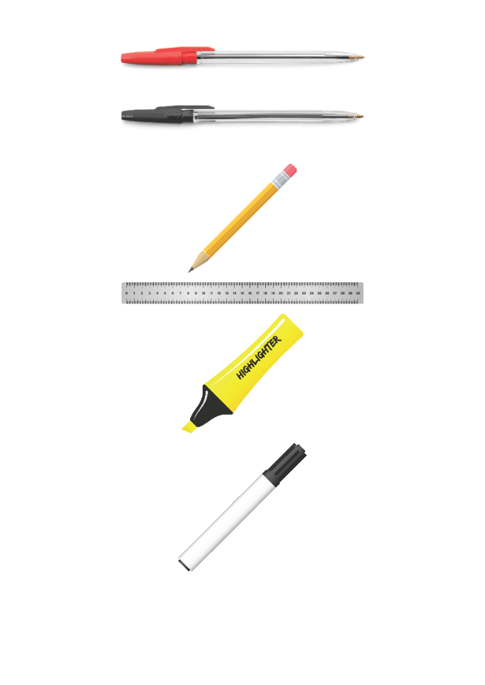


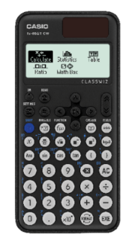


Replacement equipment for your learning wallet can be purchased at the following locations/times:
The following items can be purchased for 10p each (cash only) from West Canteen, East Canteen, the Library, and
LRC (next to W214):
Day | West Canteen | East Canteen | Library or LRC | Library
Monday | 08:00–08:35 | 08:30–08:35 | 10:10– 10:30 11:10–11:30 12:40–13:00 13:40–14:00 | 16:10–16:30
Tuesday | 08:00–08:35 | 08:30–08:35 | 10:10– 10:30 11:10–11:30 12:40–13:00 13:40–14:00 | 15:10–15:30
Wednesday | 08:00–08:35 | 08:30–08:35 | 10:10– 10:30 11:10–11:30 12:40–13:00 13:40–14:00 | 15:10–15:30
Thursday | 08:00–08:35 | 08:30–08:35 | 10:10– 10:30 11:10–11:30 12:40–13:00 13:40–14:00 | 15:10–15:30
Friday | 08:00–08:35 | 08:30–08:35 | 11:10–11:30 12:40–12:30 | 13:40–14:00
The following items can be purchased from West Office using money on your ParentPay:
£1.70
£15.00

Slide 6

Secure your Wellbeing: Learning Journey
Staying safe – rail, bike and water
What is oral health
What is personal hygiene?
What is mental health?
What is social and physical health?
What does puberty mean?
Today we will look at:
What is personal hygiene
This includes:
Definition of personal hygiene
Reasons why hygiene is important
Please remember that during the lesson we should not be asking any pupil or teacher personal questions.
Your teacher can ask you questions but this will be to check your knowledge in the lesson.

Slide 7
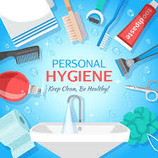
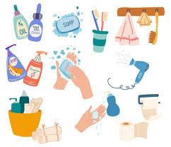
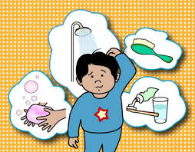
What is Personal Hygiene?
Personal hygiene is…
“how people keep their bodies clean to stay healthy, fresh and free from infections”
Maintaining good personal hygiene can help to prevent illnesses, body odour and skin problems

Slide 8

Why are we learning about this?
This links to the Golden Thread of “Secure your Wellbeing“
Maintaining good personal hygiene will help your overall wellbeing as it can prevent skin infections, body odour and illnesses

Slide 9
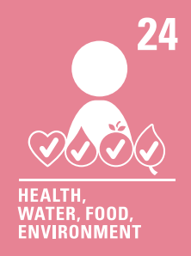
Why are we learning about this?
Article 24 states that children should have information about how to stay healthy. As you move into becoming teenagers, your body will change. During this time it is important to learn about personal hygiene in order to keep you healthy
UN Rights
of a Child

Slide 10
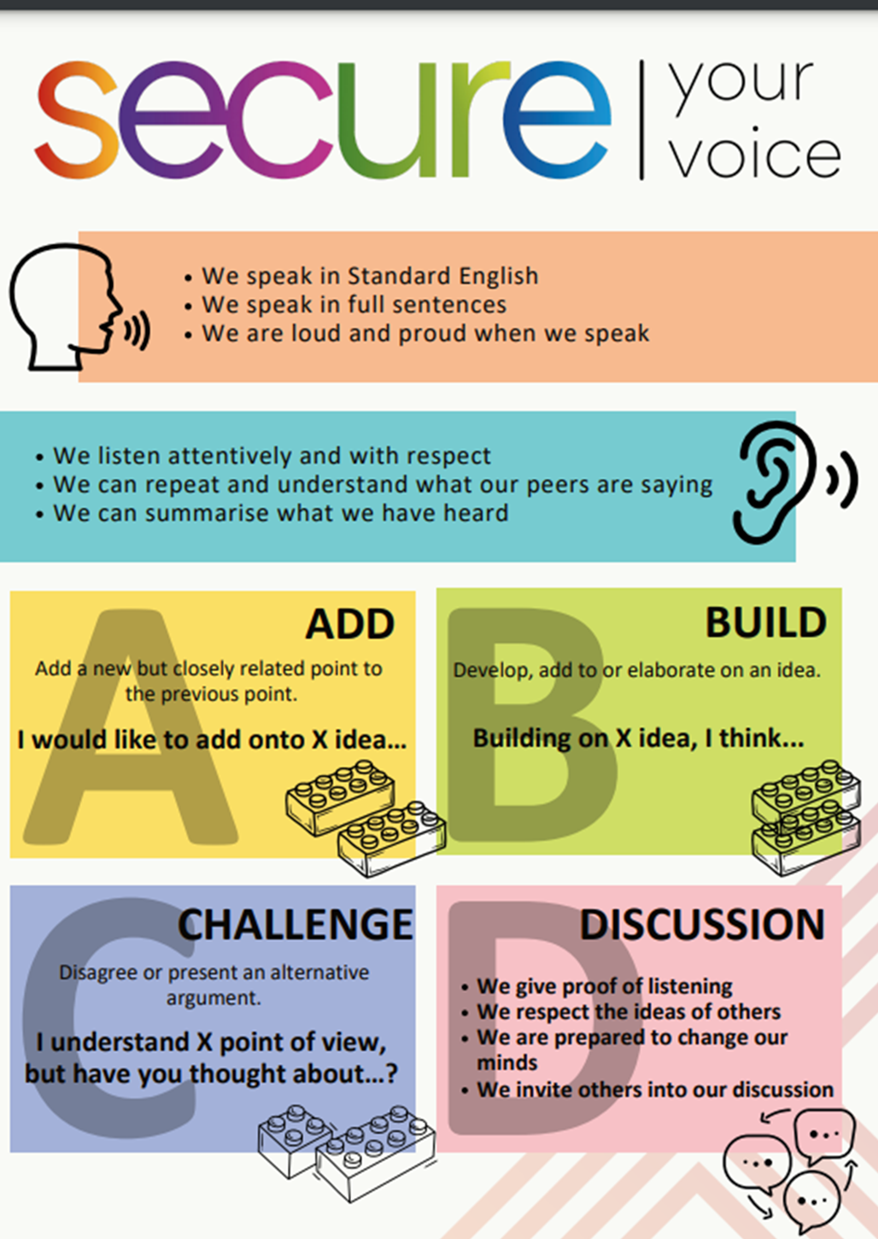
Personal Hygiene
You have 1 minute to think about the following question:
“What can a person do to have good personal hygiene?”

Slide 11
Personal Hygiene
Using your oracy helpsheet, with the person next to you, discuss your response to the question:
“What can a person do to have good personal hygiene?”
Remember to use the sentence starters to add, build or challenge what your partner has said.
Be ready to share your discussion with the class

Slide 12

Personal Hygiene
Notes:
https://www.youtube.com/watch?v=jQ2e0KH5WrI

Slide 13
Personal Hygiene
Decide if the following statement about personal hygiene is a myth or fact
“You don’t need to shower/bath every day”
This is a myth. During puberty, sweat glands are more active so regular showering/bathing is important

Slide 14
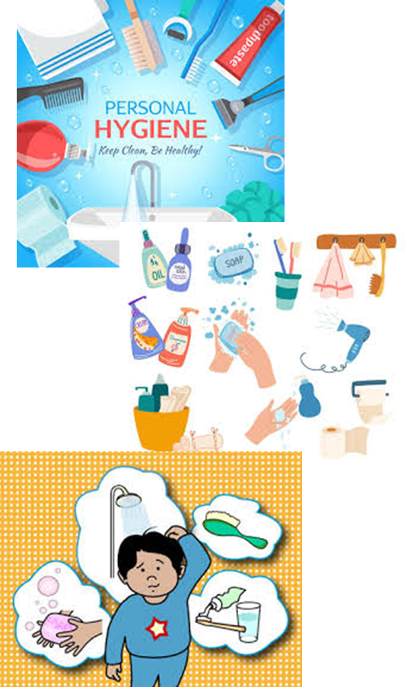
Personal Hygiene
Decide if the following statement about personal hygiene is a myth or fact
“You should wash your hands after using the toilet”
This is a fact. Handwashing prevents the spread of germs and infections

Slide 15
Personal Hygiene
Decide if the following statement about personal hygiene is a myth or fact
“Body odour only happens to adults”
This is a myth. Body odour is caused by the sweat glands which become more active during puberty. This means body odour occurs in young people too.

Slide 16
Personal Hygiene
Decide if the following statement about personal hygiene is a myth or fact
“You can wear the same socks for several days”
This is a myth. Socks trap sweat and bacteria which can lead to bad smells and infections such as “athlete’s foot”

Slide 17
Personal Hygiene
Decide if the following statement about personal hygiene is a myth or fact
“Brushing your hair too much can make it greasy”
This is a fact. Over brushing spreads natural oils from the scalp to the rest of the hair, making it look greasy.

Slide 18
Personal Hygiene
Decide if the following statement about personal hygiene is a myth or fact
“You should not share towels with family members”
This is a fact. Sharing towels can spread bacteria, fungi and even some infections like “athlete’s foot”

Slide 19
Personal Hygiene
You will be learning more about the importance of personal hygiene in your Personal Development lesson.
Until then reflect on some of the myths and facts you learnt about today. Is there anything you need to change about your personal hygiene habits?

