Slide 1


Thought of the Day
“Discipline is doing what needs to be done, even if you don’t want to do it."

Slide 2
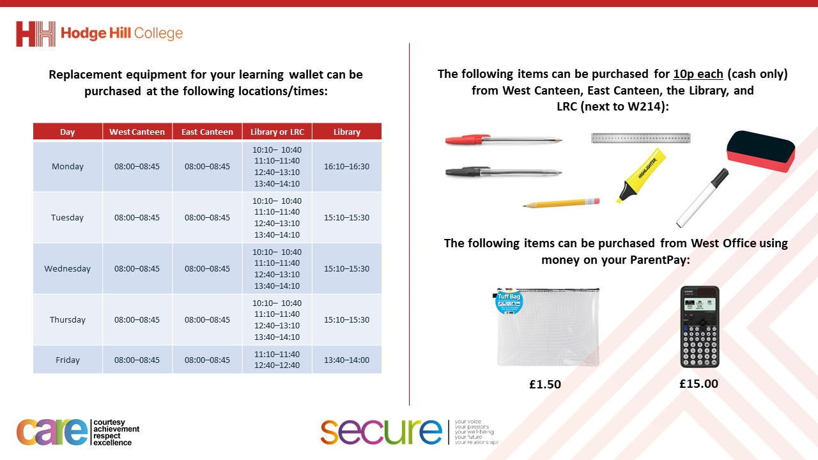

Slide 3


Careers & the World of Work

Slide 4

Discussion Point
You now have 1 minute to think about the following:
“What is a career?”

Slide 5

Discussion Point
With the person next to you discuss your response to the question:
“What is a career?”
Remember – listen carefully to what your partner has said. Repeat back what you have heard to ensure that you have understood them correctly

Slide 6
Discussion Point
Now lets share some answers with the class.
When asked you must summarise your partners answer.
Everyone else must listen carefully as you may be asked to repeat what you have just heard.
When speaking remember that everyone should hear you and follow the guidance in the speaking box on your oracy helpsheet

Slide 7
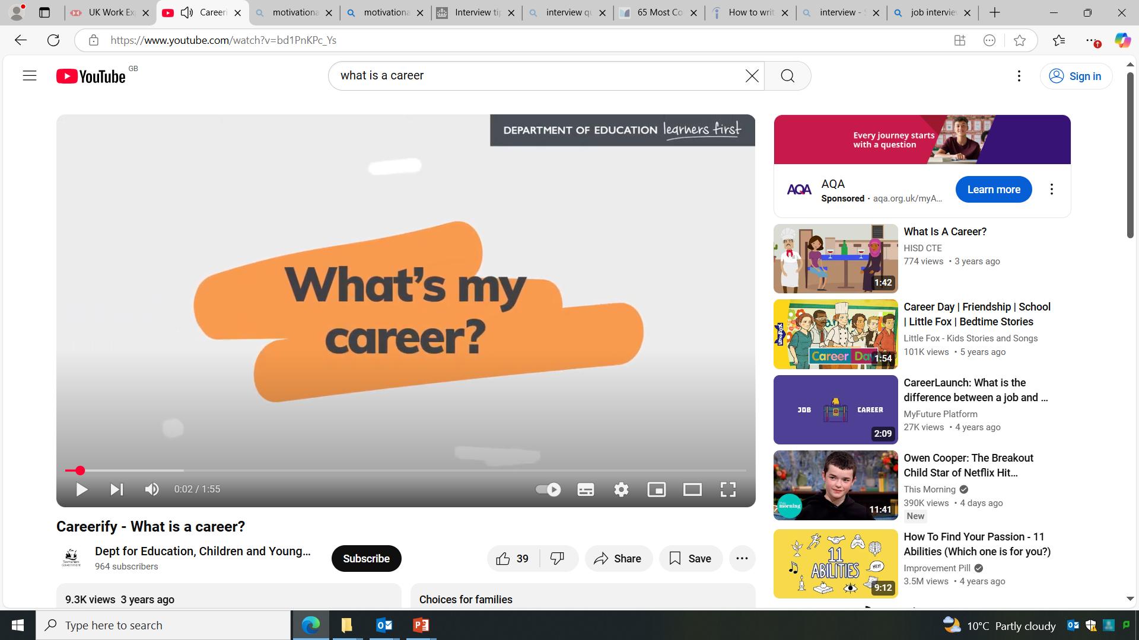
What is a career?
https://www.youtube.com/watch?v=bd1PnKPc_Ys
Notes:
https://www.youtube.com/watch?v=bd1PnKPc_Ys

Slide 8




Discuss which statement you agree with & why
You might have heard people say things like:
“A career is where you stay in the same type of job for a long time.”
“A career is when you move up a career ladder and gain more money or responsibility.”
“A career is where you progress forward on a clear career path within one industry.”
“A career is a journey through life, learning and work. You can change direction into different jobs or industries.”

Slide 9

What is a career?
Traditionally, people have thought of a career as staying in or moving upwards through a specific job. A better way of thinking about a career is a journey, which can take different directions.
Notes:
Supporting question: what are the benefits of defining career as a journey?
It gives you more freedom and opportunity.
The decisions you make now do not determine your whole life. You can change your mind.
You can move in different directions as your respond to life.

Slide 10
Discussion Point
You now have 1 minute to think about the following:
“What makes up a career journey?”

Slide 11
Discussion Point
With the person next to you discuss your response to the question:
“What makes up a career journey?”
Remember – listen carefully to what your partner has said. Repeat back what you have heard to ensure that you have understood them correctly

Slide 12
Discussion Point
Now lets share some answers with the class.
When asked you must summarise your partners answer.
Everyone else must listen carefully as you may be asked to repeat what you have just heard.
When speaking remember that everyone should hear you and follow the guidance in the speaking box on your oracy helpsheet

Slide 13








What makes up a career journey?
Jobs/work experience
Education
Qualifications
Enterprise activities
Volunteering
Your interests
Achievements
Your skills

Slide 14
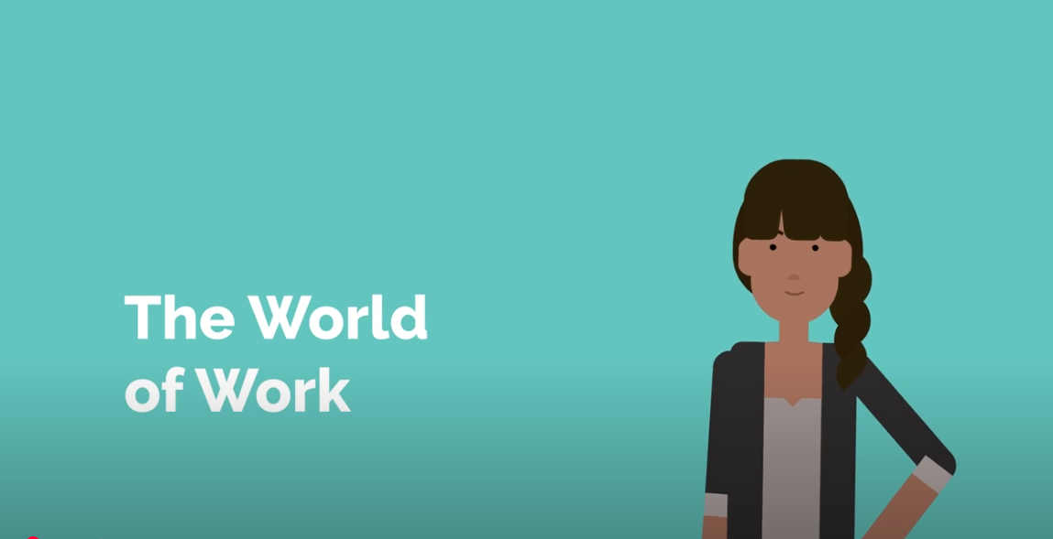
World of Work
https://www.youtube.com/watch?v=_-WBkmECf4I
Notes:
https://www.youtube.com/watch?v=_-WBkmECf4I

Slide 15











What careers are you interested in?
Music
Film
Sports
Performing arts
Medicine
Science
Construction
Transport
Finance
Law
Art and design
Education
Notes:
Icon career sectors:
Music: People who work in this sector compose, perform, conduct, and teach music.
Film and photography: People who work in film and photography are involved in the process before, during or after a shoot.
Sports: People who work in this sector teach, play, and commentate on sport and fitness.
Performing arts: People who work in this sector perform dance, plays or comedy to an audience, or support those who do.
Medicine (general): People in this sector treat non-urgent medical conditions, and refer patients to specialists if needed. There are other specific sectors for specific conditions and specialisms.
Science: Can be split into sub sectors such as Natural sciences. People in this sector try to understand how the physical world works, and use their knowledge to solve problems.
Construction: People who work in this sector help to erect and repair buildings, roads and infrastructure.
Transport: People in the transport sector move people and goods to where they need to go.
Finance: People in finance help look after their clients' money and advise on things like investments, tax, and insurance.
Law: People who work in this sector are about making sure justice is done.
Art and design: Careers in Creative Art and Design involve making visual art, and making objects, spaces and displays look good.
Education/schools: People in this sector help students and schools achieve their goals.
Supporting exercise: did you students come up with any ideas not listed?
See examples below.
Students can search career sectors on Unifrog in the Careers library. Demo Student side> Exploring pathways > Careers library.
Computers: People in this sector design, create, build, test, and fix computer hardware and software.
Dentistry: People who work in dentistry treat and care for patients' teeth and gums.
Geographic and Environmental sciences: People in this sector try to understand how our planet works, and what we can do to protect it.
Horticulture and botany: People in this sector look after, sell, or study plants
Hospitality and Tourism: People who work in hospitality and tourism provide accommodation, food, drink, and leisure services.
Marketing: People who work in marketing help to boost the sales or reputation of a brand in creative ways.
Mathematical sciences: People who work in this sector use their maths skills to solve problems or analyse data.
Media and publishing: People who work in this sector are responsible for writing, assembling, editing or publishing books, articles, and digital content.
Museums and libraries: People who work in museums and libraries look after or sell books, art, and exhibits.
Police: People in the Police sector help to maintain the law and protect the public.
Politics: Jobs in this sector involve working out what's best for society and then trying to make those things happen.
Psychology and therapy: In psychology and therapy, you’ll be helping people with their mental health, and looking at how people’s brains or minds work.
Retail and Sales: People in this sector sell goods or services to individuals and businesses.

Slide 16

Reflection
Your career journey has already started.
What are you doing now that positively contributes towards your career journey?

