Slide 1
Thought of the Day
“And now we welcome the New Year, full of things that have never been”

Slide 2


Remember to complete all homework tasks on SAM Learning
We still use Classcharts for announcements, surveys and revision material
Homework Club every morning in West Canteen from 8am
Library is open before school and at break times
Students on the following slides have not completed ALL tasks
Make sure you are completing the SET TASKS! These are the tasks your teachers have set.
Notes:
Please give time for the students to produce answers for themselves before showing answers.

Slide 3
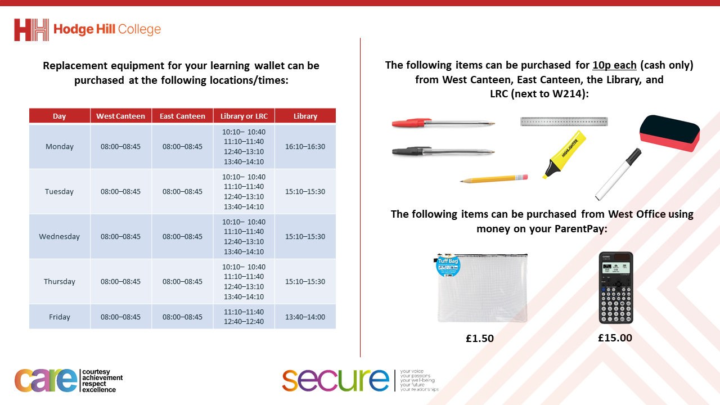

Slide 4



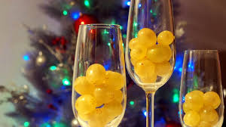
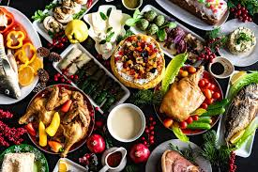
New Year
New Year is…
The start of a new calendar year and is a global event that is celebrated in various ways in different countries and cultures

Slide 5

New Year
Notes:
https://www.youtube.com/watch?v=qjPqNccGrnA

Slide 6
New Year Traditions
Some New Year traditions around the world are:
Fireworks as a symbol of light and energy for the New Year
Cold Water Plunge – start the year with a challenge
Eating 12 grapes at midnight for good luck
Smashing plates on neighbours doors to bring good luck

Slide 7

New Year Traditions
You have 1 minute to think about the following question:
“Do you have any New Year traditions?”

Slide 8
New Year Traditions
Using your oracy helpsheet, with the person next to you, discuss your response to the question:
“Do you have any New Year traditions?”
For this discussion you will not need to challenge anyone but if you have a similar tradition you can add or build on what has been said
Be ready to share your discussion with the class

Slide 9
New Year Reflections
Around 31st December and 1st January, social media is full of friends, family members and influencers reflecting on the previous year
This will largely focus on their highlights by showing photos or videos

Slide 10
New Year Reflections
However, these reflections can also include thinking about loved ones who passed away in the last year.
They can also include things that people have learnt from facing challenges in the past year

Slide 11
New Year Reflections
You have 1 minute to think about the following question:
“Do you think it is important to reflect on the previous year or just move on from it?”

Slide 12
New Year Reflections
Using your oracy helpsheet, with the person next to you, discuss your response to the question:
““Do you think it is important to reflect on the previous year or just move on from it?”
Remember to add, build or challenge on what your partner has said
Be ready to share your discussion with the class

Slide 13
New Year Resolutions
A New Year resolution is…
“a promise to oneself to improve or change”

Slide 14
New Year Resolutions
Examples of New Year resolutions are:
Exercise more
Eat more healthier
Spend less time on social media
Study more for assessments
Learn a new skills
Spend more time with family/friends

Slide 15
Reflection
Spend the next few minutes thinking about the following questions:
What was something you were proud of in 2024?
What would you like to achieve in 2025?

