Slide 1
Thought of the Day
“Cyberbullying leaves scars you can’t see, but they hurt just as much as those can”
Carrie Hope Fletcher

Slide 2


Remember to complete all homework tasks on SAM Learning
We still use Classcharts for announcements, surveys and revision material
Homework Club every morning in West Canteen from 8am
Library is open before school and at break times
Students on the following slides have not completed ALL tasks
Make sure you are completing the SET TASKS! These are the tasks your teachers have set.
Notes:
Please give time for the students to produce answers for themselves before showing answers.

Slide 3


Slide 4


Secure your Relationships: Learning Journey
What makes a good friend?
What is peer pressure?
What is the difference between bullying and banter?
Are online friendship safe?
What is cyberbullying?
What are stereotypes?
Today we will look at:
What is cyberbullying?
This includes:
Definition of cyberbullying
Discussion on where cyberbullying happens most
Please remember that during the lesson we should not be asking any pupil or teacher personal questions.
Your teacher can ask you questions but this will be to check your knowledge in the lesson.

Slide 5
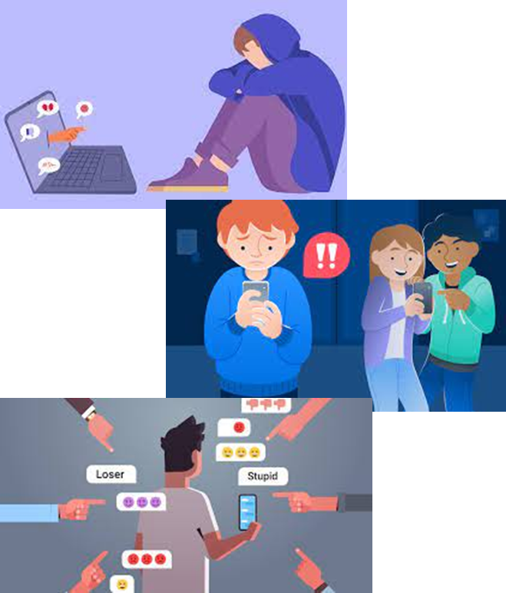
What is cyberbullying?
Cyberbullying is…
“bullying with the use of digital technologies that has the aim of scaring, angering or shaming another person”

Slide 6




Why are we learning about this?
This links to the Golden Thread of “Secure your Relationships“
Many people use the internet to connect with people. Unfortunately people say and do things online that they would not say or do in person. It is important to understand that this is cyberbullying to help you have secure relationships with friends online as well as offline.

Slide 7

Why are we learning about this?
Rule of Law is a British Value. This means that everyone is expected to follow the law of the country. Cyberbullying, particularly if a person is threatening other people can potentially be against the law.

Slide 8

Why are we learning about this?
Article 15 states that children have the right to set up and join groups. However it is important that this does not harm others. When applied to an online group chat it is important that everything said makes sure everyone is included and feels safe.
UN Rights
of a Child

Slide 9
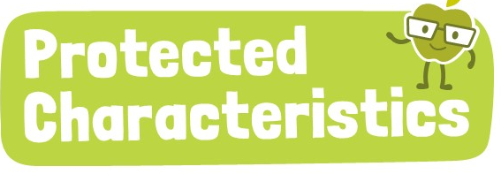
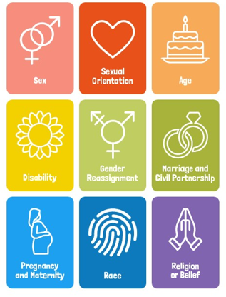
Why are we learning about this?
The Protected Characteristics ensure that no one is discriminated for identifying with one of more of the characteristics. This also applies online. No one should be discriminated online for identifying with one or more of the protected characteristics.

Slide 10
What is cyberbullying?
Cyberbullying can take place:
On social media such as TikTok and Instagram
On messaging platforms like SnapChat and WhatsApp
On gaming platforms
On many occasions this will be accessible through a mobile phone.

Slide 11

Cyberbullying
You have 1 minute to think about the following question:
“Where do you think cyberbullying happens the most? Social media or messaging apps?”

Slide 12
Cyberbullying
Using your oracy helpsheet, with the person next to you, discuss your response to the question:
“Where do you think cyberbullying happens the most? Social media or messaging apps?”
Remember to use the sentence starters to add, build or challenge what your partner has said.
Be ready to share your discussion with the class

Slide 13
Cyberbullying
You have 1 minute to think about the following question:
“Should social media and messaging app companies do more to stop cyberbullying or is this the responsibility of parents/carers?”

Slide 14
Cyberbullying
Using your oracy helpsheet, with the person next to you, discuss your response to the question:
“Should social media and messaging app companies do more to stop cyberbullying or is this the responsibility of parents/carers?”
Remember to use the sentence starters to add, build or challenge what your partner has said.
Be ready to share your discussion with the class

Slide 15
Cyberbullying
You will be learning more about cyberbullying in your Personal Development lessons this week.
Reflect on how people speak and act towards each other online when you next access social media, a messaging app or gaming platform.

Slide 16



Support
If you ever need support about cyberbullying for yourself, a friend or family member you can find it here:
Childline.org.uk
Call – 08001111
Email or chat online for support
Themix.org.uk
You can email or have one-to-chat online.
There is also a crisis messenger which is available 24/7

