Slide 1
Thought of the Day
“Words can inspire, and words can destroy. Choose yours well.”

Slide 2


Remember to complete all homework tasks on SAM Learning
We still use Classcharts for announcements, surveys and revision material
Homework Club every morning in West Canteen from 8am
Library is open before school and at break times
Students on the following slides have not completed ALL tasks
Make sure you are completing the SET TASKS! These are the tasks your teachers have set.
Notes:
Please give time for the students to produce answers for themselves before showing answers.

Slide 3


Slide 4


Secure your Relationships: Learning Journey
What makes a good friend?
What is peer pressure?
What is the difference between bullying and banter?
Are online friendship safe?
What is cyberbullying?
What are stereotypes?
Today we will look at:
What is the difference between bullying and banter
This includes:
Definition of bullying
Definition of banter
Discussion on how words can be hurtful?
Please remember that during the lesson we should not be asking any pupil or teacher personal questions.
Your teacher can ask you questions but this will be to check your knowledge in the lesson.

Slide 5
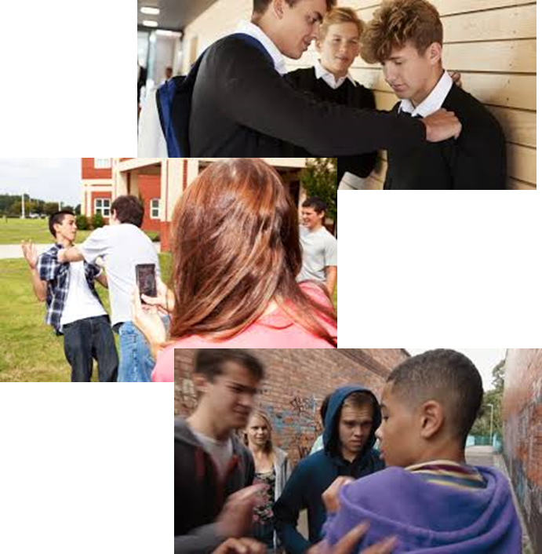
What is bullying?
Bullying is…
“repeated negative behaviour that is intended to make others feel upset, uncomfortable or unsafe”

Slide 6
What is banter?
Banter is…
“playful and friendly exchange of teasing remarks”
Banter only work when the person on the receiving end is in on joke and it does not included anything hurtful or based on something they may feel insecure about.

Slide 7




Why are we learning about this?
This links to the Golden Thread of “Secure your Relationships“
Everyone knows that bullying is wrong and should not happen. People may disguise bullying as banter. Knowing the difference between these two things will improve how you interact with friends and other people your age in and outside of school.
This will mean people will always be treated with respect.

Slide 8

Why are we learning about this?
Individual Liberty is a British Value. This means everyone has the right to act and express oneself freely. No one should feel like they cannot be themselves due to how they be treated by others who bully them.

Slide 9

Why are we learning about this?
Article 2 states that no child should be treated unfairly for any reason. This means that every child should never experience bullying. If they are bullied, this means the bullies are impacting their human rights.
UN Rights
of a Child

Slide 10
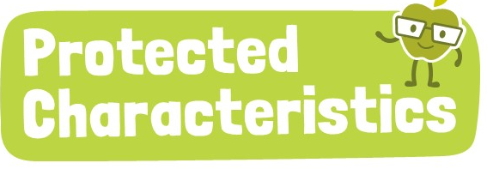
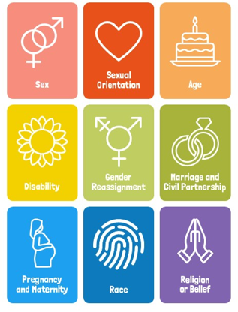
Why are we learning about this?
No one should be a victim of bullying or on the receiving end of banter about any of the protected characteristics. These characteristics are protected which means a person cannot be treated differently due to identifying with one or more of the characteristics.

Slide 11

Bullying vs banter?
You have 1 minute to think about the following question:
“Do you think banter is used as a shield to hide bullying?”

Slide 12
Bullying vs Banter
Using your oracy helpsheet, with the person next to you, discuss your response to the question:
“Do you think banter is used as a shield to hide bullying?”
Remember to use the sentence starters to add, build or challenge what your partner has said.
Be ready to share your discussion with the class

Slide 13
The power of words
Banter and joking around with friends is part of everyday life.
However it is important that banter and jokes respects boundaries.
A good friend will know and respect these boundaries and not disguise a hurtful comment with “it was just a joke”
This is because words can be very hurtful

Slide 14

The Power or Words
Notes:
https://www.youtube.com/watch?v=ddf90YKHjLY

Slide 15
Banter or Bullying?
You have 1 minute to think about the following question:
“Is the following statement an example of bullying or banter? – a group of friends joking about one of the groups new haircut”

Slide 16
Bullying vs Banter
Using your oracy helpsheet, with the person next to you, discuss your response to the question:
“Is the following statement an example of bullying or banter? – a group of friends joking about one of the groups new haircut”
Remember to use the sentence starters to add, build or challenge what your partner has said.
Be ready to share your discussion with the class

Slide 17
Banter or Bullying?
You have 1 minute to think about the following question:
“does your answer change if the person who has the new haircut doesn’t find the comments funny?”

Slide 18
Bullying vs Banter
Using your oracy helpsheet, with the person next to you, discuss your response to the question:
“does your answer change if the person who has the new haircut doesn’t find the comments funny?”
Remember to use the sentence starters to add, build or challenge what your partner has said.
Be ready to share your discussion with the class

Slide 19
Bullying vs banter
You will be looking at bullying and banter in more detail in your Personal Development lesson.
Before your lesson observe how people react to banter. Do they find it funny or does it annoy them? Does everyone think it is banter?

Slide 20



Support
If you ever need support about bullying for yourself or a friend you can find it here:
Childline.org.uk
Call – 08001111
Email or chat online for support
Themix.org.uk
You can email or have one-to-chat online.
There is also a crisis messenger which is available 24/7

