Slide 1
Thought of the Day
“It's important to remember that some of the dangers on the railway aren't always visible.”
Network Rail

Slide 2


Remember to complete all homework tasks on SAM Learning
We still use Classcharts for announcements, surveys and revision material
Homework Club every morning in West Canteen from 8am
Library is open before school and at break times
Students on the following slides have not completed ALL tasks
Make sure you are completing the SET TASKS! These are the tasks your teachers have set.
Notes:
Please give time for the students to produce answers for themselves before showing answers.

Slide 3
Nyang, Sulayman
Osei, Dillon
Khan, Layla
Matthew, Jayden
Ali, Momeenah
Tariq, Muhammed-Ali
Sajid, Zain
Zakariya ali, Raja
Zubair, Muhammad
Hasan, Walat
Zain, Zain
Karim, Asma
Ndiaye, Mamadou
Mansor, Abo-bakar
Seher, Aiza
Nur, Hanan
Johns, Natahlia
Haroon, Abdur-Raheem
Khawaja, Haris
Farbar, Samuel
Ramzan, Mohammed
Davis, Harley
Haroon, Khadija
Khaliq, Qais
Osman, Dawood
Hussain, Momina
Khan, Sulaimaan
Hussain, Alesha
Hassan, Muhammad
Ali, Zeenat
Mohammed, Owais
Raja, Muneeb
Charlton, Mason
Timmins, Wynter
Anwar, Azaan
Norris, Avaiyah
Ahmed, Eesa
Walrond, Sian
Owais, Mohammed
Ababneh, Asaad
Wahid, Harris
Imran, Atikah
Habib, Mohammed
Ali, Usman
Ahmed, Zahra
Khan, Mohammad
Azaan, Muhammed
Ahmed, Abyan
Calin, David
Altaf, Hudaifah
Timofti, Erik
Urse, Rebecca
Hussain, Altaf
Oumer, Abdulrizak
Hussain, Subhan
Manole, Jasmine-Maria
Lusamba, Anshika
Alahmad, Heba
Ahmadzai, Bilal
Tabrez, Azaan
Beckett, Daemon
Yassin, Adil
Mocanu, Eden
Ahmed, Aamil
Ali, Ayaan
Abbas, Faizaan
Following students have not competed their Maths Homework that is due on Monday 10th February. This needs to be completed as soon as possible and all other set tasks.
Students will be put into a detention if they continue to not complete homework and parents will be informed.

Slide 4
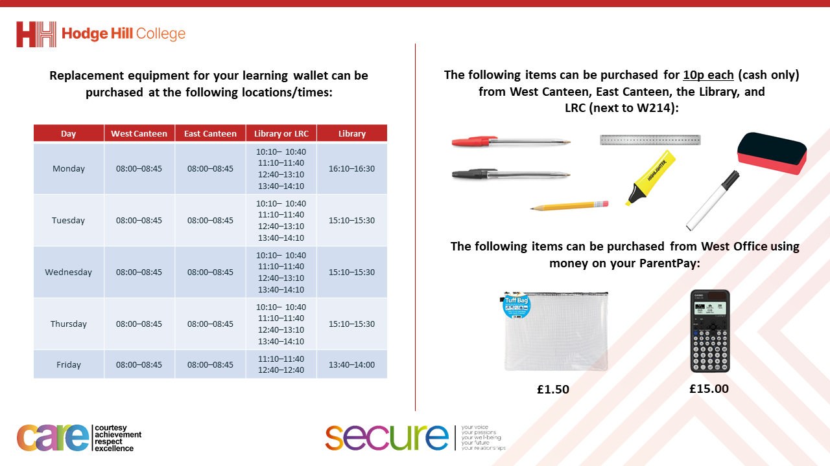

Slide 5


Secure your Wellbeing: Learning Journey
Staying safe – rail, bike and water
What is oral health
What is personal hygiene?
What is mental health?
What is social and physical health?
What does puberty mean?
Today we will look at:
Staying safe around railway tracks
This includes:
What are the dangers of railway tracks
How to stay safe around railway tracks
Please remember that during the lesson we should not be asking any pupil or teacher personal questions.
Your teacher can ask you questions but this will be to check your knowledge in the lesson.

Slide 6

Near misses on railway tracks
Notes:
https://www.youtube.com/watch?v=Te6APh36bNI

Slide 7

Why are we learning about this?
This links to the Golden Thread of “Secure your Wellbeing“
Railways tracks can be extremely dangerous. Knowing how to use them safely will keep you away from harm.

Slide 8

Why are we learning about this?
Rule of Law is a British Value that means everyone should follow the rules and laws to keep everyone safe. There are rules around where and when people should cross railways tracks in order to keep everyone safe from being seriously injured

Slide 9
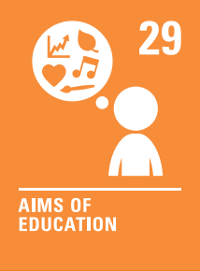
Why are we learning about this?
Article 29 states that children have the right to an education that helps them fully develop to their abilities. Learning about how to keep yourself safe will stop any tragic or serious accidents happening which could impact on you reaching your full potential.
UN Rights
of a Child

Slide 10
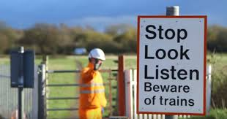

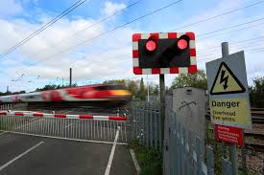
Railway Safety
Railways might look like a fun place to explore, take shortcuts or hangout with friends.
However they are extremely dangerous places.
Every year hundreds of people are injured or killed because they did not understand the risks

Slide 11
Railway Safety
Some things you may not know about trains.
Trains cannot stop quickly – depending on the speed it can take up to 1 mile for a train to come to a complete stop
Trains are quiet than you think so people may not hear them until it is too late
Trains travel at up to 125mph
The train is wider than the track. Even standing next to the track puts a person in danger of being hit

Slide 12

Railway Safety
Using your oracy helpsheet, with the person next to you, discuss your response to the question:
“What fact about trains shocked you the most?”
Remember to use the sentence starters to add, build or challenge what your partner has said.
Be ready to share your discussion with the class

Slide 13
Railway Safety
In order to stay safe near railways tracks, people should:
Stay off the tracks – they should not be used a shortcuts or places to hang out
Use proper crossing – always use level crossing, footbridges or underpasses. Never try to run across the tracks
Obey warning signs and signals – red lights and barriers mean a train is coming, even if it is not in sight
Stay behind the yellow line on platforms – stand well back from the edge to avoid any accidents

Slide 14
Scenario
Jake and Liam are walking home from school. They’re both carrying their backpacks, chatting about a new video game. Jake suddenly looks at his watch and realizes he’s running late for football practice. Jake suggests that they take the shortcut across the railways tracks instead of walking all the way to the bridge. Liam is unsure of what to do.
Task
Think about what advice you would give Liam to help him make a decision.
What could you suggest Liam says to Jake?

Slide 15
Scenario
Using your oracy helpsheet, with the person next to you, discuss your response to the question:
“what advice would you give to Liam? What could he say to Jake?”
Remember to use the sentence starters to add, build or challenge what your partner has said.
Be ready to share your discussion with the class

Slide 16
Railway Safety
Railways are for trains, not for games.
It might seem fun or harmless to hang out on the tracks but it could potentially be a life threatening or life altering decision.
Always choose the safe path – your life and your future are worth it.

