Slide 1
Thought of the Day
“The more we understand how substances affect our choices, the better we can protect ourselves from making risky decisions that change our lives forever”
Anne Longfield, former Children’s Commissioner for England

Slide 2


Remember to complete all homework tasks on SAM Learning
We still use Classcharts for announcements, surveys and revision material
Homework Club every morning in West Canteen from 8am
Library is open before school and at break times
Students on the following slides have not completed ALL tasks
Make sure you are completing the SET TASKS! These are the tasks your teachers have set.
Notes:
Please give time for the students to produce answers for themselves before showing answers.

Slide 3
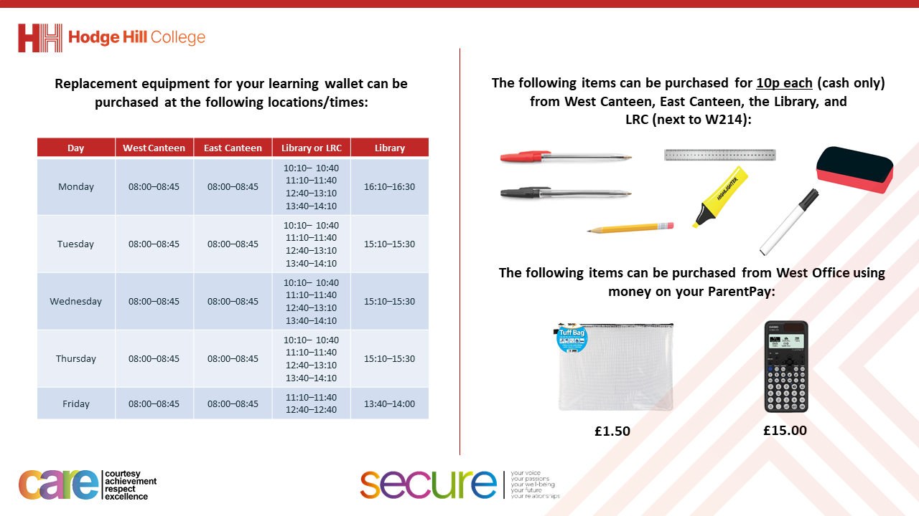

Slide 4


Secure your Relationships: Learning Journey
What makes a good friend?
What is peer pressure?
What is the difference between bullying and banter?
Are online friendship safe?
What is cyberbullying?
What are stereotypes?
Today we will look at:
Are online friendships safe?
This includes:
Definition of online relationships?
Rules around social media for children
Please remember that during the lesson we should not be asking any pupil or teacher personal questions.
Your teacher can ask you questions but this will be to check your knowledge in the lesson.

Slide 5
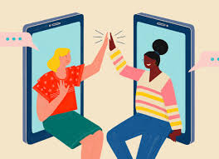
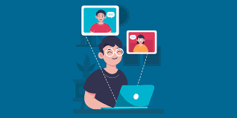

What are online friendships?
Online friendships are…
“friendships made with people through the internet”
These friendships are made on social media, gaming platforms and/or messaging apps.

Slide 6




Why are we learning about this?
This links to the Golden Thread of “Secure your Relationships“
Many people make friends with other people online. However there are some dangers in making online friends. It is important to learn how to stay safe when making online friends.

Slide 7

Why are we learning about this?
Individual Liberty is a British Value. This means everyone has the right to act and express oneself freely. This also applies online. No one should say anything online that they would not say in person.

Slide 8

Why are we learning about this?
Article 15 states that children have the right to set up and join groups. This also applies online but as long as it is within the law.
UN Rights
of a Child

Slide 9
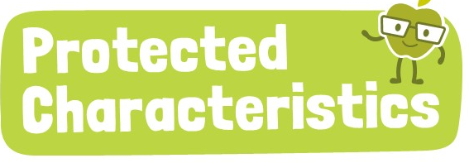
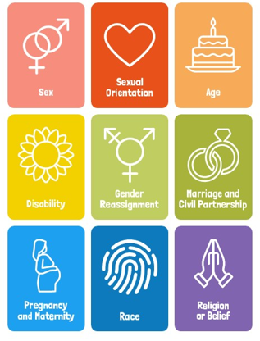
Why are we learning about this?
The Protected Characteristics ensure that no one is discriminated for identifying with one of more of the characteristics. This also applies online. No one should be discriminated online for identifying with one or more of the protected characteristics.

Slide 10
Social Media
Social Media is the main way that people form online friendships.
This includes:
Social networking apps such as Instagram and TikTok
Messaging apps such as WhatsApp and Snapchat
Gaming Platforms such as Xbox Live, Playstation Network, Roblox and Fortnite

Slide 11
Social Media
These social media apps and networks allow people to:
Stay connected with friends and family, especially those far away
Share pictures, videos, updates about their lives
To play games and connect with teammates in multiplayer games
However there are laws around the age of people who can use social media

Slide 12

Social Media Age Limits
You have 1 minute to think about the following question:
“What are the age limits to use social media in the UK?”

Slide 13
Social Media Age Limits
Using your oracy helpsheet, with the person next to you, discuss your response to the question:
“What are the age limits to use social media in the UK?”
Remember to use the sentence starters to add, build or challenge what your partner has said.
Be ready to share your discussion with the class

Slide 14
Social Media – Age Limits
Social Media Apps – must be 13 years old to have a profile.
Messaging Apps – WhatsApp is 13 years old and SnapChat is 13 years old
Gaming Platforms – Xbox Live accounts are for 13 years old and above, PlayStation Network all U18’s need parental consent, Roblox is 7 years old but there are restrictions to chat features

Slide 15
Why are there age limits
One reason there are age limits is due to issues around children speaking to other people who may not always be who they say they are.
In your Personal Development lessons this week you will be looking at are online friendship safe.

Slide 16
Reflection
Before then, think about people you have as friends or followers on social media/messaging apps/gaming networks.
The only friends/followers you have should be family and friends you know.

Slide 17



Support
If you ever need support about online friendships for yourself, a friend or family member you can find it here:
Childline.org.uk
Call – 08001111
Email or chat online for support
Themix.org.uk
You can email or have one-to-chat online.
There is also a crisis messenger which is available 24/7

