Slide 1
Thought of the Day
“No two people are the same, even if they come from the same place or look the same. Stereotypes miss what makes us unique.”
J.K. Rowling

Slide 2


Remember to complete all homework tasks on SAM Learning
We still use Classcharts for announcements, surveys and revision material
Homework Club every morning in West Canteen from 8am
Library is open before school and at break times
Students on the following slides have not completed ALL tasks
Make sure you are completing the SET TASKS! These are the tasks your teachers have set.
Notes:
Please give time for the students to produce answers for themselves before showing answers.

Slide 3
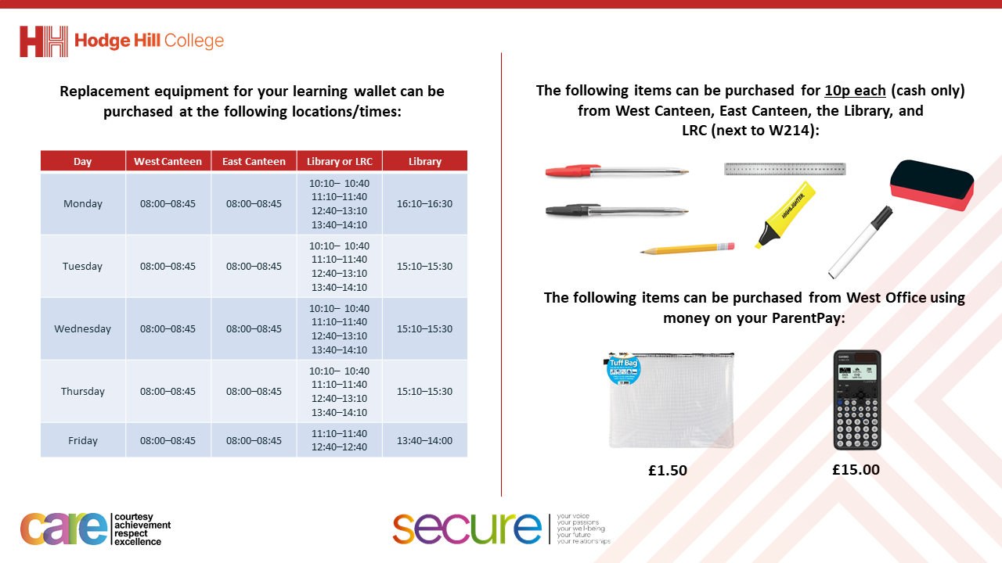

Slide 4


KIDZFIT WORKSHOPS
Don’t forget that tomorrow everyone should wear full Hodge Hill PE Kit and trainers.
Remember it is a normal school day with normal rules. Any item that is not part of the PE will be confiscated.
You must also bring all your equipment as normal including your Passport

Slide 5
KIDZFIT WORKSHOPS
Two tutor groups at a time will be taking part in the workshops.
You should go straight to West Hall when it is your turn to take part in the workshop
Period 1 – 7E1 and 7E2
Period 2 – 7E3 and 7E4
Period 3 – 7E5 and 7W1
Period 4 – 7W2 and 7W3
Period 5 – 7W4 and 7W5

Slide 6
Secure your Relationships: Learning Journey
What makes a good friend?
What is peer pressure?
What is the difference between bullying and banter?
Are online friendship safe?
What is cyberbullying?
What are stereotypes?
Today we will look at:
What are stereotypes
This includes:
Definition of stereotypes
Stereotypes and discrimination
Examples of untrue stereotypes
Please remember that during the lesson we should not be asking any pupil or teacher personal questions.
Your teacher can ask you questions but this will be to check your knowledge in the lesson.

Slide 7


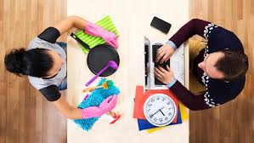
What are stereotypes?
Stereotypes are…
“a mistaken idea or belief many people think about a thing or group that is based upon how they look on the outside, which may be untrue or only partly true.”

Slide 8




Why are we learning about this?
This links to the Golden Thread of “Secure your Relationships“
Judging a person or a group of people before you get to know them cements untrue stereotypes. You can secure your relationships with people by not being judgmental and getting to know people first.

Slide 9

Why are we learning about this?
Individual Liberty is a British Value. This means that everyone is free to act and express themselves freely. It is important to not judge a person for how they act. Get to know the person to understand their view and actions even if you do not initially agree with it.

Slide 10

Why are we learning about this?
Article 2 states that children have the right to not be discriminated against. Stereotypes can lead to discrimination. It is every child’s right to not be treated unfairly for any reason.
UN Rights
of a Child

Slide 11
Examples of stereotypes
Examples of stereotypes are:
Girls are rubbish at science
Boys can’t write as good as girls
Both of these stereotypes are untrue

Slide 12

Examples of stereotypes
You have 1 minute to think about the following question:
“What other stereotypes have you heard before?”
There will be judgement on what stereotype you say!

Slide 13
Stereotypes
Using your oracy helpsheet, with the person next to you, discuss your response to the question:
“What other stereotypes have you heard before?”
Remember to use the sentence starters to add, build or challenge what your partner has said.
Be ready to share your discussion with the class

Slide 14
Stereotypes and discrimination
Stereotypes can lead to discrimination.
Discrimination is…
“unjust treated of people because of their differences or perceived differences.”

Slide 15
Stereotypes and discrimination
To stop this from happening, discrimination against certain characteristics is illegal.
This is from a law called “The Equality Act (2010)”

Slide 16
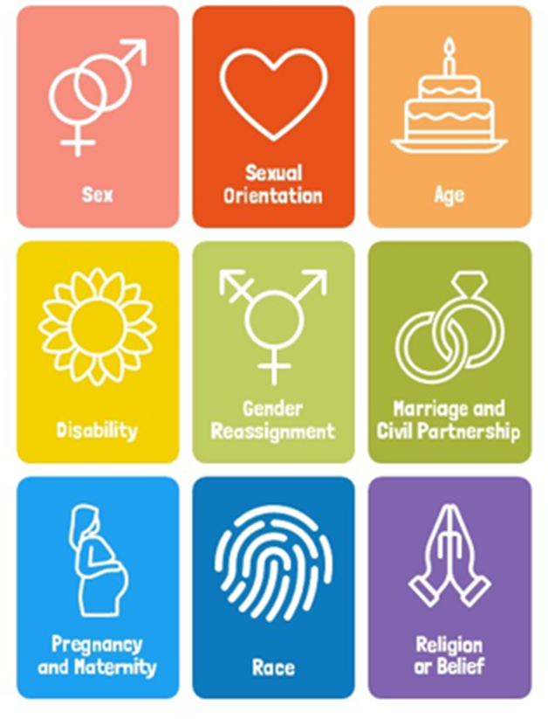
Stereotypes and discrimination
The Equality Act (2010) protects people from discrimination in the workplace and wider society.
This law applies to everyone in the UK and also online.
Where applicable all your tutor time activities and Personal Development lessons have been linked to one of these protected characteristics.

Slide 17
Stereotypes and discrimination
One protected characteristic is age.
There are lots of untrue stereotypes regarding age.
You will now discuss some age related stereotypes and explain why they are not true.

Slide 18
Age stereotypes
You have 1 minute to think about why the following stereotype is not always true:
“all old people cannot use technology right.”

Slide 19
Age stereotypes
Using your oracy helpsheet, with the person next to you, discuss your response to the question:
“why is the following stereotype not always true? “all old people cannot use technology right.””
Remember to use the sentence starters to add, build or challenge what your partner has said.
Be ready to share your discussion with the class

Slide 20
Age stereotypes
You have 1 minute to think about why the following stereotype is not always true:
“all young people are thugs and have no respect.”

Slide 21
Age stereotypes
Using your oracy helpsheet, with the person next to you, discuss your response to the question:
“why is the following stereotype not always true? “all young people are thugs and have no respect.””
Remember to use the sentence starters to add, build or challenge what your partner has said.
Be ready to share your discussion with the class

Slide 22
Age stereotypes
You have 1 minute to think about why the following stereotype is not always true:
“all young girls just cause drama.”

Slide 23
Age stereotypes
Using your oracy helpsheet, with the person next to you, discuss your response to the question:
“why is the following stereotype not always true? “all young girls just cause drama.””
Remember to use the sentence starters to add, build or challenge what your partner has said.
Be ready to share your discussion with the class

Slide 24
Reflection
It is important to not believe stereotypes.
People should challenge stereotypes in order to stop any type of discrimination.
You will be learning more about stereotypes in your Personal Development lessons this week.

Slide 25



Support
If you ever need support about stereotypes/discrimination for yourself, a friend or family member you can find it here:
Childline.org.uk
Call – 08001111
Email or chat online for support
Themix.org.uk
You can email or have one-to-chat online.
There is also a crisis messenger which is available 24/7

