Slide 1


Slide 2
Thought of the Day
“Sleep is the foundation of all good health”
Dr. Mehmet Oz

Slide 3


Slide 4


Secure your Future: Learning Journey
Making new friends
Road Safety
What is resilience
Healthy food choices
Importance of sleep
Importance of physical activity
Today we will look at:
Importance of Sleep
This includes:
What is sleep
Types of sleep
Please remember that during the lesson we should not be asking any pupil or teacher personal questions.
Your teacher can ask you questions but this will be to check your knowledge in the lesson.

Slide 5
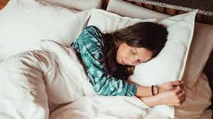
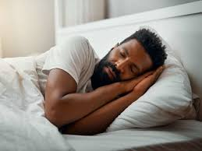
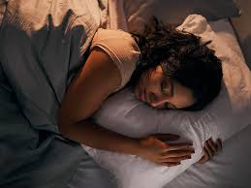
What is sleep?
Sleep is…
“a natural state that gives the body and brain time to relax”

Slide 6

How much sleep does a person need?
Using your oracy helpsheet, discuss with the person next to you:
“How much sleep should you be getting every night?
Remember we are sharing our ideas to the class and following all the advice on the oracy helpsheet.

Slide 7
How much sleep do you need?
Young people need about 9-10 hours of sleep every night.
Hands up if you got the required amount of sleep last night?

Slide 8
Types of Sleep
There are different types of sleep that people cycle through when asleep.
These are:
REM (rapid eye movement) sleep
Non-REM sleep (deep sleep)

Slide 9
REM Sleep
During this type of sleep, people have dreams. During this time, the brain is as active as when a person is awake
This sleep is important for learning and storing memories. It is like the brain is filing everything that it has learnt that day
During this sleep, the eyes move rapidly under the eyelids and the brain processes emotions and experiences to help the person prepare for the next day

Slide 10
Non-REM Sleep
This is also known as deep sleep.
This is when the body works on physical recovery and repair. This is when muscle, bones and immune system get stronger.
No dreams occur during this phase but it is crucial for feeling rested when waking up the next day.

Slide 11

Types of sleep

Slide 12

Sleep myths or facts?
Is the below statement a myth or fact?
“I can catch up on sleep during the weekend”
Myth – although a lie in might feel like it helps, it does not make up for lost sleep. Missing sleep during the week negatively impacts mood, focus and how the body grows.

Slide 13
Sleep myths or facts?
Is the below statement a myth or fact?
“Staying up late to study helps me do better”
Myth – sleep helps the brain store information and remember it the next day. Try to study earlier in the day, get a good nights sleep to help do even better in exams/tests

Slide 14
Sleep myths or facts?
Is the below statement a myth or fact?
“If I sleep too much, I’ll be lazy”
Myth – Getting enough sleep doesn’t make a person lazy – it gives energy that is required to be active during the day.

Slide 15
More about sleep
In your Personal Development lessons you will be learning much more about this topic.
Before your lesson this week, think about if you have slept well at night. When you sleep well what did you do before bed?

