Slide 1


Remember to complete all homework tasks on SAM Learning
We still use Classcharts for announcements, surveys and revision material
Homework Club every morning in West Canteen from 8am
Library is open before school and at break times
Students on the following slides have not completed ALL tasks
Make sure you are completing the SET TASKS! These are the tasks your teachers have set.
Notes:
Please give time for the students to produce answers for themselves before showing answers.

Slide 2
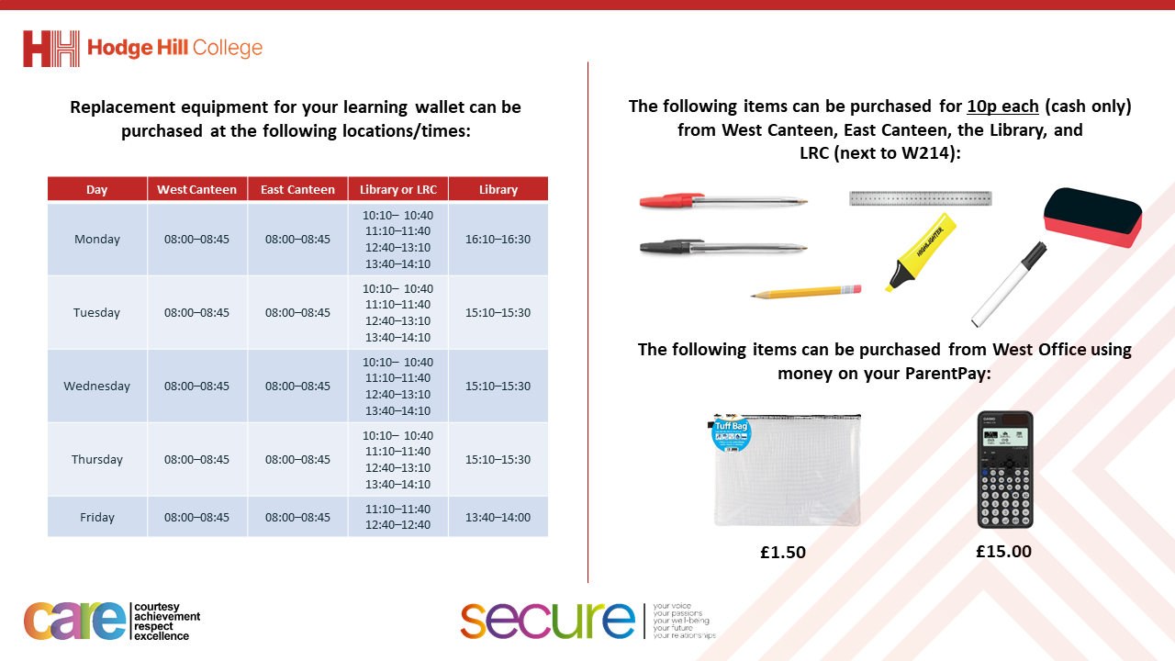

Slide 3
Thought of the Day
“The law is the glue that holds society together”

Slide 4


Secure your Future: Learning Journey
What is democracy?
Political Parties in the UK
How did the General Election work?
What does a MP do?
Who is in the UK Government?
What are laws?
Today we will look at:
What are laws?
This includes:
Definition of laws
Why laws are needed
Please remember that during the lesson we should not be asking any pupil or teacher personal questions.
Your teacher can ask you questions but this will be to check your knowledge in the lesson.

Slide 5

Why are we learning about this?
Understanding the laws and consequences of not following the law will help secure your future.
Breaking the law can result in a criminal record. This can make it more difficult to find employment opportunities and could even mean that it is impossible to get a job in certain sectors.

Slide 6

Why are we learning about this?
Rule of Law is a British Value that means “rule by the people”. All people living in the UK are expected to adhere to the law of the country in order to keep everyone safe and treated fairly.

Slide 7
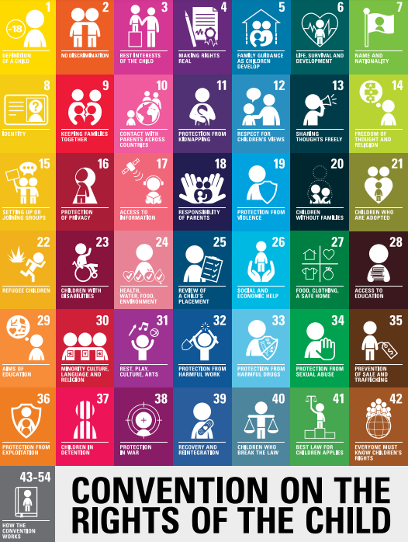
Why are we learning about this?
There is no specific article that relates to laws. However the UN Rights of a Child is an example of international law. Many countries have committed to following this law in order to keep all children safe. It is the most agreed piece of international law.
UN Rights
of a Child

Slide 8
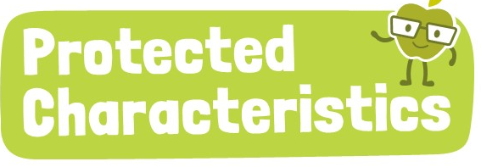
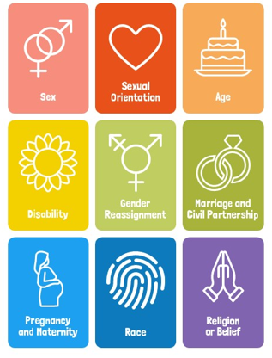
Why are we learning about this?
One example of a law is the Equality Act (2010). This law outlines 9 protected characteristics. The law states that no one should be discriminated against due to these characteristics.

Slide 9
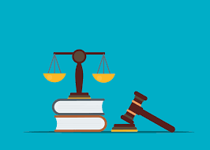

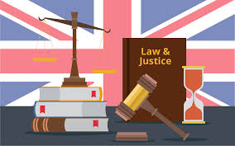
What are laws?
Laws are…
“a system of rules that a country have agreed to follow.”
Laws regulate people’s actions so if they break the law there could be penalties

Slide 10

What are laws?
Take out your oracy helpsheet from your learning wallet.
You have 1 minute to think about the following question:
“what laws are there in the UK?”

Slide 11
What are laws?
Using your oracy helpsheet, with the person next to you, discuss your response to the question:
“what laws are there in the UK?”
Remember to use the sentence starters to add, build or challenge what your partner has said.
Be ready to share your discussion with the class

Slide 12
Why are laws necessary?
Laws are necessary because:
1. Everyone is kept safe. This is achieved through laws such as speed limits, not carrying weapons, age restrictions on things like alcohol and gambling.

Slide 13
Why are laws necessary?
Laws are necessary because:
2. Everyone is treated fairly. This is shown through the Equality Act (2010) which stops people being discriminated against due to certain characteristics.

Slide 14
Why are laws necessary?
Laws are necessary because:
3. Everyone’s property is protected. This is shown through laws around theft, burglary and identity fraud.

Slide 15
Why laws are necessary?
Take out your oracy helpsheet from your learning wallet.
You have 1 minute to think about the following question:
“what would happen if there were no laws? Would people be safe, treated equally and have their property protected?”

Slide 16
Why laws are necessary?
Using your oracy helpsheet, with the person next to you, discuss your response to the question:
“what would happen if there were no laws? Would people be safe, treated equally and have their property protected?”
Remember to use the sentence starters to add, build or challenge what your partner has said.
Be ready to share your discussion with the class

Slide 17
What are laws?
In your Personal Development lesson this week you will be looking at how laws are created in the UK and if laws are the same in all countries.

