Slide 1


Remember to complete all homework tasks on SAM Learning
We still use Classcharts for announcements, surveys and revision material
Homework Club every morning in West Canteen from 8am
Library is open before school and at break times
Students on the following slides have not completed ALL tasks
Make sure you are completing the SET TASKS! These are the tasks your teachers have set.
Notes:
Please give time for the students to produce answers for themselves before showing answers.

Slide 2
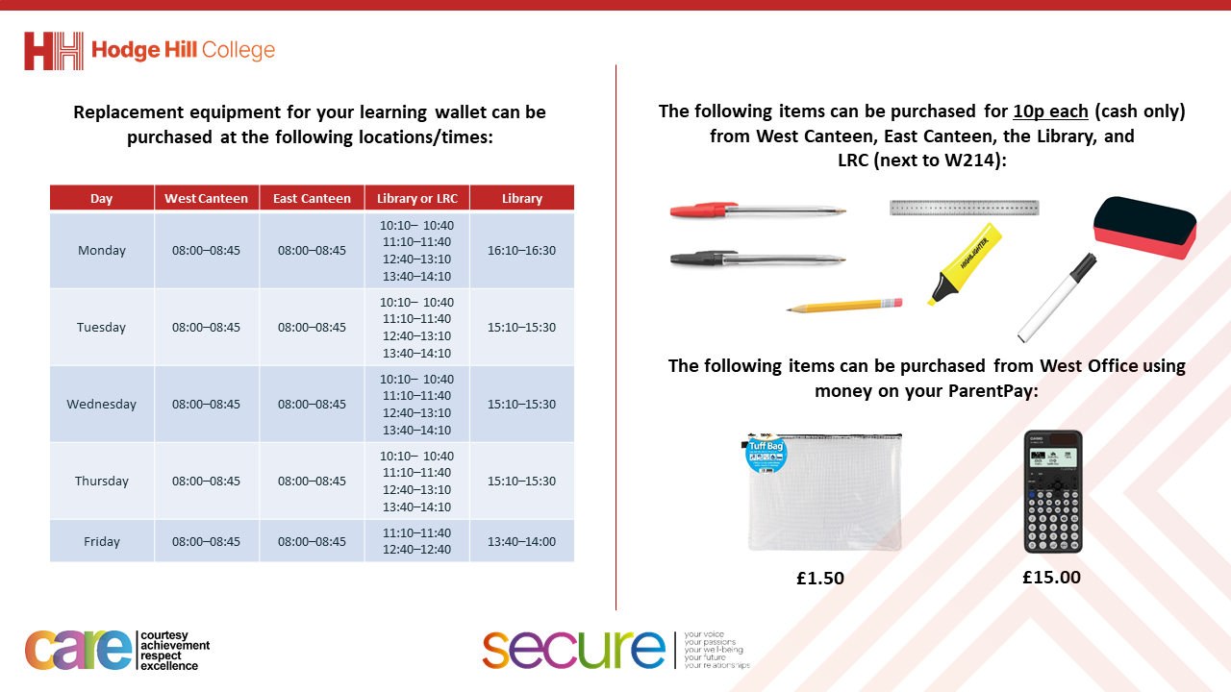

Slide 3
Thought of the Day
“A good government is one that makes the life better and fairer for all its people”
Clement Attlee (Former UK Prime Minister)

Slide 4


Secure your Future: Learning Journey
What is democracy?
Political Parties in the UK
How did the General Election work?
What does a MP do?
Who is in the UK Government?
What are laws?
Today we will look at:
Who is in the UK Government
This includes:
Structure of the UK Government
Please remember that during the lesson we should not be asking any pupil or teacher personal questions.
Your teacher can ask you questions but this will be to check your knowledge in the lesson.

Slide 5

Why are we learning about this?
It is important to learn about how politics works in the UK at a young age.
It is important to know who is in the government and what they do. This allows people to voice their approval or disapproval about what each government department is doing.
You will be more knowledgeable about the government so when you are old enough to vote you can make a more informed decision on who to vote for.

Slide 6

Why are we learning about this?
Democracy is a British Value that means “rule by the people”. All people within government have been elected by people living in the UK.

Slide 7

Why are we learning about this?
Article 17 states that Governments should ensure that children have a right to information. An example of this is learning about the positions of power in the UK government and understanding how they make decisions that impact your life and lives of everyone in the UK
UN Rights
of a Child

Slide 8
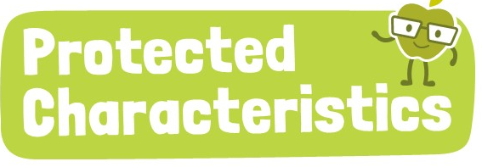
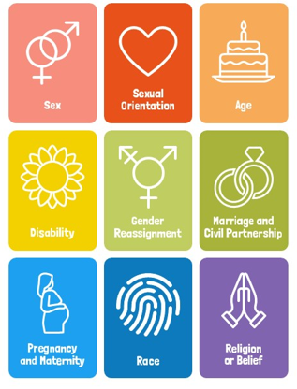
Why are we learning about this?
The decisions made by ministers in the UK Government have to ensure that none of the protected characteristics are discriminated against so everyone in the UK is treated fairly and equally

Slide 9

What does the UK Government do?
Take out your oracy helpsheet from your learning wallet.
You have 1 minute to think about the following question:
“what do you think the UK Government does?”

Slide 10
What does the UK Government do?
Using your oracy helpsheet, with the person next to you, discuss your response to the question:
“what do you think the UK Government does?”
Remember to use the sentence starters to add, build or challenge what your partner has said.
Be ready to share your discussion with the class

Slide 11
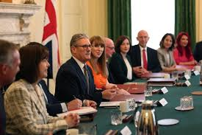
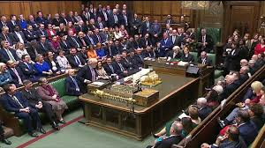
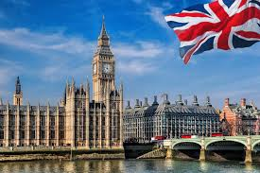
What does the UK Government do?
The UK Government is responsible for making decisions that affect everyone in the UK.
It creates and enforces law, manages public services (schools, hospitals) and ensures the safety and welfare of it’s citizens.

Slide 12
Structure of the UK Government
The UK Government is structured in the following way:
1. At the top of Government is the Monarch. This is King Charles. However they cannot make or pass laws but they do have to give the ‘final approval’. The last time a law was not approved was 1708!

Slide 13
Structure of the UK Government
The UK Government is structured in the following way:
2. Prime Minister – This is the leader of the UK Government. This is currently Sir Keir Starmer. They have overall responsibility for the policy and decisions of the government.

Slide 14
Structure of the UK Government
The UK Government is structured in the following way:
3. Cabinet Ministers (also called Secretaries of State) – These are appointed by the Prime Minister to help run the Government. This means they oversee the running of different departments. They meet each week to discuss key issues. This is called the ‘Cabinet Meeting’ There are currently 22 cabinet ministers

Slide 15
Structure of the UK Government
The UK Government is structured in the following way:
4. Ministers – Each government department ran by a cabinet minister/secretary of state is supported by ministers. They will have specific jobs within their department. There are currently 120 government ministers.

Slide 16
Structure of the UK Government
Take out your oracy helpsheet from your learning wallet.
You have 1 minute to think about the following question:
“Why do you think it is important there is a structure to Government and not just ran by one person?”

Slide 17
Structure of the UK Government
Using your oracy helpsheet, with the person next to you, discuss your response to the question:
“Why do you think it is important there is a structure to Government and not just ran by one person?”
Remember to use the sentence starters to add, build or challenge what your partner has said.
Be ready to share your discussion with the class

Slide 18
Structure of the UK Government
In your Personal Development lesson this week you will be exploring some of the government departments to see how it impacts the lives of people in the UK.

