Slide 1


Remember to complete all homework tasks on SAM Learning
We still use Classcharts for announcements, surveys and revision material
Homework Club every morning in West Canteen from 8am
Library is open before school and at break times
Students on the following slides have not completed ALL tasks
Make sure you are completing the SET TASKS! These are the tasks your teachers have set.
Notes:
Please give time for the students to produce answers for themselves before showing answers.

Slide 2
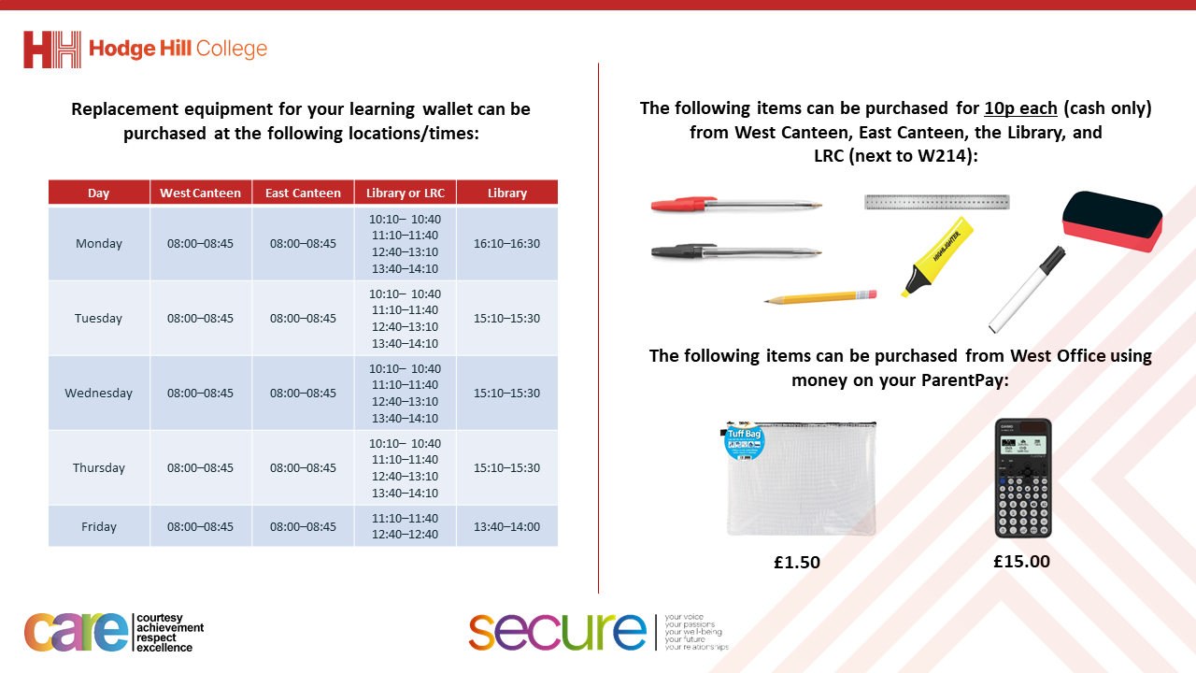

Slide 3
Thought of the Day
“An MP’s duty is to act on behalf of their community, ensuring that everyone has a voice in decisions that affect their lives”
Theresa May

Slide 4


Secure your Future: Learning Journey
What is democracy?
Political Parties in the UK
How did the General Election work?
What does a MP do?
Who is in the UK Government?
What are laws?
Today we will look at:
What does a MP do?
This includes:
What does MP stand for?
What roles do MP’s have?
Please remember that during the lesson we should not be asking any pupil or teacher personal questions.
Your teacher can ask you questions but this will be to check your knowledge in the lesson.

Slide 5

Why are we learning about this?
It is important to learn about how politics works in the UK at a young age.
Despite you not being old enough to vote, it is important to learn about how MP’s represent your local area. This can empower you to challenge your MP and have a positive impact on your community.

Slide 6

Why are we learning about this?
Democracy is a British Value that means “rule by the people”. This is important as people have voted for people to represent them and their local area. This means people have the right to see if they are being represented properly by their MP.

Slide 7

Why are we learning about this?
Article 12 states that Governments should have respect for children’s views. Although children cannot vote, they still have the human right to have their opinions and voices heard and taken seriously. Although, children do not vote, MP’s still represent the children in their constituency and they should be making decisions that protect and empower children to reach their potential.
UN Rights
of a Child

Slide 8
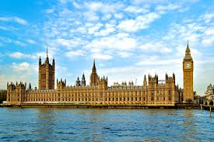
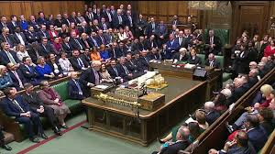
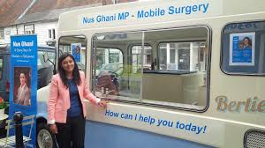
Context to the lesson
Over the last few weeks we have looked at different political parties and how the General Election worked in July 2024.
Each political party wants their candidate in each constituency (area) to win. This means that the winner becomes the MP for that constituency.
The political party with the most MP’s form the Government and the leader of the political party becomes Prime Minister.
But what is a MP and what do they do?

Slide 9

What does a MP do?
Take out your oracy helpsheet from your learning wallet.
You have 1 minute to think about the following question:
“what do you think a MP does?”

Slide 10
What political parties do you know?
Using your oracy helpsheet, with the person next to you, discuss your response to the question:
“what do you think a MP does?”
Remember to use the sentence starters to add, build or challenge what your partner has said.
Be ready to share your discussion with the class

Slide 11
What does MP stand for?
MP stands for “Member of Parliament”
There are 650 MP’s voted into Parliament. Each MP gets a “seat” in Parliament which is called the House of Commons which is the Houses of Parliament, Westminster, London
This is important to know as this means each political party is hoping to win at least 326 seats in Parliament.
This means that this political party can form the UK Government.

Slide 12
What roles do MP’s have?
As a MP is elected by local people in a constituency, MP’s have the role of representing their consistency in the House of Commons.
A picture of the House is Commons is here. You may recognise this from the news
The House of Commons is an important place for MP’s as this is where they can debate different laws and policies that will impact their constituency.
Don’t forget that the House of Commons is in London. This means that MP’s have to split their time between going to London and being present in their local constituency

Slide 13
What roles do MP’s have?
MP’s have the following roles:
1. Represent their constituents (people from their local area)

Slide 14
What roles do MP’s have?
MP’s have the following roles:
2. Support the work of a Government department. Examples of departments are Education, Health, Environment, Defence, Justice

Slide 15
What roles do MP’s have?
MP’s have the following roles:
3. Meet constituents to discuss issues they are facing

Slide 16
What roles do MP’s have?
MP’s have the following roles:
4. Campaign during elections for their party

Slide 17
What roles do MP’s have?
MP’s have the following roles:
5. Support the law making process

Slide 18
What roles do MP’s have?
MP’s have the following roles:
6. Ask questions to and challenge the Prime Minister and other Government representatives in the House of Commons

Slide 19
What roles do MP’s have?
MP’s have the following roles:
7. Visit places of interest in their constituency such as schools, hospitals and businesses

Slide 20
What roles do MP’s have?
Depending on what a MP has to do during the day will depend where they will complete their tasks.
Sometimes their role will mean that they have to be present in the House of Commons in London which can involve a lot of travelling.
Other times they may stay in their constituency to complete their roles.
Depending on that the task involves, it may require complete elements of the task in both their constituency and in the House of Commons in London.
On the next slide you will have to decide where their different roles are completed.

Slide 21
What roles do MPs have?
Represent their constituents (people from their local area)
Support the work of a Government department (Education, Health, Defence)
Meet constituents to discuss issues they are facing
Campaign during elections for their party
Support the law making process
Ask questions of the Prime Minister in the House of Commons
Visit places of interest in their constituency (schools, hospitals, businesses)
CONSTITUENCY
HOUSE OF COMMONS
BOTH

