Slide 1


Remember to complete all homework tasks on SAM Learning
We still use Classcharts for announcements, surveys and revision material
Homework Club every morning in West Canteen from 8am
Library is open before school and at break times
Students on the following slides have not completed ALL tasks
Make sure you are completing the SET TASKS! These are the tasks your teachers have set.
Notes:
Please give time for the students to produce answers for themselves before showing answers.

Slide 2
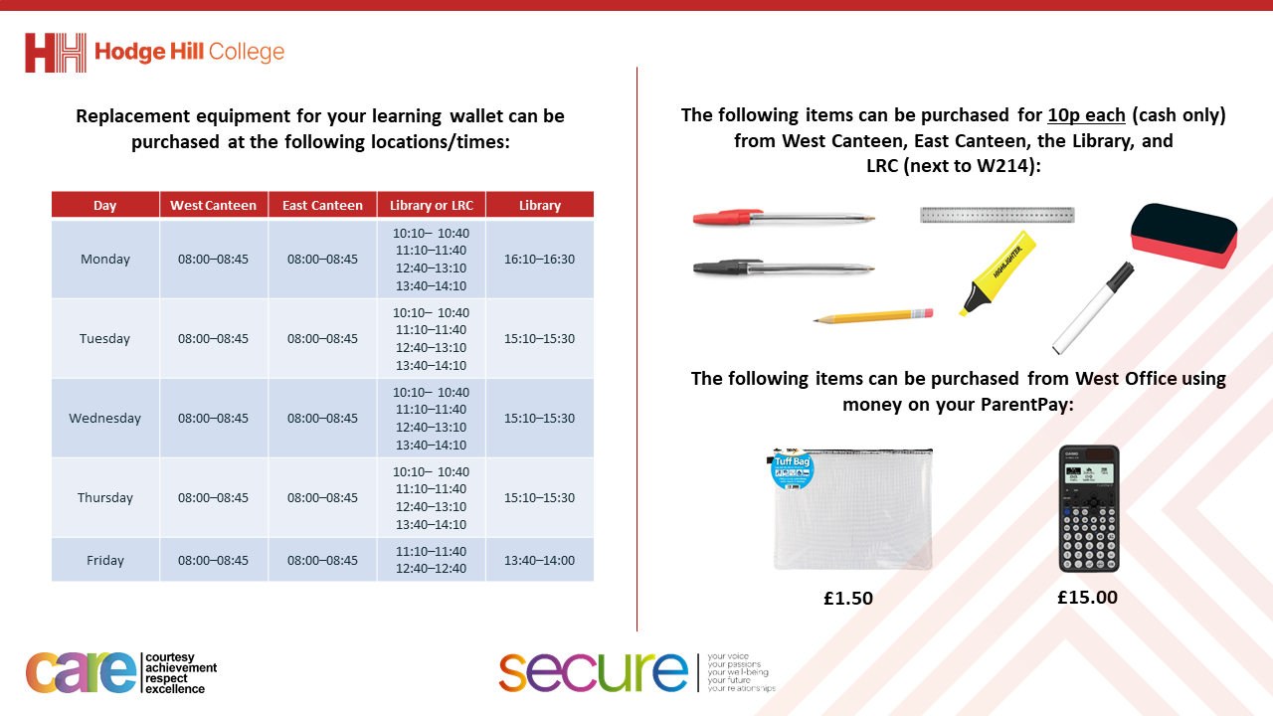

Slide 3
Thought of the Day
“Friends are the only family you choose”
Jess C. Scott

Slide 4


Secure your Relationships: Learning Journey
What makes a good friend?
What is peer pressure?
What is the difference between bullying and banter?
Are online friendship safe?
What is cyberbullying?
What are stereotypes?
Today we will look at:
What makes a good friend
This includes:
Qualities of a good friend
Why friendship matters
Are friendships always perfect?
Please remember that during the lesson we should not be asking any pupil or teacher personal questions.
Your teacher can ask you questions but this will be to check your knowledge in the lesson.

Slide 5
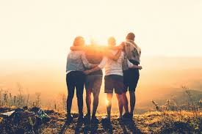
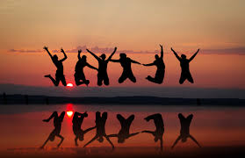
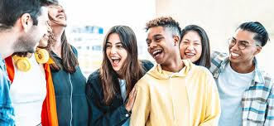
What is friendship?
Friendship is…
“a close relationship between 2 or more people who care about and support each other”

Slide 6




Why are we learning about this?
This links to the Golden Thread of “Secure your Relationships“
Friends are an important aspect of life as having secure friendships can benefit physical and mental health.
Knowing what a good friend is will help you to secure your current friendships and also with new friendships you make in the future.

Slide 7

Why are we learning about this?
Individual Liberty is a British Value. This means everyone has the right to believe, act and express oneself freely. A good friend will respect a person doing this and will not force them to be someone they are not.

Slide 8
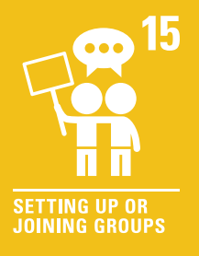
Why are we learning about this?
Article 15 states that children have the right to meet with friends and join groups. This means that children have the right to freedom of association so they can choose who they are friends with. Friendship cannot be forced upon a child.
UN Rights
of a Child

Slide 9
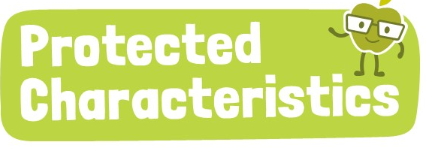
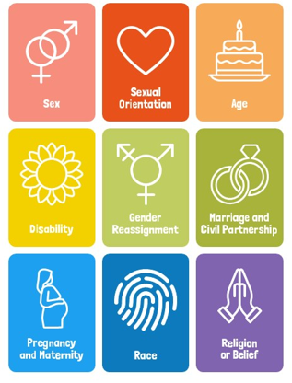
Why are we learning about this?
The protected characteristics outline things people should not be discriminated for. Friends will not treat another friend differently due to their differences, instead they will celebrate them

Slide 10

Being a good friend
Notes:
https://www.youtube.com/watch?v=QPLgtZLx9UE

Slide 11

What makes a good friend?
You have 1 minute to think about the following question:
“what makes a person a good friend?”

Slide 12
What makes a good friend?
Using your oracy helpsheet, with the person next to you, discuss your response to the question:
“what makes a person a good friend?”
Remember to use the sentence starters to add, build or challenge what your partner has said.
Be ready to share your discussion with the class

Slide 13
Why friendship matters
Humans are social beings. This means we all like it when we are surrounded by others.
Friendships offers opportunities to feel connected to other people, that are not family members. This means that people have better support networks to rely on when they are having a difficult time.

Slide 14
Why friendship matters
Ultimately, friendships make life more enjoyable, help us through difficult times and teach important life skills.
Many pupils may say the best thing about being at school is seeing their friends. This shows that friendships make your day better at school.

Slide 15
Why friendships matter
You have 1 minute to think about the following question:
“How would life be different, if you could not see your friends?”

Slide 16
What are laws?
Using your oracy helpsheet, with the person next to you, discuss your response to the question:
“How would life be different, if you could not see your friends?”
Remember to use the sentence starters to add, build or challenge what your partner has said.
Be ready to share your discussion with the class

Slide 17
Why friendship matters
In your Personal Development lessons this week you will be learning more about what makes a good friend and are friendships always perfect?

