Slide 1
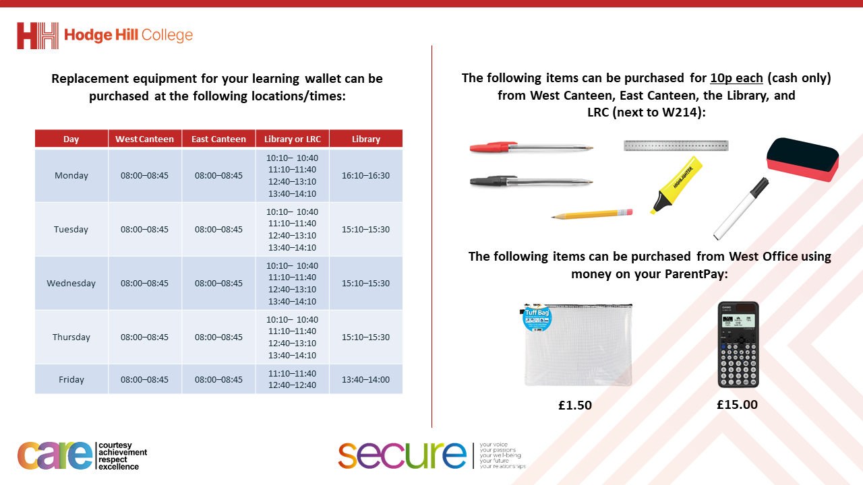

Slide 2
Thought of the Day
“We are stronger together. In a democracy, every voice matters”

Slide 3




Slide 4
Secure your Future: Learning Journey
What is democracy?
Political Parties in the UK
What are laws?
How did the General Election work?
What do MP’s do everyday?
What would you do as a MP?
Today we will look at:
What is democracy?
This includes:
Definition of democracy
Democracy in the UK
Quiz
Please remember that during the lesson we should not be asking any pupil or teacher personal questions.
Your teacher can ask you questions but this will be to check your knowledge in the lesson.

Slide 5

What is democracy?
Using your oracy helpsheet, discuss with the person next to you:
“What is democracy? Where have you heard the term before?”
Remember we are sharing our ideas to the class and following all the advice on the oracy helpsheet.

Slide 6


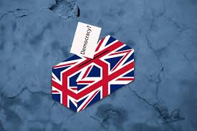
What is democracy?
Democracy is..
“rule by the people”
This means that in countries that follow democracy, the people elect the government and have a say in how the country is run.
This means that it is a fair system that ensure everyone in that country has a voice

Slide 7

What is democracy?
Watch the video to learn more about democracy
Notes:
https://www.youtube.com/watch?v=u6jgWxkbR7A

Slide 8
Democracy in the UK
Democracy is a British Value.
This means in the UK there is a culture built upon freedom and equality, where everyone is aware of their rights and responsibility.
This is why British Values, URC Children Rights and Protected Characteristics are included in our news discussions in Tutor Time.

Slide 9
Democracy in the UK
Examples of democracy in the UK:
1. Parliament – The UK has a Parliament with 2 houses – the House of Commons and the House of Lords. They are responsible for lots of things but they also help to make laws that keep everyone in the UK safe

Slide 10
Democracy in the UK
Examples of democracy in the UK:
2. Prime Minister – The leader of the Government is the Prime Minister. This is the leader of the political party that has the most Members of Parliament (MPs)

Slide 11
Democracy in the UK
Examples of democracy in the UK:
3. Members of Parliament (MP’s) – These are people elected to represent their local areas (called constituencies) in the House of Commons

Slide 12
Democracy in the UK
Examples of democracy in the UK:
4. Local Councils – In addition to national government, there are local councils that make decisions for the towns and cities within their council area. Members of the council are also elected.

Slide 13
Hinge Questions – whiteboard activity
3
Rules!
I will ask the question and give you some thinking time. (no more than 10 seconds)
Write the answer and turn your whiteboard over so nobody can see it.
When I am ready I will put on the 3 to 1 counter.
When ‘Show me’ appears on the board you must hold up your whiteboard (even if you don’t know the answer and there is nothing on your board)
2
1
Show me!
(even if your whiteboard is blank)

Slide 14
Hinge Questions – whiteboard activity
What democratic votes happened this year in the West Midlands?
Local council votes including electing the Mayor of West Midlands
General Election to vote on what political party runs the Government

Slide 15
Hinge Questions – whiteboard activity
Who is the Mayor of West Midlands?
Richard Parker

Slide 16
Hinge Questions – whiteboard activity
What political party is in charge of the government?
Labour

Slide 17
Hinge Questions – whiteboard activity
Who is the UK Prime Minister?
Sir Keir Starmer

Slide 18
Hinge Questions – whiteboard activity
Who was the previous UK Prime Minister?
Rishi Sunak

Slide 19
Hinge Questions – whiteboard activity
Where are the Houses of Parliament in the UK?
Westminister, London

Slide 20
Hinge Questions – whiteboard activity
Where does the Prime Minister live in London?
10 Downing Street

