Slide 1


Remember to complete all homework tasks on SAM Learning
We still use Classcharts for announcements, surveys and revision material
Homework Club every morning in West Canteen from 8am
Library is open before school and at break times
Students on the following slides have not completed ALL tasks
Make sure you are completing the SET TASKS! These are the tasks your teachers have set.
Notes:
Please give time for the students to produce answers for themselves before showing answers.

Slide 2
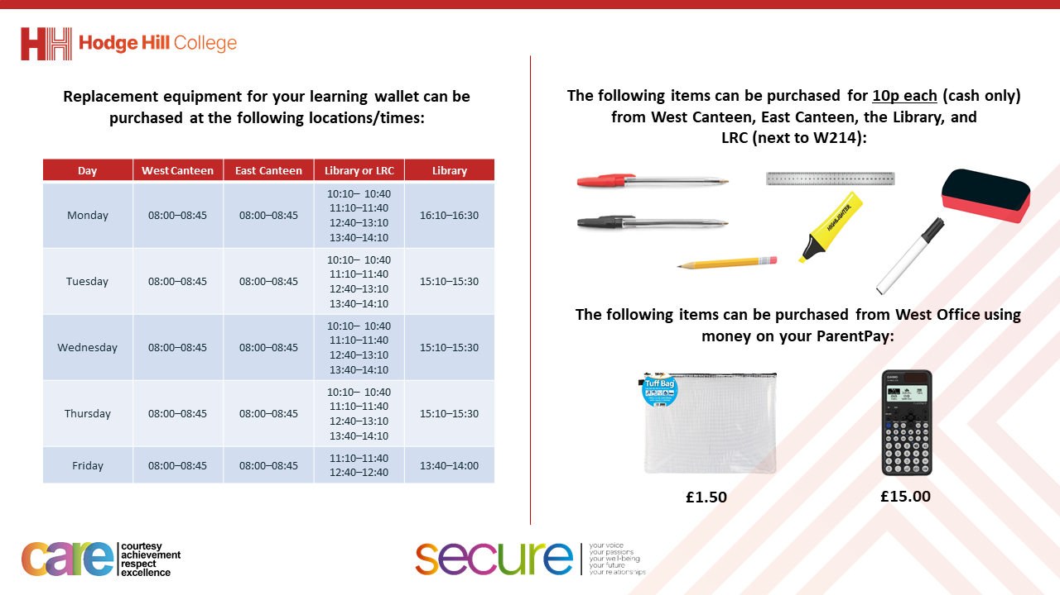

Slide 3

Hodgehill’s Got
Talent!
This Wednesday, Year 7 will be watching ‘Hodgehill’s Got Talent’ instead of your lesson during period 4. Please make sure to muster instead of going to your lesson and enjoy the show!

Slide 4
Thought of the Day
“Be a leader, not a follower”

Slide 5


Secure your Relationships: Learning Journey
What makes a good friend?
What is peer pressure?
What is the difference between bullying and banter?
Are online friendship safe?
What is cyberbullying?
What are stereotypes?
Today we will look at:
What is peer pressure?
This includes:
What is peer pressure?
Example of peer pressure happening
Please remember that during the lesson we should not be asking any pupil or teacher personal questions.
Your teacher can ask you questions but this will be to check your knowledge in the lesson.

Slide 6
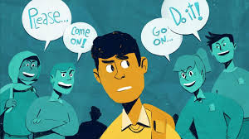
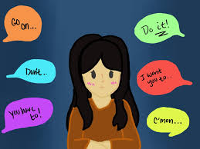
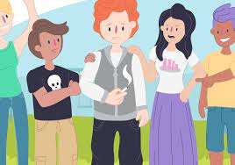
What is peer pressure?
Peer pressure is…
“being influenced by other people (peers) to act in a certain way”

Slide 7




Why are we learning about this?
This links to the Golden Thread of “Secure your Relationships“
Being part of a group is an important part of being a young person. However it is important to retain your individuality and not act the way expected of the group.
Learning about peer pressure helps to secure relationships with other people while maintaining your own values.

Slide 8

Why are we learning about this?
Individual Liberty is a British Value. This means everyone has the right to act and express oneself freely. No one should be forced or feel under pressure to act in a way that they are not comfortable with or that does not reflect their character

Slide 9
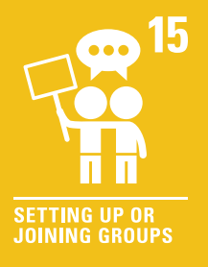
Why are we learning about this?
Article 15 states that children have the right to meet with friends and join groups. However this is only a right if it does not harm other people. This means that if peer pressure leads to negative consequences, this is not a right and it is impacting other children’s rights.
UN Rights
of a Child

Slide 10

What is peer pressure?
You have 1 minute to think about the following question:
“Is peer pressure when a pupil is told to do something by a teacher?”

Slide 11
What is peer pressure?
Using your oracy helpsheet, with the person next to you, discuss your response to the question:
“Is peer pressure when a pupil is told to do something by a teacher?”
Remember to use the sentence starters to add, build or challenge what your partner has said.
Be ready to share your discussion with the class

Slide 12

What is peer pressure?
This is an example of peer pressure
Notes:
https://www.youtube.com/watch?v=aOOsfkM-nGQ

Slide 13
What is peer pressure?
You have 1 minute to think about the following question:
“Why do you think Nadia turned round to face the ‘wrong’ way in the lift?”

Slide 14
What is peer pressure?
Using your oracy helpsheet, with the person next to you, discuss your response to the question:
“Why do you think Nadia turned round to face the ‘wrong’ way in the lift?”
Remember to use the sentence starters to add, build or challenge what your partner has said.
Be ready to share your discussion with the class

Slide 15
What is peer pressure?
You have 1 minute to think about the following question:
“What do you think you would do if you were in Nadia’s position?”

Slide 16
What is peer pressure?
Using your oracy helpsheet, with the person next to you, discuss your response to the question:
“What do you think you would do if you were in Nadia’s position?”
Remember to use the sentence starters to add, build or challenge what your partner has said.
Be ready to share your discussion with the class

