Slide 1


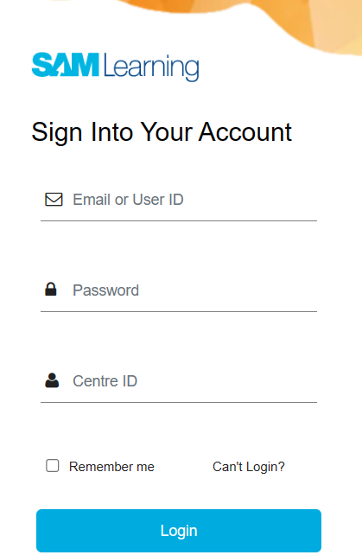

Tutor Notice
Homework will start today for Year 7 Monday 16th September
You will go on to SAM Learning and click on Set Tasks to see all your tasks.
You will receive Homework on a weekly basis so you need to log in and complete work every week.
If you need help or access to a computer/device there is:
Homework Club every morning in West Canteen from 8am onwards.
Library computers available every break time and afterschool
You will receive log in information this week to put into your passports.
Any issues please come see Mrs Shaheen in W309
USER ID will be your Date of Birth followed by your initials
PASSWORD will be the same as your USERID
Centre ID : B36HH2
Notes:
https://www.youtube.com/watch?v=QYmr9pVtryo

Slide 2


Slide 3
Secure your Future: Learning Journey
Making new friends
Road Safety
What is resilience
Healthy food choices
Importance of sleep
Importance of physical activity
Today we will look at:
Road Safety
This includes:
Looking at different scenarios to decide if they are safe or not
Please remember that during the lesson we should not be asking any pupil or teacher personal questions.
Your teacher can ask you questions but this will be to check your knowledge in the lesson.

Slide 4

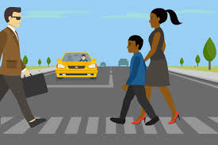
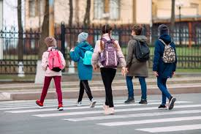
Road Safety
This week are looking at road safety.
This is an important topic as many of you will be walking to school on your own for the first time.
It is important to use the roads properly so you arrive at school and return from school safely

Slide 5
Road Safety
We are going to look at different scenarios.
After each scenario you will discuss how risky each scenario is. You will do this by giving a score out of 10 (1 being the least risky, 10 being the highest level of risk).
You should have your oracy helpsheet in front of you to help with your discussion

Slide 6

Road Safety Scenario
You have 1 minute to discuss the following scenario
“Crossing the road when a green man is not showing”
Remember to listen to your partners score and reason. You can then respond with your own score and reason.
Be ready to share your partners score and reason with the class

Slide 7
Road Safety Scenario
You have 1 minute to discuss the following scenario
“Listening to music when crossing the road”
Remember to listen to your partners score and reason. You can then respond with your own score and reason.
Be ready to share your partners score and reason with the class

Slide 8
Road Safety Scenario
You have 1 minute to discuss the following scenario
“Using a phone (texting, scrolling on social media) when crossing the road”
Remember to listen to your partners score and reason. You can then respond with your own score and reason.
Be ready to share your partners score and reason with the class

Slide 9
Road Safety Scenario
You have 1 minute to discuss the following scenario
“not crossing the road at a designated crossing point”
Remember to listen to your partners score and reason. You can then respond with your own score and reason.
Be ready to share your partners score and reason with the class

Slide 10
Road Safety Scenario
You have 1 minute to discuss the following scenario
“cycling on the pavement”
Remember to listen to your partners score and reason. You can then respond with your own score and reason.
Be ready to share your partners score and reason with the class

Slide 11

Road Safety
What are the rules safe steps outlined in the video for staying safe while walking alongside a road

Slide 12
Road Safety - Reflection
You will be learning more about road safety in your Personal Development lesson this week.
Before this lesson reflect on how safe you are walking to and from school.
Is there anyway you could be more safe?

