Slide 1


Slide 2


Secure your Future: Learning Journey
Making new friends
Getting to school safely
What is resilience
Healthy food choices
Importance of sleep
Importance of physical activity
Today we will look at:
Making friends
This includes:
Qualities of a good friend
Please remember that during the lesson we should not be asking any pupil or teacher personal questions.
Your teacher can ask you questions but this will be to check your knowledge in the lesson.

Slide 3
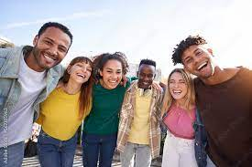
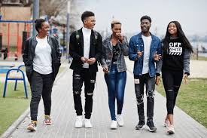
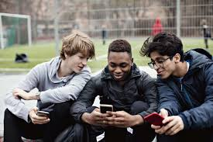
Friendship
Research shows that having stable and healthy friendship is good for your physical and mental well being.
Everyone looks forward to spending time with their friends.
In school being with your friends at break time may be the highlight of your day because you value the time you get to spend with your friends outside of the classroom

Slide 4
What makes a good friend?
A good friend has many characteristics
A characteristic in this context is a feature or quality of a person
With the person next to you discuss as many characteristics you can thing off that make a good friend.
Be ready to share your answers with the class

Slide 5

What makes a good friend?
What are the top 10 characteristics of a good friend?
Notes:
https://www.youtube.com/watch?v=OQ8imwnRSyc play from beginning to 2:48

Slide 6
What makes a good friend?
The 10 characteristics of a good friend are:
Honesty
Loyalty
Kindness
Respect
Support
Trust
Communication
Individuality
Growth
Humour
Task
What are the top 3 qualities you look for in a friend?
Why?
Be ready to share your answers with the class

