Slide 1


Remember to complete all homework tasks on SAM Learning
We still use Classcharts for announcements, surveys and revision material
Homework Club every morning in West Canteen from 8am
Library is open before school and at break times
Students on the following slides have not completed ALL tasks
Make sure you are completing the SET TASKS! These are the tasks your teachers have set.
Notes:
Please give time for the students to produce answers for themselves before showing answers.

Slide 2
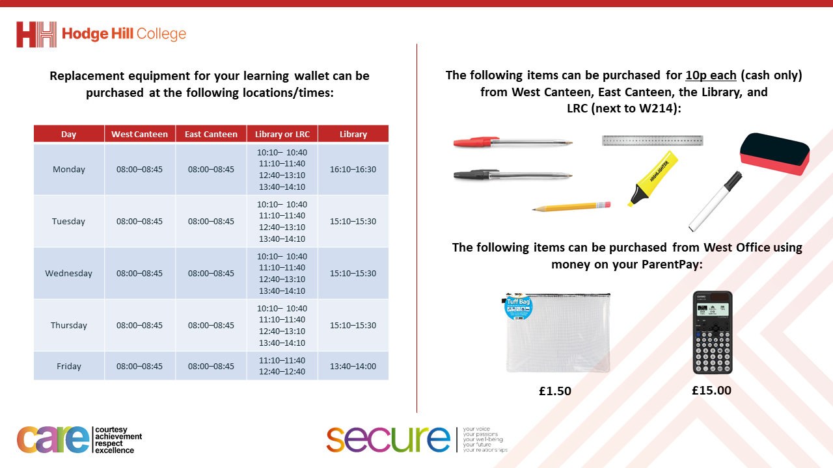

Slide 3
Thought of the Day
“Your vote is your voice”
Laung Ung

Slide 4


Secure your Future: Learning Journey
What is democracy?
Political Parties in the UK
How did the General Election work?
What is a MP?
What do MP’s do everyday?
What are laws?
Today we will look at:
How did the UK General Election work?
This includes:
What is a constituency
What were the results in the Hodge Hill and North Solihull consistuency?
Please remember that during the lesson we should not be asking any pupil or teacher personal questions.
Your teacher can ask you questions but this will be to check your knowledge in the lesson.

Slide 5

Why are we learning about this?
It is important to learn about how politics works in the UK at a young age.
Despite you not being old enough to vote, it is important to learn about this now so that when you are 18 you are equipped with the knowledge and understanding to vote for a political party that has the same beliefs and values as you

Slide 6

Why are we learning about this?
Democracy is a British Value that we learn about before half term. This mean “rule by people” as this happens by people being able to freely vote for a political party to represent them in Government

Slide 7

Why are we learning about this?
Article 12 states that Governments should have respect for children’s views. Although children cannot vote, they still have the human right to have their opinions and voices heard and taken seriously. An example of how this happens in the UK is the UK Youth Parliament which gives young people access to the policy making process to be the voice of young people in the UK.
UN Rights
of a Child

Slide 8
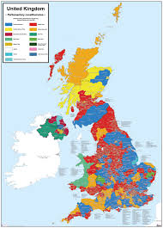
How elections work
During elections, people (known formally as constituents) vote for a person to represent their local area (known formally as a constituency) in Government.
There 650 constituencies in the UK.

Slide 9
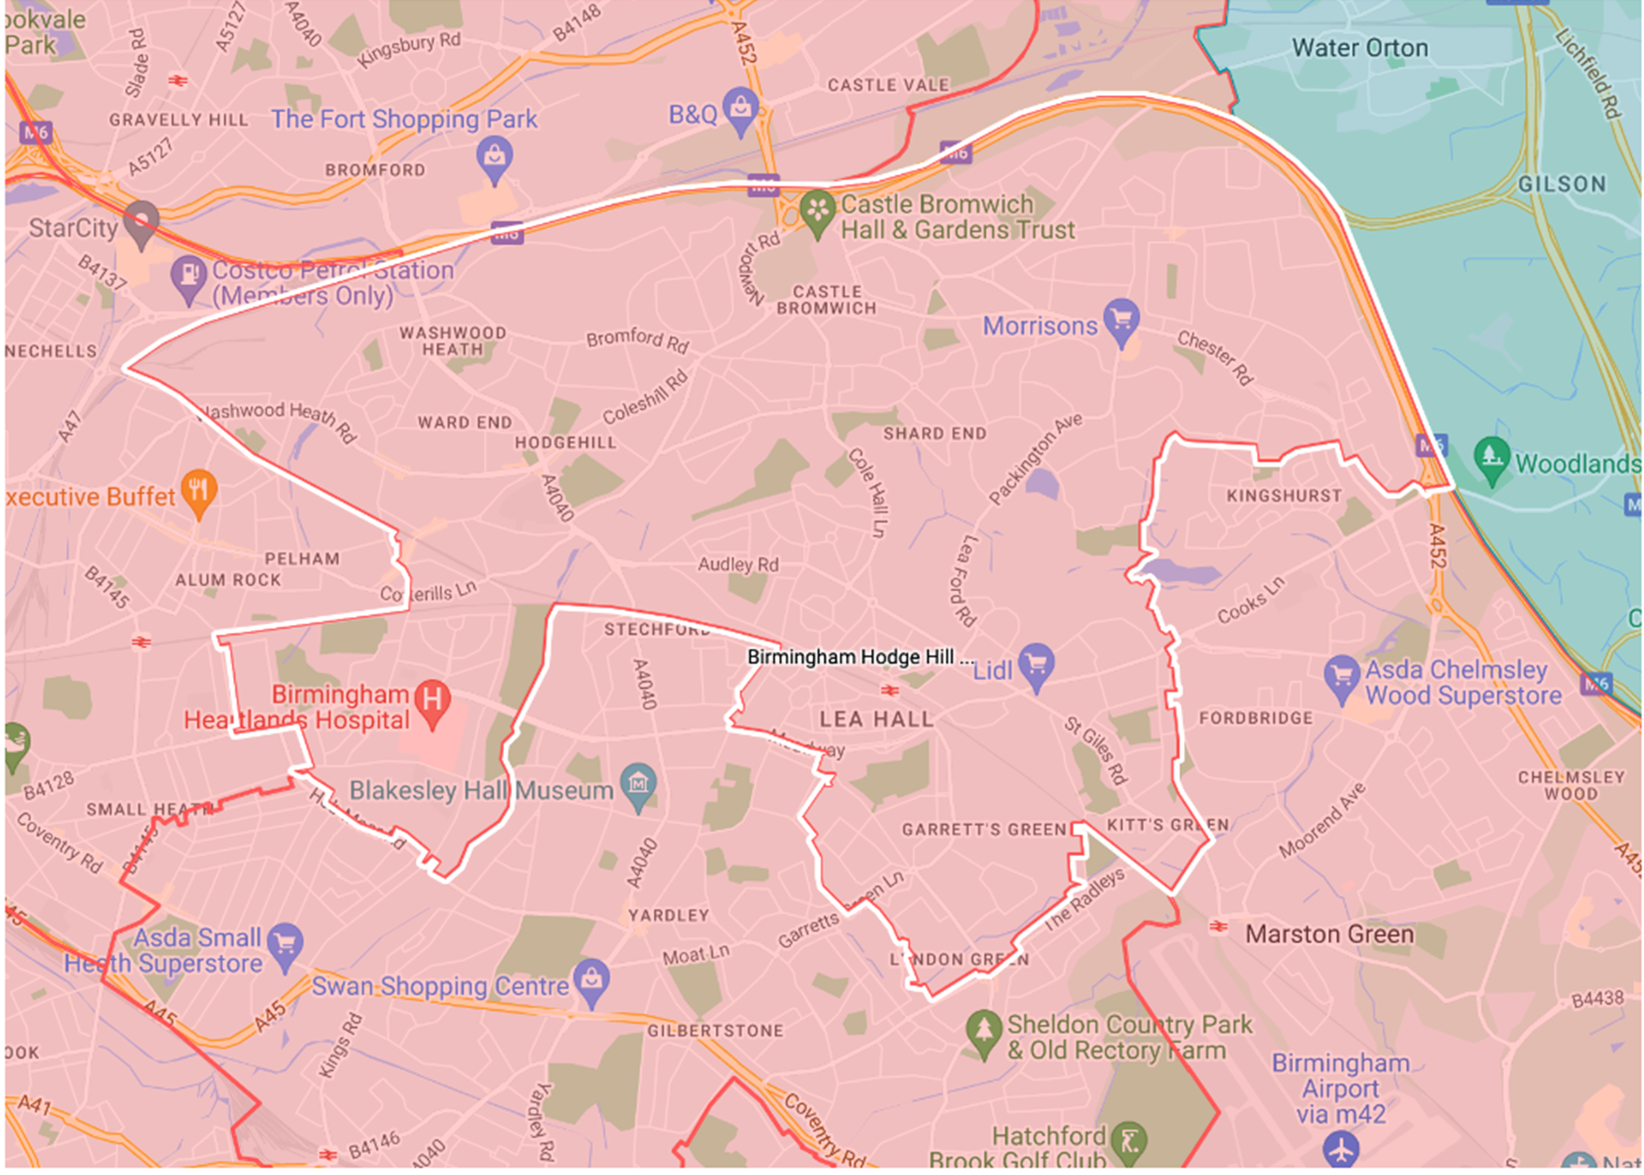
What is our constituency?
Hodge Hill College is part of the “Hodge Hill and North Solihull” constituency.
The General Election in July 2024 was the first time this constituency existed, after constituency borders were changed after the previous General Election in 2019.
The constituency borders are shown by the white line.

Slide 10

Who could people vote for in the constituency?
The Conservative candidate was Caroline Clapper
Some things that the Conservative’s say they will do in Government are:
Cut more tax so people have more money to spend
Recruit more doctors and nurses to help reduce the waiting times
Help the climate by getting to “net zero” – this means no longer adding to the total amount of greenhouse gases in the atmosphere
Ban mobile phones during the school day in all schools
Stop illegal immigration and reduce the total immigration levels in the UK

Slide 11

Who could people vote for in the constituency?
The Labour candidate was Liam Byrne. Liam Byrne was the MP for the former constituency that included Hodge Hill
Some things that Labour say they will do in Government are:
Not increase tax such as income tax and national insurance
Reduce waiting times in the NHS through more appointments, operations and scans
Create Great Britain Energy which will invest in new renewable energy projects
Recruit 6,500 new teachers and mental health support in all secondary school
Set up a new border security command to target the criminal gangs helping illegal immigrants into the UK

Slide 12

Who could people vote for in the constituency?
The Liberal Democrats candidate was Qasim Mohammed Esak
Some things that Liberal Democrats say they will do in Government are:
Get overall debt falling by ensuring day-to-day spending does not exceed that brought in by tax
Recruit 8,000 more GP’s so everyone can see a GP within 7 days
Ensure 90% of all electricity is from renewable sources by 2030.
Every school will have a qualified mental health professional
Reduce the salary threshold for skilled visas to help bring people with the right skills to the UK

Slide 13

Who could people vote for in the constituency?
The Green Party candidate was Imran Ali Khan
Some things that The Green Party say they will do in Government are:
Introduce a wealth tax on those who assets over £10 million
Spend £50 billion on health and social care per year to help the NHS
Help the climate through building new footpaths and cycle paths. Banning flights that would take less than 3 hours by train
End high stakes testing such as GCSE’s
Remove minimum income levels for spouses (husband/wife) of those who have work visas in the UK

Slide 14

Who could people vote for in the constituency?
The Reform UK candidate was Jamie Pullin
Some things that Reform UK say they will do in Government are:
Raise the minimum tax threshold from £12,550 to £20,000 so people have more money
Aim to get to zero NHS waiting lists in 2 years
Fast track more oil and gas licenses and not work towards getting to “net zero”
Make school curriculums more patriotic
Freeze non essential immigration and deport foreign nationals with criminal convictions

Slide 15

Who could people vote for in the constituency?
The Workers Party for Britain candidate was James Giles.
Some things that Workers Party for Britain say they will do in Government are:
Raise the minimum tax threshold from£12,550 to £21,200 so people have more money
Ensure the NHS is nationalised and reduce the use of private hospitals
Have a referendum of “net zero” to highlight who will benefit financially from net zero
Have free public transport for all children and have free breakfast and lunch meals for all children
Review immigration policy to have fair visa and citizenship arrangements to discourage illegal immigration

Slide 16

Who would you vote for?
Take out your oracy helpsheet from your learning wallet.
You have 1 minute to think about the following question:
“who would you vote for?”

Slide 17
What political parties do you know?
Using your oracy helpsheet, with the person next to you, discuss your response to the question:
“Who would you vote for?”
Remember to use the sentence starters to add, build or challenge what your partner has said.
Be ready to share your discussion with the class

Slide 18
What were the results?
The results of the UK General Election in the Hodge Hill and North Solihull constituency was:
Liam Byrne, Labour – 31.2% of the votes
James Giles, Workers Party for Britain – 26.6% of the votes
Jamie Pullin, Reform UK – 18.9% of the votes
Caroline Clapper, Conservatives – 13.6% of the votes
Imran Khan, Green Party – 6.9% of the votes
Qasim Esak, Liberal Democrats – 2.8% of the votes

Slide 19
Election results
Take out your oracy helpsheet from your learning wallet.
You have 1 minute to think about the following question:
“Are you surprised by who was voted for in this constituency?”

Slide 20
What political parties do you know?
Using your oracy helpsheet, with the person next to you, discuss your response to the question:
“Are you surprised by who was voted for in this constituency?”
Remember to use the sentence starters to add, build or challenge what your partner has said.
Be ready to share your discussion with the class

