Slide 1
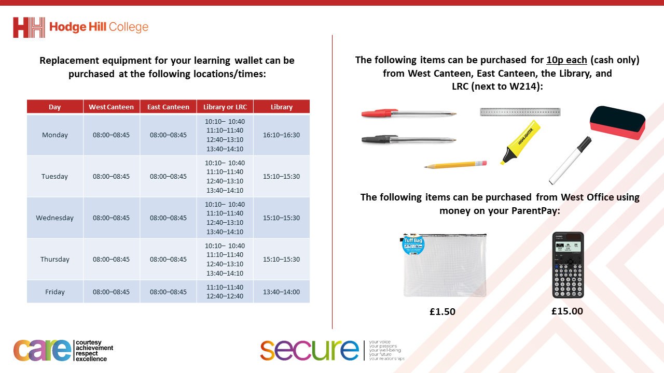

Slide 2
Thought of the Day
“Movement is a medicine for creating change in a person’s physical, emotional and mental states”
Carol Welch

Slide 3


Slide 4


Secure your Future: Learning Journey
Making new friends
Road Safety
What is resilience
Healthy food choices
Importance of sleep
Importance of physical activity
Today we will look at:
Importance of physical activity
This includes:
What is physical activity
What types of physical activity are there
Where can you be physically active?
Please remember that during the lesson we should not be asking any pupil or teacher personal questions.
Your teacher can ask you questions but this will be to check your knowledge in the lesson.

Slide 5

What does Physical Activity mean?
Using your oracy helpsheet, discuss with the person next to you:
“What is physical activity? Where have you heard the phrase before?”
Remember we are sharing our ideas to the class and following all the advice on the oracy helpsheet.

Slide 6
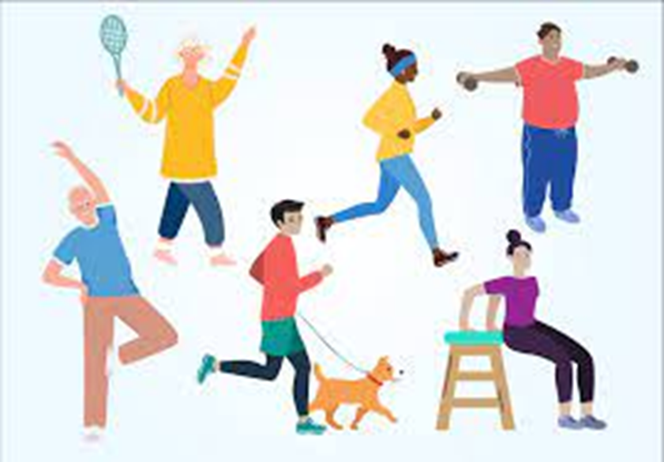
What is physical activity?
Physical Activity is..
“any bodily movement produced by the muscles that expends energy”
This means that physical activity includes movement during leisure times and also for transport to get to and from places

Slide 7
Types of physical activity?
Using your oracy helpsheet, discuss with the person next to you:
“what types of physical activity are there?”
Remember we are sharing our ideas to the class and following all the advice on the oracy helpsheet.

Slide 8
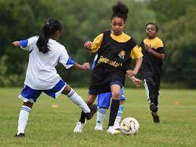
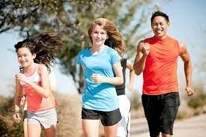
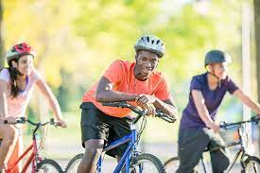
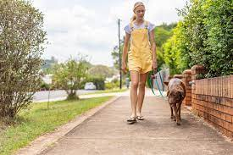
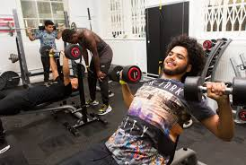
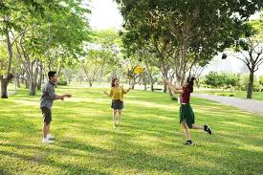
Types of Physical Activity?
Different types of physical activity can include:
Playing sport
Going for a run
Cycling to and from school
Going for a walk (with or without a pet)
Doing a workout at home or in the gym
Playing with friends in the park or playground

Slide 9
Where can you be physically active?
Using your oracy helpsheet, discuss with the person next to you:
“where can you be physically active?
Remember we are sharing our ideas to the class and following all the advice on the oracy helpsheet.

Slide 10
Where can you be physically active?
Places that you can be physically active include:
After school clubs – look at our extra curricular timetable and join one of the sports clubs
Local sports clubs – in the local area there are football clubs, rugby clubs, dance and gymnastic clubs, basketball clubs, and Sport4Life

Slide 11
Where can you be physically active?
Places that you can be physically active include:
3. Walk or cycle to school – don’t get dropped off by parents/carers. If you get the bus can you get off earlier and walk one extra stop
4. During breaktimes – use the fitness equipment/courts/MUGA/3G pitch to play some sports with friends in between lessons

Slide 12
Where can you be physically active?
Places that you can be physically active include:
5. Use local playgrounds and parks – when meeting up with friends don’t always stay inside – can you use a local playground or park to be physically active
6. Local leisure centres – these have lots of different courts and equipment to hire. Many also have swimming pools and gyms that have specific opening times for young people

Slide 13
Reflection
You will be learning much more about the importance of being physically active in your Personal Development lessons this week.
Before this lesson reflect on ways you have been physically active this week. What activities have you done? How did you feel before and after doing some physical activity?

Slide 14

Reflection
While watching the video think about how exercise affects the brain. You will be learning more about this in your Personal Development lessons.
Notes:
https://www.youtube.com/watch?v=XzBt1lOHPyQ

