Slide 1





Write the date: 14 April 2025
Write the Title and Golden Thread
Title – Personal Hygiene
Golden Thread – Secure Your Wellbeing
Underline both using your ruler & take out your oracy helpsheet
Complete the following questions:
What is being described: “the practice of keeping the mouth clean and free from disease, decay and other problems”
Give a way of staying safe when riding a bike
True or False: stereotypes lead to discrimination
Oral health
Wear a helmet, wear bright and visible clothing, do not listen to music through headphones
True

Slide 2
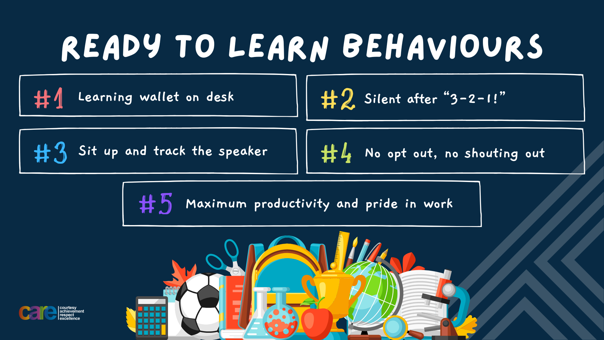

Slide 3


Secure your Wellbeing: Learning Journey
Staying safe – rail, bike and water
What is oral health
What is personal hygiene?
What is mental health?
What is social and physical health?
What does puberty mean?
Today we will look at:
What is personal hygiene
This includes:
Definition of personal hygiene
How to maintain good personal hygiene
Please remember that during the lesson we should not be asking any pupil or teacher personal questions.
Your teacher can ask you questions but this will be to check your knowledge in the lesson.

Slide 4
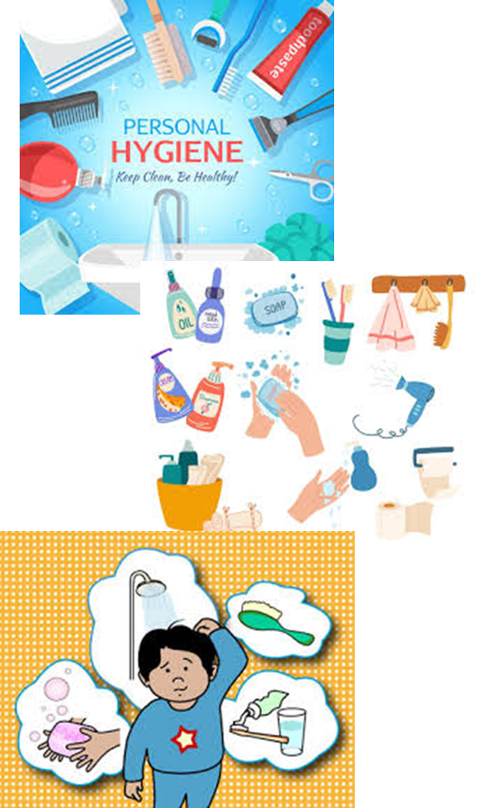
Tutor Time Recap
In your Personal Development Tutor Time activity, you looked at personal hygiene
In your books answer the following question:
“What is the definition of personal hygiene?”
Sentence starter – Personal hygiene is…

Slide 5
Tutor Time Recap
Personal Hygiene is…
“how people keep their bodies clean to stay healthy, fresh and free from infections”
Task – use your red pen to add to what you had written down.

Slide 6




Tutor Time Recap
This links to the Golden Thread of “Secure your Wellbeing” as Maintaining good personal hygiene will help your overall wellbeing as it can prevent skin infections, body odour and illnesses
Article 24 states that children should have information about how to stay healthy. As you move into becoming teenagers, your body will change. During this time it is important to learn about personal hygiene in order to keep you healthy
UN Rights
of a Child

Slide 7
Importance of Personal Hygiene
Personal Hygiene is important for many reasons.
Some of these reasons are:
Prevents illness as it reduces the spread of germs
Prevents body odour as it helps people smell fresh and feel confident
Protects the skin as it can reduce acne, rashes and irritation
Helps to avoid embarrassment

Slide 8
Importance of Personal Hygiene
Personal Hygiene is important for many reasons.
Some of these reasons are:
Prevents illness as it reduces the spread of germs
Prevents body odour as it helps people smell fresh and feel confident
Protects the skin as it can reduce acne, rashes and irritation
Helps to avoid embarrassment
In the margin write “SYV” – This stands for “Secure Your Voice”
Highlight “SYV”
Write down the benefits of personal hygiene in order of most importance to you

Slide 9

Personal Hygiene
Using your oracy helpsheet, discuss with the person next to you discuss:
“What do you think is the most important benefit to having good personal hygiene?”
Remember to use the sentence starters to add, build or challenge what your partner has said.
Be ready to share your discussion with the class

Slide 10

Hinge Questions – whiteboard activity
3
Rules!
I will ask the question and give you some thinking time. (no more than 10 seconds)
Write the answer and turn your whiteboard over so nobody can see it.
When I am ready I will put on the 3 to 1 counter.
When ‘Show me’ appears on the board you must hold up your whiteboard (even if you don’t know the answer and there is nothing on your board)
2
1
Show me!
(even if your whiteboard is blank)

Slide 11
Hinge Questions – whiteboard activity
What is being described?
“how people keep their bodies clean to stay healthy, fresh and free from infections”
Personal Hygiene

Slide 12

Hinge Questions – whiteboard activity
What golden thread does this topic relate to?
A – Secure your Future
B – Secure your Wellbeing
C – Secure your Relationships
D – Secure your Voice

Slide 13
Hinge Questions – whiteboard activity
True or False
“One reason personal hygiene is important is that it prevents illness”
A – True
B – False

Slide 14
Hinge Questions – whiteboard activity
True or False
“Body odour occurs from maintain good personal hygiene”
A – True
B – False

Slide 15
Hinge Questions – whiteboard activity
True or False
“Maintaining good personal hygiene can reduce acne and spots”
A – True
B – False

Slide 16
Hinge Questions – whiteboard activity
True or False
“Maintaining good personal hygiene can boost a persons confidence”
A – True
B – False

Slide 17
Sweat
One of the biggest reasons to look after personal hygiene is due to the increased amount of sweat that is produced during puberty.
Sweat is the main cause of body odour. This happens due to the amount of bacteria in sweat.

Slide 18
Sweat
Using your oracy helpsheet, discuss with the person next to you discuss:
“What areas of the body get most sweaty?”
Remember to use the sentence starters to add, build or challenge what your partner has said.
Be ready to share your discussion with the class

Slide 19
Sweat
The areas of the body that get the most sweaty are:
Armpits
Genitals
Feet
This means that these areas should be washed daily using soap and warm water.
To reduce the amount of sweat particularly in the armpits, antiperspirant deodorant can be used. It can also keep the body smelling fresh.

Slide 20
Sweat
Complete the following sentences
The main cause of body odour is…..
This happens because of the amount of……
The areas of the body that get the most sweaty are…
This means these areas should be washed….
When washing a person should use….

Slide 21
Sweat
Use your red pen to add to your answers
The main cause of body odour is…..sweat
This happens because of the amount of……bacteria
The areas of the body that get the most sweaty are…armpits, feet and genitals
This means these areas should be washed….daily
When washing a person should use….soap and warm water

Slide 22
Top Tips for good personal hygiene
There are different top tips for maintaining good personal hygiene for different areas of the body

Slide 23
Top Tips for good personal hygiene
Hand and Nail Hygiene
Hands pick up germs from surfaces, people and objects.
To have good hand and nail hygiene people should:
Wash hands with soap before eating
Wash hands with soap after using the toilet
Trim nails once a week
Avoid biting nails

Slide 24
Top Tips for good personal hygiene
Hair and Body Hygiene
To have good hair and body hygiene people should:
Shower/bath once a day using soap/shower gel
Avoid using the same towel as other family members
Wash hair using shampoo 2-3 times a week
Use deodorant to smell fresh and reduce amount of sweat

Slide 25
Top Tips for good personal hygiene
Clothing Hygiene
To have good clothing hygiene people should:
Change underwear daily to stay fresh
Change socks daily or if they have become wet or dirty
Wash clothes regularly

Slide 26
Top Tips for good personal hygiene
In the margin write “SYV” – This stands for “Secure Your Voice”
Highlight “SYV”
Write down the one top tip for maintaining good personal hygiene in:
  Hand and nails
  Hair and body
  Clothing

Slide 27
Top Tips for good personal hygiene
There are also top tips for maintaining good personal hygiene when playing sports such as in PE.
To maintain good personal hygiene people should:
Not wear to many layers – layers trap heat and sweat which can cause rashes
Change out of sport clothing- this is why you should not wear uniform under PE kit
Change socks after playing sports

Slide 28
Hinge Questions – whiteboard activity
3
Rules!
I will ask the question and give you some thinking time. (no more than 10 seconds)
Write the answer and turn your whiteboard over so nobody can see it.
When I am ready I will put on the 3 to 1 counter.
When ‘Show me’ appears on the board you must hold up your whiteboard (even if you don’t know the answer and there is nothing on your board)
2
1
Show me!
(even if your whiteboard is blank)

Slide 29
Hinge Questions – whiteboard activity
True or False
“sweat is the main cause of body odour”
A – True
B – False

Slide 30
Hinge Questions – whiteboard activity
True or False
“people should only shower/bath every 2-3 days”
A – True
B – False

Slide 31
Hinge Questions – whiteboard activity
True or False
“people should wear antiperspirant deodorant to reduce the amount of sweat”
A – True
B – False

Slide 32
Hinge Questions – whiteboard activity
True or False
“The three areas that get the most sweaty are armpits, feet and genitals”
A – True
B – False

Slide 33
Hinge Questions – whiteboard activity
True or False
“Biting nails is a good way of maintaining nail hygiene”
A – True
B – False

Slide 34
Hinge Questions – whiteboard activity
True or False
“Clothes should be washed regularly”
A – True
B – False

Slide 35
Hinge Questions – whiteboard activity
True or False
“You should wear your uniform under your PE kit”
A – True
B – False

Slide 36
Hinge Questions – whiteboard activity
True or False
“You should put your uniform on over your PE kit after PE lessons”
A – True
B – False

Slide 37
Personal Hygiene - scenario
In the margin write “SYV” – This stands for “Secure Your Voice”
Highlight “SYV”
Answer the following question:
“What advice would you give Jake about looking after his personal hygiene?”
Jake is 12 years old and loves playing football. After playing football he doesn’t bother to shower and will wear the same football until it is really dirty.
Jake thinks people in school are starting to avoid sitting beside him or standing close to him

Slide 38
Personal Hygiene
Using your oracy helpsheet, discuss with the person next to you discuss:
“What advice would you give Jake about looking after his personal hygiene?”
Remember to use the sentence starters to add, build or challenge what your partner has said.
Be ready to share your discussion with the class

Slide 39
Personal Hygiene - scenario
In the margin write “SYV” – This stands for “Secure Your Voice”
Highlight “SYV”
Answer the following question:
“What advice would you give Emily about looking after her personal hygiene?”
Emily is 12 years old and she has noticed that she is becoming sweaty during the day and especially after PE.
She normally just puts her uniform on over the top of her PE but she thinks that she is starting to smell bad.
She doesn’t know why this is happening as she used to do this in Primary School with no issue

Slide 40
Personal Hygiene
Using your oracy helpsheet, discuss with the person next to you discuss:
“What advice would you give Emily about looking after her personal hygiene?”
Remember to use the sentence starters to add, build or challenge what your partner has said.
Be ready to share your discussion with the class

Slide 41



Support
If you ever need support about personal hygiene for yourself, a friend or family member you can find it here:
Childline.org.uk
Call – 08001111
Email or chat online for support
Themix.org.uk
You can email or have one-to-chat online.
There is also a crisis messenger which is available 24/7

Slide 42


