Slide 1





Write the date: 14 April 2025
Write the Title and Golden Thread
Title – What is puberty
Golden Thread – Secure Your Wellbeing
Underline both using your ruler & take out your oracy helpsheet
Complete the following questions:
What is being described: “how we interact with other people in different situations”
True or False: there is stigma (negative thoughts) around mental health
Give one reason why personal hygiene is important
Social Health
true
Prevents illness, prevent body odour, protects skin, helps to avoid embarrassment

Slide 2
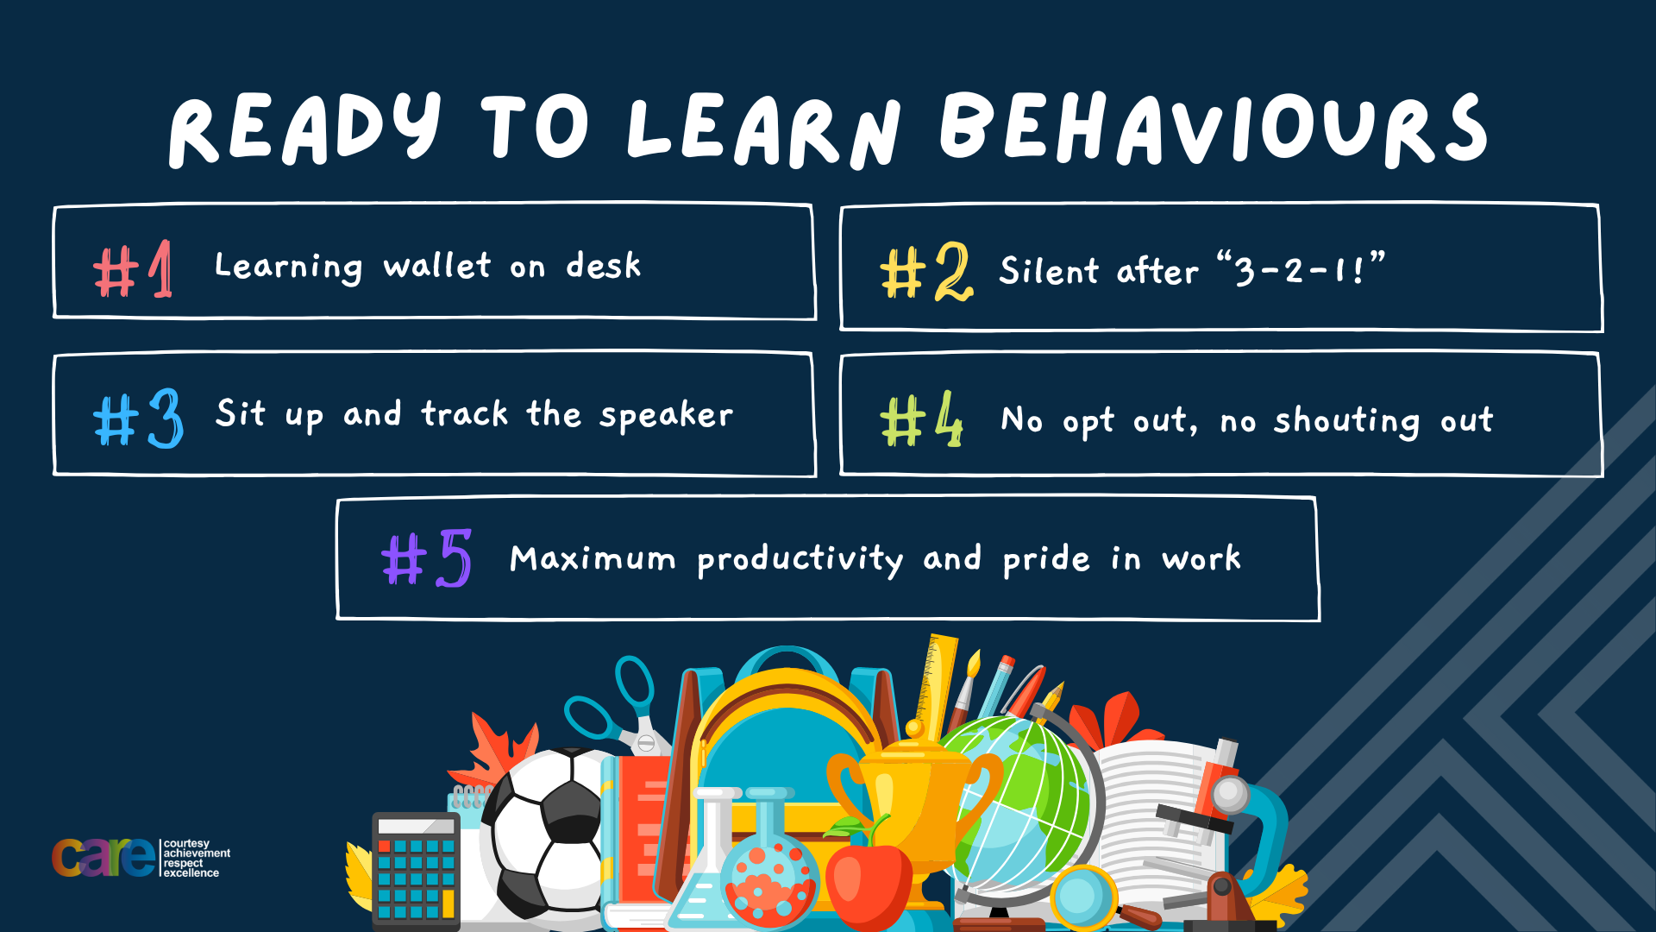

Slide 3


Secure your Wellbeing: Learning Journey
Staying safe – rail, bike and water
What is oral health
What is personal hygiene?
What is mental health?
What is social and physical health?
What does puberty mean?
Today we will look at:
What changes happen during puberty
This includes:
What physical changes happen to everyone?
What physical changes happen specifically to boys/girls
What emotional changes happen during puberty
Please remember that during the lesson we should not be asking any pupil or teacher personal questions.
Your teacher can ask you questions but this will be to check your knowledge in the lesson.

Slide 4
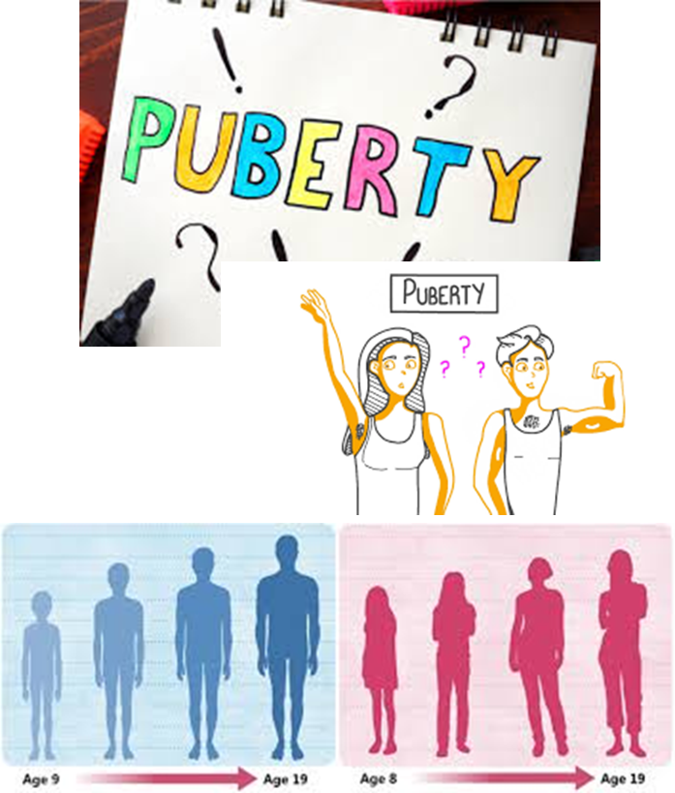
Tutor Time recap
In your Personal Development Tutor Time activity, you looked at puberty.
In your books answer the following question:
“What is the definition of puberty?”
Sentence starter – “Puberty is…”

Slide 5
Tutor Time recap
Puberty is…
“a period of time when a child’s body starts to develop into an adult body”
Task – use your red pen to add to what you had written down.

Slide 6




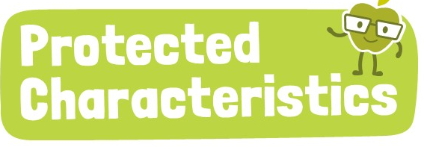
Tutor Time Recap
This links to the Golden Thread of “Secure your Wellbeing” as people can struggle mentally with changes during puberty but it is important to understand these changes are natural
Article 24 states that children have the right to information about how to stay healthy. It is important to understand puberty as it can be a difficult time due to heightened emotions during puberty
Age is a Protected Characteristic. People should not be treated differently due to their age, however more patience may be needed with teenagers due to emotional and hormonal changes happening.
UN Rights
of a Child

Slide 7

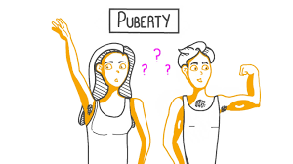
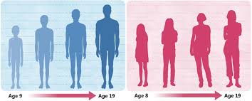
When does puberty begin?
Puberty begins for people between the ages of 8-14 years old.
This shows that puberty is different for everyone and the changes during this time can take several years to complete.
These changes can be classed as either physical or emotional

Slide 8

Physical changes that happen during puberty
While watching the video write down as many physical changes that happen during puberty as you can
Notes:
https://www.youtube.com/watch?v=Y6eFTuh0bxY

Slide 9
Physical changes that happen during puberty
The next number of slides will go over the physical changes that happen during puberty.
Task – use your red pen to add to your list of physical changes that happen during puberty

Slide 10

Physical changes during puberty
The physical changes that happen to everyone during puberty are:
- Growth spurt and weight gain – the body is growing which explains why people get hungrier as they need to fuel this growth. Growth happens at different times and in different ways which is why people are different shapes and sizes.

Slide 11
Physical changes during puberty
The physical changes that happen to everyone during puberty are:
- Stretch marks – due to growth spurts people may develop stretch marks which are dark purple lines around the hips, thighs and breasts. However they do fade over time.

Slide 12
Physical changes during puberty
The physical changes that happen to everyone during puberty are:
- Genitals grow – just like the rest of the body, genitals grow. Just like the body, genitals grow into all different shapes and sizes

Slide 13
Physical changes during puberty
The physical changes that happen to everyone during puberty are:
- Sweat more – This causes body odour and happens especially around feet, genitals and underarms

Slide 14
Physical changes during puberty
The physical changes that happen to everyone during puberty are:
- Spots and Acne – This happens around the face, neck, chest and back and is caused by the body producing too much oil, which clogs up the pores in the skin. There are 3 times of spots – blackheads, whiteheads and blind spots

Slide 15
Physical changes during puberty
The physical changes that happen to everyone during puberty are:
- Thicker body hair – hair around the body gets thicker including around genitals (pubic hair). Body hair starts of fluffy but gets coarser, thicker and more curly over time.

Slide 16
Physical changes that happen during puberty
Spots and Acne is a physical change that young people struggle with the most.
In the margin write “SYV” – This stands for “Secure Your Voice”
Highlight “SYV”
Answer the question:
“Why do you think young people struggle most with spots and acne?”

Slide 17

Physical Changes during Puberty
Using your oracy helpsheet, with the person next to you, discuss your response to the question:
“Why do you think young people struggle most with spots and acne?”
Remember to use the sentence starters to add, build or challenge what your partner has said.
Be ready to share your discussion with the class

Slide 18
Physical changes during puberty
Although these are physical changes that happen to everyone, there are specific changes during puberty for girls and boys.

Slide 19
Physical changes during puberty - boys
The physical changes that are more specific to boys are:
Voice deepens (voice breaks) – happens due to the thickening of the vocal cords
Muscle development – increased muscle mass and shoulders broaden
Growth of facial hair – this is hair that appears on the face and is why some males have beards and mustaches

Slide 20
Physical changes during puberty - girls
The physical changes that are more specific to girls are:
Breast development – happens over a period of time. This development is different for every girl.
Menstruation (periods) begin – This happens at different times and over time this will regulate to happen approximately every 28 days
Body shape changes – Hips widen and fat distribution shifts around thighs, buttocks and breasts. This is different for every girl, hence why all girls are different shapes and sizes

Slide 21
Physical changes during puberty - girls
Complete the sentences below:
A physical change during puberty that is unique to boys is…
A physical change during puberty that is unique to girls is…

Slide 22
Hinge Questions – whiteboard activity
3
Rules!
I will ask the question and give you some thinking time. (no more than 10 seconds)
Write the answer and turn your whiteboard over so nobody can see it.
When I am ready I will put on the 3 to 1 counter.
When ‘Show me’ appears on the board you must hold up your whiteboard (even if you don’t know the answer and there is nothing on your board)
2
1
Show me!
(even if your whiteboard is blank)

Slide 23
Hinge Questions – whiteboard activity
Is the answer boys, girls or everyone
During puberty the voice breaks
Boys

Slide 24
Hinge Questions – whiteboard activity
Is the answer boys, girls or everyone
During puberty menstruation starts
Girls

Slide 25
Hinge Questions – whiteboard activity
Is the answer boys, girls or everyone
During puberty body hair gets thicker
Everyone

Slide 26
Hinge Questions – whiteboard activity
Is the answer boys, girls or everyone
During puberty spots/acne happens
Everyone

Slide 27
Emotional/Social changes that happen during puberty
While watching the video write down as many emotional & social changes that happen during puberty as you can
Notes:
https://www.youtube.com/watch?v=Bjee0QgqC10

Slide 28
Emotional/social changes that happen during puberty
The next number of slides will go over the emotional/social changes that happen during puberty.
Task – use your red pen to add to your list of emotional/social changes that happen during puberty

Slide 29
Emotional/social changes during puberty
The emotional/social changes that happen to everyone during puberty are:
- Mood swings – emotions can change from 1 minute to the next. This can be from happy to sad, confused to anger.

Slide 30
Emotional/social changes during puberty
The emotional/social changes that happen to everyone during puberty are:
- Thoughts about body image – People become more concerned about how they look and what clothes they wear.

Slide 31
Emotional/social changes during puberty
The emotional/social changes that happen to everyone during puberty are:
- Tastes change – This is not just about what foods people enjoy but also clothes, music, friends. What people liked before might not be what they like now.

Slide 32
Emotional/social changes during puberty
The emotional/social changes that happen to everyone during puberty are:
-Desire for more independence – This can be from family and friends. People may not always want to do what their parents/families want them to do

Slide 33
Emotional/social changes during puberty
The emotional/social changes that happen to everyone during puberty are:
- Crushes – people might start to feel attracted to others

Slide 34
Emotional/social changes during puberty
The emotional/social changes that happen to everyone during puberty are:
Mood swings
Thoughts about body image
Tastes change
Desire for independence
crushes
In the margin write “SYV” – This stands for “Secure Your Voice”
Highlight “SYV”
Answer the question:
“What emotional/social change do you think teenagers find most difficult?

Slide 35
Emotional/Social changes during Puberty
Using your oracy helpsheet, with the person next to you, discuss your response to the question:
“Why do you think young people struggle most with spots and acne?”
Remember to use the sentence starters to add, build or challenge what your partner has said.
Be ready to share your discussion with the class

Slide 36
Hinge Questions – whiteboard activity
3
Rules!
I will ask the question and give you some thinking time. (no more than 10 seconds)
Write the answer and turn your whiteboard over so nobody can see it.
When I am ready I will put on the 3 to 1 counter.
When ‘Show me’ appears on the board you must hold up your whiteboard (even if you don’t know the answer and there is nothing on your board)
2
1
Show me!
(even if your whiteboard is blank)

Slide 37
Hinge Questions – whiteboard activity
True or False
“During puberty people will experience stable moods”
False

Slide 38
Hinge Questions – whiteboard activity
True or False
“During puberty people might experience crushes”
True

Slide 39
Hinge Questions – whiteboard activity
True or False
“During puberty people want to be more independent”
True

Slide 40
Hinge Questions – whiteboard activity
True or False
“During puberty people will enjoy the same music and tv shows they liked when they were younger”
False (mostly) – some of this may stay the same particularly music

Slide 41
Scenario
Jake is 13 years old, and he's noticing a lot of changes happening to his body. His voice has started to crack, and it's getting deeper, which makes him feel self-conscious when he talks in class. He's also seeing hair grow on his face and under his arms, and he’s worried because he seems to be growing much faster than his friends. Jake is confused and embarrassed about these changes, and he's not sure if what’s happening is normal.
Questions – discuss with your partner and be ready to share with the class
What process is Jake currently experiencing?
Are the changes that Jake is experiencing normal?
What advice would you give Jake?

Slide 42
Scenario
Sophia is 13 years old and has recently started noticing changes in her body. Her breasts are growing, and she’s just started her period, which makes her feel awkward around her friends. She’s also noticed that her emotions change quickly—sometimes she’s happy, and other times she feels sad for no reason. Sophia is confused and feels like she’s the only one going through these changes
Questions – discuss with your partner and be ready to share with the class
Are the changes that Sophia is experiencing normal?
What advice would you give Sophia?

Slide 43
Scenario
Imagine you are now 18 years old and you have largely completed the puberty process.
Choose if you have a younger brother or sister who is 12 years old. You have started to notice changes in them.
What advice would you give them? What could you tell them about what they might experience over the next few months and years?
Write out your answers in your books. Be ready to share your answers with the class as part of a class discussion.

Slide 44



Support
If you ever need support about changes during puberty for either yourself or a friend/family member, you can get support from the following places
Childline.org.uk
Call – 08001111
Email or chat online for support
Themix.org.uk
You can email or have one-to-chat online.
There is also a crisis messenger which is available 24/7

Slide 45
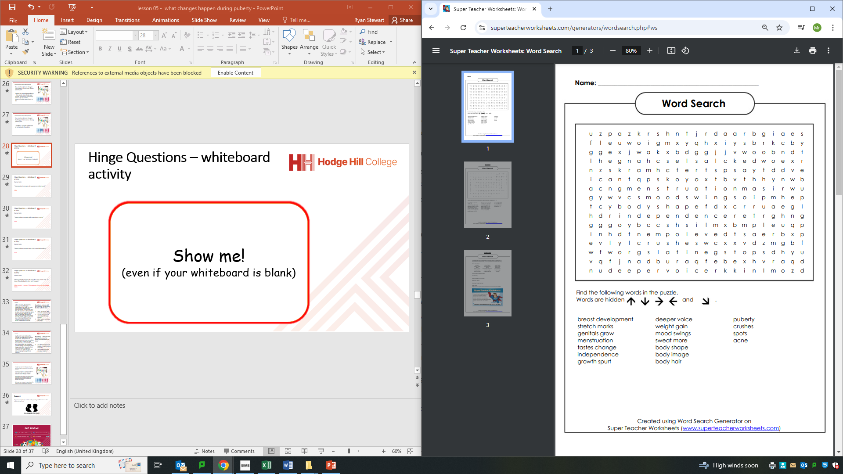
Extension Activity
The word search below contains keywords from the lesson. Can you find any?
Words are written vertically, horizontally, diagonally and backwards

Slide 46


