Slide 1





Write the date: 14 April 2025
Write the Title and Golden Thread
Title – Oral Health
Golden Thread – Secure Your Wellbeing
Underline both using your ruler & take out your oracy helpsheet
Complete the following questions:
What is being described: “body’s involuntary response to being suddenly immersed into cold water around 15 degrees or lower.”
True or False – “stereotypes are always true”
Give an example of cyberbullying
Cold water shock
False
Spreading lies/rumours, posting photos/videos without permission, sending hurtful/abusive/threatening messages, impersonating someone online

Slide 2
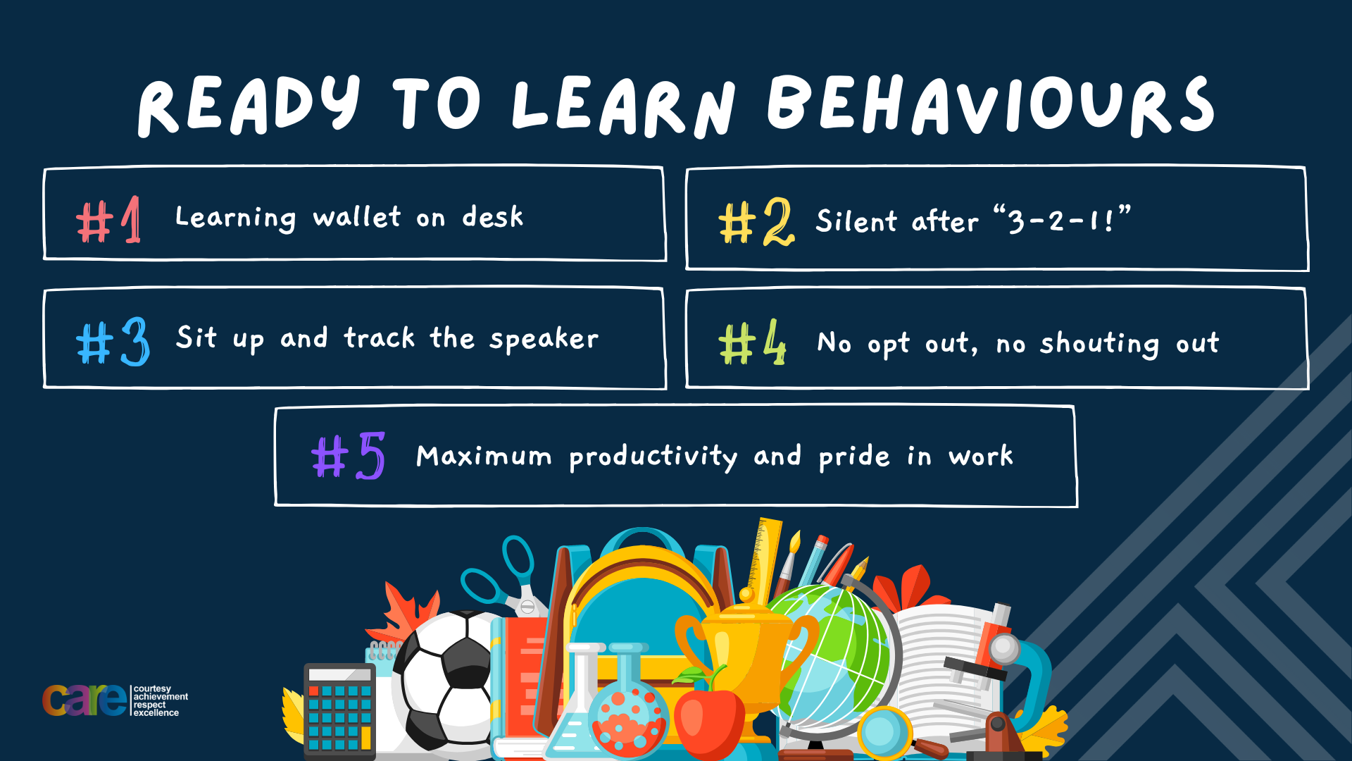

Slide 3


Secure your Wellbeing: Learning Journey
Staying safe – rail, bike and water
What is oral health
What is personal hygiene?
What is mental health?
What is social and physical health?
What does puberty mean?
Today we will look at:
Importance of oral health
This includes:
Definition of oral health
Benefits of oral health and disadvantages of not maintaining good oral health
Oral health plans
Please remember that during the lesson we should not be asking any pupil or teacher personal questions.
Your teacher can ask you questions but this will be to check your knowledge in the lesson.

Slide 4
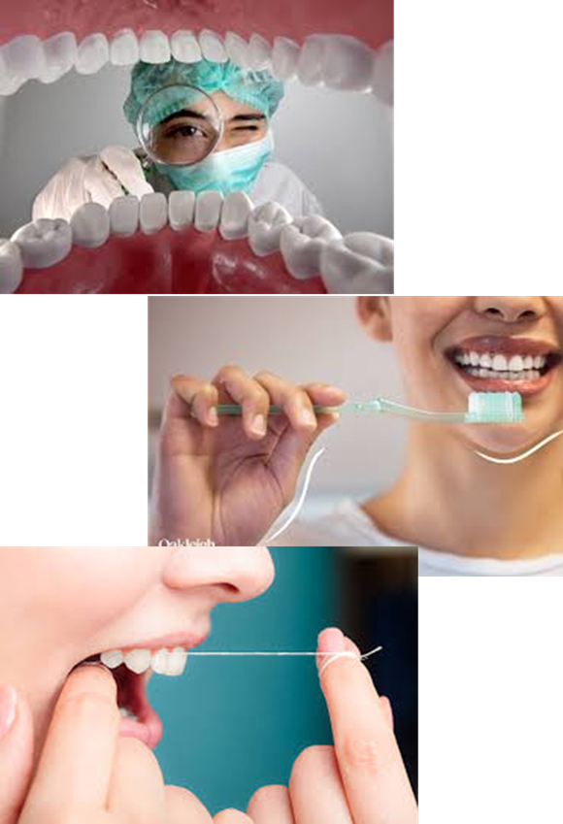
Tutor Time Recap
In your Personal Development Tutor Time activity, you looked at oral health
In your books answer the following question:
“What is the definition of oral health?”
Sentence starter – Oral health is…

Slide 5
Tutor Time Recap
Oral health is…
“the practice of keeping the mouth clean and free from disease, decay and other problems”
Task – use your red pen to add to what you had written down.

Slide 6




Tutor Time Recap
This links to the Golden Thread of “Secure your Wellbeing” as poor oral health can lead to tooth decay and gum disease. Good oral health is also linked to better physical and mental health.
Article 24 states that children have the right to the best health care possible. In the UK, children receive free dental care. It is important to visit the dentist in order to maintain good oral health. Dental care can be very expensive in the future if oral health is not maintained during childhood
UN Rights
of a Child

Slide 7
Benefits of tooth brushing
As discussed in tutor time, the main way of maintaining good oral health is through brushing teeth.
There are lots of benefits of tooth brushing:
Makes the mouth feel clean and fresh
Removes plaque from teeth so they look clean and less yellow
Leads to fresh smelling breath
Gums remain health
Stops tooth decay so teeth stay stronger for longer

Slide 8
Benefits of tooth brushing
As discussed in tutor time, the main way of maintaining good oral health is through brushing teeth.
There are lots of benefits of tooth brushing:
Makes the mouth feel clean and fresh
Removes plaque from teeth so they look clean and less yellow
Leads to fresh smelling breath
Gums remain health
Stops tooth decay so teeth stay stronger for longer
In the margin write “SYV” – This stands for “Secure Your Voice”
Highlight “SYV”
Write down the benefits of tooth brushing in order of most importance to you

Slide 9

Importance of brushing teeth
Using your oracy helpsheet, discuss with the person next to you discuss:
“What do you think is the most important benefit to tooth brushing? Why?”
Remember to use the sentence starters to add, build or challenge what your partner has said.
Be ready to share your discussion with the class

Slide 10
Disadvantages of not brushing teeth
Although there are many benefits, people don’t always brush their teeth. This can lead to…
More bacteria (germs) living in people’s mouths
Plaque building up on teeth making them look dirty
People having bad breath
Gums becoming red and swollen making them bleed
Teeth begin to hurt and holes begin to develop due to tooth decay

Slide 11
Disadvantages of not brushing teeth
Although there are many benefits, people don’t always brush their teeth. This can lead to…
More bacteria (germs) living in people’s mouths
Plaque building up on teeth making them look dirty
People having bad breath
Gums becoming red and swollen making them bleed
Teeth begin to hurt and holes begin to develop due to tooth decay
In the margin write “SYV” – This stands for “Secure Your Voice”
Highlight “SYV”
Write down the disadvantages in order. You should start with the biggest disadvantage first

Slide 12
Disadvantages of not brushing teeth
Using your oracy helpsheet, discuss with the person next to you discuss:
“What do you think is the biggest disadvantage to not brushing teeth? Why?”
Remember to use the sentence starters to add, build or challenge what your partner has said.
Be ready to share your discussion with the class

Slide 13
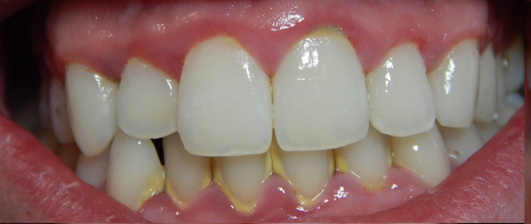
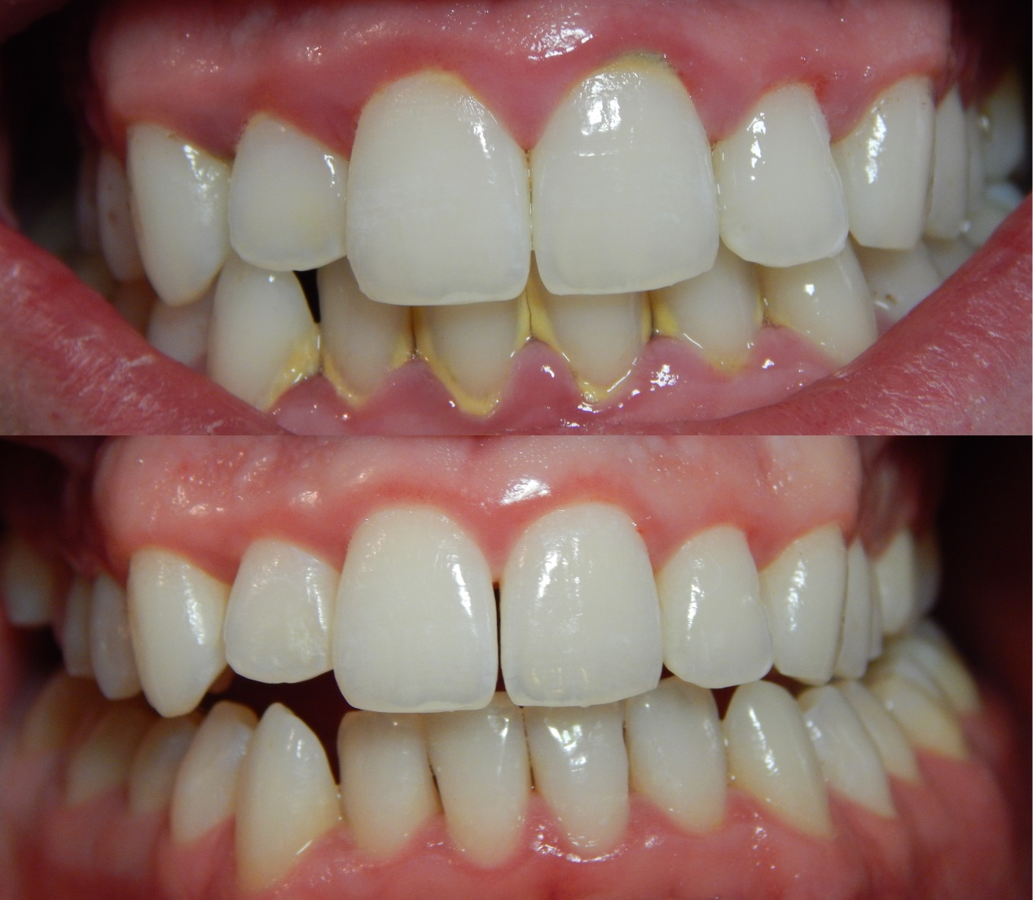
Oral Health
The photo at the top shows teeth that have a build up of plaque and tartar.
The picture are the bottom shows teeth that do not have a build up of plaque or tartar

Slide 14
Oral Health
Plaque is a sticky, yellow substance made up of millions of harmful germs that coat the teeth.
It is these germs that produce acid from the sugar in food and drinks. This acid begins to destroy teeth.
When plaque has been there a long time it goes hard and is difficult to remove through brushing teeth. This is called tartar.

Slide 15
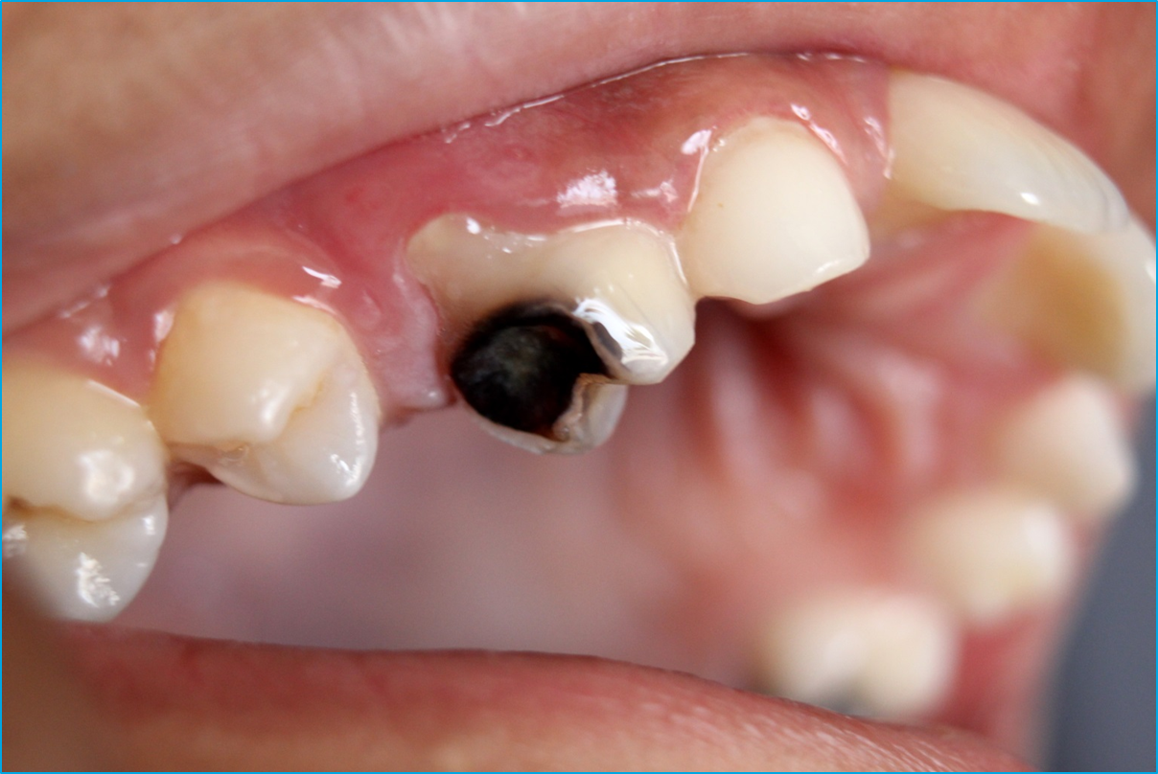
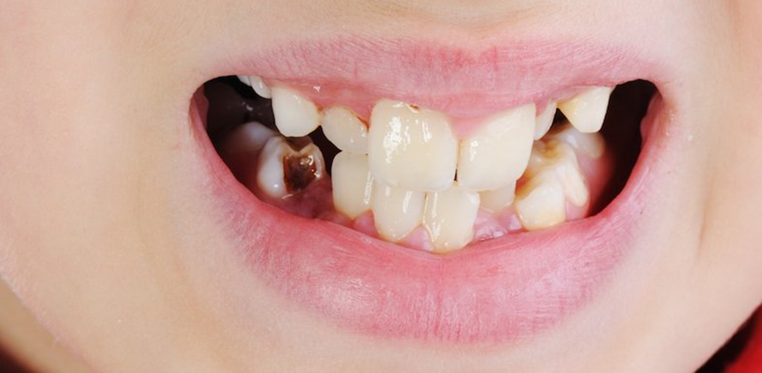
Oral Health
Not removing plaque or tartar from teeth can lead to tooth decay.
Tooth decay is when holes called cavities form in teeth. This leads to toothache, problems eating and drinking and also negatively impacts sleep.
Tooth decay can also impact mental health as it stops people from smiling as they do not want to show their teeth. This means they may stop doing things they enjoy.

Slide 16
Oral Health
There are things everyone can do to stop plaque, tartar and tooth decay.
These are:
Brush teeth twice a day, once in the morning and once at night
Use a fluoride toothpaste as this can reduce chances of tooth decay by 50%
Visit a dentist regularly (twice a year) so all teeth can be checked properly

Slide 17

Hinge Questions – whiteboard activity
3
Rules!
I will ask the question and give you some thinking time. (no more than 10 seconds)
Write the answer and turn your whiteboard over so nobody can see it.
When I am ready I will put on the 3 to 1 counter.
When ‘Show me’ appears on the board you must hold up your whiteboard (even if you don’t know the answer and there is nothing on your board)
2
1
Show me!
(even if your whiteboard is blank)

Slide 18
Hinge Questions – whiteboard activity
What is being described?
“the practice of keeping the mouth clean and free from disease, decay and other problems”
Oral Health

Slide 19

Hinge Questions – whiteboard activity
What golden thread does this topic relate to?
A – Secure your Future
B – Secure your Wellbeing
C – Secure your Relationships
D – Secure your Voice

Slide 20
Hinge Questions – whiteboard activity
Write down 1 benefit of tooth brushing
Makes the mouth feel clean and fresh
Removes plaque from teeth so they look clean and less yellow
Leads to fresh smelling breath
Gums remain health
Stops tooth decay so teeth stay stronger for longer

Slide 21
Hinge Questions – whiteboard activity
Write down 1 disadvantage of not brushing teeth
More bacteria (germs) living in people’s mouths
Plaque building up on teeth making them look dirty
People having bad breath
Gums becoming red and swollen making them bleed
Teeth begin to hurt and holes begin to develop due to tooth decay

Slide 22
Hinge Questions – whiteboard activity
True or False
“If a person does not brush their teeth, plaque starts to build up on the teeth making them look yellow”
A – True
B – False

Slide 23
Hinge Questions – whiteboard activity
True or False
“Tartar is harden plaque”
A – True
B – False

Slide 24
Hinge Questions – whiteboard activity
True or False
“tooth decay is when holes appear in the tooth”
A – True
B – False

Slide 25
Hinge Questions – whiteboard activity
True or False
“there is no need to worry about tooth decay”
A – True
B – False

Slide 26
Hinge Questions – whiteboard activity
True or False
“Toothpaste should not contain fluoride”
A – True
B – False

Slide 27
Oral Health
Complete the following sentences in your books
Plaque is a _________ substance that contains millions of ______. When harden it is called _________. Plaque and tartar produce ______ which starts to destroy teeth. This can lead to ___________. This can stop a person ________ due to being embarrassed by their teeth. This is why it is important to brush teeth _______ a day with __________ that contains __________. People should also visit a _________ twice a year so all teeth can be properly __________
Word Bank
Dentist
Fluoride
Sticky
Germs
Smiling
Twice
Toothpaste
Tartar
Acid
Tooth Decay
Checked
sticky
germs
tartar
acid
Tooth decay
smiling
twice
toothpaste
fluoride
dentist
checked

Slide 28

How to brush teeth
While watching the video write down the top tips to brushing teeth properly
Notes:
https://www.youtube.com/watch?v=1q10LWifXkw

Slide 29
Brushing teeth properly
Using your oracy helpsheet, discuss with the person next to you discuss:
“What were the top tips for brushing teeth correctly?”
Remember to use the sentence starters to add, build or challenge what your partner has said.
Be ready to share your discussion with the class

Slide 30
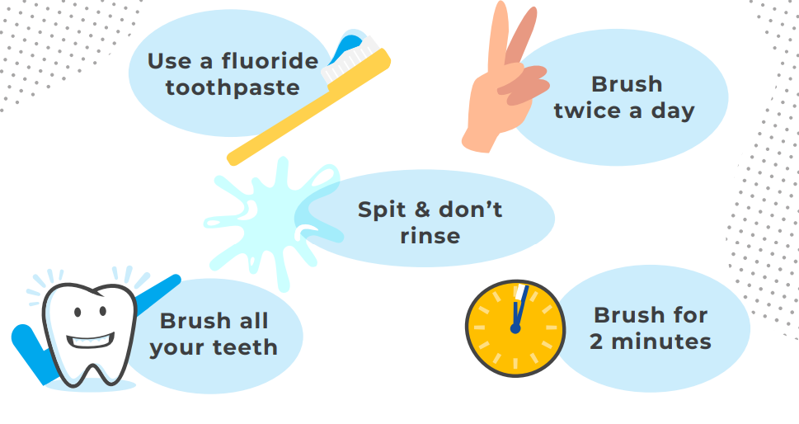
Brushing teeth properly

Slide 31
Oral Health - scenario
In the margin write “SYV” – This stands for “Secure Your Voice”
Highlight “SYV”
Answer the following question:
“What advice would you give Jayden about starting to brush their teeth more often?”
Jayden is 14 years old ands know they should brush their teeth but they often forget or just can’t be bothered. Jayden is normally always running late and would rather style their hair than brush their teeth to save time. At night they like falling asleep in bed while watching TV. They are normally to comfortable to get out of bed to brush their teeth before falling asleep.

Slide 32
Oral Health
Using your oracy helpsheet, discuss with the person next to you discuss:
“What advice would you give Jayden about starting to brush their teeth more often?”
Remember to use the sentence starters to add, build or challenge what your partner has said.
Be ready to share your discussion with the class

Slide 33
Oral Health
Top things to remember when looking after oral health
Use a fluoride toothpaste
Brush teeth twice a day for 2 minutes each time
Make sure all teeth are brushed
Use floss or interdental brushes to remove food between teeth
Spit toothpaste out, do not rinse mouth out with water

Slide 34



Support
If you ever need support about oral health for yourself, a friend or family member you can find it here:
Childline.org.uk
Call – 08001111
Email or chat online for support
Themix.org.uk
You can email or have one-to-chat online.
There is also a crisis messenger which is available 24/7

Slide 35


