Slide 1





Write the date: 14 April 2025
Write the Title and Golden Thread
Title – What is mental health
Golden Thread – Secure Your Wellbeing
Underline both using your ruler & take out your oracy helpsheet
Complete the following questions:
What is being described: “how people keep their bodies clean to stay healthy, fresh and free from infections”
How many times should you brush your teeth everyday?
True or False: it is safe to take selfies along railway tracks if you can’t see a train
Personal Hygiene
Twice – once in the morning and once at night
False

Slide 2
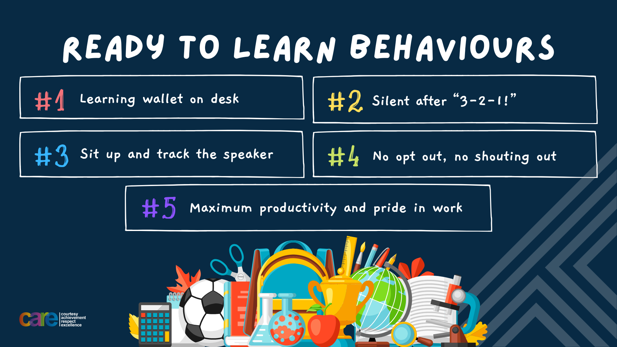

Slide 3


Secure your Wellbeing: Learning Journey
Staying safe – rail, bike and water
What is oral health
What is personal hygiene?
What is mental health?
What is social and physical health?
What does puberty mean?
Today we will look at:
What is mental health?
This includes:
Definition of mental health?
Difference between mental health and mental illness
Ways to improve mental health?
Please remember that during the lesson we should not be asking any pupil or teacher personal questions.
Your teacher can ask you questions but this will be to check your knowledge in the lesson.

Slide 4
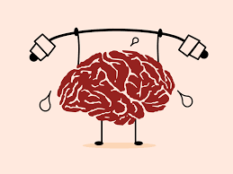


Tutor Time recap
In your Personal Development Tutor Time activity, you looked at mental health
In your books answer the following question:
“What is the definition of mental health?”
Sentence starter – Mental health is…

Slide 5
Tutor Time recap
Mental health is…
“a state of mental well being that enables people to cope with the stresses of life, realise their abilities, learn well and work well and contribute to their community”
Task – use your red pen to add to what you had written down.

Slide 6




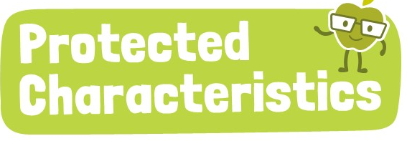
Tutor Time Recap
This links to the Golden Thread of “Secure your Wellbeing” as mental health is just as important as physical health. Having good mental health will give you an overall better wellbeing
Article 24 states that children should have information about how to stay healthy. This includes mental health. Knowing how to look after mental health is important to make sure you are happy.
There are 9 protected characteristics. Unfortunately, people are treated differently due to identifying with these characteristics. This can negatively impact their mental health.
UN Rights
of a Child

Slide 7
Talking about mental health
Conversations about mental health have become more common, more open and more positive in recent years.
However there are still lots of misconceptions about mental health.

Slide 8
Talking about mental health - misconceptions
It is important to understand what is a misconception as some people might think that a misconception is a fact.
You will be shown a common misconception on the board.
You will then have to write down a response to challenge the misconception

Slide 9
Talking about mental health - misconceptions
In the margin write “SYV” – This stands for “Secure Your Voice”
Highlight “SYV”
Write down your response if you overheard this misconception.
Sentence starter – “to respond to this misconception I would say…”
“I don’t think mental health is a very big issue”
This is a common misconception. A response to this is…
“Mental health problems are quote common. 1 in 4 adults and 1 in 8 children experience them every year”

Slide 10
Talking about mental health - misconceptions
In the margin write “SYV” – This stands for “Secure Your Voice”
Highlight “SYV”
Write down your response if you overheard this misconception.
Sentence starter – “to respond to this misconception I would say…”
“I don’t think people with mental health problems are going to be able to lead a full and happy life”
This is a misconception. A response to this is…
“There might be challenges and they might need support but many people can still lead a full and happy life with a mental health condition.”

Slide 11
Talking about mental health - misconceptions
In the margin write “SYV” – This stands for “Secure Your Voice”
Highlight “SYV”
Write down your response if you overheard this misconception.
Sentence starter – “to respond to this misconception I would say…”
“I think you can tell if someone has a mental health problem by looking at them”
This is a misconception. A response to this is…
“You cannot see a mental health condition by looking at someone and this can make it hard for people to talk about it”

Slide 12
Stigma around mental health
Although talking about mental health is promoted, there is still stigma (negative/unfair beliefs people have about something) around mental health.

Slide 13
Stigma around mental health
This means that sometimes people find it difficult to talk about mental health, or might have little understanding of it and can therefore say things that might be unhelpful or offensive to others.
Often this can happen without the person meaning to upset or offend someone

Slide 14
Stigma around mental health
We are now going to look at some comments that can regularly cause unintended offence or upset to someone.
When these comments are said, the person saying them has no idea how people around them could be feeling mentally.

Slide 15
Stigma around mental health
For each comment you will need to come up with an alternative phrase that has the same meaning but might not cause any unintended offence.
Example – “the traffic was crazy this morning”
An alternative comment could have been “the traffic was really busy today”.
This is more appropriate as a person hearing this could be struggling with their mental health and could feel that they are going crazy, even if they do not seem like this on the outside.

Slide 16
Stigma around mental health
In the margin write “SYV” – This stands for “Secure Your Voice”
Highlight “SYV”
Write down how you would rephrase the sentence
Sentence starter – “another way to say this is…”
How could this sentence be rephrased?
“That party was so mental”
Be ready to share your responses with the class

Slide 17

Stigma around mental health
Using your oracy helpsheet, with the person next to you, discuss your response to the question:
“how would you rephrase the sentence?”
Remember to use the sentence starters to add, build or challenge what your partner has said.
Be ready to share your discussion with the class

Slide 18
Stigma around mental health
“that party was so mental”
This comment demonstrates the flippant way people can use mental health language. This reinforces the stigma around mental health.
Instead a person could say “that party was so much fun”

Slide 19
Stigma around mental health
In the margin write “SYV” – This stands for “Secure Your Voice”
Highlight “SYV”
Write down how you would rephrase the sentence
Sentence starter – “another way to say this is…”
How could this sentence be rephrased?
“Really? You look fine to me”
Be ready to share your responses with the class

Slide 20
Stigma around mental health
Using your oracy helpsheet, with the person next to you, discuss your response to the question:
“how would you rephrase the sentence?”
Remember to use the sentence starters to add, build or challenge what your partner has said.
Be ready to share your discussion with the class

Slide 21
Stigma around mental health
“really? You look fine to me”
This is a common example of a typical responses people with a mental health issue sometimes get from family or friends. This diminishes the issues and minimizes the impact of experiencing a mental health issue.
A way to rephrase this comment is “Really? Is there anything I can do for you?”

Slide 22
Stigma around mental health
In the margin write “SYV” – This stands for “Secure Your Voice”
Highlight “SYV”
Write down how you would rephrase the sentence
Sentence starter – “another way to say this is…”
How could this sentence be rephrased?
“Man up! Stop being such a drama queen”
Be ready to share your responses with the class

Slide 23
Stigma around mental health
Using your oracy helpsheet, with the person next to you, discuss your response to the question:
“how would you rephrase the sentence?”
Remember to use the sentence starters to add, build or challenge what your partner has said.
Be ready to share your discussion with the class

Slide 24
Stigma around mental health
“Man up! Stop being such a drama queen”
This is an example of a comment that includes unhelpful advice that people sometimes receive when discussing a mental health concern
A way to rephrase this comment is “do you want to talk about what you are finding difficult”

Slide 25
Challenging Stigma
The best way to end stigma is to challenge it.
However this can be difficult to do especially with your friends.

Slide 26
Challenging Stigma
Some ideas to challenge the stigma is:
Avoid using language that might be offensive/upsetting
Challenge this language if they hear it used
Encourage people to be understanding about mental health
Avoid making fun of mental health issues – challenge it if heard said by other people

Slide 27
Challenging Stigma
In the margin write “SYV” – This stands for “Secure Your Voice”
Highlight “SYV”
Write down your response to the question on the left
“What could be done in schools to challenge mental health stigma?”

Slide 28
Stigma around mental health
Using your oracy helpsheet, with the person next to you, discuss your response to the question:
“What could be done in schools to challenge mental health stigma?”
Remember to use the sentence starters to add, build or challenge what your partner has said.
Be ready to share your discussion with the class

Slide 29
Challenging Stigma
Some ideas to challenge the stigma is:
Teach more about mental health – this is the point of this lesson
Promote sources of support – at Hodge Hill College we promote “telling someone you trust”
Use displays to promote talking about mental health
Have “positive mental health” events
Make all people feel included in the school community.

Slide 30
Hinge Questions – whiteboard activity
3
Rules!
I will ask the question and give you some thinking time. (no more than 10 seconds)
Write the answer and turn your whiteboard over so nobody can see it.
When I am ready I will put on the 3 to 1 counter.
When ‘Show me’ appears on the board you must hold up your whiteboard (even if you don’t know the answer and there is nothing on your board)
2
1
Show me!
(even if your whiteboard is blank)

Slide 31
Hinge Questions – whiteboard activity
What is being described?
“a state of mental well being that enables people to cope with the stresses of life, realise their abilities, learn well and work well and contribute to their community”
Mental health

Slide 32
Hinge Questions – whiteboard activity
Could the following statement cause unintended upset or offensive to someone struggling with their mental health?
“isn’t depression the same as just being a bit sad”
Yes – this diminishes how that person is currently feeling

Slide 33
Hinge Questions – whiteboard activity
Could the following statement cause unintended upset or offensive to someone struggling with their mental health?
“that is a real first world problem. Some people have bigger problems”
Yes – this diminishes how that person is currently feeling regardless of how others see the problem

Slide 34
Hinge Questions – whiteboard activity
If a person hears language that makes fun of mental health, what could they do about it?
Challenge the use of the language

Slide 35



Support
If you ever need support about mental health for either yourself or a friend/family member, you can get support from the following places
Childline.org.uk
Call – 08001111
Email or chat online for support
Themix.org.uk
You can email or have one-to-chat online.
There is also a crisis messenger which is available 24/7

Slide 36


