Slide 1





Write the date: 14 April 2025
Write the Title and Golden Thread
Title – Introduction to careers and world of work
Golden Thread – Secure Your Future
Underline both using your ruler & take out your oracy helpsheet
Complete the following questions:
What is being described: “a period of time when a child’s body starts to develop into an adult body”
State a benefit of having good social health
True or False: one way to challenge stigma around mental health is to avoid using language that might be offensive/upsetting
Puberty
Eat a healthier diet, be more physically active, less likely to smoke/vape, manage stress, lower risk of major health problems, overall happier life
True

Slide 2
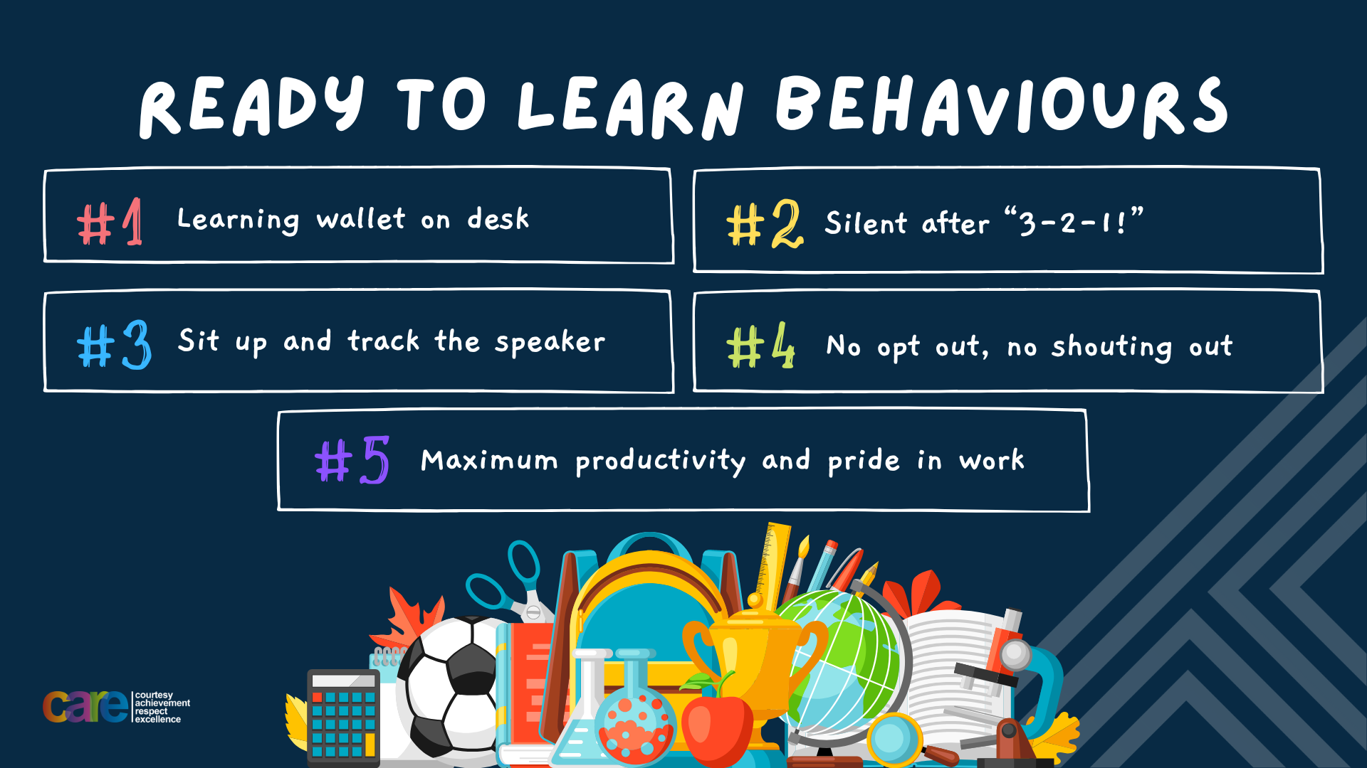

Slide 3


Secure your Future: Learning Journey
Introduction to careers and the world of work
Different careers and sectors
Skills and qualities needed for work
The importance of education and training
Workplace responsibilities
Dream jobs
Today we will look at:
Introduction to careers and the world of work
This includes:
Definitions of careers and world of work
Identify different careers
Recognise how people get into careers
Please remember that during the lesson we should not be asking any pupil or teacher personal questions.
Your teacher can ask you questions but this will be to check your knowledge in the lesson.

Slide 4



What are Careers?
In your books complete the following sentence:
“I think the definition of a career is…”

Slide 5
What are Careers?
The definition of career is…
“a journey through working life”
It is not just one job
Task – use your red pen to add to what you had written down

Slide 6
What is the world of work
In your books complete the following sentence:
“I think the definition of world of work is…”

Slide 7
What is the world of work?
The definition of the world of work is…
“all the jobs people do and how workplaces operate”
Task – use your red pen to add to what you had written down

Slide 8

Why are we learning about this?
This links to the Golden Thread of “Secure your Future”
This is really important for your future as what we will learn can clarify questions you had about different careers, what different jobs do and what will be expected of you when you are old enough to have a job or even run your own business

Slide 9
Hinge Questions – whiteboard activity
3
Rules!
I will ask the question and give you some thinking time. (no more than 10 seconds)
Write the answer and turn your whiteboard over so nobody can see it.
When I am ready I will put on the 3 to 1 counter.
When ‘Show me’ appears on the board you must hold up your whiteboard (even if you don’t know the answer and there is nothing on your board)
2
1
Show me!
(even if your whiteboard is blank)

Slide 10
Hinge Questions – whiteboard activity
What is being described?
“a journey through working life”
Career

Slide 11
Hinge Questions – whiteboard activity
What is being described?
“all the jobs people do and how workplaces operate”
World of Work

Slide 12
Hinge Questions – whiteboard activity
What job is being described?
This job requires a stethoscope, patient notes, uniform. At work they care for people and monitor health
Doctor/Nurse

Slide 13
Hinge Questions – whiteboard activity
What job is being described?
This job requires a hard hat, trowel and cement mixer.
Builder/Brick Layer

Slide 14
Hinge Questions – whiteboard activity
What job is being described?
This job creates apps, games and websites. It requires a computer and knowing code.
Software Developer

Slide 15
Hinge Questions – whiteboard activity
What job is being described?
This job helps animals when they are sick or injured.
Vet

Slide 16
Hinge Questions – whiteboard activity
What job is being described?
This job requires lots of creativity to make visual pieces for displays or to sell
Artist

Slide 17
Careers and World of Work
In the margin write “SYV” – This stands for “Secure Your Voice”
Highlight “SYV”
Answer the question:
“How do people choose a job or a career?”

Slide 18

Careers and World of Work
Using your oracy helpsheet, with the person next to you, discuss your response to the question:
“How do people choose a job or a career?”
Remember to use the sentence starters to add, build or challenge what your partner has said.
Be ready to share your discussion with the class

Slide 19
Careers and World of Work
There are multiple ways that people can find themselves a job or a career.
This may include:
-apprenticeships
-going to university
-gaining experience in a sector and progressing

Slide 20
Careers and World of Work
Everyone’s path to a job or career is very different.
However some jobs and careers require people to have completed certain requirements along their own path

Slide 21
Careers and World of Work
Match up the careers with the requirements of a career path
Must have attended university
Retail assistant
Completed a relevant apprenticeship
Doctor
Achieved at least a 4 in Maths and English at GCSE level
Plumber

Slide 22
Careers and World of Work
In the margin write “SYV” – This stands for “Secure Your Voice”
Highlight “SYV”
Answer the question:
“Why do jobs different requirements?”

Slide 23
Careers and World of Work
Using your oracy helpsheet, with the person next to you, discuss your response to the question:
“Why do jobs different requirements?”
Remember to use the sentence starters to add, build or challenge what your partner has said.
Be ready to share your discussion with the class

Slide 24
Careers and World of Work
Task
Choose a job you know something about
Write down what requirements would be expected of a person on the path to having this job.

Slide 25
Careers and World of Work
Using your oracy helpsheet, with the person next to you, discuss your response to the question:
“What job did you choose and what is the requirements for this job?”
Remember to use the sentence starters to add, build or challenge what your partner has said.
Be ready to share your discussion with the class

Slide 26
Careers and World of Work
It is important to remember that regardless of a persons pathway to a career or job, everyone is different and if they work hard can be successful

Slide 27
Careers and World of Work - scenario
Chloe spends most of her time in a hospital ward helping patients get better. She checks their temperature, gives them medicine, and talks to them to keep them calm. Chloe always loved science at school, especially biology. After finishing her GCSEs, she did a college course in Health and Social Care and then completed a university degree. Now she works long shifts, but she enjoys making a difference.
In the margin write “SYV” – This stands for “Secure Your Voice”
Highlight “SYV”
Answer the questions:
- What is Chloe’s job?
- What were the main steps in their career journey?

Slide 28
Careers and World of Work
Using your oracy helpsheet, with the person next to you, discuss your response to the question:
“What is Chloe’s job and what were the main steps in their career journey?”
Remember to use the sentence starters to add, build or challenge what your partner has said.
Be ready to share your discussion with the class

Slide 29
Careers and World of Work - scenario
Jamal works for a popular video game company in Manchester. He spends his day designing characters, backgrounds, and game levels on his computer. He loved art and ICT at school and always enjoyed creating things. After school, he went to college to study Graphic Design, then completed a university course in Game Art. Jamal also practised a lot at home using design software and even made his own small games as a teen.
In the margin write “SYV” – This stands for “Secure Your Voice”
Highlight “SYV”
Answer the questions:
- What is Jamal’s job?
- What were the main steps in their career journey?

Slide 30
Careers and World of Work
Using your oracy helpsheet, with the person next to you, discuss your response to the question:
“What is Jamal’s job and what were the main steps in their career journey?”
Remember to use the sentence starters to add, build or challenge what your partner has said.
Be ready to share your discussion with the class

Slide 31
Careers and World of Work - scenario
Amina loved fixing things as a child—she was always helping her grandad with tools. After school, she decided university wasn’t for her. Instead, she applied for an apprenticeship with a local company that repairs cars and vans. She worked alongside skilled professionals and learned how to diagnose engine problems and carry out repairs. Now, a few years later, she’s a qualified mechanic and works in a busy garage.
In the margin write “SYV” – This stands for “Secure Your Voice”
Highlight “SYV”
Answer the questions:
- What is Amina’s job?
- What were the main steps in their career journey?

Slide 32
Careers and World of Work
Using your oracy helpsheet, with the person next to you, discuss your response to the question:
“What is Amina’s job and what were the main steps in their career journey?”
Remember to use the sentence starters to add, build or challenge what your partner has said.
Be ready to share your discussion with the class

Slide 33
Careers and World of Work
It is never to early to start thinking about potential jobs and careers.
Throughout your time at Hodge Hill College you will have lots of opportunities to explore careers and help to prepare you for entering the world of work.
If you have any questions about careers please speak to Mrs Jamil or Mr Broadrick

Slide 34


