Slide 1





Write the date: 14 April 2025
Write the Title and Golden Thread
Title – Different careers and career sectors
Golden Thread – Secure Your Future
Underline both using your ruler & take out your oracy helpsheet
Complete the following questions:
What is being described: “a journey through working life”
State a physical change that happens to everyone during puberty
True or False: one benefit of social health is that people might eat less unhealthy foods and snacks?
Career
Growth spurt, stretch marks, genitals grow, sweat more, spots and acne, thicker body hair,
True

Slide 2
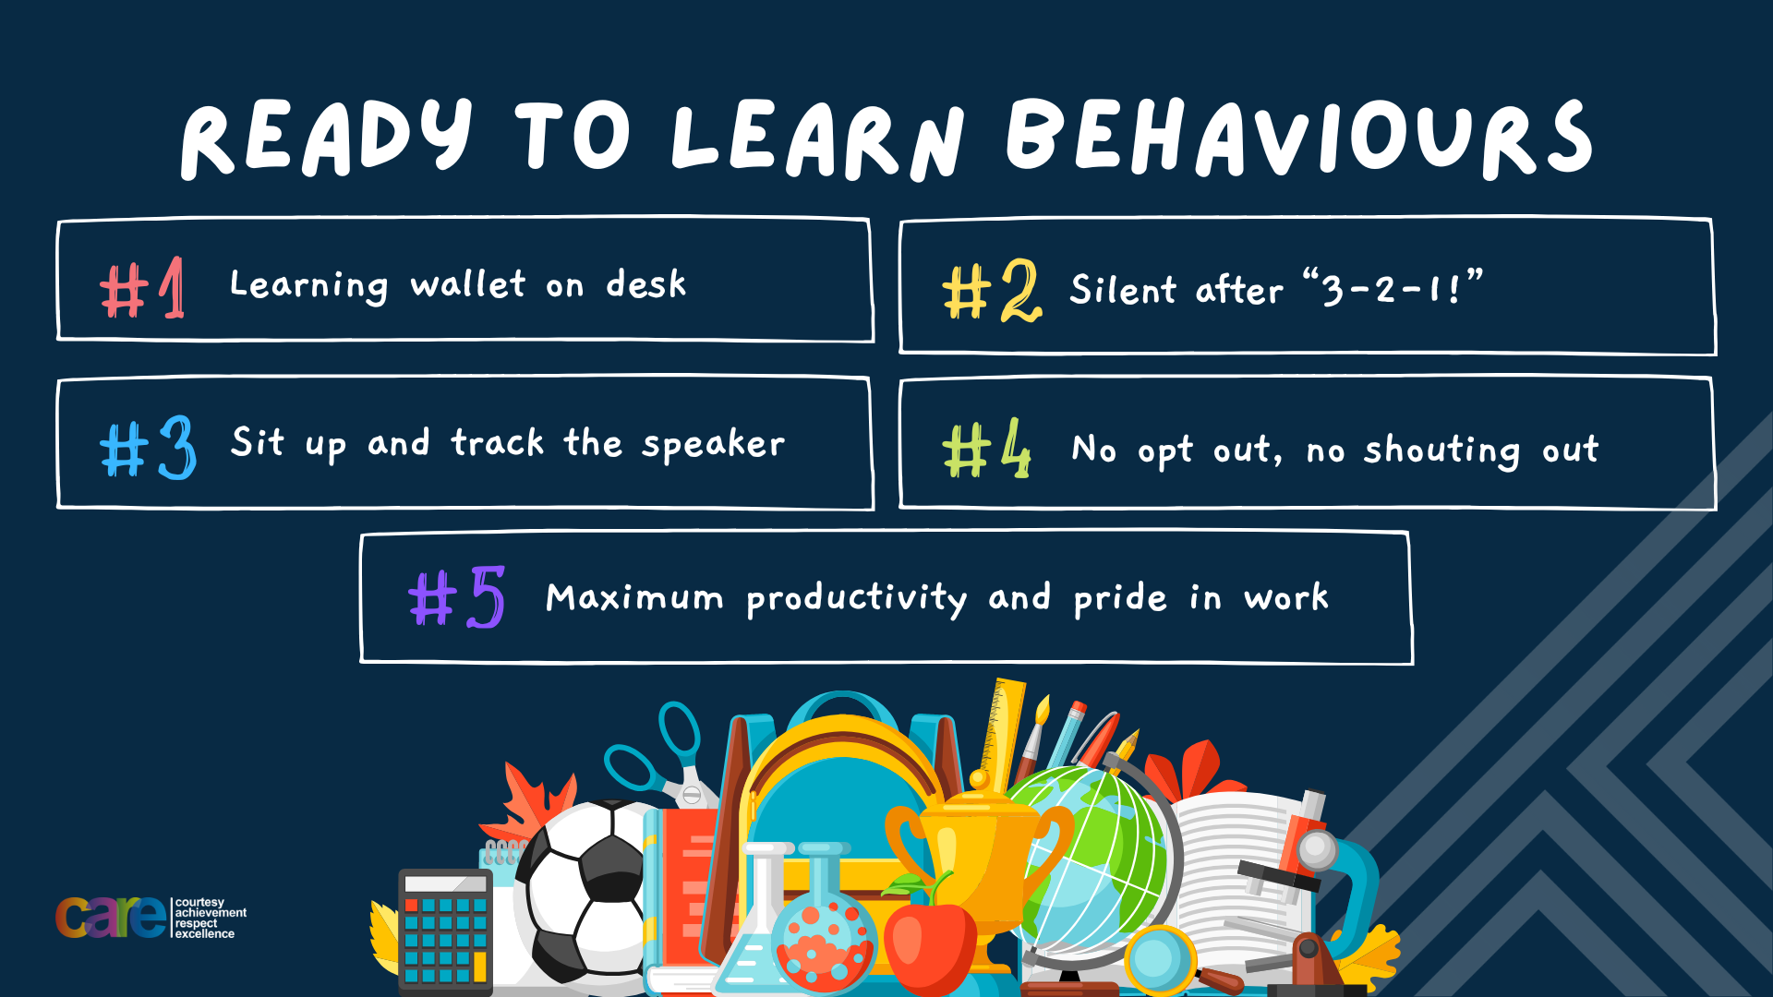

Slide 3


Secure your Future: Learning Journey
Introduction to careers and the world of work
Different careers and sectors
Skills and qualities needed for work
The importance of education and training
Workplace responsibilities
Dream jobs
Today we will look at:
Introduction to careers and the world of work
This includes:
Definitions of careers and world of work
Identify different careers
Recognise how people get into careers
Please remember that during the lesson we should not be asking any pupil or teacher personal questions.
Your teacher can ask you questions but this will be to check your knowledge in the lesson.

Slide 4



What is a career sector?
In your books complete the following sentence:
“I think the definition of a career sector is…”

Slide 5
What is a career sector?
The definition of career sector is…
“a broad grouping of industries and organisations in a similar type of work”
It is not just one job
Task – use your red pen to add to what you had written down

Slide 6

Why are we learning about this?
This links to the Golden Thread of “Secure your Future”
This is really important for your future as what we will learn can clarify questions you had about different careers, what different jobs do and what will be expected of you when you are old enough to have a job or even run your own business

Slide 7

Discussion Point
You have 1 minute to think about the following question:
“What career sectors do you know?”

Slide 8
Discussion Point
With the person next to you, discuss your response to the question:
“What career sectors do you know?”
Remember to use your oracy helpsheet to add, build and challenge during the discussion.
Be ready to share your discussion with the class.

Slide 9
Career Sectors
Some career sectors are:
Healthcare
Education
Construction
Digital/technology
Creative Arts
Public services
Hospitality

Slide 10








Career Sectors
Looking at the pictures below, decide what career sector they work in
Healthcare
Education
Construction
Digital/technology
Public Services
Creative Arts
Hospitality
Construction

Slide 11
Hinge Questions – whiteboard activity
3
Rules!
I will ask the question and give you some thinking time. (no more than 10 seconds)
Write the answer and turn your whiteboard over so nobody can see it.
When I am ready I will put on the 3 to 1 counter.
When ‘Show me’ appears on the board you must hold up your whiteboard (even if you don’t know the answer and there is nothing on your board)
2
1
Show me!
(even if your whiteboard is blank)

Slide 12
Hinge Questions – whiteboard activity
What is being described?
“a broad grouping of industries and organisations in a similar type of work”
Career sectors

Slide 13

Hinge Questions – whiteboard activity
What job sector would a paramedic work in?
A – Construction
B – Hospitality
C – Creative Arts
D - Healthcare

Slide 14
Hinge Questions – whiteboard activity
What job sector would an electrician work in?
A – Public Services
B – Construction
C – Education
D - Healthcare

Slide 15
Hinge Questions – whiteboard activity
What job sector would a chef work in?
A – Healthcare
B – Construction
C – Hospitality
D - Education

Slide 16
Hinge Questions – whiteboard activity
What job sector would an app developer work in?
A – Education
B – Construction
C – Hospitality
D – Digital/technology

Slide 17
Hinge Questions – whiteboard activity
What job sector would a fashion designer work in?
A – Education
B – Creative Arts
C – Hospitality
D – Digital/technology

Slide 18
Discussion Point
You have 1 minute to think about the following question:
“What do you think are the biggest career sectors in the UK?”

Slide 19
Discussion Point
With the person next to you, discuss your response to the question:
“What do you think are the biggest career sectors in the UK?”
Remember to use your oracy helpsheet to add, build and challenge during the discussion.
Be ready to share your discussion with the class.

Slide 20
Career Sectors in the UK
Across the UK, the career sectors with the biggest employment are:
Healthcare – the NHS is the largest employer
Retail – supermarkets, high street shops
Education – schools, colleges, universities
Hospitality – hotels, restaurants and tourism
Manufacturing – factories, automotives and aerospace
Construction – builders, trades people
Digital/technology – app developers and software

Slide 21
Discussion Point
You have 1 minute to think about the following question:
“What do you think are the biggest career sectors in Birmingham?”

Slide 22
Discussion Point
With the person next to you, discuss your response to the question:
“What do you think are the biggest career sectors in Birmingham?”
Remember to use your oracy helpsheet to add, build and challenge during the discussion.
Be ready to share your discussion with the class.

Slide 23
Career Sectors in Birmingham
In Birmingham, the career sectors with the biggest employment are:
Manufacturing – particularly automotive due to Jaguar Land Rover and others.
Healthcare – two big hospitals – Birmingham Women’s and Children Hospital and Queen Elizabeth Hospital
Construction – particularly due to HS2 rail project and lots of major urban development projects
Education – large number of schools and 5 universities
Technology/digital – particularly in areas like Digbeth and what has been dubbed “Silicon Canal”

Slide 24
Career Sectors
In the margin write “SYV” – This stands for “Secure Your Voice”
Highlight “SYV”
Answer the question:
“What career sector would you like to work in and why?”

Slide 25

Careers sectors
Using your oracy helpsheet, with the person next to you, discuss your response to the question:
“What career sector would you like to work in and why?”
Remember to use the sentence starters to add, build or challenge what your partner has said.
Be ready to share your discussion with the class

Slide 26
Career Sectors
In the margin write “SYV” – This stands for “Secure Your Voice”
Highlight “SYV”
Answer the question:
“What career sector would you not like to work in and why?”

Slide 27
Careers sectors
Using your oracy helpsheet, with the person next to you, discuss your response to the question:
“What career sector would you not like to work in and why?”
Remember to use the sentence starters to add, build or challenge what your partner has said.
Be ready to share your discussion with the class

Slide 28
Career Sectors
Choosing a career sector can be difficult.
There are lots of things to consider when choosing.

Slide 29

Career Sectors
While watching the video, write down some things to consider when choosing a career sector
Notes:
https://www.youtube.com/watch?v=P6ccfmejRiw

Slide 30
Choosing a career sector
Match up the reasons for choosing a career sector
Working in an industry that aligns with your passions or interests can be immensely satisfying
Longevity and stability
Different industries have distinct work cultures
Job satisfaction
Career progression
Chosen industry can dictate your earning potential
Some sectors provide clearer or more varied pathways for career development
Work – Life balance
Industries at the forefront of innovation and change often provide opportunities for continuous learning
Personal growth and development
Financial Prospects
Some industries have more staying power than others

Slide 31
Choosing a career sector
Some reasons for choosing a career sector are:
Longevity and stability
Job satisfaction
Financial prospects
Career Progression
Work – life balance
Personal growth and development
In the margin write “SYV” – This stands for “Secure Your Voice”
Highlight “SYV”
Answer the question:
“What reason is most important for you when choosing a career sector? Why?”

Slide 32
Choosing a career sector
Using your oracy helpsheet, with the person next to you, discuss your response to the question:
“What reason is most important for you when choosing a career sector? Why?”
Remember to use the sentence starters to add, build or challenge what your partner has said.
Be ready to share your discussion with the class

Slide 33
Careers and World of Work - scenario
Dylan has always loved taking things apart and figuring out how they work. At home, he helped his uncle fix a motorbike, and at school, he enjoys science and design technology the most. When he left school at 16, he started an apprenticeship with Jaguar Land Rover in Solihull to train as a mechanical engineer. He likes learning by doing, and one day he hopes to help design eco-friendly electric cars.
In the margin write “SYV” – This stands for “Secure Your Voice”
Highlight “SYV”
Answer the questions:
- What is Dylan’s job?
- What career sector does Dylan work in?
- Why did Dylan choose this job sector?

Slide 34
Careers and World of Work - scenario
Aaliyah is friendly, calm under pressure, and loves helping people. She volunteers at her local community centre in Birmingham and always knew she wanted to make a difference. After getting her GCSEs, she went to college to study health and social care, then went to university to become a nurse. She now works at Birmingham Children’s Hospital and says she loves making young patients smile
In the margin write “SYV” – This stands for “Secure Your Voice”
Highlight “SYV”
Answer the questions:
- What is Aaliyah’s job?
- What career sector does Aaliyah work in?
- Why did Aaliyah choose this job sector?

Slide 35
Careers and World of Work - scenario
Priya grew up in a large family where money was sometimes tight. She’s very ambitious and has always said she wants to earn a lot of money when she’s older so she can help her family, travel the world, and one day buy her own house. At school, she’s excellent at maths and problem-solving. After doing well in her GCSEs and A-levels, she got into a top university to study finance. She is now an investment banker in London — a job that pays very well but also involves long hours and hard work.
In the margin write “SYV” – This stands for “Secure Your Voice”
Highlight “SYV”
Answer the questions:
- What is Priya’s job?
- What career sector does Priya work in?
- Why did Priya choose this job sector?

Slide 36
Careers and World of Work
It is never to early to start thinking about potential jobs and careers.
Throughout your time at Hodge Hill College you will have lots of opportunities to explore careers and help to prepare you for entering the world of work.
If you have any questions about careers please speak to Mrs Jamil or Mr Broadrick

Slide 37


