Slide 1





Write the date: 14 April 2025
Write the Title and Golden Thread
Title – What is social health
Golden Thread – Secure Your Wellbeing
Underline both using your ruler & take out your oracy helpsheet
Complete the following questions:
What is being described: “a state of mental well being that enables people to cope with the stresses of life, realise their abilities, learn well and work well and contribute to their community”
What parts of the body sweat the most
True or False: toothpaste should include fluoride
Mental Health
Feet, armpits, genitals
True

Slide 2
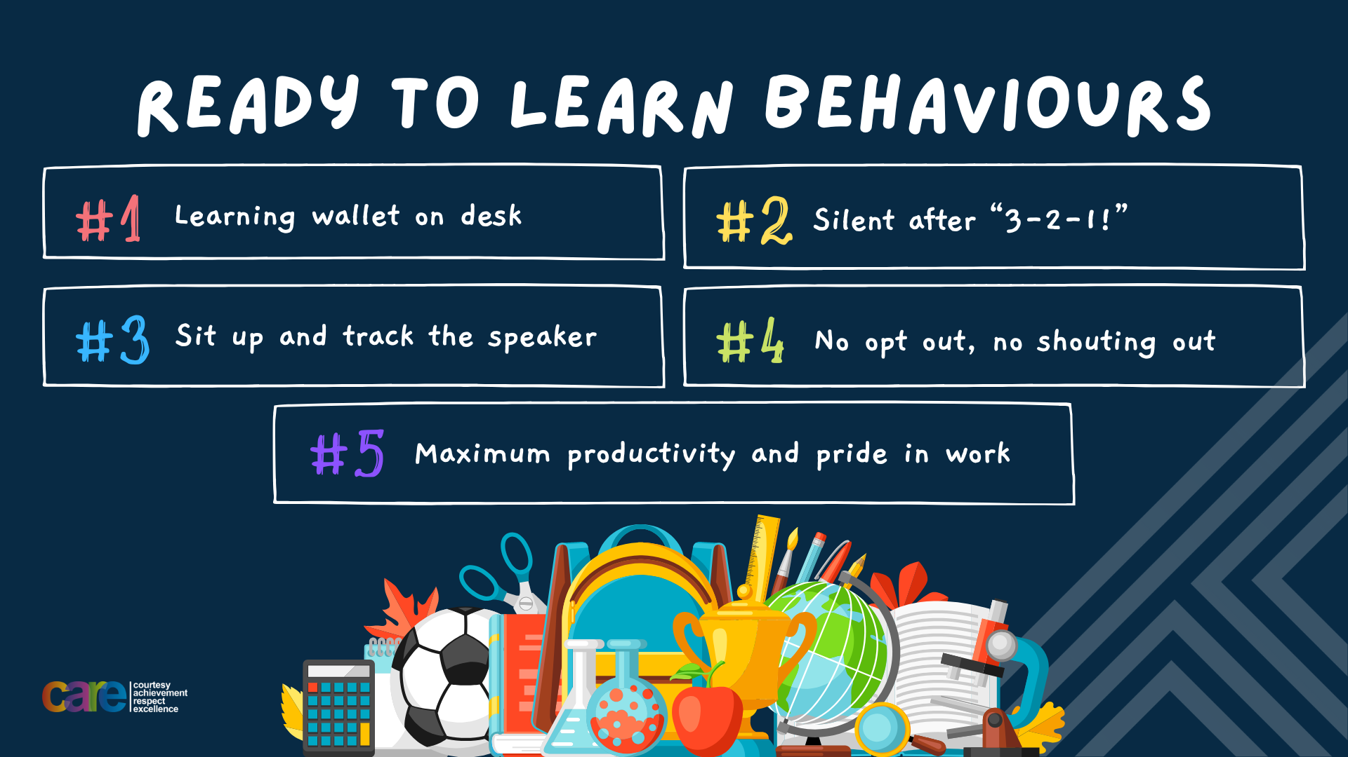

Slide 3


Secure your Wellbeing: Learning Journey
Staying safe – rail, bike and water
What is oral health
What is personal hygiene?
What is mental health?
What is social and physical health?
What does puberty mean?
Today we will look at:
What is social health?
This includes:
Definition of social health
Benefits of social health
Please remember that during the lesson we should not be asking any pupil or teacher personal questions.
Your teacher can ask you questions but this will be to check your knowledge in the lesson.

Slide 4

Tutor Time recap
In your Personal Development Tutor Time activity, you looked at social health
In your books answer the following question:
“What is the definition of social health?”
Sentence starter – Social health is…

Slide 5
Tutor Time recap
Social health is…
“how we interact with other people in different situations”
Task – use your red pen to add to what you had written down.

Slide 6




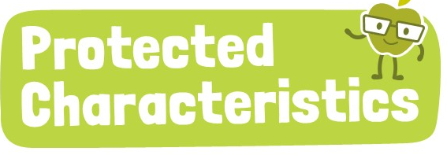
Tutor Time Recap
This links to the Golden Thread of “Secure your Wellbeing” as social health is a core element of overall wellbeing which can positively impact mental and physical health
Article 15 states that children have the right to join or set up groups. This is an example of good social health as people will be working together and surrounded by like minded people
There are 9 protected characteristics. Unfortunately, people are treated differently due to identifying with these characteristics. This can negatively impact their social health as they will not interact well with people who do not identify the same as them.
UN Rights
of a Child

Slide 7
Benefits of Social Health
In tutor time you watched a video that outlined the benefits of having good social health.
We are going to watch the video again. While watching the video complete the following sentence:
“Benefits of social health are…”

Slide 8

What is social health?
Notes:
https://www.youtube.com/watch?v=f3dBPulbLSk

Slide 9

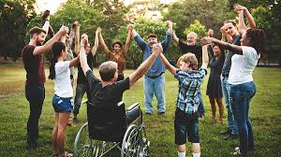

Benefits of social health
Benefits of social health are:
Eat a healthier diet
Be more physical active
Less likely to smoke/vape
Manage stress
Lower risk of major health problems
Overall happier life

Slide 10
Benefits of social health
In the margin write “SYV” – This stands for “Secure Your Voice”
Highlight “SYV”
Add to your list in red pen and number the benefits in order of what you think is most important.
Benefits of social health are:
Eat a healthier diet
Be more physical active
Less likely to smoke/vape
Manage stress
Lower risk of major health problems
Overall happier life

Slide 11

Benefits of social health
Using your oracy helpsheet, with the person next to you, discuss your response to the question:
“What benefit of social health do you think is most important? Why?”
Remember to use the sentence starters to add, build or challenge what your partner has said.
Be ready to share your discussion with the class

Slide 12
Hinge Questions – whiteboard activity
3
Rules!
I will ask the question and give you some thinking time. (no more than 10 seconds)
Write the answer and turn your whiteboard over so nobody can see it.
When I am ready I will put on the 3 to 1 counter.
When ‘Show me’ appears on the board you must hold up your whiteboard (even if you don’t know the answer and there is nothing on your board)
2
1
Show me!
(even if your whiteboard is blank)

Slide 13
Hinge Questions – whiteboard activity
What is being described?
“how we interact with other people in different situations”
Social health

Slide 14

Hinge Questions – whiteboard activity
What golden thread does this topic relate to?
A – Secure your Future
B – Secure your Wellbeing
C – Secure your Relationships
D – Secure your Voice

Slide 15
Hinge Questions – whiteboard activity
True or False
“One benefit of social health is that people might eat less unhealthy foods and snacks”
A – True
B – False

Slide 16
Hinge Questions – whiteboard activity
True or False
“One benefit of social health is that people might spend more time on social media instead of being physically active”
A – True
B – False

Slide 17
Hinge Questions – whiteboard activity
True or False
“One benefit of social health is that people are more likely to smoke and vape”
A – True
B – False

Slide 18
Hinge Questions – whiteboard activity
True or False
“One benefit of social health is that people less likely to have some major health problems in the future such as cardiovascular disease”
A – True
B – False

Slide 19
Hinge Questions – whiteboard activity
True or False
“One benefit of social health is that people are generally happier”
A – True
B – False

Slide 20
Components of social health
There are 4 key components to social health. These are:
Friendships and relationships
Communication skills
Teamwork and Cooperation
Respect and Inclusion

Slide 21
Components of social health
There are 4 key components to social health. These are:
Friendships and relationships
Communication skills
Teamwork and Cooperation
Respect and Inclusion
Write these 4 components down in your books under the subtitle components of social health

Slide 22
Components of social health
Friendships and relationships are important for social health because:
They help people feel connected and valued
They can help people through life’s ups and downs
They teach important social skills like trust and empathy

Slide 23
Components of social health
In the margin write “SYV” – This stands for “Secure Your Voice”
Highlight “SYV”
Complete the following sentence
“A good friend is someone who…”

Slide 24
Components of social health
Using your oracy helpsheet, with the person next to you, discuss your response to the question:
“How did you finish the sentence: a good friend is someone who…”
Remember to use the sentence starters to add, build or challenge what your partner has said.
Be ready to share your discussion with the class

Slide 25
Components of social health
Another key component is communication. This is important because:
It lets people share their feelings, resolve conflicts and builds trust
It promotes listening. Communication is not just talking. It is about listening and understanding
It teaches that non-verbal communication such a body language is just as important as words

Slide 26
Components of social health
Task – to look at your communication skills complete the following steps:
With the person next to you, number yourselves 1 and 2
1 you are going to tell 2 about what TV show/YouTube channel you are currently enjoying.
2 – you must listen as you will be asked to explain what 1 has said to you.

Slide 27
Components of social health
Task – now swap roles:
2 you need to explain what your dream holiday is
1 you must listen as you will be asked to retell what has been said to you

Slide 28
Components of social health
Think about the conversations you have just had. You can also think about other conversations you have had with friends and family.

Slide 29
Components of social health
In the margin write “SYV” – This stands for “Secure Your Voice”
Highlight “SYV”
Answer the following questions:
How does it feel to be listened to?
How does it feel when you are interrupted, especially when the interruption is not related to what you were saying?

Slide 30
Components of social health
Using your oracy helpsheet, with the person next to you, discuss your response to the question:
“How does it feel to be listened to? How does it feel when you are interrupted, especially when the interruption is not related to what you were saying?”
Remember to use the sentence starters to add, build or challenge what your partner has said.
Be ready to share your discussion with the class

Slide 31
Components of social health
The next component of social health is teamwork and cooperation. This is important because:
Working well in teams can help people achieve goals and learn from others
Teamwork builds cooperation, problem solving and communication skills
It promotes inclusivity to make sure everyone is involved and feel like they are contributing

Slide 32
Components of social health
In groups of 3 or 4 complete the following challenge:
You need to solve what the following words translate too:
“yobxh fp lro dlxi”
Clue – each letter in the alphabet shifts forward 3 letters. If you get to “z” then restart at “A” Example – Y is B

Slide 33
Components of social health
The answer was…
“break is our goal”

Slide 34
Components of social health
In groups of 3 or 4 complete the following challenge:
Riddle 1 – What has keys but can’t open locks?
Riddle 2 – What has to be broken before you can use it?
Riddle 3 – A man shaves many times during the day but at the end of the day he still has a beard, How is this possible?

Slide 35
Components of social health
The answers were:
Riddle 1 – What has keys but can’t open locks? = a piano
Riddle 2 – What has to be broken before you can use it? = an egg
Riddle 3 – A man shaves many times during the day but at the end of the day he still has a beard, How is this possible? = The man is a barber

Slide 36
Components of social health
The last component is respect and inclusion. This is important because:
Respect allows people to feel valued, heard and accepted
It ensure people from all backgrounds, cultures and experiences feel welcome

Slide 37
Components of social health
In the margin write “SYV” – This stands for “Secure Your Voice”
Highlight “SYV”
Answer the following questions:
I think respect is important because…
We can include other people by…

Slide 38
Components of social health
Using your oracy helpsheet, with the person next to you, discuss your response to the question:
“How did you finish the sentences?”
Remember to use the sentence starters to add, build or challenge what your partner has said.
Be ready to share your discussion with the class

Slide 39
Reflection
Social health is about forming strong, healthy relationships through good communication, respect, and teamwork.
Friendships, listening, and being inclusive are essential for positive social health.
Small acts of kindness, such as showing respect and helping others, can have a big impact.

Slide 40



Support
If you ever need support about social health for either yourself or a friend/family member, you can get support from the following places
Childline.org.uk
Call – 08001111
Email or chat online for support
Themix.org.uk
You can email or have one-to-chat online.
There is also a crisis messenger which is available 24/7

Slide 41


