Slide 1
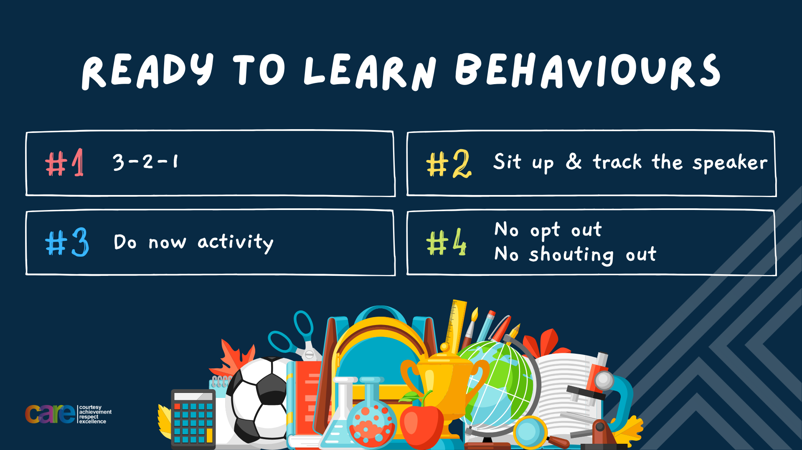

Slide 2





Write the date: 14 April 2025
Write the Title and Golden Thread
Title – What is cyberbullying?
Golden Thread – Secure Your Relationships
Underline both using your ruler & take out your oracy helpsheet
Complete the following questions:
What is being described: ““friendships made with people through the internet”
True or False – “bullying and banter are the same thing”
How do you set goals?
Online friendships
False
SMART

Slide 3


Secure your Relationships: Learning Journey
What makes a good friend?
What is peer pressure?
What is the difference between bullying and banter?
Are online friendship safe?
What is cyberbullying?
What are stereotypes?
Today we will look at:
What is cyberbullying?
This includes:
Definition of cyberbullying
Examples of cyberbullying
Please remember that during the lesson we should not be asking any pupil or teacher personal questions.
Your teacher can ask you questions but this will be to check your knowledge in the lesson.

Slide 4
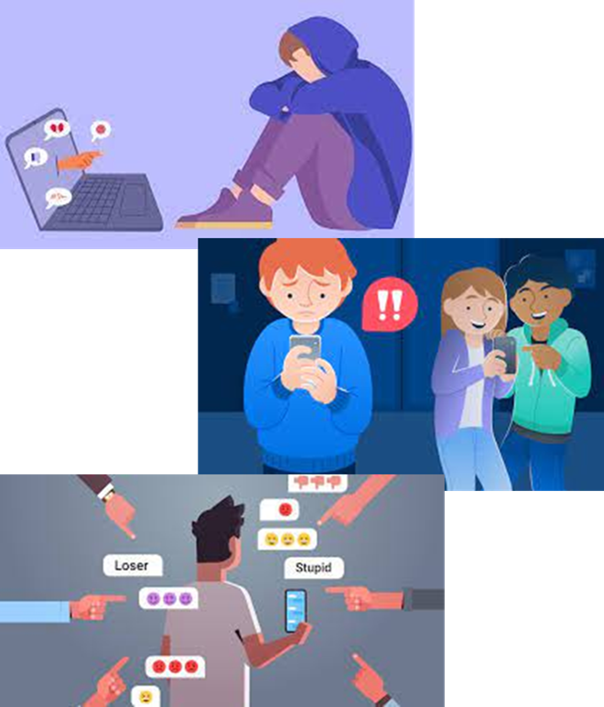
Tutor Time Recap
In your Personal Development Tutor Time activity, you started to look at cyberbullying
In your books answer the following question:
“What is the definition of cyberbullying?”
Sentence starter – cyberbullying is…

Slide 5

Tutor Time Recap
Cyberbullying is:
“bullying with the use of digital technologies that has the aim of scaring, angering or shaming another person”
Task – use your red pen to add to the definition you had written down.

Slide 6
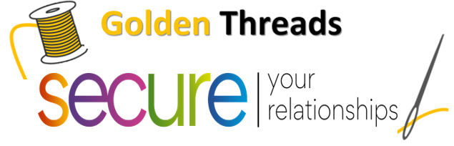

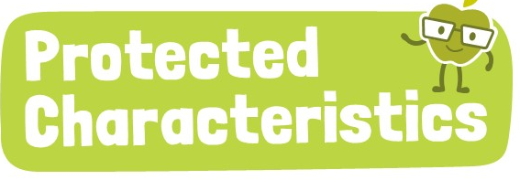
Tutor Time Recap
We are learning this because:
Links to the Golden Thread of “Secure your relationships”. How people treat each other offline should be the same online
Rule of Law is a British Value. It is against the law to threaten people online.
Article 15 of the UN Rights of a Child state children have the right to set up and join groups. This also applies online but as long as it is within the law and does not harm other people
No one should be treated differently for identifying with one or more of the protected characteristics. This also applies online.
UN Rights
of a Child

Slide 7
Examples of cyberbullying
Examples of cyberbullying include:
Spreading lies or rumours about someone online
Posting photos or videos (especially embarrassing ones) of other people without their permission. Refusal to remove photos/videos if requested
Sending hurtful, abusive or threatening messages, images of videos to someone
Impersonating someone (making a fake profile) and sending messages to others pretending to be them

Slide 8
Examples of cyberbullying
Examples of cyberbullying include:
Spreading lies or rumours about someone online
Posting photos or videos (especially embarrassing ones) of other people without their permission. Refusal to remove photos/videos if requested
Sending hurtful, abusive or threatening messages, images of videos to someone
Impersonating someone (making a fake profile) and sending messages to others pretending to be them
Task
In the margin write “SYV” – This stands for “Secure Your Voice”
Highlight “SYV”
Write down the examples of cyberbullying in rank order of what you think is most common.

Slide 9

Examples of cyberbullying
Using your oracy helpsheet, discuss with the person next to you:
“what example of cyberbullying do you think is most common?”
Remember to use the sentence starters to add, build or challenge what your partner has said.
Be ready to share your discussion with the class

Slide 10

Hinge Questions – whiteboard activity
3
Rules!
I will ask the question and give you some thinking time. (no more than 10 seconds)
Write the answer and turn your whiteboard over so nobody can see it.
When I am ready I will put on the 3 to 1 counter.
When ‘Show me’ appears on the board you must hold up your whiteboard (even if you don’t know the answer and there is nothing on your board)
2
1
Show me!
(even if your whiteboard is blank)

Slide 11
Hinge Questions – whiteboard activity
What is being described?
“bullying with the use of digital technologies that has the aim of scaring, angering or shaming another person”
cyberbullying

Slide 12

Hinge Questions – whiteboard activity
What golden thread does this topic relate to?
A – Secure your Future
B – Secure your Wellbeing
C – Secure your Relationships
D – Secure your Voice

Slide 13
Hinge Questions – whiteboard activity
True or False:
“cyberbullying can only happen online”
A – True
B - False

Slide 14
Hinge Questions – whiteboard activity
True or False:
“spreading rumours about someone online is an example of cyberbullying”
A – True
B - False

Slide 15
Hinge Questions – whiteboard activity
True or False:
“pretending to be another person online is an example of cyberbullying”
A – True
B - False

Slide 16
Hinge Questions – whiteboard activity
True or False:
“people should treat each other the same online as they do offine”
A – True
B - False

Slide 17
Online vs Offline behaviour
There is often a disconnect between our perception of life on and offline.
This can make it difficult to decide what counts as acceptable and unacceptable behaviour.
Research shows that 46% of young people say that “real life” is only what happens offline

Slide 18
Online vs Offline behaviour
It is clear that as society, people need to reflect on what they say online.
People need to realise that what they say “online” has a huge impact “offline”
Everyone should be treating each other the same online as we would like to be treated offline.

Slide 19
Your online behaviour
There are now going to be a number of statements on the board.
For each statement, give your 1 point if you have displayed this behaviour online in the past.
It is important that you are honest with yourself. No one will be asked to share their score. This is a reflection exercise for you.

Slide 20
Your online behaviour
You have shared a screenshot of someone else’s status/photo to a group chat so you can laugh at it
Trolled (either verbally or via message) somebody in an online game
Liked or shared something online that openly makes fun of another person
Done something to simply annoy someone you don’t like online

Slide 21
Your online behaviour
Like or shared something online that openly insults or offends another person (either someone you know or a celebrity/influencer)
Sent a nasty message, either privately or publically to someone you know offline
Created a fake profile and used it to annoy or upset someone

Slide 22
Your online behaviour
Teamed up against another player on a game so that they lose
Joined an online pile on (an attack by a large group of people against one person)
Trolled someone you don’t know for a joke
Sent a nasty message either privately or publically to somebody you do not know offline

Slide 23
Your online behaviour
Now total up your score.
1-3 points – you’re a first class online citizen – you should be proud of your online behaviour
4-7 points – you’re on dodgy ground – some of the stuff you’ve done online is a bit concerning and it could be hurting other people
8-11 points – it’s time to rethink your online behaviour – a lot of what you do online is damaging to other people

Slide 24
Effects of cyberbullying
When bullying happens “offline” or in “real life” you can remove yourself from the environment to give yourself space and you can begin to feel safe again
When cyberbullying happens it can feel like there is no escape as you feel attacked from everywhere even when you’re sitting in your own home

Slide 25
Effects of cyberbullying
Cyberbullying can affect you in 3 main ways:
Mentally – feeling upset, embarrassed, stupid, afraid or angry
Emotionally – feeling ashamed or losing interest in the things you enjoy
Physically – feeling tired and experience constant stomach aches or headaches

Slide 26
Hinge Questions – whiteboard activity
3
Rules!
I will ask the question and give you some thinking time. (no more than 10 seconds)
Write the answer and turn your whiteboard over so nobody can see it.
When I am ready I will put on the 3 to 1 counter.
When ‘Show me’ appears on the board you must hold up your whiteboard (even if you don’t know the answer and there is nothing on your board)
2
1
Show me!
(even if your whiteboard is blank)

Slide 27
Hinge Questions – whiteboard activity
True or False:
“cyberbullying only impacts people when they are online”
A – True
B - False

Slide 28
Hinge Questions – whiteboard activity
What impact is being described:
“makes a person feel embarrassed, stupid, afraid or angry”
A – Mentally
B - Physically
C - Emotionally

Slide 29
Hinge Questions – whiteboard activity
What impact is being described:
“makes a person feel ashamed or lose interest in the things they enjoy”
A – Mentally
B - Physically
C - Emotionally

Slide 30
Hinge Questions – whiteboard activity
What impact is being described:
“makes a person feel more tired or experience stomach aches or headaches”
A – Mentally
B - Physically
C - Emotionally

Slide 31
Fill in the gaps
Cyberbullying is bullying that happens ________. It is designed to ________, _______ or annoy people. Cyberbullying can be towards people who you _____ or don’t know such as _________. Cyberbullying can make it feel like you are always being ________, even at home. It can affect you ________ as you can feel upset or embarrassed. It can affect you _______ as you may lose interest in things you enjoy. It can affect you ________ as you may feel more tired or have stomach aches or headaches more often
Word Bank
Celebrities
Online
Attacked
Mentally
Physically
Hurt
Emotionally
Know
Embarrass
Online
hurt
embarrass
know
celebrities
attacked
mentally
emotionally
physically

Slide 32




Support for Bullying – outside of school
Childline.org.uk
Call – 08001111
Email or chat online for support
Nationalbullyinghelpline.co.uk
Call 0845 225 5787
Open 9-5 Mon-Fri and 10-12 on Saturday
Themix.org.uk
You can email or have one-to-chat online.
There is also a crisis messenger which is available 24/7
Victimsupport.org.uk
Call – 0808 1689 111
Online one-to-to chat

Slide 33

Support
If you ever need support about cyberbullying in school:

Slide 34


