Slide 1
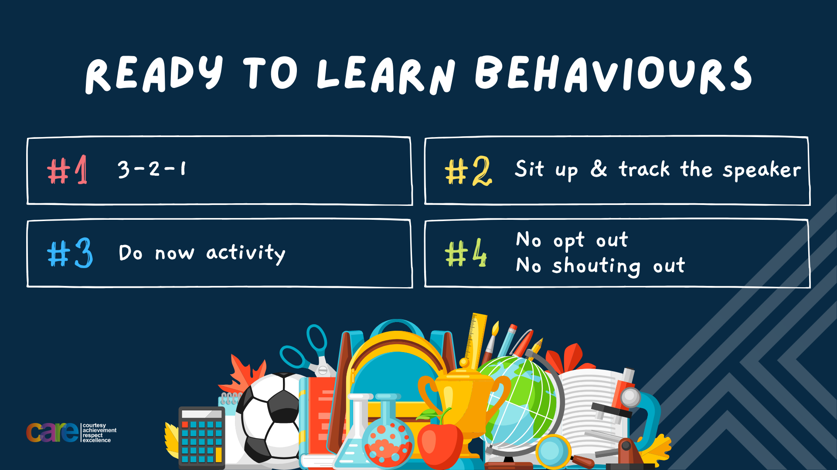

Slide 2





Write the date: 14 April 2025
Write the Title and Golden Thread
Title – Are online friendships safe?
Golden Thread – Secure Your Relationships
Underline both using your ruler & take out your oracy helpsheet
Complete the following questions:
What is being described: “repeated negative behaviour that is intended to make others feel upset, uncomfortable or unsafe”
What is being described: “playful and friendly exchange of teasing remarks
Give one characteristic of a good friend.
bullying
Banter
Kind, Funny, Loyal, Smart, Caring, Trustworthy

Slide 3


Secure your Relationships: Learning Journey
What makes a good friend?
What is peer pressure?
What is the difference between bullying and banter?
Are online friendship safe?
What is cyberbullying?
What are stereotypes?
Today we will look at:
Are online friendship safe?
This includes:
Definitions of online friendships
Examples of safe friendships
What to look out for in unsafe online friendships
Please remember that during the lesson we should not be asking any pupil or teacher personal questions.
Your teacher can ask you questions but this will be to check your knowledge in the lesson.

Slide 4
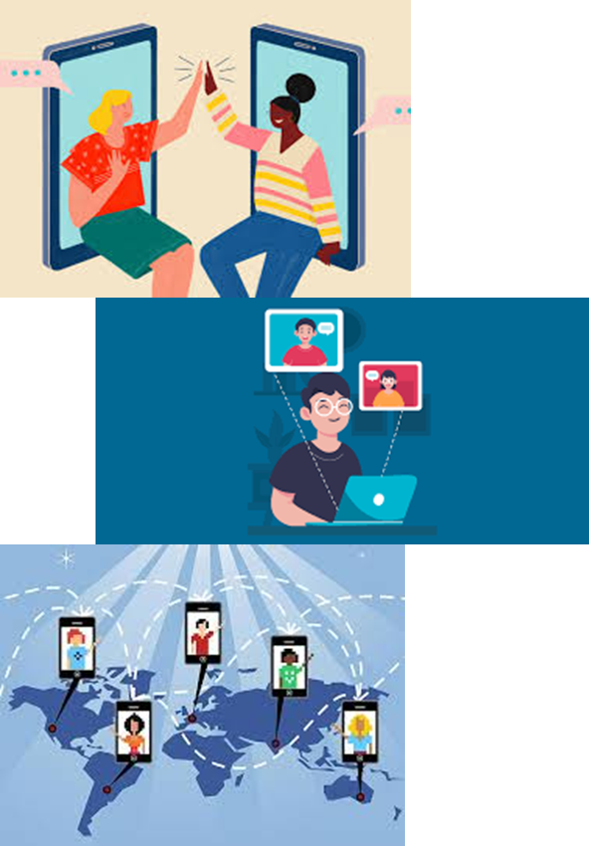
Tutor Time Recap
In your Personal Development Tutor Time activity, you started to look at online friendships
In your books answer the following question:
“What is the definition of online friendships?”
Sentence starter – online friendships are…

Slide 5
Tutor Time Recap
Online friendships are:
“friendships made with people through the internet”
Task – use your red pen to add to the definition you had written down.

Slide 6
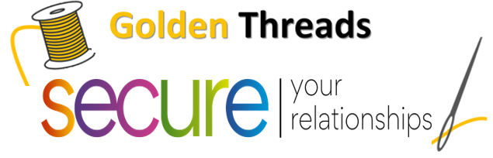

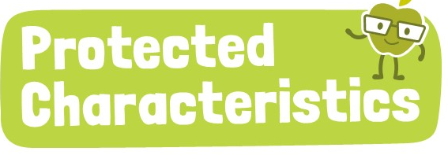
Tutor Time Recap
We are learning this because:
Links to the Golden Thread of “Secure your relationships”. Staying safe in our online friendships will help you know if that friend is who they say you are
Individual Liberty is a British Value and no one should feel like they cannot be themselves due to how others may treat them. This applies to online friendship too
Article 15 of the UN Rights of a Child state children have the right to set up and join groups. This also applies online but as long as it is within the law.
No one should be treated differently for identifying with one or more of the protected characteristics. This also applies online.
UN Rights
of a Child

Slide 7
Safe Online Friendships
Safe online friendships have the following characteristics:
They are also friends with them offline
They are kind and respectful to each other
They support each other when playing online games
Only speak about things each other has in common

Slide 8
Unsafe Online Friendships
Unsafe online friendships have the following characteristics
They do not know each other offline and have never met in person
People ask for personal information (address, school, contact number)
They ask for the online friendship to be kept a secret
They make others feel uncomfortable, scared or anxious by the things they say or content they share

Slide 9
Unsafe Online Friendships
Online friendships
Safe Characteristics | Unsafe Characteristics
Friends with each other offline | Do not know each other offline
Kind and respectful | They ask for personal information
Supportive when playing games | Ask for the friendship to be kept a secret
Only speak about things they have in common | Make others feel uncomfortable, scared or anxious in what they say and share
Task
In the margin write “SYV” – This stands for “Secure Your Voice”
Highlight “SYV”
Draw and complete the table. You need to write out the characteristics in the order of most importance to you

Slide 10

Characteristics of online friendship
Using your oracy helpsheet, discuss with the person next to you:
“what do you think the most important safe characteristic of an online friendship?”
Remember to use the sentence starters to add, build or challenge what your partner has said.
Be ready to share your discussion with the class

Slide 11
Characteristics of online friendship
Using your oracy helpsheet, discuss with the person next to you:
“what do you think the most important unsafe characteristic of an online friendship to watch out for?”
Remember to use the sentence starters to add, build or challenge what your partner has said.
Be ready to share your discussion with the class

Slide 12

Hinge Questions – whiteboard activity
3
Rules!
I will ask the question and give you some thinking time. (no more than 10 seconds)
Write the answer and turn your whiteboard over so nobody can see it.
When I am ready I will put on the 3 to 1 counter.
When ‘Show me’ appears on the board you must hold up your whiteboard (even if you don’t know the answer and there is nothing on your board)
2
1
Show me!
(even if your whiteboard is blank)

Slide 13
Hinge Questions – whiteboard activity
What is being described?
“friendships made with people through the internet”
Online friendships

Slide 14

Hinge Questions – whiteboard activity
What golden thread does this topic relate to?
A – Secure your Future
B – Secure your Wellbeing
C – Secure your Relationships
D – Secure your Voice

Slide 15
Hinge Questions – whiteboard activity
Is the statement below safe or unsafe:
“having a friend online that you have never met offline”
A – Safe
B – Unsafe

Slide 16
Hinge Questions – whiteboard activity
Is the statement below safe or unsafe:
“following another person in school and you play online games together”
A – Safe
B – Unsafe

Slide 17
Hinge Questions – whiteboard activity
Is the statement below safe or unsafe:
“following another person online, they say they know your cousin. They things they say make you feel uncomfortable”
A – Safe
B – Unsafe

Slide 18
Hinge Questions – whiteboard activity
Is the statement below safe or unsafe:
“Playing online games together and they ask you to not tell your other friends and family that you play against each other”
A – Safe
B – Unsafe

Slide 19
Safe Online friendship scenario
Ben plays Minecraft with a group. They only talk about the game and never ask for personal information. The group often works together on creative builds and discusses new updates in the game.
Task
In the margin write “SYV” – This stands for “Secure Your Voice”
Highlight “SYV”
3. Answer the following question in your book – why is this an example of safe online friendship?
Sentence starter – This is a safe online friendship because…

Slide 20
Safe online friendship scenario
Using your oracy helpsheet, discuss with the person next to you:
“why is this an example of safe online friendship?”
Remember to use the sentence starters to add, build or challenge what your partner has said.
Be ready to share your discussion with the class

Slide 21
Unsafe Online friendship scenario
Sophie receives messages from someone claiming to be her age but avoids answering direct questions about their identity. They send vague photos and insist Sophie send pictures back. This makes Sophie feel uncomfortable.”
Task
In the margin write “SYV” – This stands for “Secure Your Voice”
Highlight “SYV”
3. Answer the following question in your book – why is this an example of an unsafe online friendship?
Sentence starter – This is an unsafe online friendship because…

Slide 22
Unsafe online friendship scenario
Using your oracy helpsheet, discuss with the person next to you:
“why is this an example of an unsafe online friendship?”
Remember to use the sentence starters to add, build or challenge what your partner has said.
Be ready to share your discussion with the class

Slide 23
What to do if you feel unsafe online
If a person ever feels unsafe when speaking to a friend online they should:
Stop talking to/messaging the person immediately
Block the person on the platform
Report the account
Talk to a trusted adult about the experience

Slide 24
What to do if you feel unsafe online
Although a person may have messaged or sent content that can be uncomfortable, it is important that you do not delete this.
Instead show it to a trusted adult and use it when reporting the account.

Slide 25
Hinge Questions – whiteboard activity
3
Rules!
I will ask the question and give you some thinking time. (no more than 10 seconds)
Write the answer and turn your whiteboard over so nobody can see it.
When I am ready I will put on the 3 to 1 counter.
When ‘Show me’ appears on the board you must hold up your whiteboard (even if you don’t know the answer and there is nothing on your board)
2
1
Show me!
(even if your whiteboard is blank)

Slide 26
Hinge Questions – whiteboard activity
True or False
“if you feel uncomfortable online, you should just ignore it”
A – True
B – False

Slide 27
Hinge Questions – whiteboard activity
True or False
“if you feel uncomfortable online, you block and report the account”
A – True
B – False

Slide 28
Hinge Questions – whiteboard activity
True or False
“if you feel uncomfortable online, you should continue messaging the person and hope that they stop”
A – True
B – False

Slide 29
Hinge Questions – whiteboard activity
True or False
“if you feel uncomfortable online, you should tell a trusted adult and show them what made you feel uncomfortable”
A – True
B – False

Slide 30
Scenario
Lets you again at the unsafe friendship scenario:
“Sophie receives messages from someone claiming to be her age but avoids answering direct questions about their identity. They send vague photos and insist Sophie send pictures back. This makes Sophie feel uncomfortable.”
Task
In the margin write “SYV” – This stands for “Secure Your Voice”
Highlight “SYV”
3. Answer the following question in your book – what advice would you give Sophie?”
Sentence starter – The advice I would give Sophie is…

Slide 31
Scenario
Using your oracy helpsheet, discuss with the person next to you:
“what advice would you give Sophie?”
Remember to use the sentence starters to add, build or challenge what your partner has said.
Be ready to share your discussion with the class

Slide 32
Scenario
Lets look at another scenario
“Tom really enjoys posting TikTok videos. He is starting to get lots of followers but they are mostly people he does not know. One follower has started sending him direct messages. They talk most days now. The follower has asked Tom to make sure he doesn’t tell any of his friends or family that they message. Tom hadn’t considered this before but is uneasy about keeping secrets.
Task
In the margin write “SYV” – This stands for “Secure Your Voice”
Highlight “SYV”
3. Answer the following questions in your book:
Is this a safe or unsafe online friendship? Why?
What advice would you give Tom?

Slide 33
Scenario
Using your oracy helpsheet, discuss with the person next to you:
“Is this a safe or unsafe online friendship? Why?”
Remember to use the sentence starters to add, build or challenge what your partner has said.
Be ready to share your discussion with the class

Slide 34
Scenario
Using your oracy helpsheet, discuss with the person next to you:
“What advice would you give Tom?”
Remember to use the sentence starters to add, build or challenge what your partner has said.
Be ready to share your discussion with the class

Slide 35



Support
If you ever need support about online friendships for yourself, a friend or a family member you can find it here:
Childline.org.uk
Call – 08001111
Email or chat online for support
Themix.org.uk
You can email or have one-to-chat online.
There is also a crisis messenger which is available 24/7

Slide 36
Reflection
Online friendship can be safe and a positive experience. This will happen with people that know each other offline too.
Unsafe online friendships are between people that do not know each other offline, want the friendship kept a secret, make others feel uncomfortable and want to know lots of personal information but never share their personal information.

Slide 37


