Slide 1
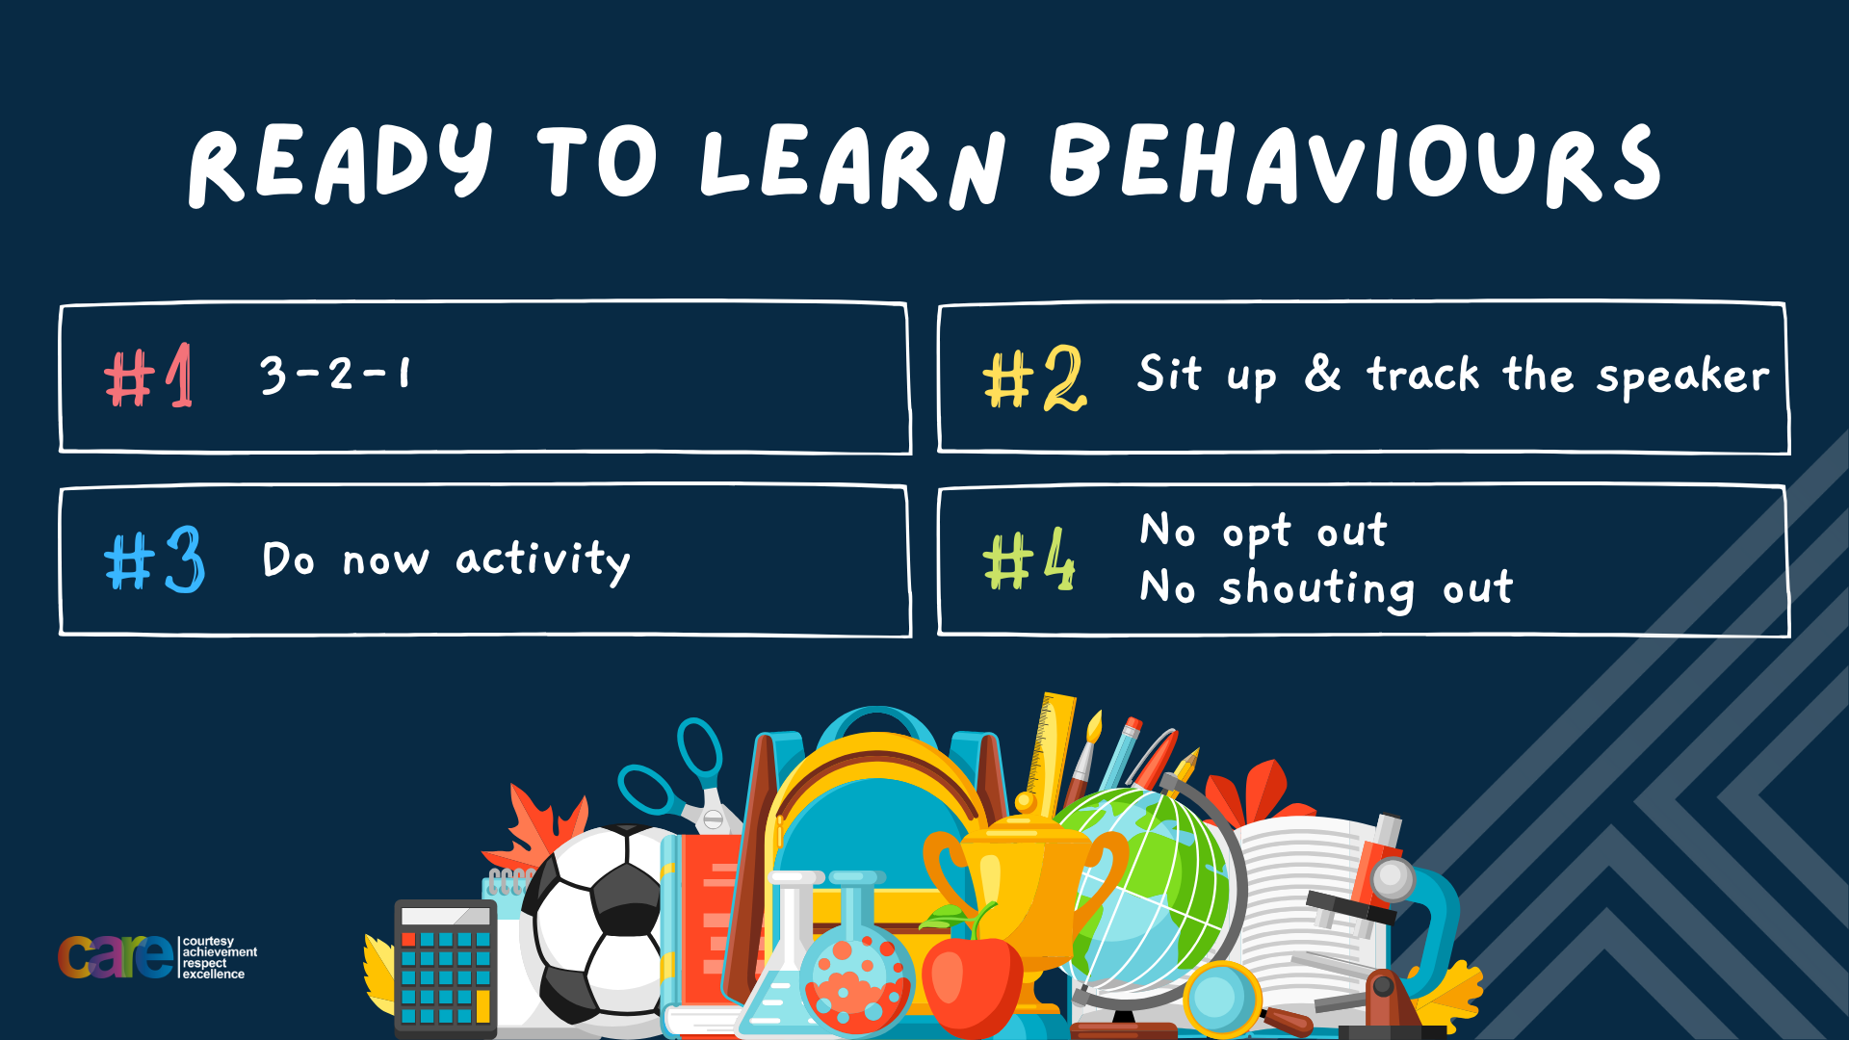

Slide 2








Write the date: 14 April 2025
Write the title: What is the difference between bullying and banter
Underline both using your ruler in your learning wallet. Take out your oracy helpsheet too.
Complete the following questions:
What is being described: “being influenced by other people (peers) to act in a certain way”
Give one characteristic of a good friend
Give a consequence a person may face if they break a law
Peer Pressure
Kind, Funny, Loyal, Smart, Caring, Trustworthy
Caution, Fines, community service, prison

Slide 3


Secure your Relationships: Learning Journey
What makes a good friend?
What is peer pressure?
What is the difference between bullying and banter?
Are online friendship safe?
What is cyberbullying?
What are stereotypes?
Today we will look at:
What is the difference between bullying and banter
This includes:
Definitions of bullying and banter
Types of bullying
Understand the difference between bullying and banter
Please remember that during the lesson we should not be asking any pupil or teacher personal questions.
Your teacher can ask you questions but this will be to check your knowledge in the lesson.

Slide 4
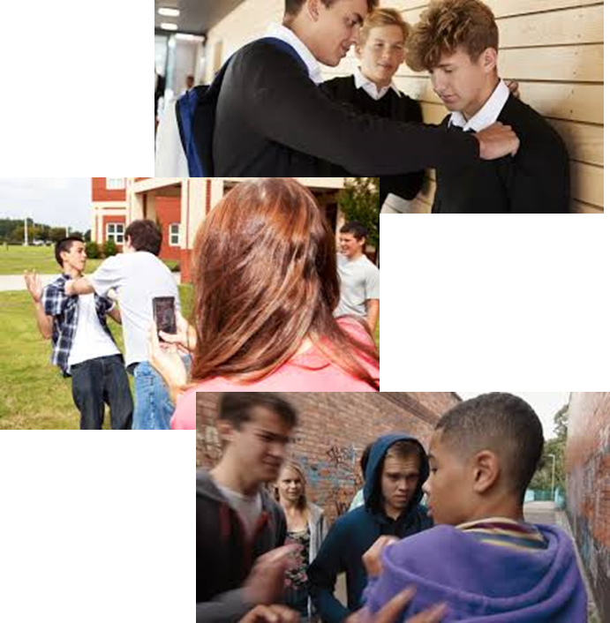
Tutor Time Recap
Bullying is “repeated negative behaviour that is intended to make others feel upset, uncomfortable or unsafe”
Banter is “playful and friendly exchange of teasing remarks” However the joke must include the person receiving the banter and not be hurtful or include something they may feel insecure about.

Slide 5
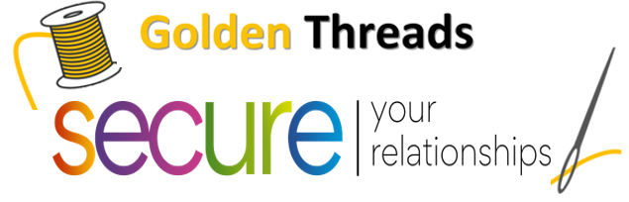

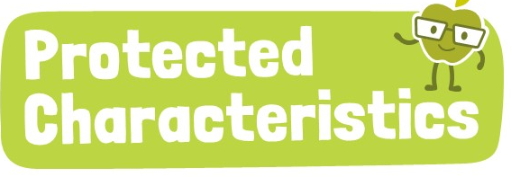
Tutor Time Recap
We are learning this because:
Links to the Golden Thread of “Secure your relationships”. Knowing the difference between bullying and banter will help how you interact with friends in and outside of school and be a good friend
Individual Liberty is a British Value and no one should feel like they cannot be themselves due to how others may treat them
Article 2 of the UN Rights of a Child state children should never be treated unfairly. Bullies do not treat people fairly and take away this right.
No one should be bullied for identifying with one or more of the protected characteristics. Protected characteristics are there so people are not treated differently.
UN Rights
of a Child

Slide 6
Types of bullying
There are different types of bullying.
The types of bullying are:
Verbal bullying
Indirect bullying
Physical bullying

Slide 7
Types of Bullying
With the person next to you discuss which definition links to each type of bullying
The repeated negative use of body contact to intentionally hurt others
Verbal Bullying
The repeated negative use of speech, sign language or verbal gestures to intentionally hurt others
Indirect Bullying
Repeated negative use of actions which are neither physical or verbal to intentionally hurt others. An example is spreading rumours
Physical Bullying

Slide 8
Types of bullying
There are different types of bullying.
The types of bullying are:
Verbal bullying
Indirect bullying
Physical bullying
Task
Write down the types of bullying in order of what you think is most common.

Slide 9

Types of bullying
Using your oracy helpsheet, discuss with the person next to you:
“what type of bullying do you think is most common?”
Remember to use the sentence starters to add, build or challenge what your partner has said.
Be ready to share your discussion with the class

Slide 10
Bullying or Banter
Sometimes bullies can try to disguise their bullying as banter.
An example of this is saying things like “it’s just a bit of banter” or “it is just a joke, calm down”
It is easier to use banter to hide verbal and indirect bullying.

Slide 11

Hinge Questions – whiteboard activity
3
Rules!
I will ask the question and give you some thinking time. (no more than 10 seconds)
Write the answer and turn your whiteboard over so nobody can see it.
When I am ready I will put on the 3 to 1 counter.
When ‘Show me’ appears on the board you must hold up your whiteboard (even if you don’t know the answer and there is nothing on your board)
2
1
Show me!
(even if your whiteboard is blank)

Slide 12
Hinge Questions – whiteboard activity
What is being described?
“repeated negative behaviour that is intended to make others feel upset, uncomfortable or unsafe”
Bullying

Slide 13
Hinge Questions – whiteboard activity
What is being described?
“playful and friendly exchange of teasing remarks”
Banter

Slide 14

Hinge Questions – whiteboard activity
What golden thread does this topic relate to?
A – Secure your Future
B – Secure your Wellbeing
C – Secure your Relationships
D – Secure your Voice

Slide 15
Hinge Questions – whiteboard activity
True or False:
“bullies can try to hide bullying by describing it as banter”
A – True
B – False

Slide 16
Hinge Questions – whiteboard activity
What type of bullying is being described?
“a bullying is kicking and punching someone”
A – Verbal Bullying
B – Indirect Bullying
C – Physical Bullying

Slide 17
Hinge Questions – whiteboard activity
What type of bullying is being described?
“a bullying is excluding someone from joining in an activity”
A – Indirect Bullying
B – Physical Bullying
C – Verbal Bullying

Slide 18
Hinge Questions – whiteboard activity
What type of bullying is being described?
“a bully is swearing and making rude gestures”
A – Physical Bullying
B – Indirect Bullying
C – Verbal Bullying

Slide 19
It is not banter if…
There are a few easy rules to remember to know if it is not banter:
The words used can make a person upset
The person who is the target of the banter is not a friend or part of a friendship group
The target of the banter is not laughing or they have gone quiet after initially laughing along
The target of the banter has asked for the comments to stop but they carry on
The banter focuses on a person’s insecurities

Slide 20

Video
While watching the video answer the following questions
Is Sarah a victim of bullying or banter?
What signs are there that the “banter” was not being received well by Sarah?
What could the people making the comments have done differently if they noticed Sarah was not happy with their “banter”
Notes:
https://youtu.be/NAwkckpkapA

Slide 21
Bullying vs Banter scenarios
This week, Taylor’s been really busy with after school activities. They’ve been so busy that they totally forgot to do their Maths homework! Thankfully, they were able to copy their best friend’s. This doesn't usually happen, and Taylor was a bit embarrassed, but they laughed about it with their friends.
That evening, someone makes a social media story with a photo of Taylor and the hashtag #fail on it. Taylor knows they meant it as a joke, and they can kind of see how it’s funny, but they message the person and ask them to take it down anyway.
Before they know it, some of Taylor’s friends have shared the story and it feels like it’s everywhere. The next day, everyone in the school seems to know about Taylor’s mistake. They start whispering ‘#fail’ to Taylor when they pass in the corridor. This goes on for almost a whole term.
Task – Think about your answer to the question:
“At the beginning is Taylor a victim of bullying or banter?”

Slide 22
Bullying vs Banter
Using your oracy helpsheet, discuss with the person next to you:
“At the beginning is Taylor a victim of bullying or banter?”
Remember to use the sentence starters to add, build or challenge what your partner has said.
Be ready to share your discussion with the class

Slide 23
Bullying vs Banter scenarios
This week, Taylor’s been really busy with after school activities. They’ve been so busy that they totally forgot to do their Maths homework! Thankfully, they were able to copy their best friend’s. This doesn't usually happen, and Taylor was a bit embarrassed, but they laughed about it with their friends.
That evening, someone makes a social media story with a photo of Taylor and the hashtag #fail on it. Taylor knows they meant it as a joke, and they can kind of see how it’s funny, but they message the person and ask them to take it down anyway.
Before they know it, some of Taylor’s friends have shared the story and it feels like it’s everywhere. The next day, everyone in the school seems to know about Taylor’s mistake. They start whispering ‘#fail’ to Taylor when they pass in the corridor. This goes on for almost a whole term.
Task – Think about your answer to the question:
“By the end of the scenario was Taylor a victim of bullying? If you think they were, what type of bullying did they receive?”

Slide 24
Bullying vs Banter
Using your oracy helpsheet, discuss with the person next to you:
“By the end of the scenario was Taylor a victim of bullying? If you think they were, what type of bullying did they receive?”
Remember to use the sentence starters to add, build or challenge what your partner has said.
Be ready to share your discussion with the class

Slide 25
Bullying vs Banter scenario
Zayn’s not very good at football. His friends make jokes about how he’ll never make the school team or have a career in the Premier League. Zayn’s OK with this – he still enjoys playing for fun at lunchtime and he knows that he’s good at other things. He laughs with his friends about how he’d be rubbish on the school team – he’d probably kick the ball the wrong way or fall over during an important match!
Some of Zayn’s friends continue the joke the next day. Soon, everyone in his class is making jokes and it shows no sign of stopping. He feels a bit picked on so he says, ‘OK, enough now – the joke’s getting old!’. No one listens, though.
Every lunchtime, Zayn’s friends gather round him and make ‘jokes’ about how bad he is at football. Everyone laughs. No one wants him to play on their team, then Zayn’s friends steal his shoes and throw them on the roof so he can’t play at all. They keep doing this every day for a week.
Task
Read the scenario on the left and complete the following sentences.
In the first paragraph Zayn is having _______ with his friends. We know this because Zayn….
In paragraph 2 the banter is now becoming ________. We know this because Zayn….
In the third paragraph Zayn is definitely a victim of ______ because his friends actions were ________ and _________.
The type of bullying Zayn is a victim of is…..

Slide 26
Bullying vs Banter
Using your oracy helpsheet, discuss with the person next to you:
“What did you write for each answer?”
Remember to use the sentence starters to add, build or challenge what your partner has said.
Be ready to share your discussion with the class

Slide 27
Reflection
Banter is part of every friendship. However it is important to make sure banter is always positive and remains a joke without anyone being hurt or upset due to a comment.
All types of bullying is wrong. It is also wrong to try to hide bullying as banter.
Don’t forget it is not banter if a person does not find it funny or it hurts their feelings

Slide 28



Support
If you ever need support about bullying for yourself or a friend you can find it here:
Childline.org.uk
Call – 08001111
Email or chat online for support
Themix.org.uk
You can email or have one-to-chat online.
There is also a crisis messenger which is available 24/7

Slide 29


